Slide 1


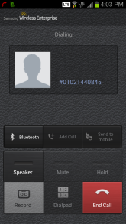
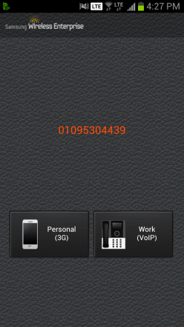
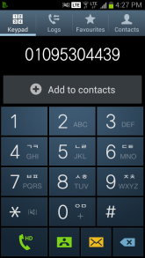
WE VoIP User Guide
(OfficeServ)
(2014.10.27)

Slide 2
※ Specification Summary
Part | Item | Specification | Remarks
Client | Android Phone | Android version 4.0.2 or later installed smartphone Samsung Galaxy S and Galaxy Note series flagship models are recommended. (Galaxy S2/S3/S4/S5 and Galaxy Note2/3/4) | Do not support issues that occur in your smartphone, even if voice quality issue.
 | iPhone | iPhone5/5S or later, iOS 7 or later
 | Language | Korean, English
 | Country | Korea, U.S.A, U.K., Italy, South Africa, Australia, Chile, Austria, Belgium, Canada, Finland, Germany, Greece, Netherlands, New Zealand, Peru, Russia, Slovenia, Spain, Sweden
 | Use Place | In office where installed OfficeServ system. (Not supports in Hotspot or mobile network)
System | Model & Max Users |  | If you need more than 40 users, ask to R&D.
 | Software | MP software package V4.80 or later
Features | Codec | G.711 : Available G.729 : Not available Wideband (SILK, AMR-WB) : Available | iPhone client has some limitation . (Wideband Codec, sRTP/ARIA)
 | sRTP | OS7400/7200 : Available. Others : Not available
 | TCP
 | TLS | Not available | SIP trunk call can be used
 | Call Features | Make call, Call Transfer, Call Hold, Single CID, Manual Handover Simultaneous Ringing, Unreachable Forward, Call Move, Smart Routing | iPhone client has some limitation. (Incoming)
OfficeServ Model | 7030 | 7070 | 7100 | 7200S | 7200 | 7400
Recommended Max | 5 | 5 | 10 | 10 | 20 | 40

Slide 3
Contents
Ⅰ. WE VoIP Client Installation
Ⅱ. OfficeServ System Programming
Ⅲ. Special Features

Slide 4
Ⅰ. WE VoIP Client Installation
1. WE VoIP Client Installation
2. Use of WE VoIP
3. Limitation

Slide 5

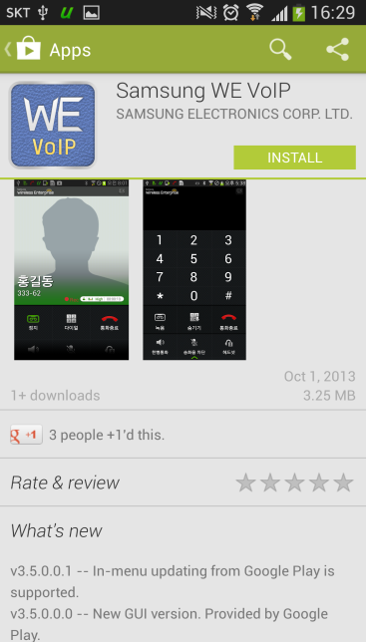
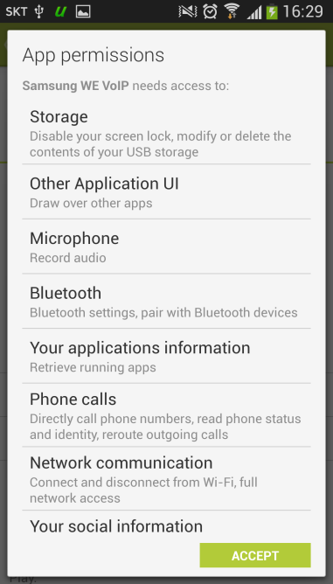
1. WE VoIP Installation – Android (1/2)
1) Prerequisites
Android Version 4.0.2 or later installed smartphone
Samsung Galaxy S and Galaxy Note series flagship models are recommended.
(Galaxy S2/S3/S4/S5 and Galaxy Note2/Note3/Note4)
2) Download and installation
Download on Google Play Store (Keyword: Samsung WE VoIP)

Slide 6
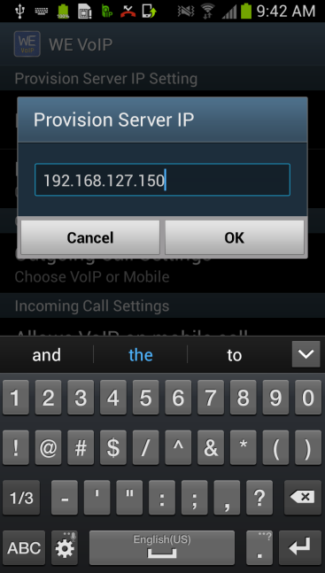
1. WE VoIP Installation - Android (2/2)
3) Starting setup
After launching WE VoIP app, input only the IP of OfficeServ without additional information.
Please input the IP on the popup “Provision Server IP” of first screen.
WE VoIP client downloads profile, and tries to register to server automatically after you input.
※ IP of OfficeServ: You can see on DM 2.1.0, 2.1.2.
If the wireless network is equal to Officeserv’s, input DM 2.1.0’s IP. If not, input DM 2.1.2’s ‘Public IP 1’

Slide 7
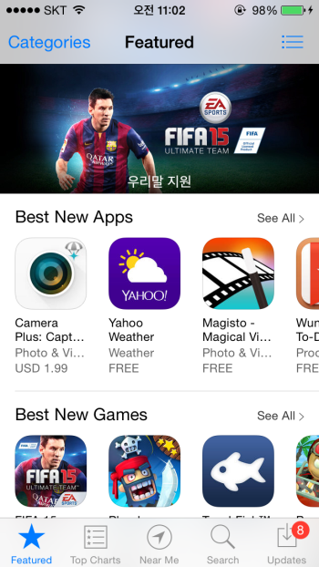
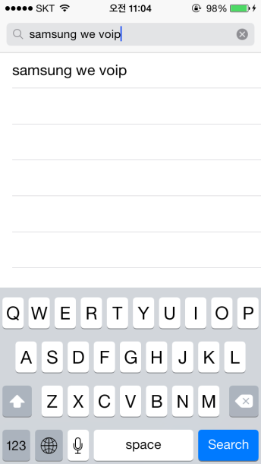
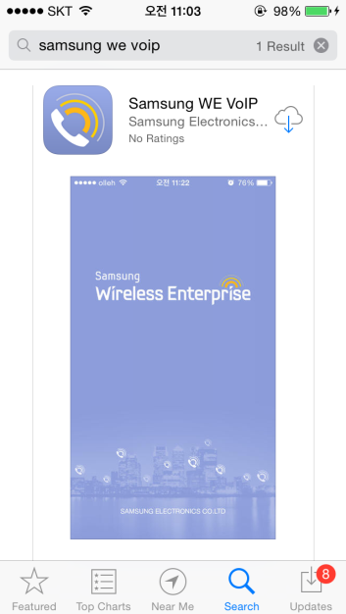
1. WE VoIP Installation – iPhone (1/2)
1) Prerequisites
iOS 7 or later installed smartphone
iPhone 5 or later models are recommended. (iPhone 5, iPhone 5c, iPhone 5s)
2) Download and installation
Download on App Store (Keyword: Samsung WE VoIP)

Slide 8
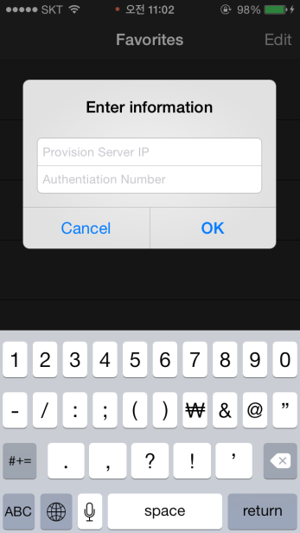
1. WE VoIP Installation – iPhone (2/2)
3) Starting setup
After launching WE VoIP app, input only the IP of OfficeServ and the authentication number without additional information.
Please input the IP and the number on the popup “Enter information” of first screen.
WE VoIP client downloads profile, and tries to register to server automatically after you input.
※ IP of OfficeServ: You can see on DM 2.1.0, 2.1.2.
If the wireless network is equal to Officeserv’s, input DM 2.1.0’s IP. If not, input DM 2.1.2’s ‘Public IP 1’

Slide 9
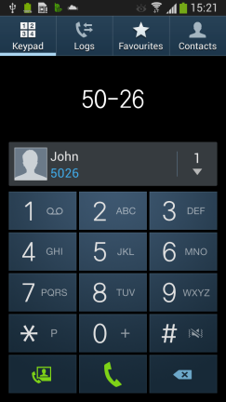

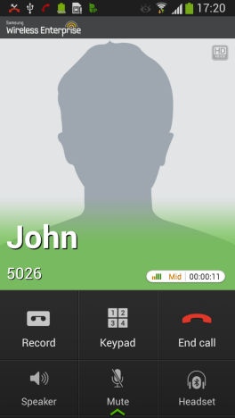
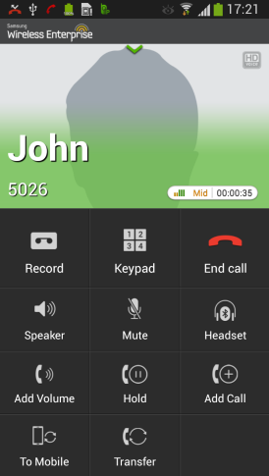
2. Use of WE VoIP - Android (1/2)
1) Making a call
You can use WE VoIP call by dialing on your mobile integrated dialer. Press call button, and you can see the choice screen. In the screen, you can select call via the Mobile call or VoIP call.
2) Additional Features
You can use the call feature by press the screen
Scroll up the button, and you can use all call features

Slide 10

2. Use of WE VoIP – Android (2/2)
■ WE VoIP Call feature buttons
Buttons | Descriptions
Record | You can record the voice of call. Use ‘Recording list’ menu for play recorded files, or You can get files from /smv/records folder of file system of phone.
Keypad | DTMF keypad is shown.
End Call | End the call.
Speaker | Use speakerphone.
Mute | Turn off the mic.
Headset | Use bluetooth headset
Add volume | You can get extra volume.
Hold | Hold the call.
Add call | Not available for officeServ
To mobile | Transfer to mobile call. You can use this feature in non-WiFi area.
Transfer | Transfer call to other number.

Slide 11
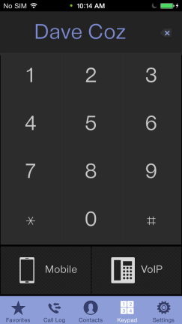
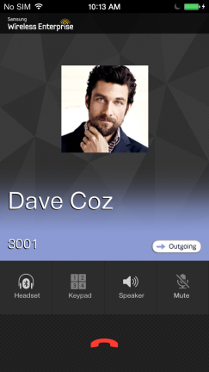
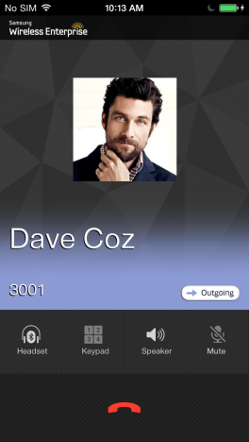
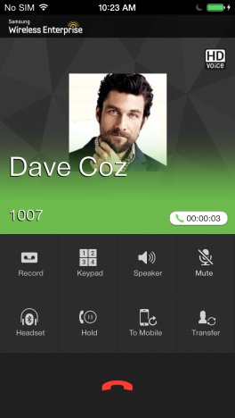
2. Use of WE VoIP – iPhone (1/2)
1) Making a call
You can use WE VoIP call by dialing on Keypad tap in the application. In the screen, you can select call via the Mobile call or VoIP call with each button.
2) Additional Features
You can use the call feature by press the screen
Scroll up the button, and you can use all call features

Slide 12

2. Use of WE VoIP – iPhone (2/2)
■ WE VoIP Call feature buttons
Buttons | Descriptions
Record | You can record the voice of call. Use ‘Recording list’ menu in Settings tab for play recorded files.
Keypad | DTMF keypad is shown.
Speaker | Use speakerphone.
Mute | Turn off the mic.
Headset | Use bluetooth headset
Hold | Hold the call.
To mobile | Transfer to mobile call. You can use this feature in non-WiFi area.
Transfer | Transfer call to other number.
End Call | End the call.

Slide 13
3. Limitation – iPhone
Users have to input their mobile phone number for authenticate because iPhone does not permit access to the phone number of device.
To make a VoIP call, users have to use WE VoIP application. That feature does not work with “Phone” application.
Users can view call log for VoIP calls at “Call Log” tab in WE VoIP application. The list is not shown in “Phone” application.
Due to the OfficeServ system does not support push service, WE VoIP application can not receive VoIP calls. The application is for outgoing only. Please make “Simultaneous Ring” be possible by setting the OfficeServ for receive call not only desk phone but also iPhone via cellular network.
(See III-1. Simultaneous Ring - iPhone)

Slide 14
Ⅱ. OfficeServ System Programming
System IP Configuration
License
3. WE VoIP Configuration
4. User Information
5. Login Profile
6. Mobile Profile

Slide 15
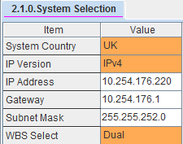
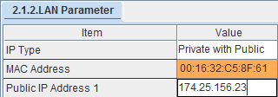
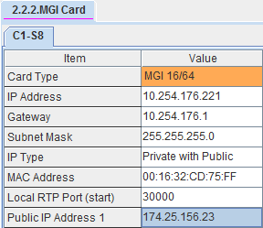
1. System IP Configuration
■ Set the ‘IP Type’ to ‘Private’, the WE VoIP client should use in office area.
(If you use WE VoIP client in remote office, set the ‘IP Type’ to ‘Private with Public’)
On DM 2.1.0, Set the System IP
On DM 2.1.2, Set the IP Type to ‘Private’
On DM 2.2.2, Set the MGI Card’s IP and Set IP Type to ‘Private’

Slide 16
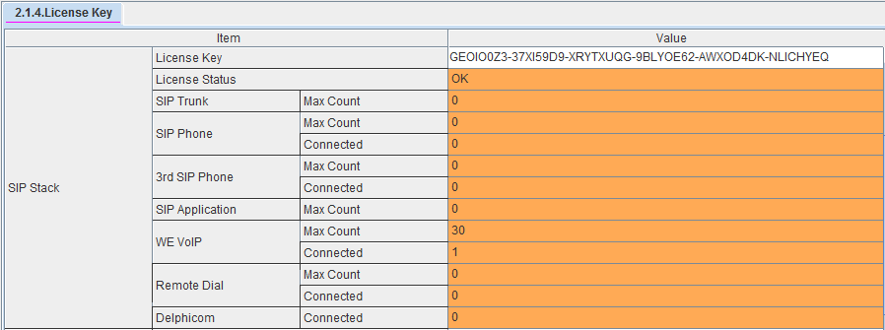
2. License
■ Input the license key on DM 2.1.4
(WE VoIP clients can register max to ‘WE VoIP Max Count’,
Following table is recommended license count for each OfficeServ model)
OfficeServ Model | 7030 | 7070 | 7100 | 7200S | 7200 | 7400
Max License | 5 | 5 | 10 | 10 | 20 | 40

Slide 17
3. WE VoIP Configuration
■ SIP configuration should be modified for WE VoIP
Set TCP – Reuse
On DM 5.2.24, Set ‘Sip Signal Type’ to ‘TCP’ for a WE VoIP user.
On DM 5.2.12, Set TCP mode to ‘REUSE’
On DM 5.2.12, Change the TCP port not equal to 5060. (ex:20200)
※ In UDP protocol, session connection(port) expire time is too short, so cannot be used in mVoIP.
5060 port should be avoided because mobile service provider controls the 5060 port sometimes.
2) WE VoIP Client Expire Time
Set the SIP Extension Configuration- SIP Expire Time to 1800s or 3600s on DM 5.2.12.
※ The shorten expire time, the more frequently wake up the phone. It causes more battery consumption.

Slide 18
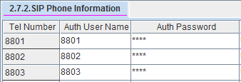
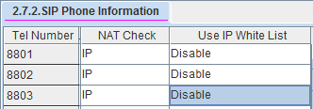
4. User Information
1) Set User ID and Password on DM 2.7.2
2) Set the IP White List on DM 2.7.2
White List option permits connection from configured IP, disable the white list option for WE VoIP extension.

Slide 19
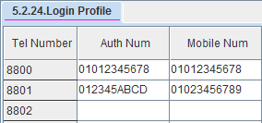
5. Login profile (1/2)
■ Set the login profile on DM 5.2.24
1) Input Auth Number and Mobile Number.
- Input the mobile phone number on [Auth Num] tab for registration.
- (exception) On some devices, mac address is displayed on app
screen instead of mobile number. For this device, MAC address
should be input on [Auth Num] tab.
- Input the mobile phone number on [Mobile Num] tab for Smart Routing feature

Slide 20
5. Login profile (2/2)
2) Other options
DM 5.2.24 Login Profile (Recommend default value)
Option | Description
Noise Suppression RX Noise Suppression TX | Set the option ‘Noise Suppression’ If it is enabled, small noise is suppressed.
AECM | Set Auto Echo Cancellation Mode.
Echo | Set Echo Cancellation feature.
Swing Free RX Swing Free TX | Set diamond voice solution. It makes voice quality on Samsung Galaxy devices.
CNG | Set Comfort Noise Generation. If it is enabled, small noise is generated.
DTMF Type | Set the DTMF type.
Use sRTP | Enable or Disable the sRTP.
Multi Frame Multicast | Set MultiFrame/Multicast option. It is avail for Samsung AP/APC. It reduces AP’s computing load.
TOS | Set the value TOS of IP header.
Jitter | Set jitter buffer size. Big buffer size reduces jitter but increase end-to-end delay.
SIP Signal Type | Set SIP protocol.

Slide 21
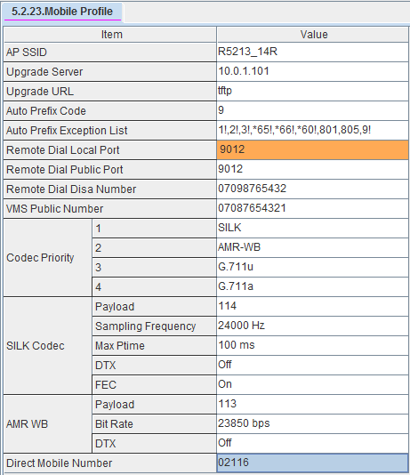
6. Mobile profile (1/3)
■ DM 5.2.23 Mobile profile
1) AP SSID
AP’s SSID is the criteria to separate internal area and external area. WE VoIP tries to connect (internal) system IP if device is connected to WiFi network has SSID inputted this field. If the SSID of connected WiFi is not equal to value on this field, WE VoIP tries to connect Public IP.
※ Caution
SSID should have distinction to avoid duplication to other AP’s SSID.

Slide 22
6. Mobile profile (2/3)
2) Other options (1)
Other options on DM 5.2.23 ‘Mobile Profile‘
Option | Description
Auto Prefix Code | Set the auto prefix code. By the prefix rule(Auto Prefix Exception List), WE VoIP generates prefix code automatically when user dials.
Auto Prefix Exception List | Set the exception rule that do not add prefix. <Example> 4 digits (XXXX), The numbers start with specific numbers (specific numbers!) (예) In 4digits extension, and start number with 805, The case you want to not add prefix. => XXXX, 805!
Codec Priority | Set the codec priority.
※ Auto Prefix Code Example
If trunk prefix code is 9, and only 4digits extension is used in example site,
Users need not to add prefix code manually under the below setting.
- Auto Prefix Code: 9
- Auto Prefix Exception List; XXXX,9!

Slide 23
6. Mobile profile (3/3)
2) Other options (2) : Recommend use of default values.
Option | Description
SILK Codec | Set the options about SILK codec. Payload Sampling Frequency Max Ptime – Max packet time interval DTX FEC
AMR-WB | Set the options about AMR-WB codec Payload Bit Rate DTX
Direct Mobile Number | Set the numbers that be called via only 3G.

Slide 24
Ⅲ. Special Features
1. Simultaneous Ring
2. Call forward unreachable
3. Manual Handover
4. Smart Routing
5. Call Move
6. Miscellaneous

Slide 25

1. Simultaneous Ring - Android
■ Station Pair
On DM 4.2.1, set the station pair WE VoIP client and desk phone.
- If user receive the call the one of station pair, missing call is not
remain on the other.
- If set the call forward or DND option, both is applied.
■ Single CID number service
On DM 4.2.1, enable ‘Single CID Number’ option
- If WE VoIP is paired to desk phone that has primary number by ‘Single CID number ‘ option,
WE VoIP call shows primary number and CID instead of its CID. (Internal call)
- In external call by trunk, use ‘Send CLI Number’ on DM 2.3.4 instead of ‘Single CID number ‘
(Changed CID number is now shown on SMDR log)

Slide 26
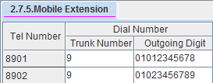

1. Simultaneous Ring - iPhone (1/2)
■ Receiving call in iPhone with Desk phone
You must use station pair feature for iPhone to receive an incoming call
- OfficeServ doesn’t present ‘PUSH service’ essential to receive WE VoIP incoming call in iPhone. In order to receive an incoming call, some settings below are needed.
iPhone user can receive incoming call simultaneously with the iPhone and the desk phone. The incoming call to iPhone is via 3G or 4G cellular network not via WiFi. (But its fare is charged to PBX.)
Programming
1) Set Mobex Extension’s Dial Number
2) Set Station Pair between Desk Phone and Mobex Extension

Slide 27

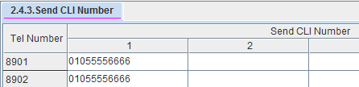
1. Simultaneous Ring - iPhone (2/2)
■ Single CID number service
1) Set ‘Trunk To MOBEX CLI’ on DM 2.1.5(System Options) to ‘MOBEX’
2) Set Mobex Extension’s ‘Send CLI Number’ on DM 2.4.3(Send CLI Number) to Office Main Number or others

Slide 28

2. Call forward unreachable
■ Unreachable forward
- If WE VoIP client is not registered, incoming call is forward to set number on ‘Call forward unreachable’.
- After OfficeServ system sends call message to WE VoIP client, If there’s no response from WE VoIP client in ‘Call forward unreachable Time’, the call is transferred to the number set on ‘Call forward unreachable’
After ringing on WE VoIP client, If user do not accept call, the call is transferred to the number set on ‘Call Forward No Answer’
■ Programming
On DM 2.7.5, set trunk number and mobile number on outgoing digit.
On DM 2.7.2, set modex extension number -Call forward unreachable.
On DM 5.14.2, set ‘Call Forward Unreachable Time’ (default : 5 sec)

Slide 29
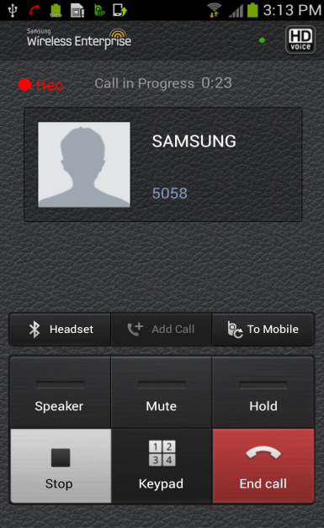

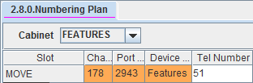
3. Manual handover
■ Transfer to mobile
Press ‘To Mobile’ button on the line, the call is transferred to mobile call
from VoIP call.
- On the VoIP call, press ‘To mobile’ button.
- New incoming call from mobile on VoIP busy. (beep sound)
- Until user accept the new call, current VoIP is avail.
When user accepts mobile call, VoIP is finished but the call is continuous on
mobile call.
■ Programming
1) On DM 2.7.5, set trunk number and mobile number on ‘outgoing digit’
2) On DM 2.7.2, set Mobex extension number on ‘Call Forward Unreachable number’
3) On DM 2.8.0, set MOVE feature code
Click

Slide 30

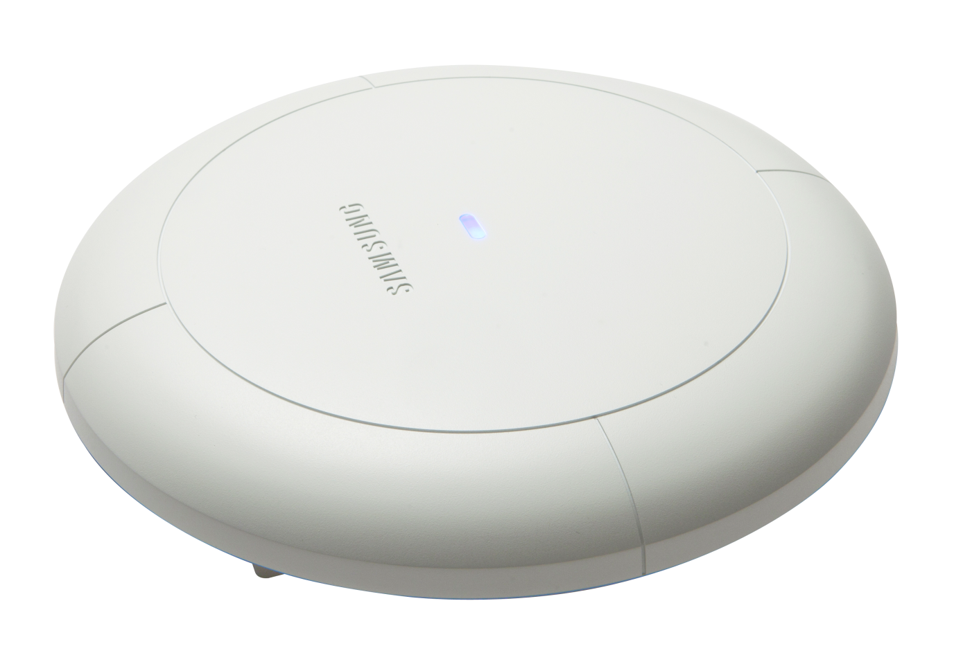


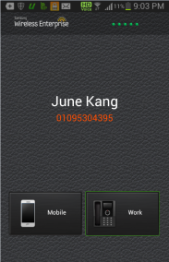

4. Smart Routing
■ Cost reduction by using Smart routing service
In case that WE VoIP client makes call to mobile number by touching Mobile button,
OfficeServ checks the availability of extension coupled to called mobile number.
If the extension is avail, OfficeServ calls to the extension number instead of called mobile number.
Dialing to A-mobile number
3G/4G
Smart Routing to A-ext. number
AP
Click
A
Office
■ Programming
1) On DM 2.7.2, set Mobex extension number on ‘Call Forward Unreachable number’
2) On DM 5.2.24, set the Mobile Number.

Slide 31
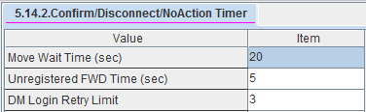
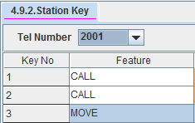
5. Call Move – Android only
■ Seamless call move between a desk phone and WE VoIP client
Desk phone → WE VoIP : when you press ‘Call Move’ button on your desk phone, WE VoIP client starts ringing. WE VoIP client answers the call, WE VoIP client has the call continue and the desk phone goes to idle state.
WE VoIP → Desk phone : when you press ‘Call Move’ button on your desk phone, the desk phone has the call continue and WE VoIP client goes to idle state.
※ Only Android WE VoIP supports call move feature.
■ Programming
1) On DM 4.2.1, make station pair with WE VoIP client and desk phone.
2) On DM 4.9.2, make ‘MOVE’ key on desk phone.
3) On DM 5.14.2, set ‘Move Wait Time’. (default : 20 sec)

Slide 32
6. Miscellaneous
Item | Description
Trunk type | For additional features of WE VoIP client, SIP or ISDN is required. (Analog trunk can’t disconnect call normally sometimes)
Codec | Do not set the MGI codec to ‘G.729’ for use of WE VoIP client. (Exclude ‘G.729’ on phone codec setting for use of IP phone and SIP Phone also)
TCP/sRTP | OfficeServ 7400/7200 supports. (other OfficeServ systems not supports)
TLS | Not Available. (OfficeServ 7400/7200 supports TLS feature for SIP trunk, but not for phones)
Virtual Slot | For use of ‘call move’ or ‘Smart routing ‘ service, 1 or upper slots are assigned for Group Conf. slot on DM 6.3.2 Virtual Card Change. (3 channels per a call.)
Etc. | You can use WE VoIP client in office where installed OfficeServ system. (Not supports in Hotspot or mobile network)

Slide 33







