Slide 1







Distribution
Ver.1.0
English
SCM Express V6.4.0 Configuration Guide

Slide 2
History
Version | Date | Changes
1.0 | 2018.06 | Initial version for V6.4.0.x
Notes:
Note

Slide 3

| Random CLI
| Billing with PRI Redirecting Number
| External Call Forwarding Coloring Service
| Multi-ring List menu added in multibatch page
Notes:
3

Slide 4
V6.4.0.x Cautions
< Upgrade Cautions! >
After upgrading to V6.4.0.x,
Notes:
Note

Slide 5
Random CLI

Slide 6
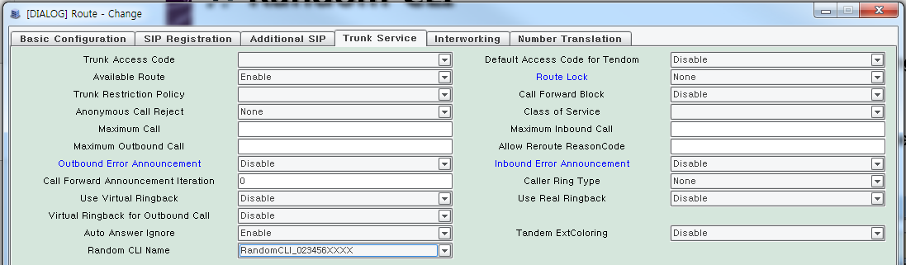

Random CLI
The random CLI is a feature that sends an outbound-only number to the calling number.
If you want to use this function, you need to set up the DB below.
[CONFIGURATION> Trunk Routing> Random CLI].
[CONFIGURATION> Trunk Routing> Route> Trunk Service> Random CLI Name]
- Random CLI
- Random CLI name
Notes:
Note

Slide 7
Billing with PRI Redirecting Number

Slide 8
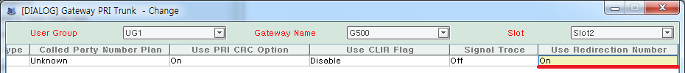
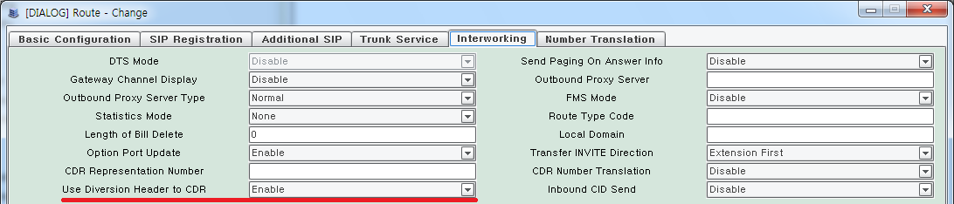
Billing with PRI Redirecting Number
When the PRI Redirecting Number is received, it is stored in the Pilot Billed Number on CDR (tandem billing only).
DB Settings
Set item ‘Use Redirecting Number’ to ‘On’ in [CONFIGURATION >
Gateway > IPX Setting > Gateway PRI Trunk] menu.
Set item ‘Use Diversion Header to CDR’ to ‘Enable’ in [CONFIGURATION >
Trunk Routing > Route > Interworking tab] menu.
Notes:
Note

Slide 9
External Call Forwarding Coloring Service

Slide 10
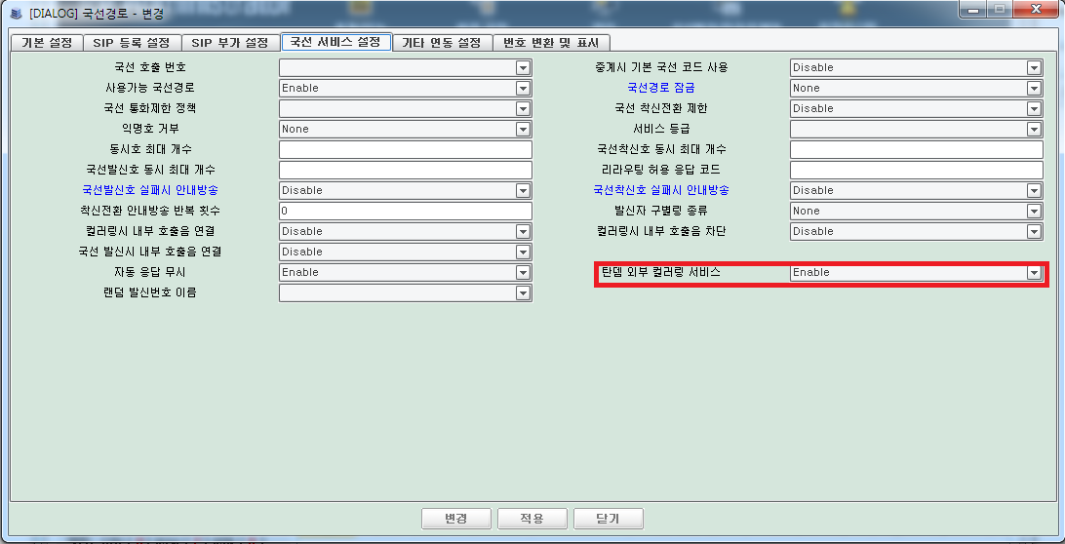
External Call Forwarding Coloring Service
This function is that SCM provides coloring Service in external call forwarding call
If you want to use this function, you need to set up the DB below.
[CONFIGURATION > TRUNK ROUTING > ROUTE > TRUNK SERVICE > TANDEM EXTCOLORING ] set “Enable”
Notes:
Note

Slide 11
Multi-ring List menu added in multibatch page

Slide 12
Multi-ring List menu added in multibatch page(1/2)
Multi-ring List
  Menu: [Tool > Customer Data Import/Export > Multi-ring List]
  Users can upload or download multi-ring list data through excel file at once
  Users also can modify data in this page
  Users cannot delete data in this page
Notes:
Note

Slide 13
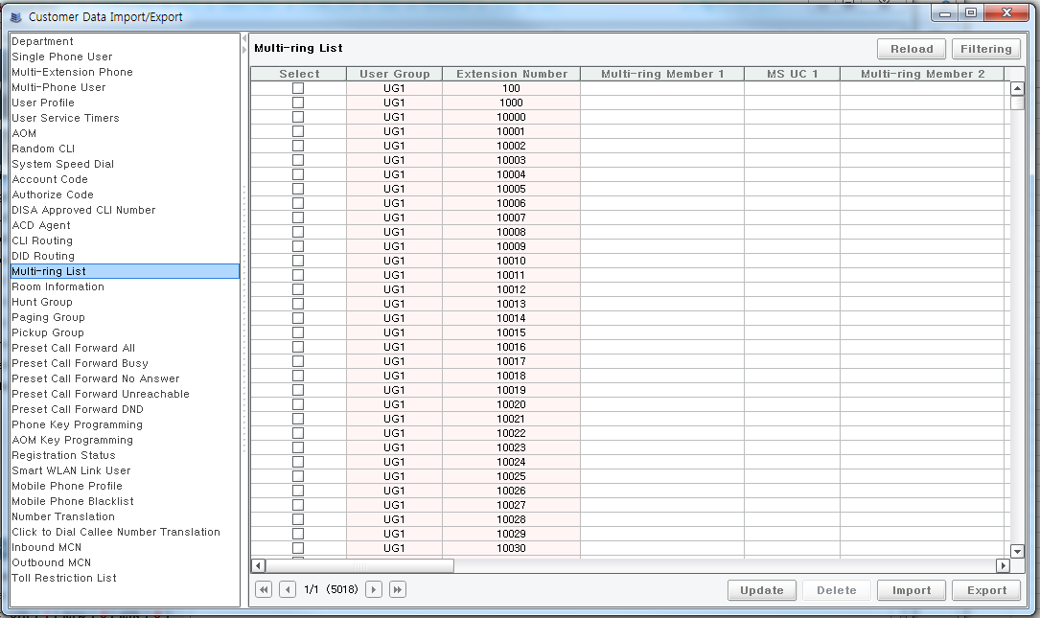
Multi-ring List menu added in multibatch page(2/2)
Move to [Tool > Customer Data Import/Export > Multi-ring List] Menu.
Notes:
Note

Slide 14






Notes:
14

