Slide 1
Transmission Cables

Slide 2
ML TN/CN to TCU
Straight Cat5 Ethernet Cable

Slide 3
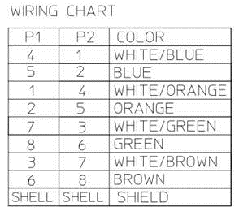
TCU/SIU to DUG20

Slide 4
ICF to TCU (P1= 2 Dsub9pin , P2= RJ45 )

