Slide 1
Baseband 5212 integration
ENURNUG

Slide 2
contents
Baseband Introduction
Full Manual Integration
Full USB Integration (Smart Laptop)
Other new function
Reference

Slide 3
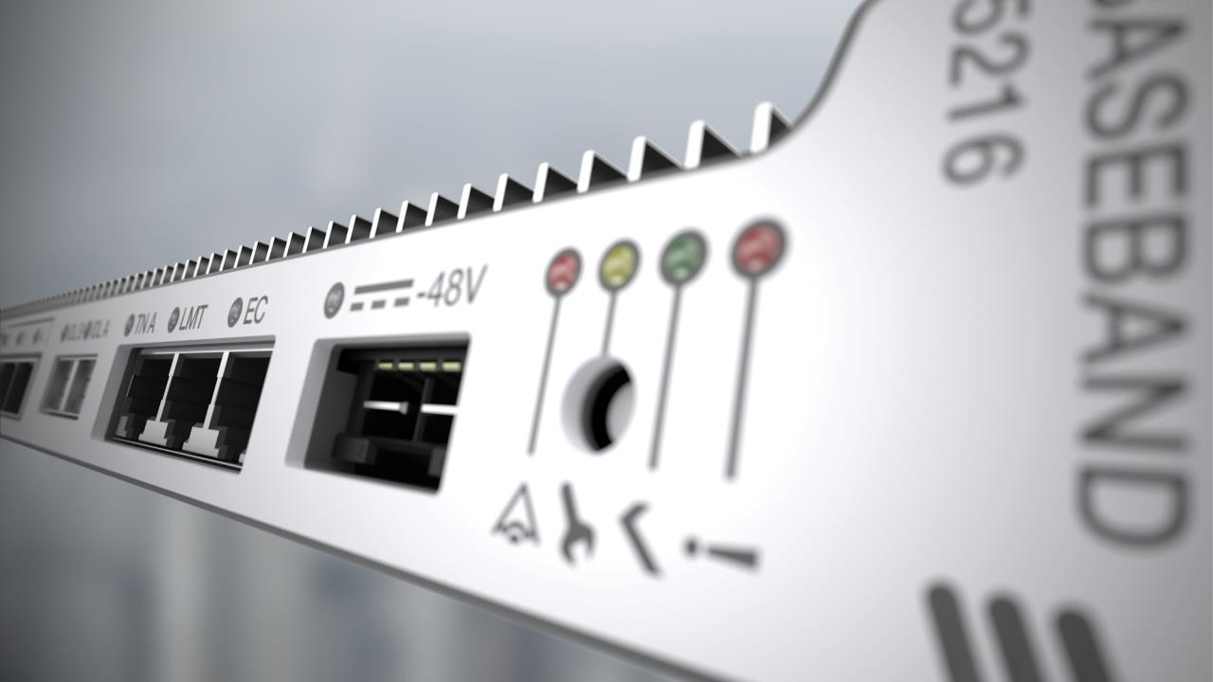
World’s best Baseband made better
2x
Notes:
We took the world's best baseband and made it better à Evidence from live networks around the world show again and again, Ericsson is the technology leader with the best performing networks and the most compact baseband on the market.
2X Multi-core à Ericsson has taken its world leading multi-core architecture and doubled the number of processor cores to 256, coupled to our cutting edge parallel processing software, Ericsson delivers the industry leading radio network system.
2X Multi-standard à Ericsson's new baseband unit supports LTE (FDD & TDD), WCDMA and GSM on the same hardware platform. This provides operator's with a future proof solution and full flexibility in how/when to migrate existing spectrum assets to LTE in the future.
2X Multi-mode à Deploy LTE using our new baseband unit and utilize it's powerful capacity for GSM or WCDMA also. Combined with the best radios in the business, you can deploy LTE on an existing GSM or WCDMA site and simultaneously modernize the GSM or WCDMA equipment, without deploying extra hardware. In addition, the operator is future prepared for migrating the GSM or WCDMA spectrum to LTE, with a simple software update.
2X Cell capacity à Supporting 5 LTE bands with Carrier Aggregation or aggregating FDD & TDD carriers to provide coverage AND capacity, Ericsson's new baseband unit provides the bandwidth demanded by increasing traffic and the transformation to 5G.

Slide 4
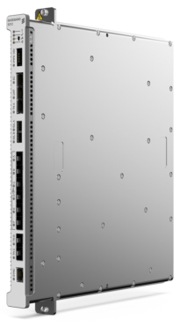
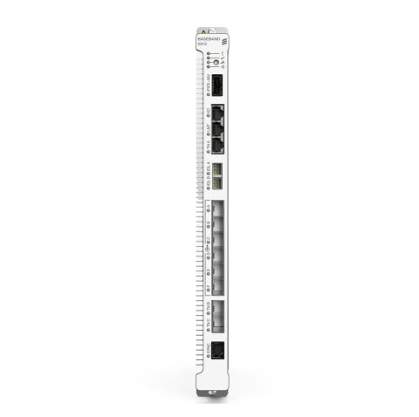


Baseband 5212 hardware capabilities
WCDMA HW prepared
576 CE Downlink & 576 CE Uplink
960 CE EUL Uplink*
384 HSDPA & 384 EUL users
252 Mbps Downlink & 92 Mbps Uplink
Up to 12 cell carriers / 180 HSDPA codes
Single BB pool, perfect pooling of CE
WCDMA HW capabilities W16A
576 CE Downlink & 384 CE Uplink
960 CE EUL Uplink*
384 HSDPA & 384 EUL users
Up to 6 cell carriers / 90 HSDPA codes
WCDMA HW capabilities W16B
576 CE Downlink & 384 CE Uplink
960 CE EUL Uplink*
384 HSDPA & 384 EUL users
Up to 12 cell carriers / 180 HSDPA codes
Single BB pool, perfect pooling of CE
*With FAJ 121 2598 CE extension for EUL

Slide 5
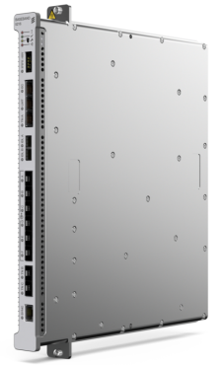
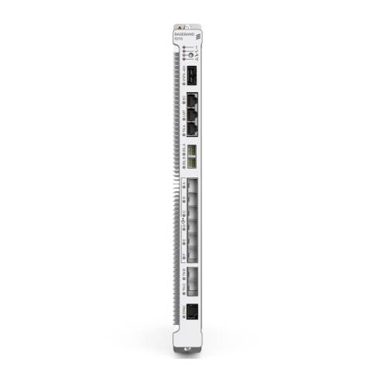
Baseband 5216 hardware capabilities
WCDMA HW prepared
1152 CE Downlink & 1152 CE Uplink
1920 CE EUL Uplink*
768 HSDPA & 768 EUL users
336 Mbps Downlink & 138 Mbps Uplink
Up to 24 cell carriers / 360 HSDPA codes
Single BB pool, perfect pooling of CE
WCDMA HW capabilities W16A
1152 CE Downlink & 768 CE Uplink
1920 CE EUL Uplink*
768 HSDPA & 384 EUL users
Up to 6 cell carriers / 90 HSDPA codes
WCDMA HW capabilities W16B
1152 CE Downlink & 768 CE Uplink
1920 CE EUL Uplink*
768 HSDPA & 384 EUL users
Up to 12 cell carriers / 180 HSDPA codes
Single BB pool, perfect pooling of CE
*With FAJ 121 2598 CE extension for EUL

Slide 6
Baseband 5216 Future Mixed Mode capabilities*
WCDMA + LTE
576 CE Downlink & 576 CE Uplink
960 CE EUL Uplink
384 HSDPA & 384 EUL users
252 Mbps Downlink & 92 Mbps Uplink
Up to 12 cell carriers / 180 HSDPA codes
Single BB pool, perfect pooling of CE
WCDMA + GSM
576 CE Downlink & 576 CE Uplink
960 CE EUL Uplink
384 HSDPA & 384 EUL users
252 Mbps Downlink & 92 Mbps Uplink
Up to 12 cell carriers / 180 HSDPA codes
Single BB pool, perfect pooling of CE
First mixed mode in W16B
*Hardware prepared

Slide 7
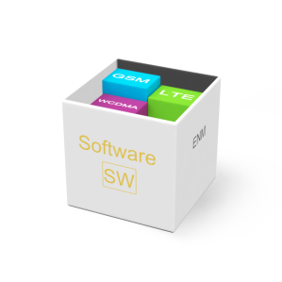
SW Feature support Aspects
2015
Q2
Q3
Q4
2016
Q2
Q3
Q4
15B
16A
16B
LTE
*
WCDMA
**
GSM
Most SW feature used today in commercial networks are supported with W16A
All RNC related features are by default supported
Always consult ERS Baseband SW roadmap
Examples of not supported features in W16A, but candidates for W16B.
FAJ 121 1883 CE capacity for EUL Smartphones
FAJ 121 1357 Configurable Carrier Bandwidth
FAJ 121 1490 Dual Band HSPA Multi carrier
FAJ 121 3908 Narrowband Interference rejection
FAJ 121 1481 F-DPCH
FAJ 121 3698 HSDPA Dynamic Power sharing
FAJ 121 1443 EUL Single HARQ process scheduling
Notes:
Ericsson Radio System marks a generational shift in how to build radio networks. A key part of this shift is the release of a new Multi-Standard capable Baseband platform featuring the Baseband 5216 and 5212 products.
The new Baseband platform will build support of the different Radio standards in stages as shown in the above picture, where the solid coloration indicates full functional support by the end of the period. In general the most commonly used functionality will be supported first to facilitate the smoothest and fastest possible introduction of the new hardware. For example even from W16A, 80% of the most commonly used WCMDA features will be supported on the new Baseband 5216. However, for specific customers it may still mean that a key feature or Value Package is not supported in the first release. So to avoid misunderstandings and commercial risks, always consult the latest SW functionality support roadmap to confirm whether all of your customer’s critical functionality will be available in the necessary timeframe.
The strategy for Baseband 5216 and 5212 is to make a phased introduction. A brief overview of the introduction strategy is; first release Baseband 5216 for standard LTE configurations in the 15B software release and to support extreme LTE capacity and complex configurations in the 16A software release.
In the second phase, Baseband 5212 will be supported in the LTE 16A software release and both Baseband 5216 & 5212 will be supported in the WCDMA 16A software release.
In the third phase, GSM support will be added to Baseband 5216 & 5212, as well as software support for mixing two standards on the same physical Baseband 5216 hardware.

Slide 8
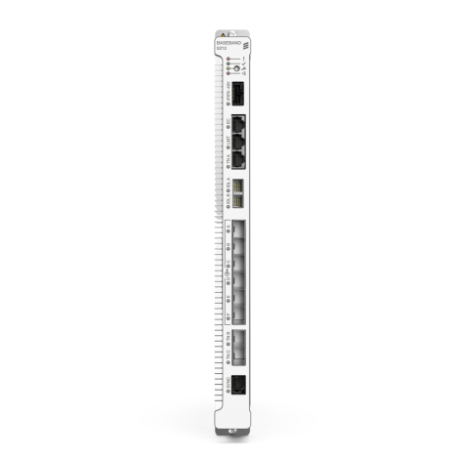
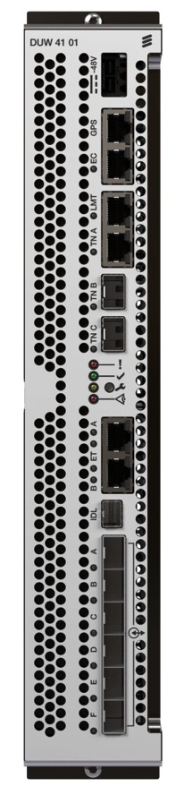
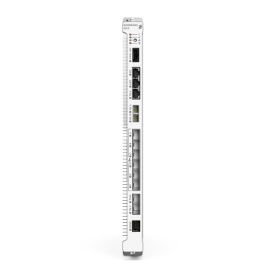
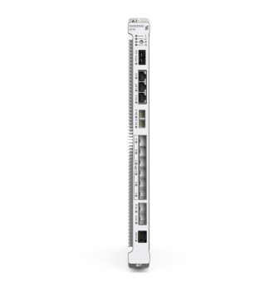

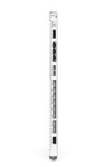

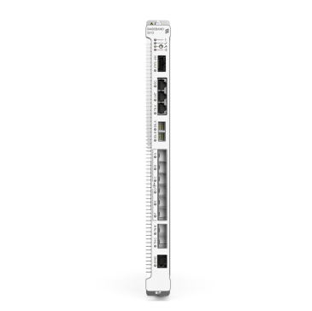

HW support Aspects
Baseband 5212 and 5216 cannot interconnect with DUW
Will be treated as different logical RBS
IDL
Dual Baseband 5212 and/or 5216 is not planned to be supported supported in W16A/B
Will be supported in later releases
Baseband 5212/5216 and DUW will support connections towards same radio running mixed mode configuration
RRUS 12
Baseband 5216 and 5212 fully supports multi-standard radio units
Single standard radio units RUW/RRUW cannot be supported
RRUW 01
CPRI

Slide 9
Pre-requesites
Tools:
Laptop with browser Internet Explorer/Mozilla Firefox
LAN Straight Cable
MoShell minimum MoShell16
SFTP Application
USB SL (for SL integration)
Software:
- Upgrade Package W16A CP2 or later

Slide 10
Pre-requesites
Configuration Files
RBS Summary Script
Site Basic Script
Site Equipment Script
License Key File (LKF)
Upgrade Package
Transport Network Script
Radio Network Script

Slide 11
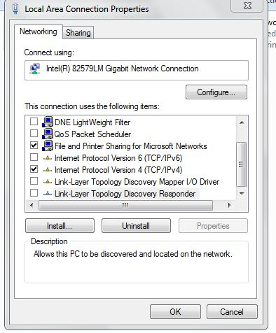
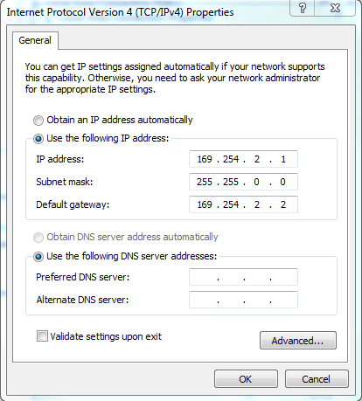
Full manual integration
Power Up Baseband 5212
Connect Laptop to port LMT Baseband using RJ45 cable
IP Laptop Setting

Slide 12
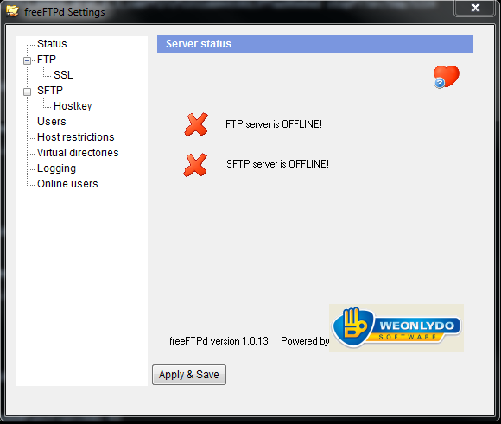
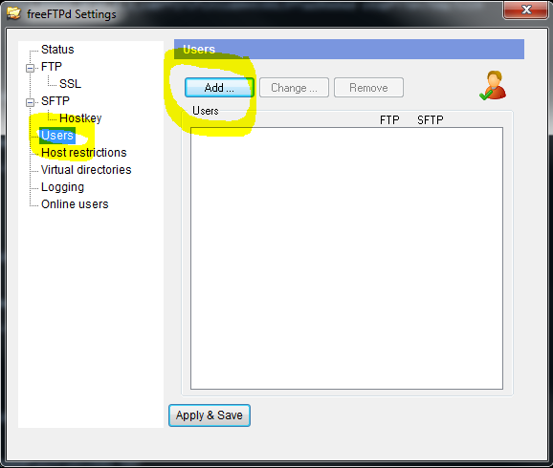
Full manual integration
Firewall and antivirus should be disabled in the local PC
Setting SFTP Server (Recommendation FreeFTPd)
- IpAddress : 169.254.2.1
- User : ftp
- Password : ftp

Slide 13
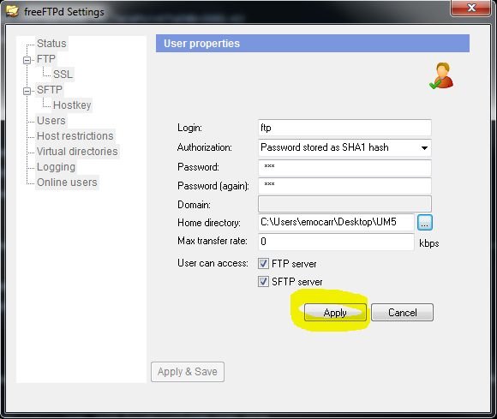
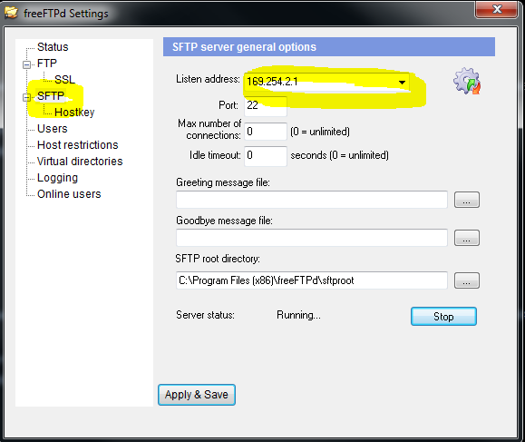
Full manual integration
Setting SFTP Server (Continue..)

Slide 14
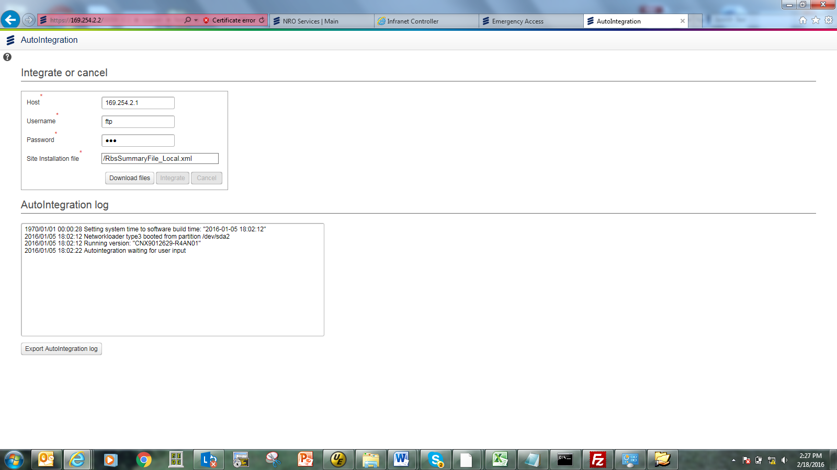
Full manual integration
Open IE, Log in to AutoIntegration Web GUI : https://169.254.2.2
- Host : 169.254.2.1 (IP Laptop)
- Username : ftp
- Password: ftp
- Site Installation File: /<RBS_Summary>.xml

Slide 15
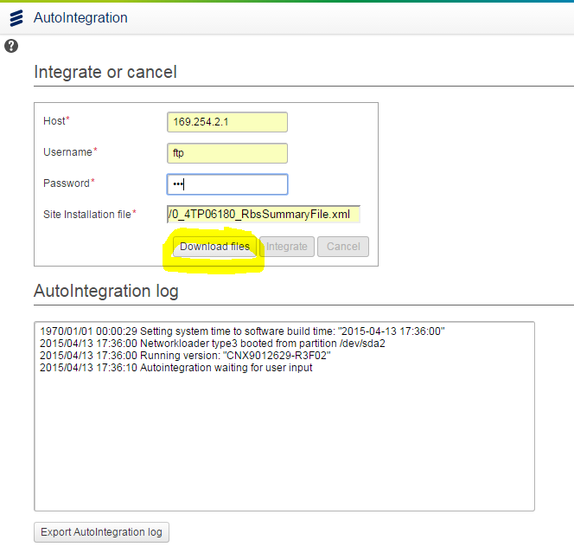
Full manual integration
Press button ‘Download Files’ until download complete. Proses download will appear in AutoIntegration log

Slide 16
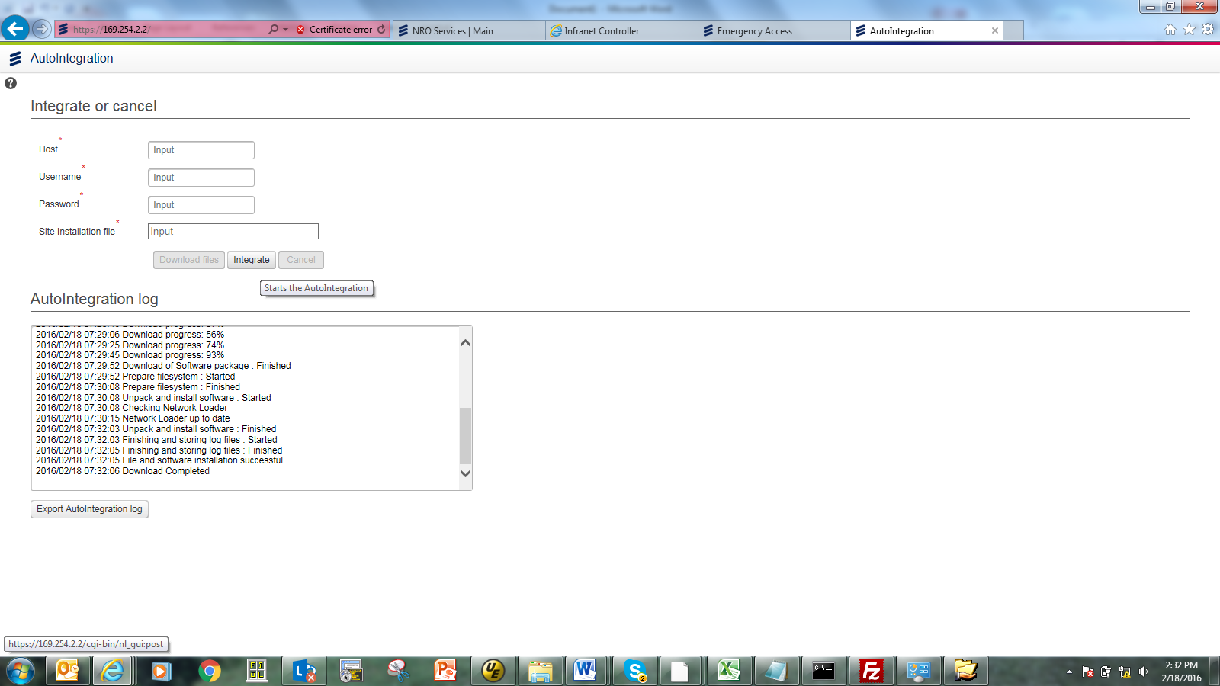
Full manual integration
After download files complete, press button “Integrate” for starting integration. Baseband will restart before integration process started (estimation 15 minutes)
Make sure transmission cable already connect to TRM Equipment (mandatory)

Slide 17
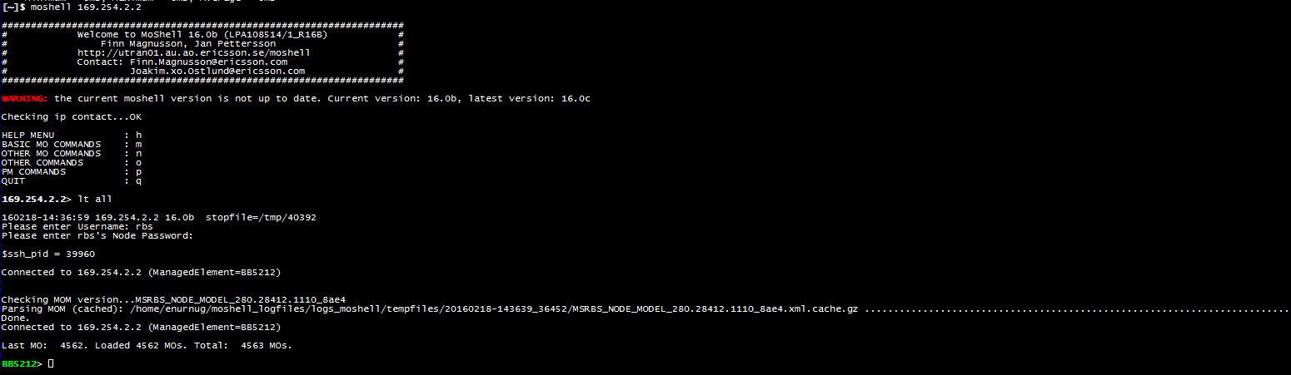
Full manual integration
After Auto Integration complete, in AutoIntegration Web GUI will appear “Welcome to RBS”. Open Moshell, log in to RBS using default IP 169.254.2.2.
Type “lt all”, then fill user & password : rbs
If Integration process failed/error, Baseband will automatically restore to factory setting. Details error check in Emergency Access https://169.254.2.2/ea.html

Slide 18
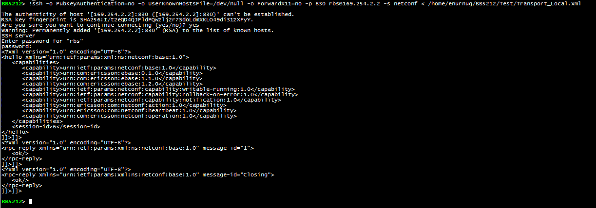
Full manual integration
Running Transport Network & Radio Network script via Netconf with command below.
!ssh -o PubKeyAuthentication=no -o UserKnownHostsFile=/dev/null -o ForwardX11=no -p <port_netconfssh> rbs@169.254.2.2 -s netconf < filename.xml
Example : !ssh -o PubKeyAuthentication=no -o UserKnownHostsFile=/dev/null -o ForwardX11=no -p 830 rbs@169.254.2.2 -s netconf < /home/enurnug/BB5212/Test/Transport_Local.xml

Slide 19
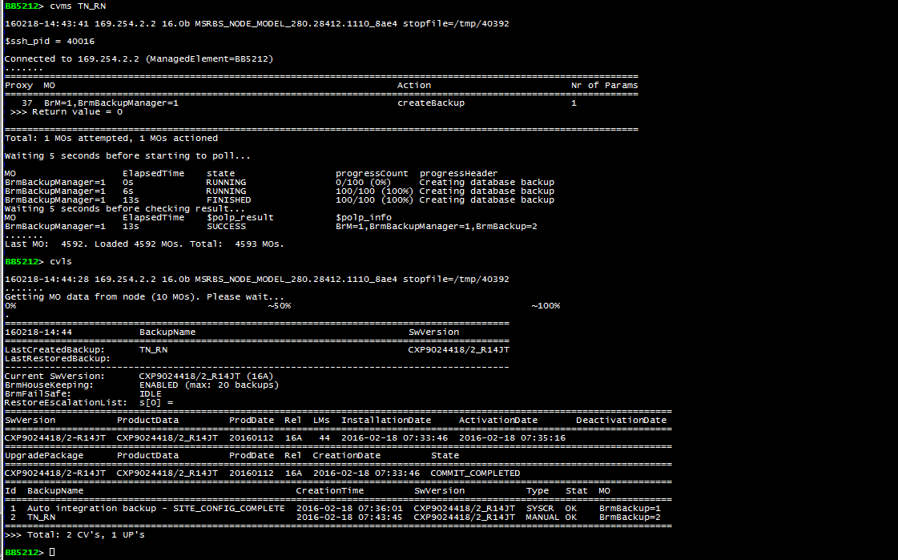
Full manual integration
Create Backup Configuration with command below.
“acc BrM=1, BrmBackupManager=1 createBackup”

Slide 20
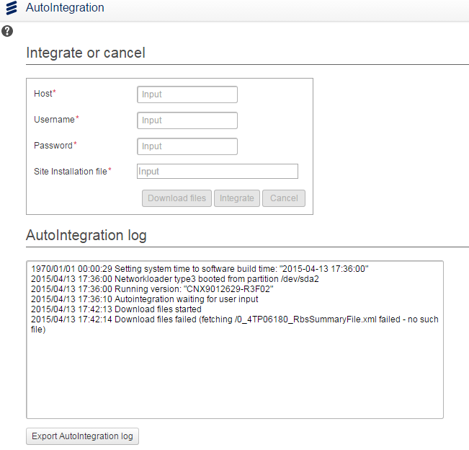
troubleshooting
If integration failed, error message will appear in AutoIntegration log https://169.254.2.2

Slide 21
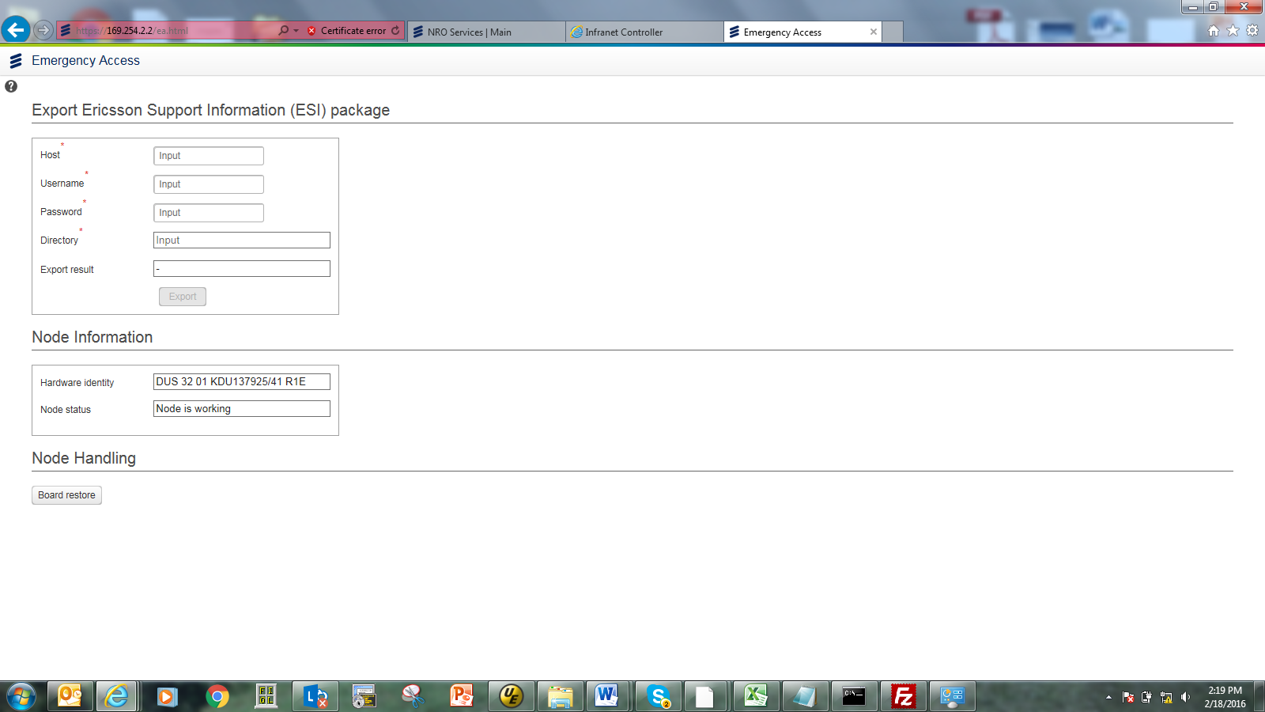
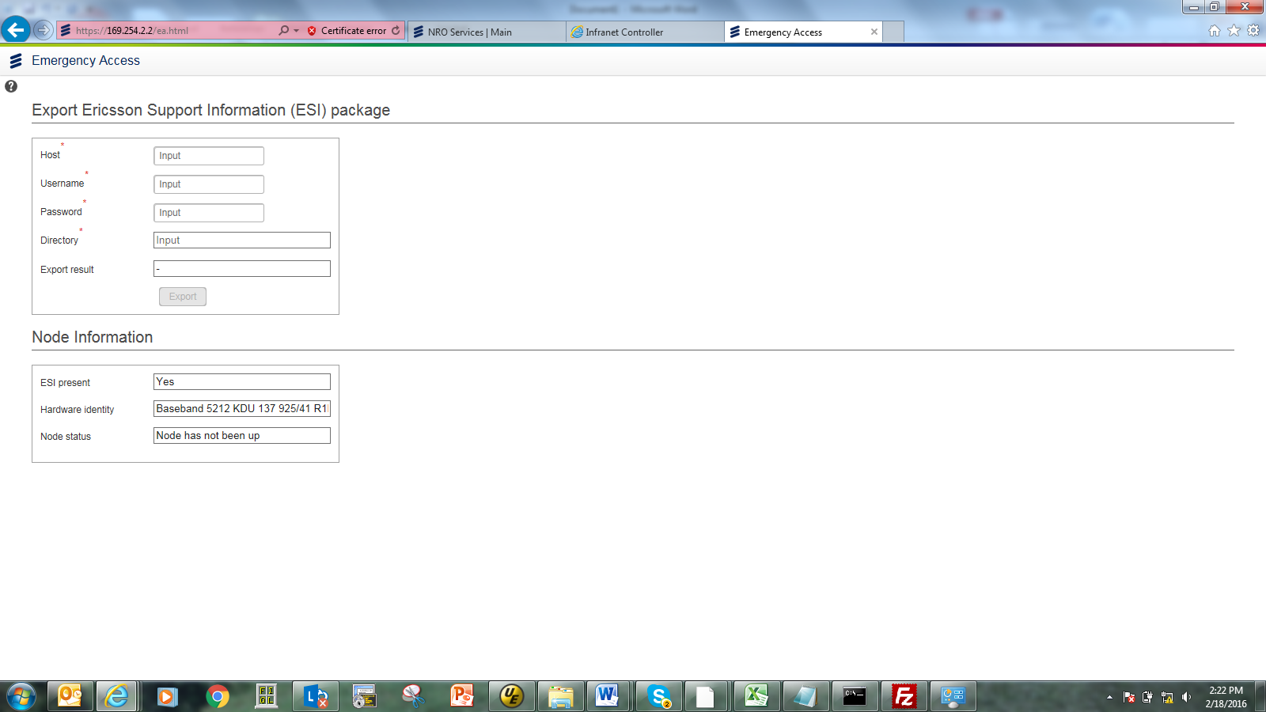
troubleshooting
Check status board in Emergency Access https://169.254.2.2/ea.html

Slide 22
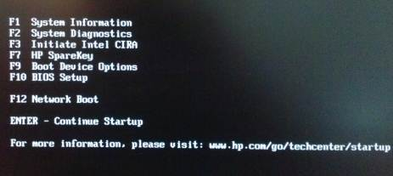
Smartlaptop integration
Plugin USB SmartLaptop
Restart Client laptop, booting to USB SL

Slide 23
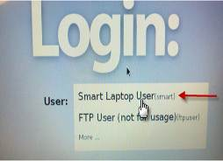
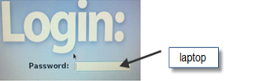
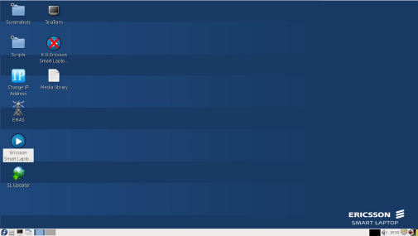
Smartlaptop integration
Login to smart laptop with password “laptop”
Screen desktop SL will appear

Slide 24
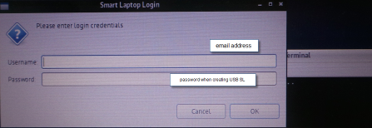
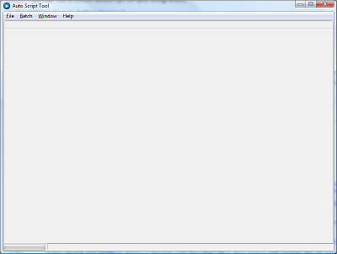
Smartlaptop integration
Click smartlaptop icon, fill username & password for USB smart laptop

Slide 25
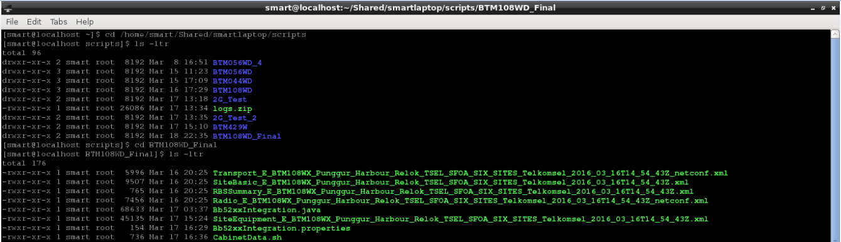
Smartlaptop integration
Before running smartlaptop, fill Cabinet Data RBS.
Open Terminal, go to folder where the script will be running as command below.
- cd /home/smart/Shared/smartlaptop/scripts
- list file : ls -ltr
- cd <folder script name>
- list file : ls –ltr
- File CabinetData.sh must available

Slide 26
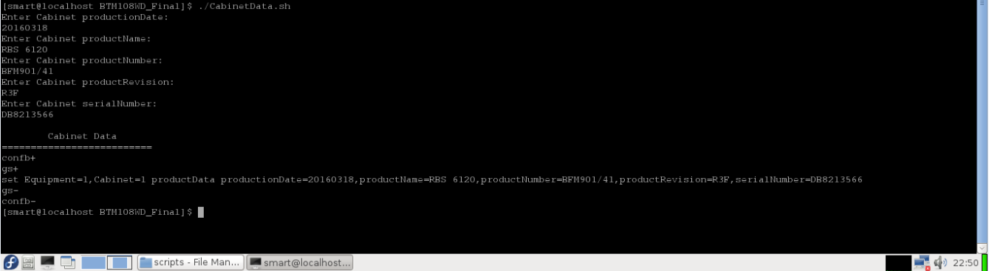
Smartlaptop integration
Running command: ./CabinetData.sh, then fill Cabinet Data RBS description. This step will generate script CabinetData.mos

Slide 27
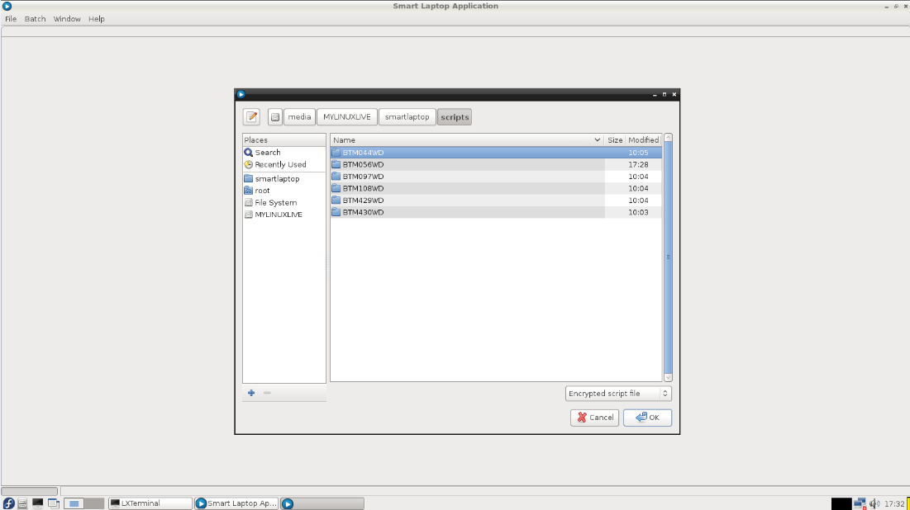
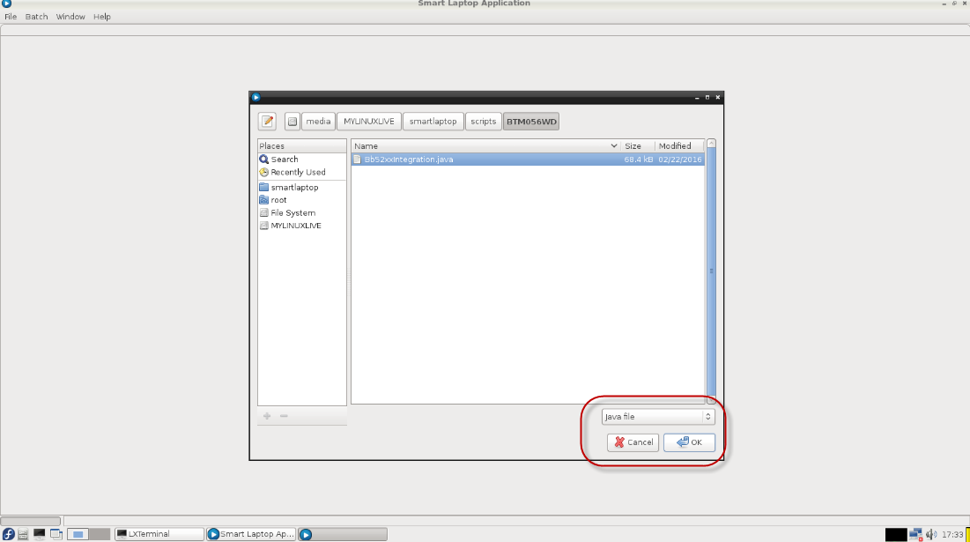
Smartlaptop integration
Go to smartlaptop window, Click : File > open Scripts > Chose script folder > chose “Java file” then OK

Slide 28
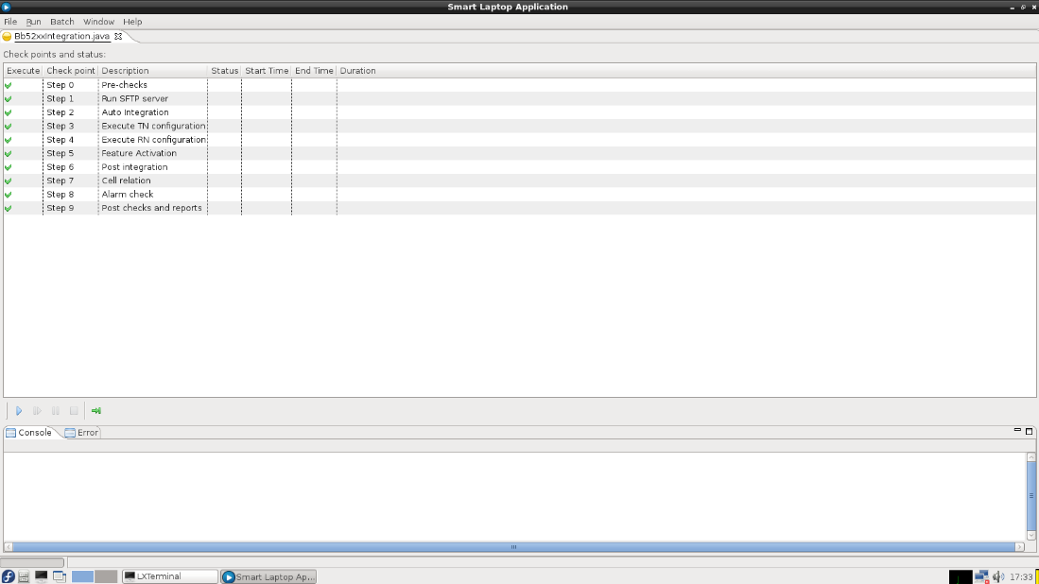
Smartlaptop integration
Make sure transmission cable already connect to the TRM Equipment (mandatory)
Press tombol Play to run integration process

Slide 29
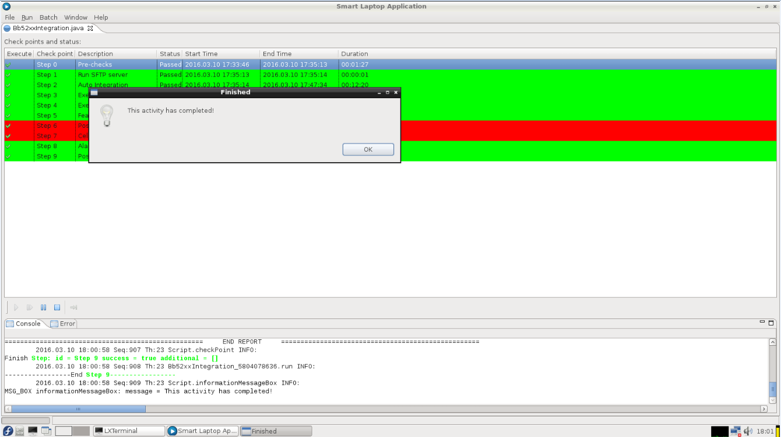
Smartlaptop integration
Please follow display smartlaptop environments during integration process until finish

Slide 30
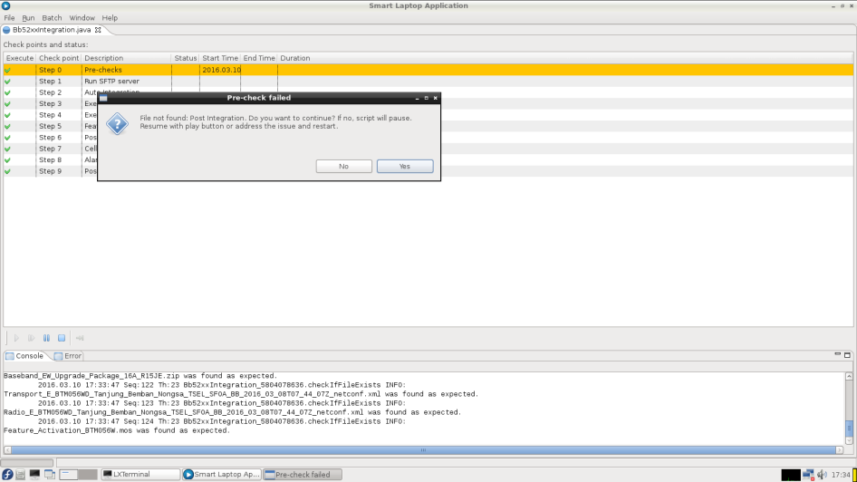
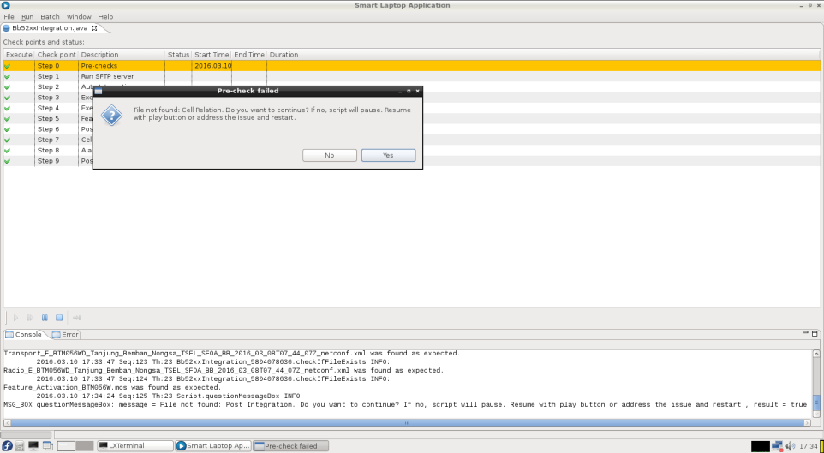
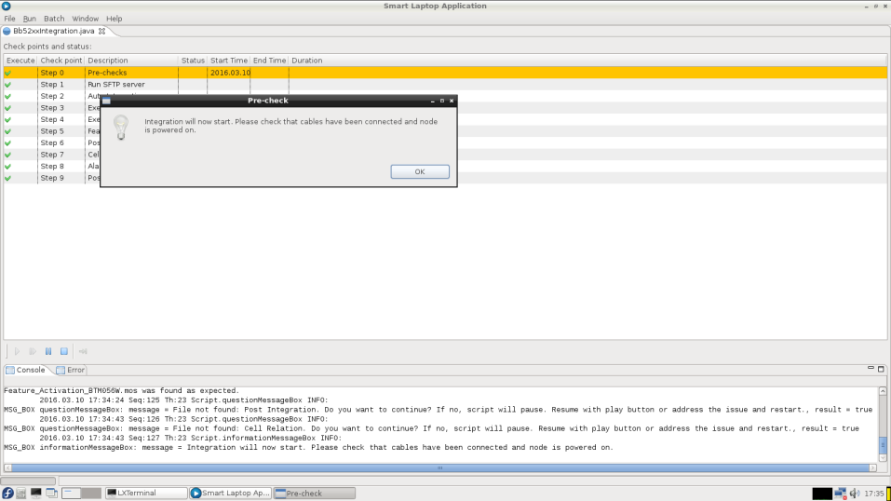
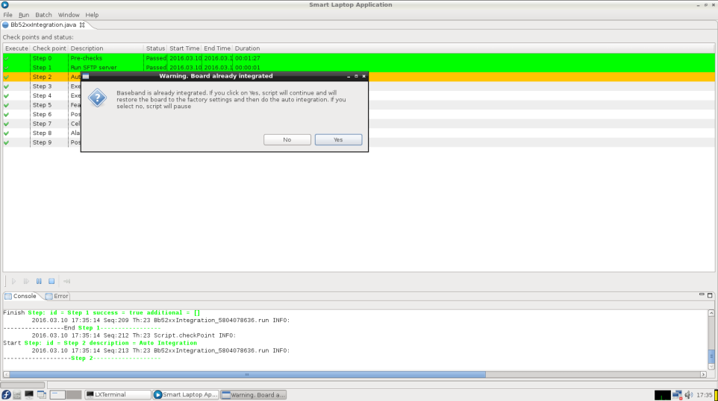
Smartlaptop integration
display smartlaptop environtment

Slide 31
Basic commands
# Log on node : moshell <Node IP> )
#Make CV: acc BrmBackupManager createBackup
#Delete CV: acc BrmBackupManager deleteBackup
#cvset & node restart on startable CV: acc BrmBackup=XX restore
#Restart Node: acc FieldReplaceableUnit=1 restartUnit
#Ping test: mcc Router=Traffic ping 10.211.38.86 --count 2 --packetsize 1000
#Cek macc address router: mcc Router=vr_Traffic3G show arp-cache
Notes:
moshell <nodeip>
Moshell will automatically detect the node type (CPP / RCS / Pico / etc) and set the TCP ports for the various interfaces to the appropriate values.
If the username is unknown or incorrect, moshell will prompt for the username.
For COM nodes, moshell will by default access the MO interface via COMCLI over SSH.
To use a different access method (NETCONF / TLS / etc), it is possible to specify the option "-v comcli=<value>".
Refer to the file moshell/moshell for more detailed description about the comcli parameter.
#-------------------------------------------------------------------------------
# COMCLI special values.
#
# VALUE NODE TYPE
# comcli=10 pico commercial
# comcli=11 pico RnD
# comcli=12 NetSim and APG43L 1.x
# comcli=13 pico commercial via netconf
# comcli=20 g2 commercial via COMCLI/SSH
# comcli=21 g2 RnD via COMCLI/SSH
# comcli=22 g2 RCSsim via COMCLI/SSH
# comcli=23 g2 commercial via netconf/SSH
# comcli=24 g2 RnD via netconf/SSH
# comcli=25 g2 via comcli/TLS + sam.p12
# comcli=26 g2 via comcli/TLS + pemfiles
# comcli=27 g2 via comcli/TLS + ssucredentials
# comcli=28 g2 via comcli/SSH+TLS with connection menu
# comcli=30 NetSim
# comcli=31 BSP
# comcli=32 PGM
# comcli=33 Nestim via netconf
# comcli=34 APG43L 2.x
# comcli=35 EPG/SSR
#license:hget featurestate= state$|key|descri

Slide 32
References
[1] Ericsson Radio System Baseband Portfolio Description
[2] Moshell_for_COM_PA36.doc
[3] CPI Baseband Radio Node 16A
[4] Baseband 5216 Migration Procedure

