Slide 1

Welcome to
CU IRAN Ericsson Base band training
Hadi Faramarzi
14’ Apr 2017

Slide 2
Agenda:
1- What are E/// base bands
2-Different types of base bands
3-What is different between DuS and base band
4-how to install base band units
5-how power up and commission BB
6-integration
7-Troubleshooting

Slide 3
1- What are E/// base bands

Slide 4
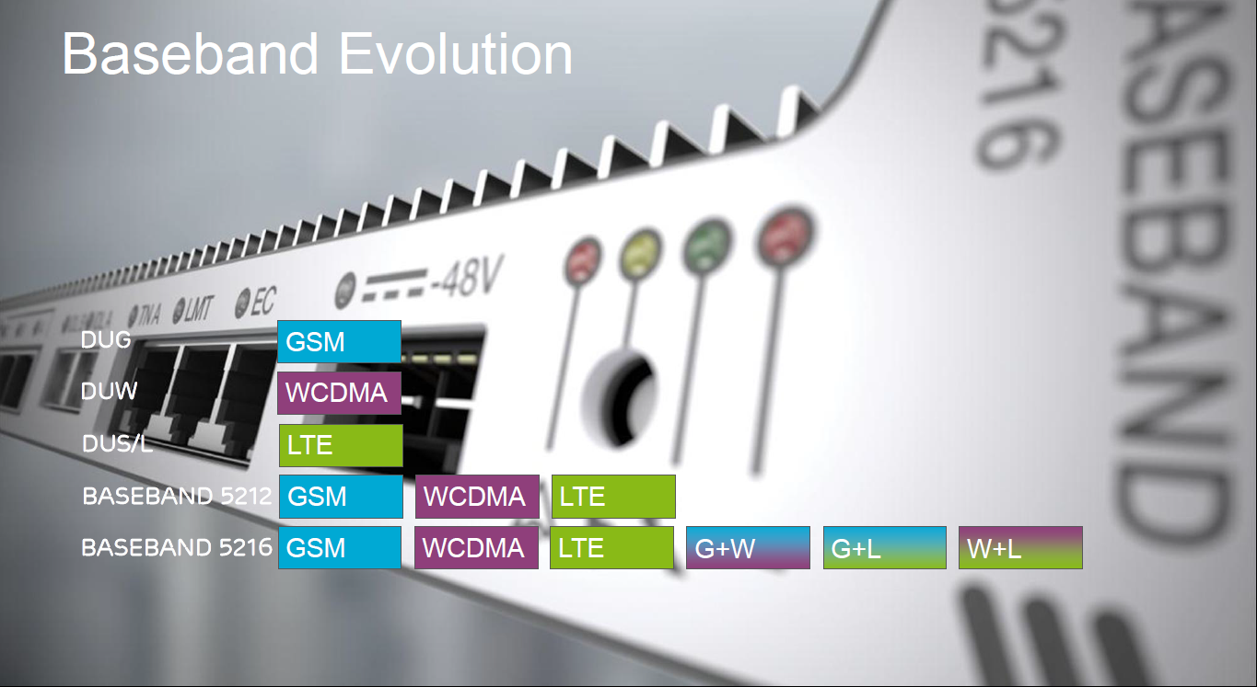
1- What are E/// base bands

Slide 5
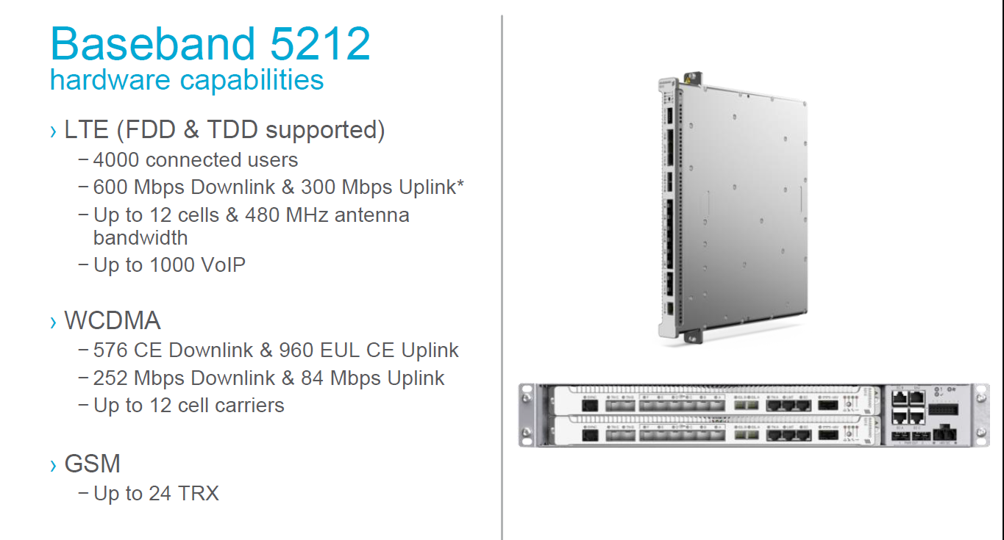
2-Different types of base bands

Slide 6
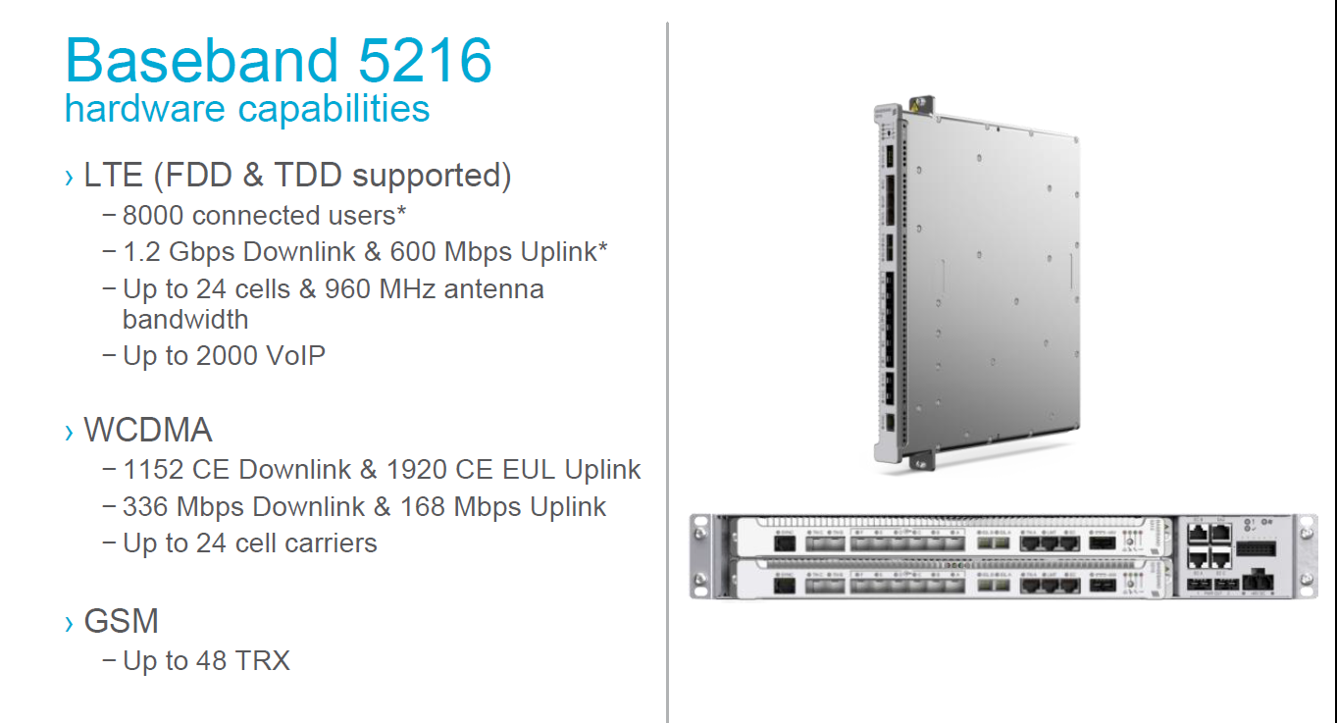
2-Different types of base bands

Slide 7
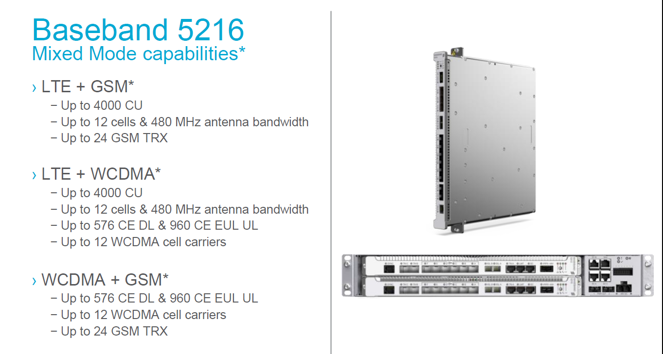
2-Different types of base bands

Slide 8
2-Different types of base bands

Slide 9
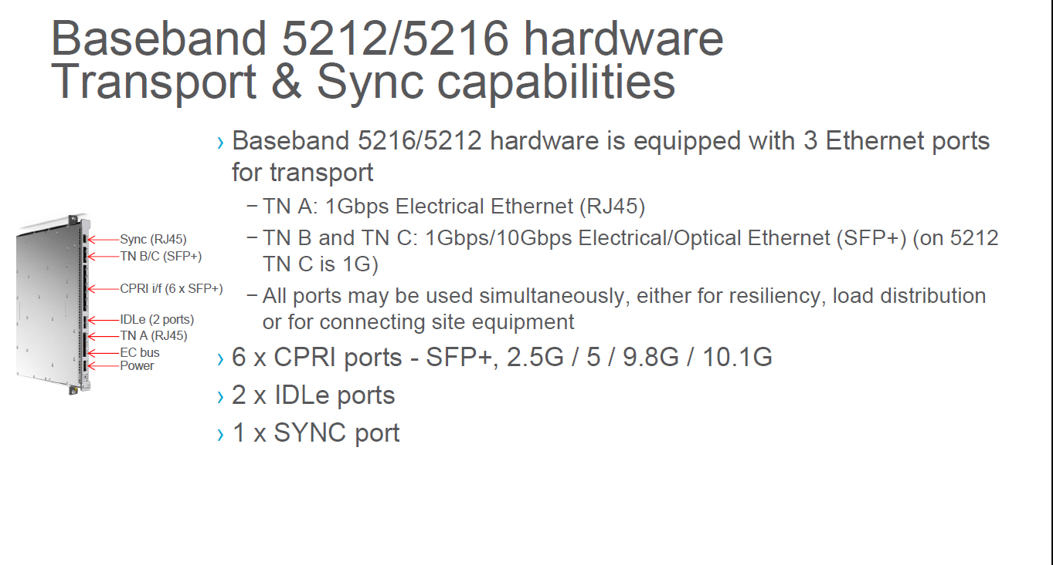
2-Different types of base bands

Slide 10
3-What is different between DuS and base band

Slide 11
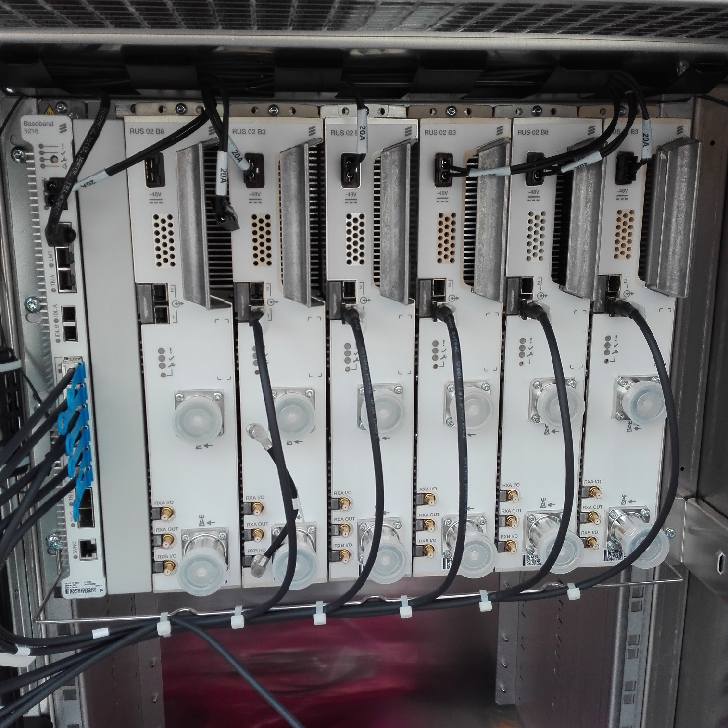
4-how to install base band units

Slide 12
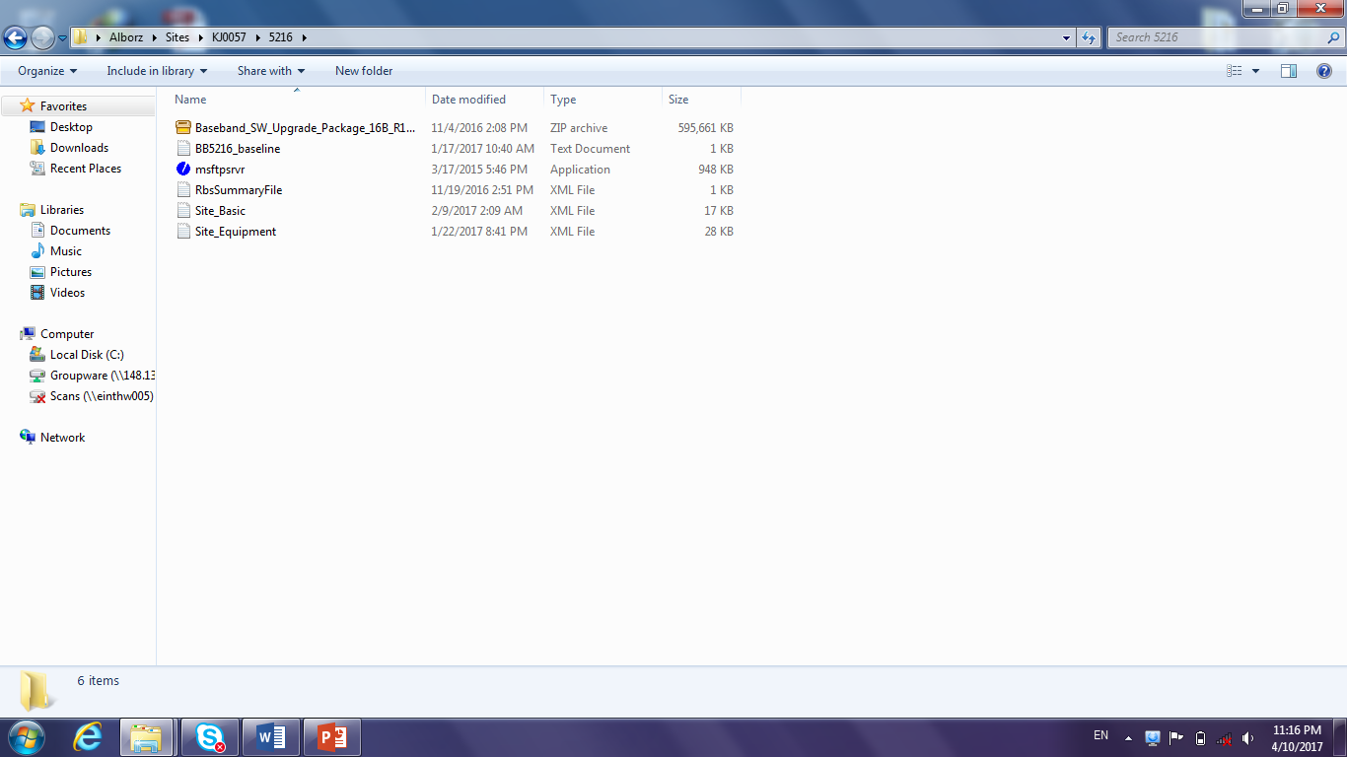
5-how power up and commission BB
1-To commission a BB, the following files are required

Slide 13
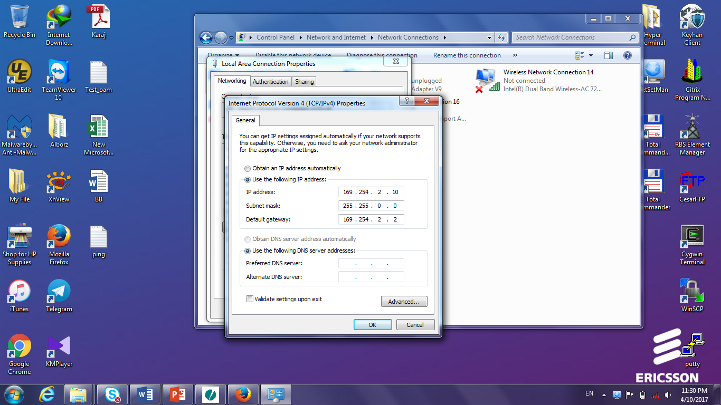
5-how power up and commission BB
2- set your laptop IP

Slide 14
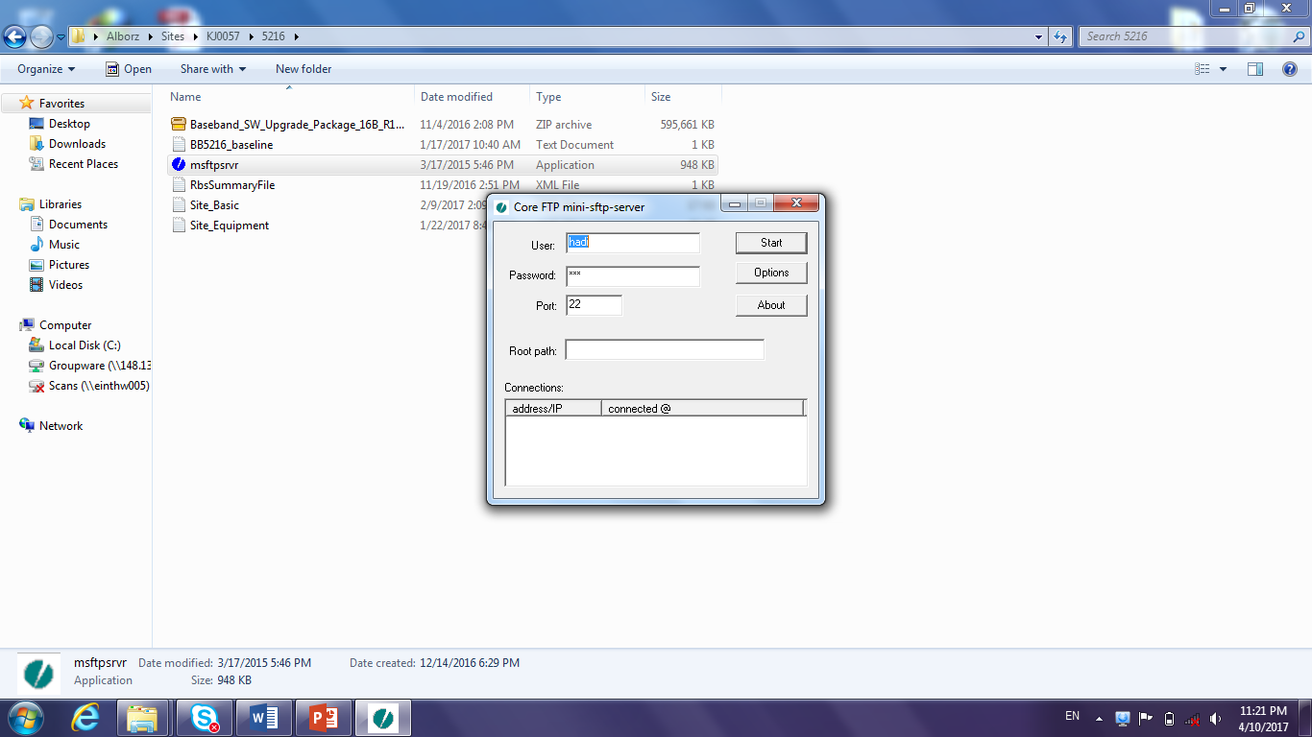
5-how power up and commission BB
3- Start the sftp

Slide 15
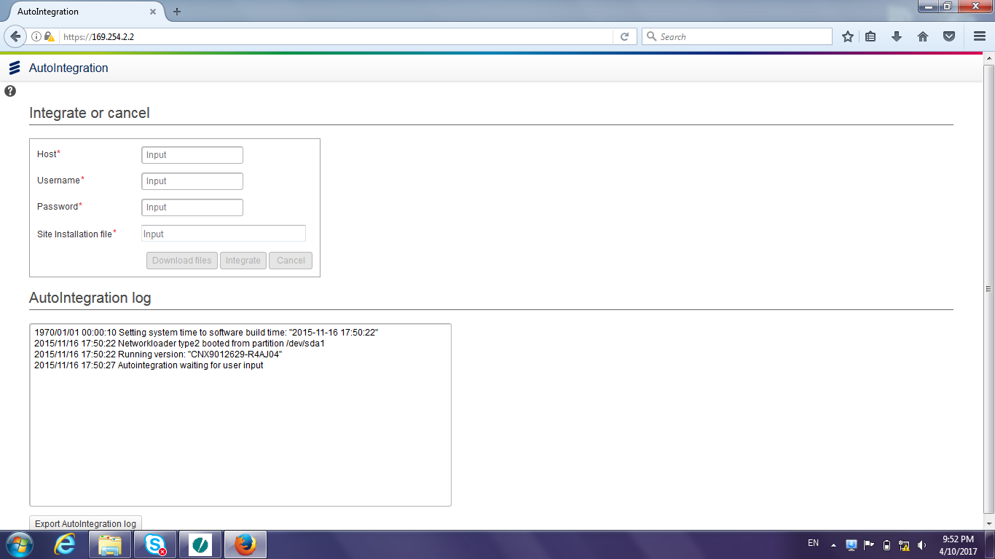
5-how power up and commission BB
4- Open an IE and use this address https://169.254.2.2

Slide 16
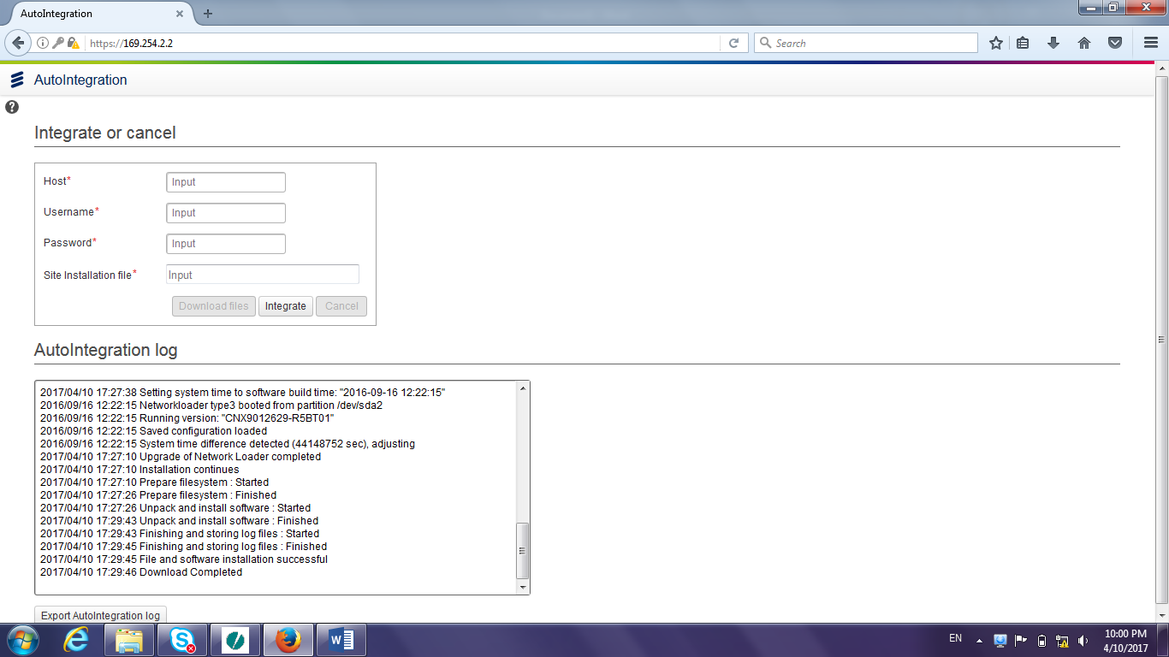
5-how power up and commission BB
5- Click integrate

Slide 17
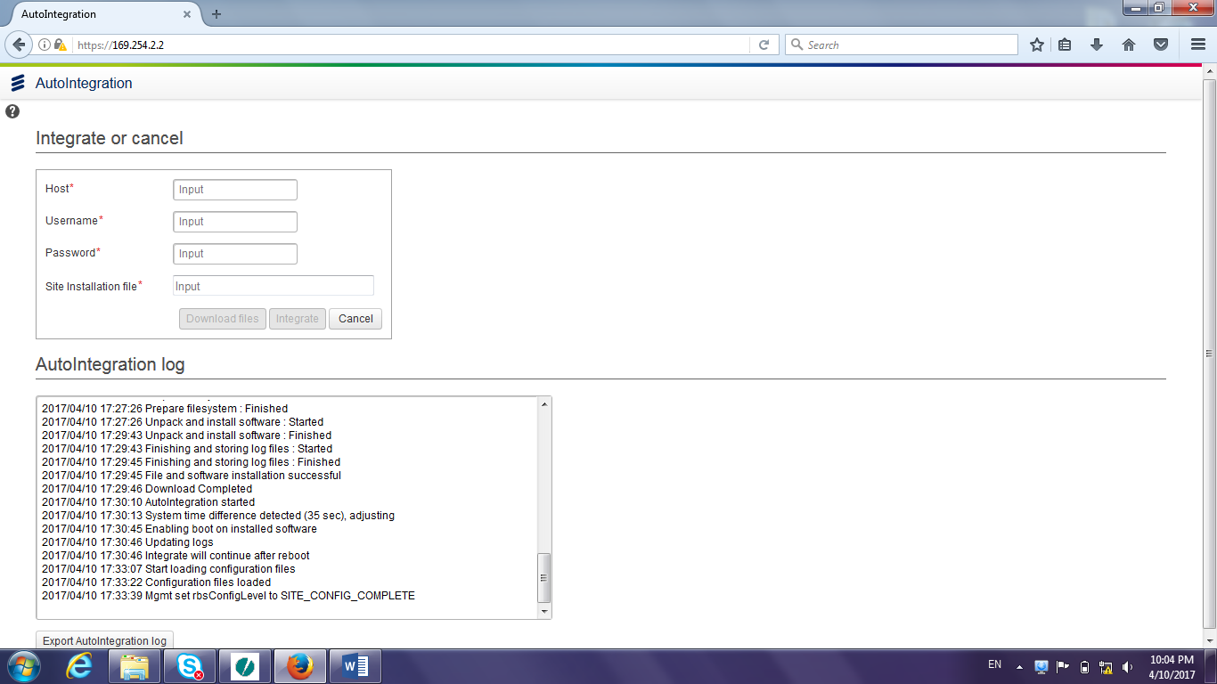
5-how power up and commission BB
6- Configuration complete

Slide 18
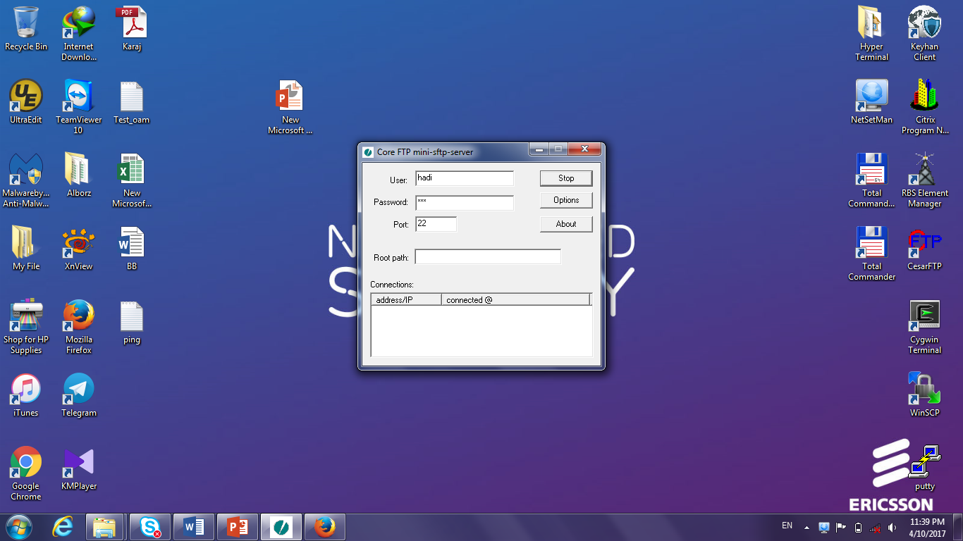
5-how power up and commission BB
7- Stop sftp

Slide 19
6-integration
8- Run Baseline Script in moshell
9- Ping OAM with below comment
“mcc addressip ping --count 3 10.18.30.2 | grep transmitted”
10- Call integration team

Slide 20
IF during commission or loading scripts on base band anything happened or script loading failed, you need to format your BB and start commissioning again.
7-Troubleshooting
How to format
Base Band

Slide 21
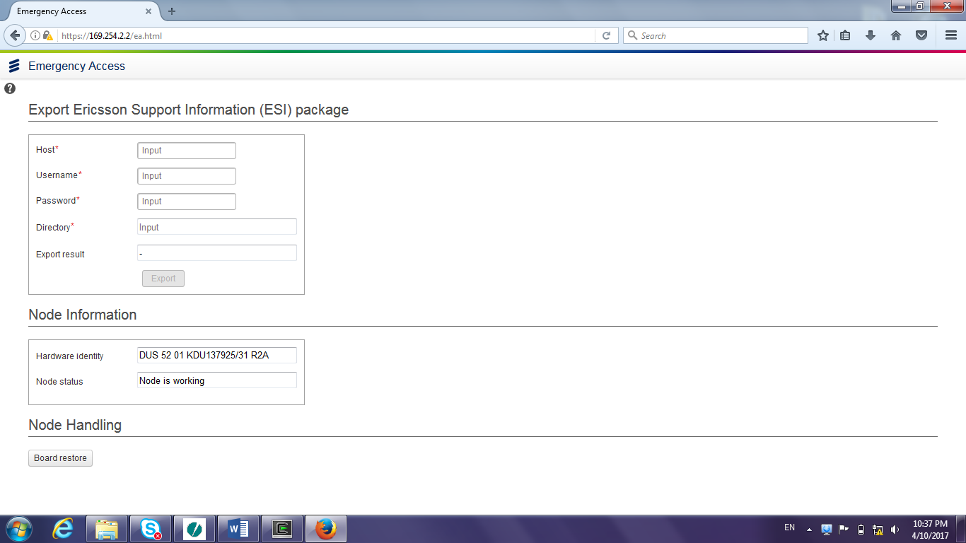
7-Troubleshooting(Format BB)
open an IE and use below address: “https://169.254.2.2/ea.html”

Slide 22
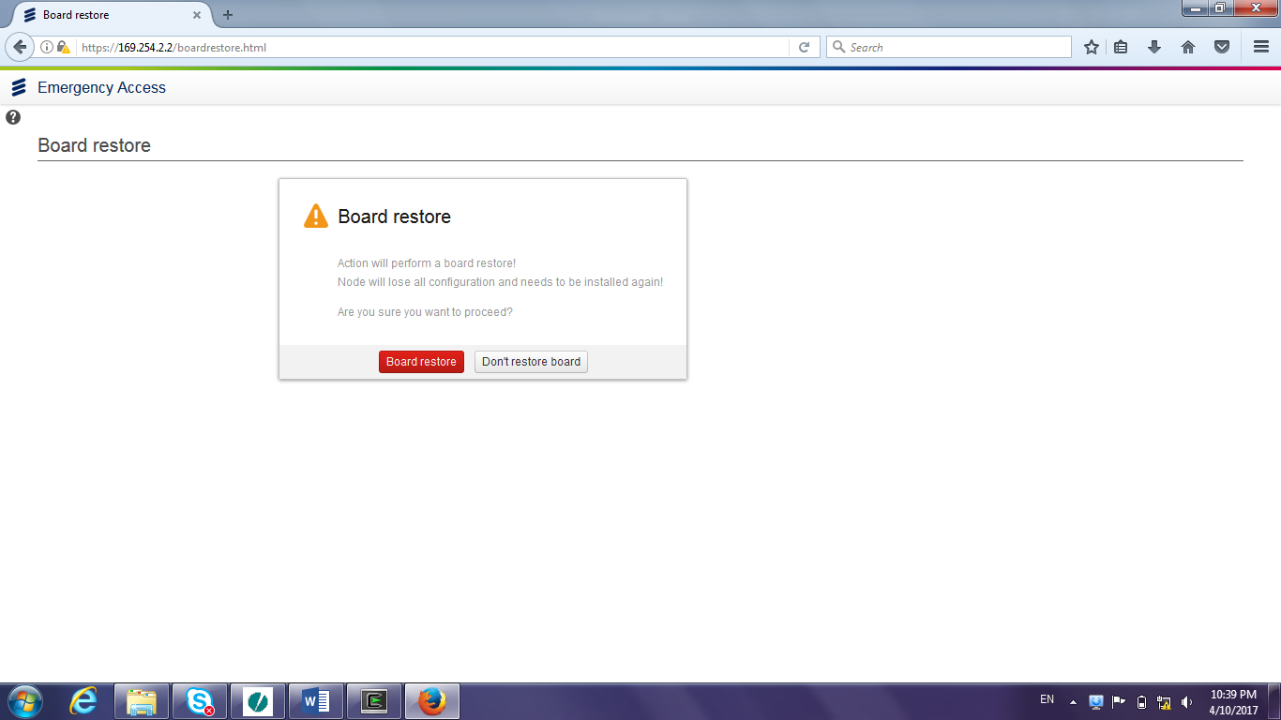
7-Troubleshooting(Format BB)
Click on board restore
Note: Once formatting bb is finished, the laptop will reconnect to bb and get new ip and operation led will start to blink,
then you can start to commission again.

Slide 23


