Slide 1
Format Baseband and reinstall Config by CV

Slide 2
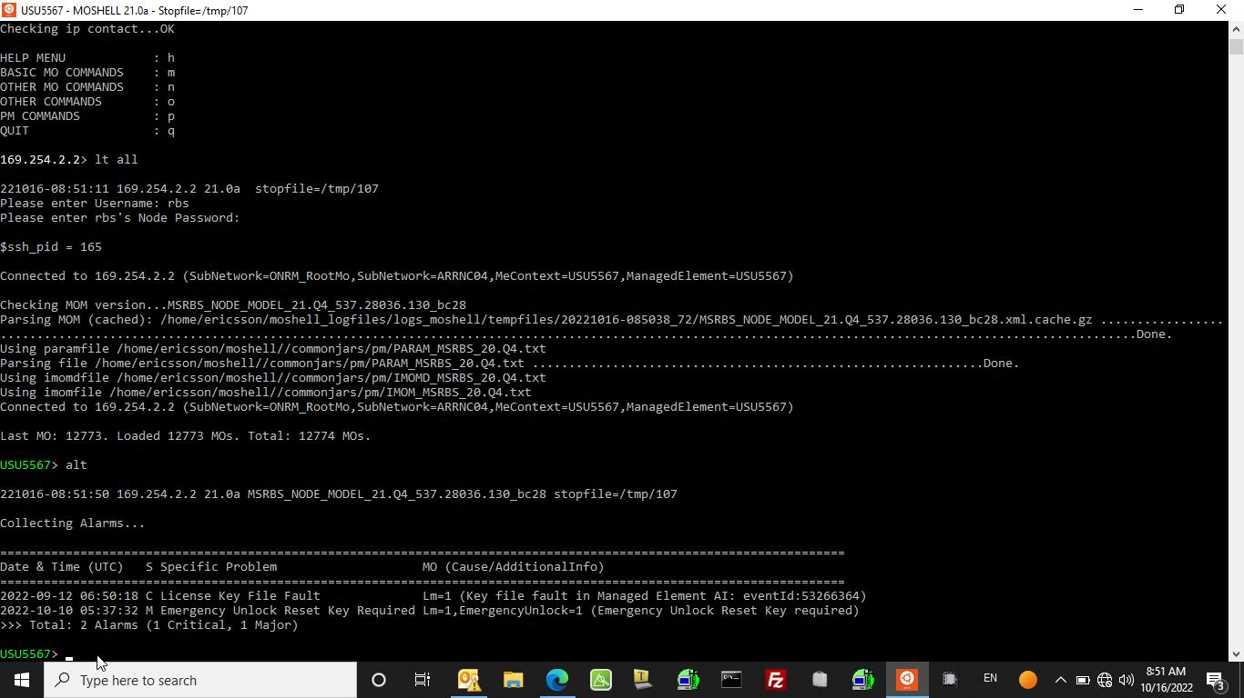
Step 1 :- login to baseband by moshell

Slide 3
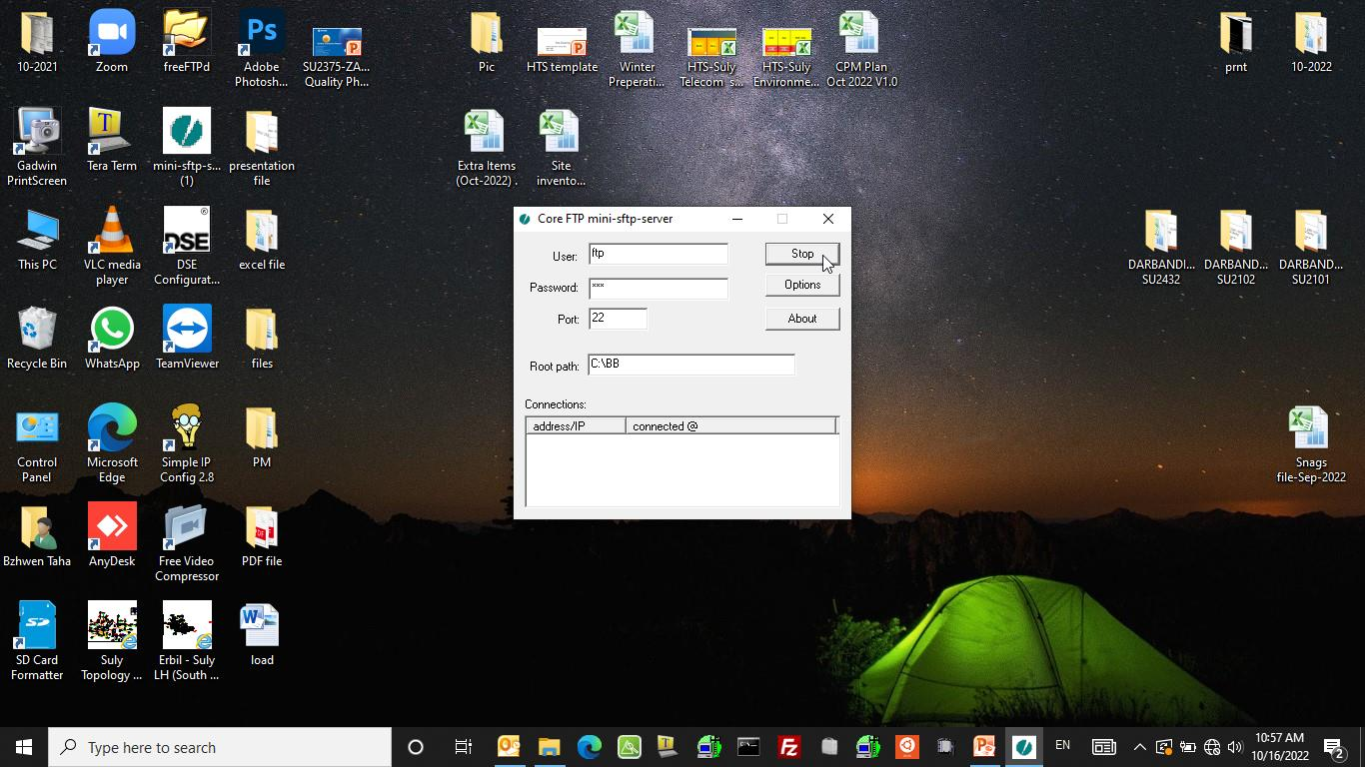
Step 2 :- Start FTP server

Slide 4
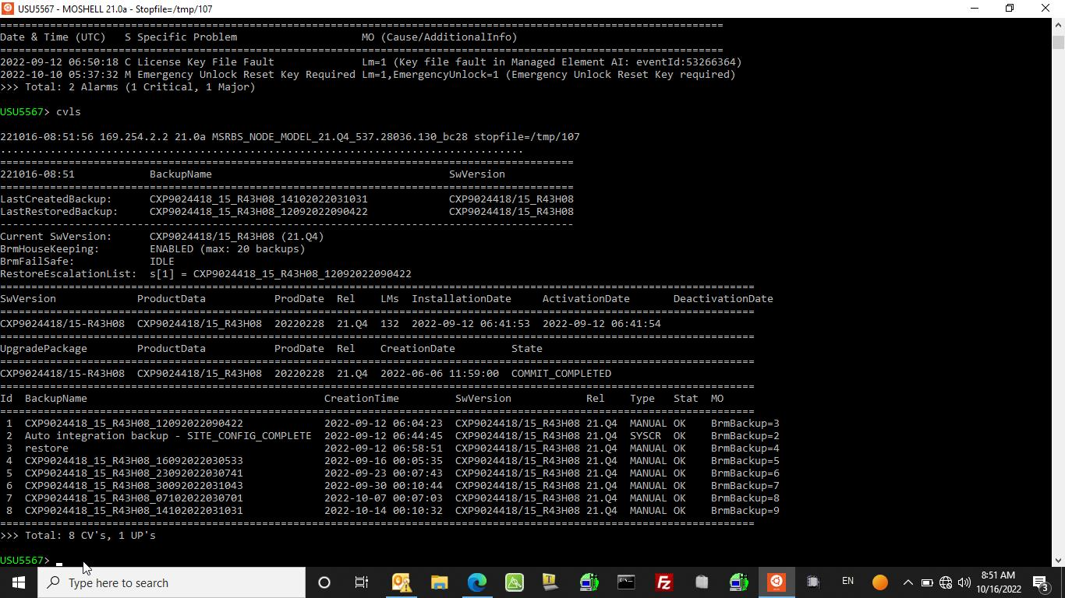
Step 3 :- use command (cvls) NO. of CVs saved inside Node

Slide 5
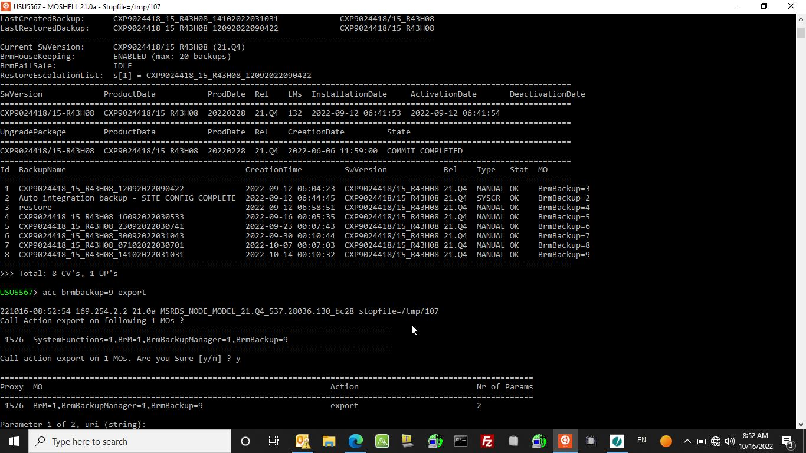
Step 4 :- use command (acc brmbackup=(NO. of last CV BRM backup) export) for get baseband backup.

Slide 6
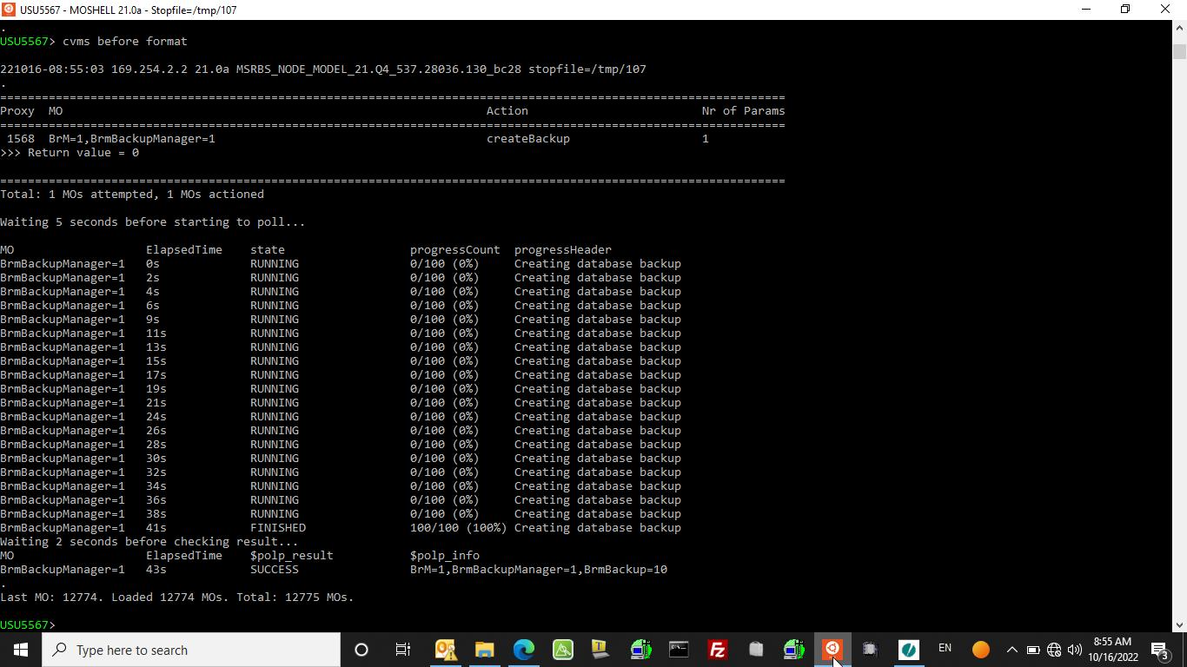
Step 5 :- use command (cvms (name of CV)) for Save Config before formatting baseband inside node.

Slide 7
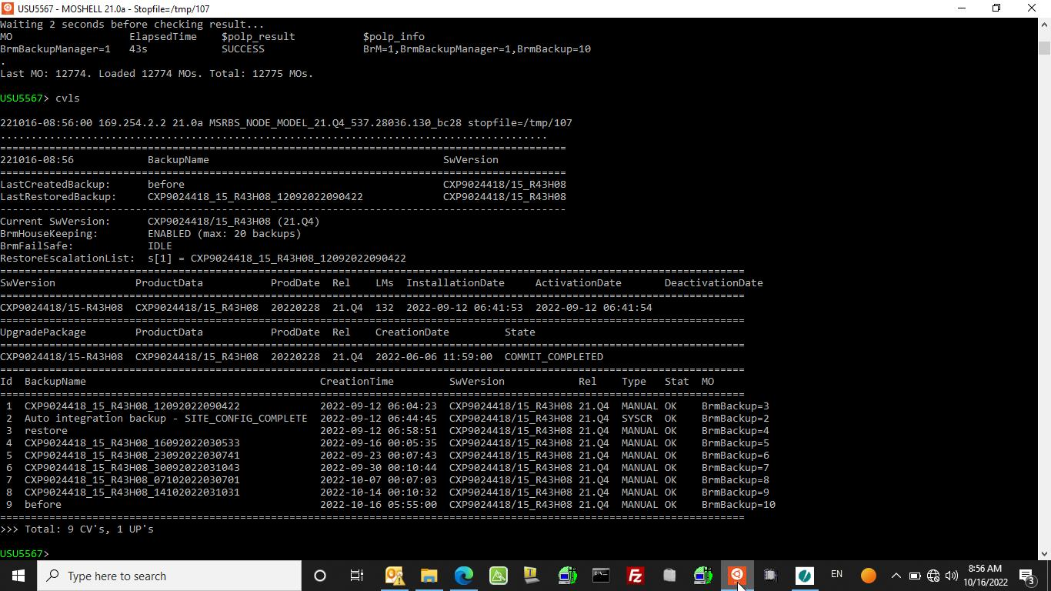
Step 6 :- use command (cvls) for check if your CV saved or not

Slide 8
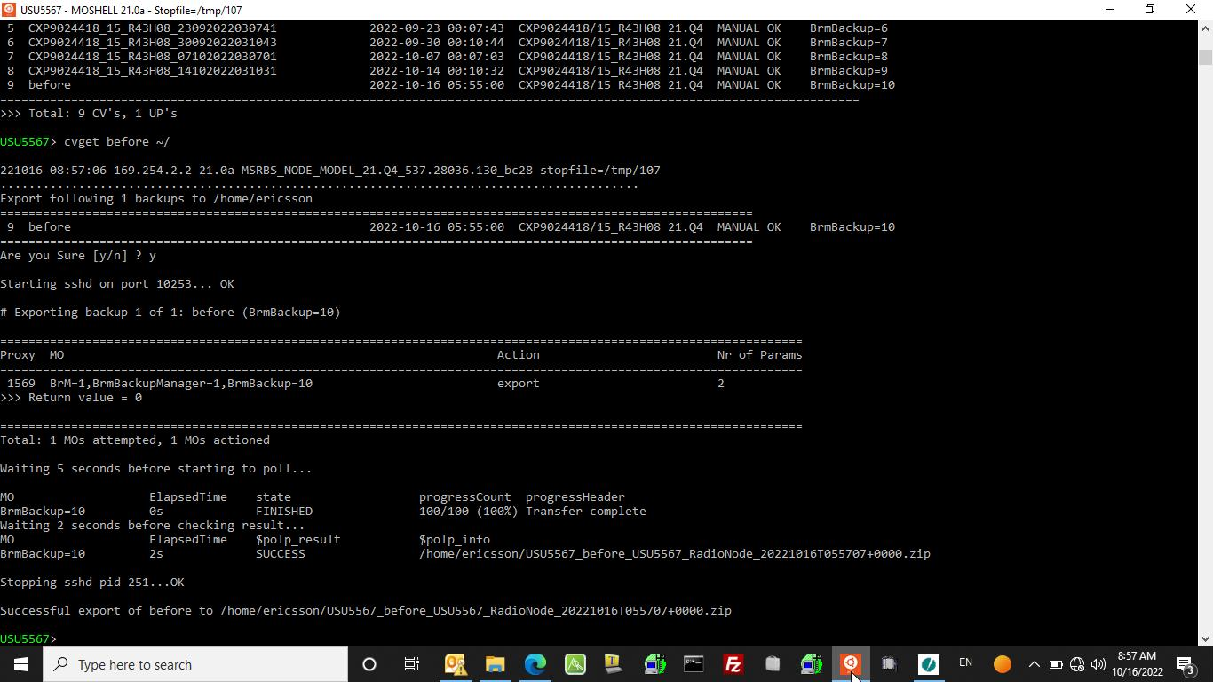
Step 7 :- Use command (cvget (name of your CV) ~/) for download your CV from node to your computer
CV location inside computer

Slide 9
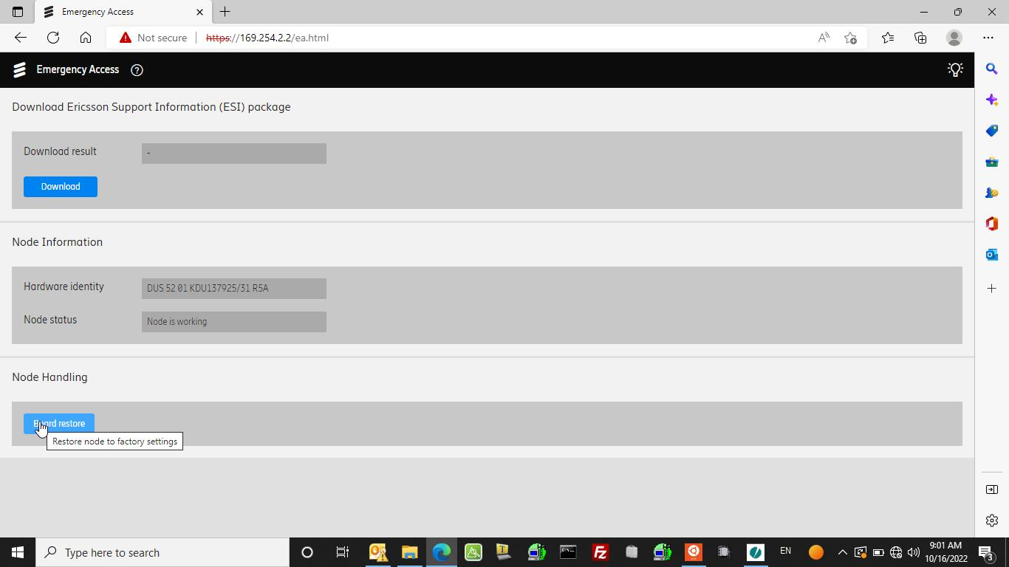
Step 8 :- format baseband

Slide 10
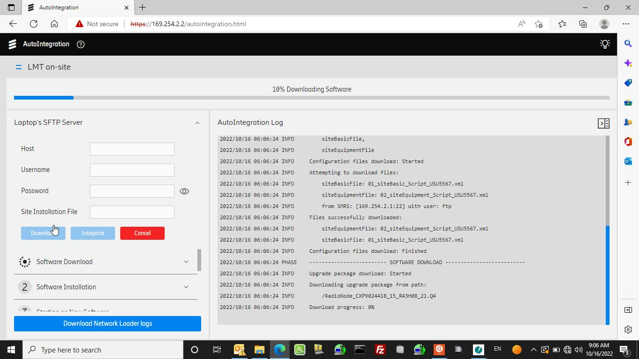
Step 9 :- download script to baseband

Slide 11
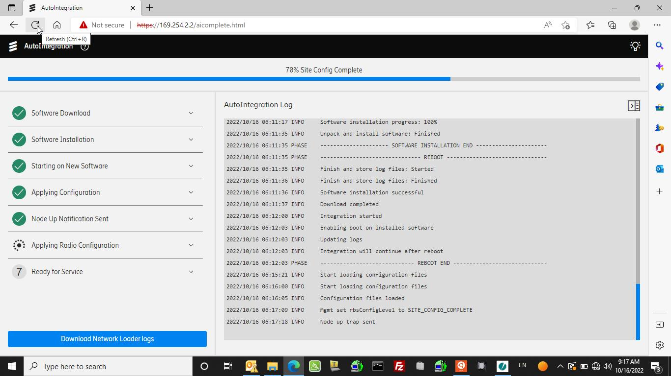
download script completed (node up trap sent) go to moshell

Slide 12
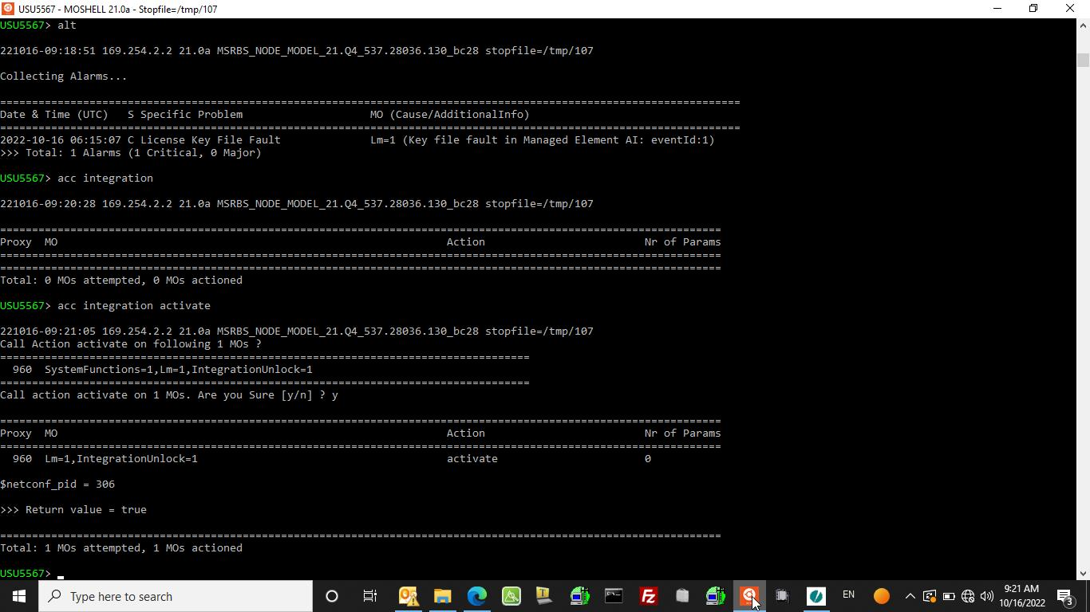
Step 10 :- use command (acc integration activate ) for activate integration unlock

Slide 13
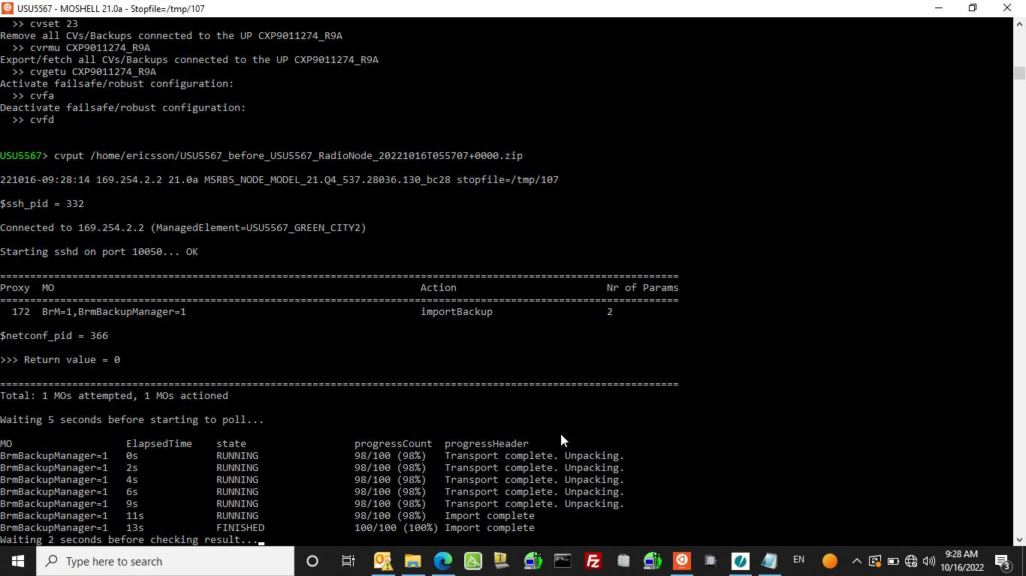
Step 11 :- use command ( cvput (the location of CV in your laptop) )
Copy ($polp_info)location of CV inside your laptop in slide 8 and past here

Slide 14
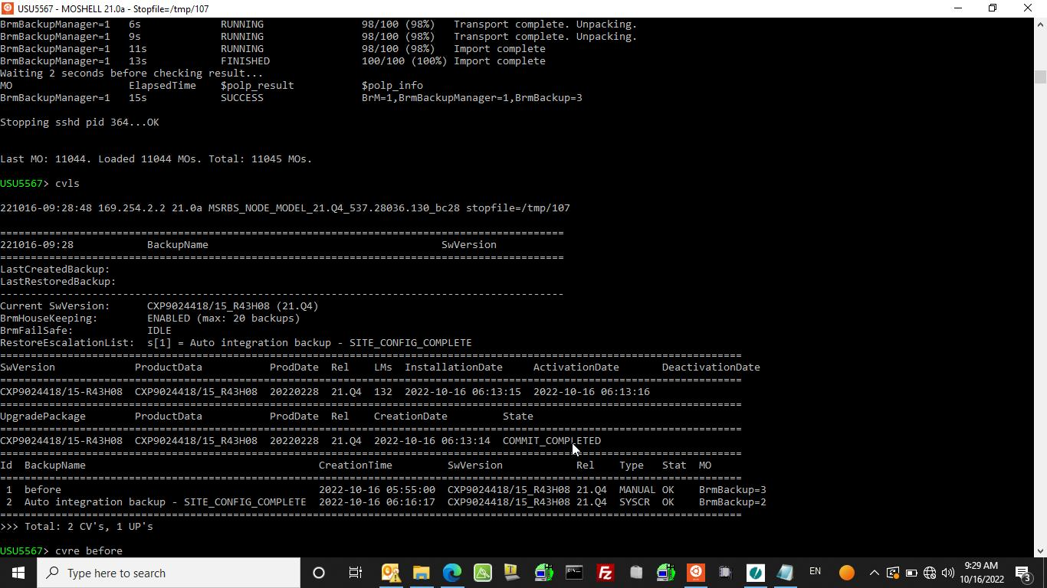
Use command (cvls) now you have your CV inside node

Slide 15
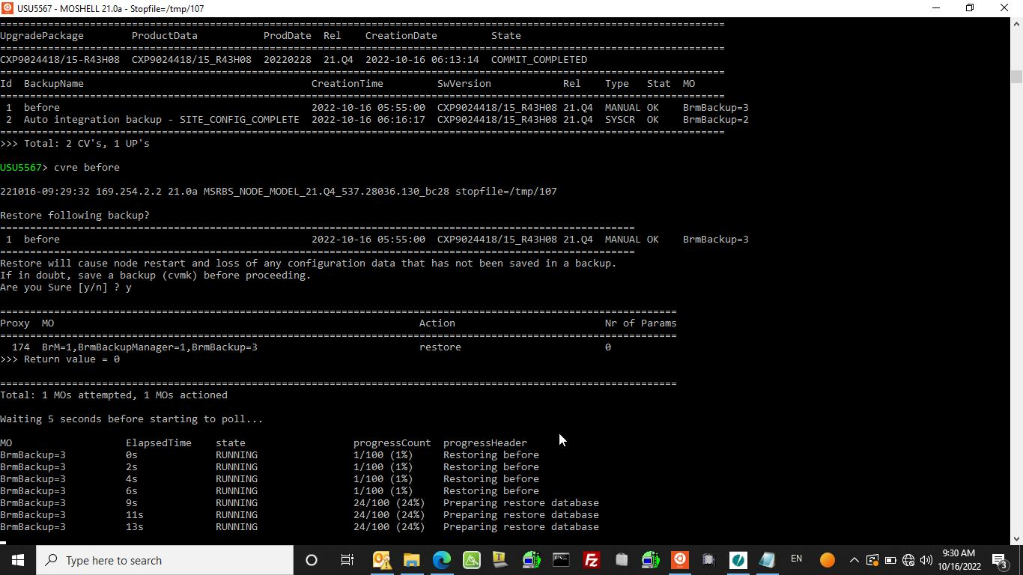
Step 12 :- use command (cvre (name of your cv )) for restore the site by uploading cv

Slide 16
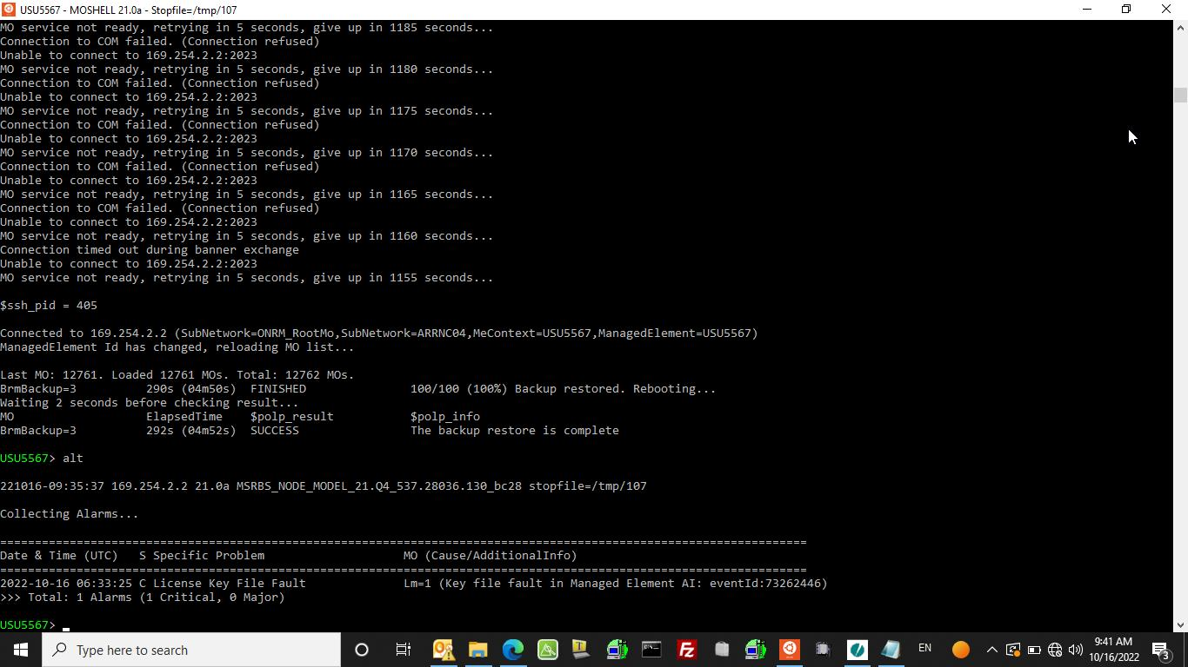
Finally baseband rebooted automatically after reboot site was up check with NMC.

Slide 17

Thank you

