Slide 1
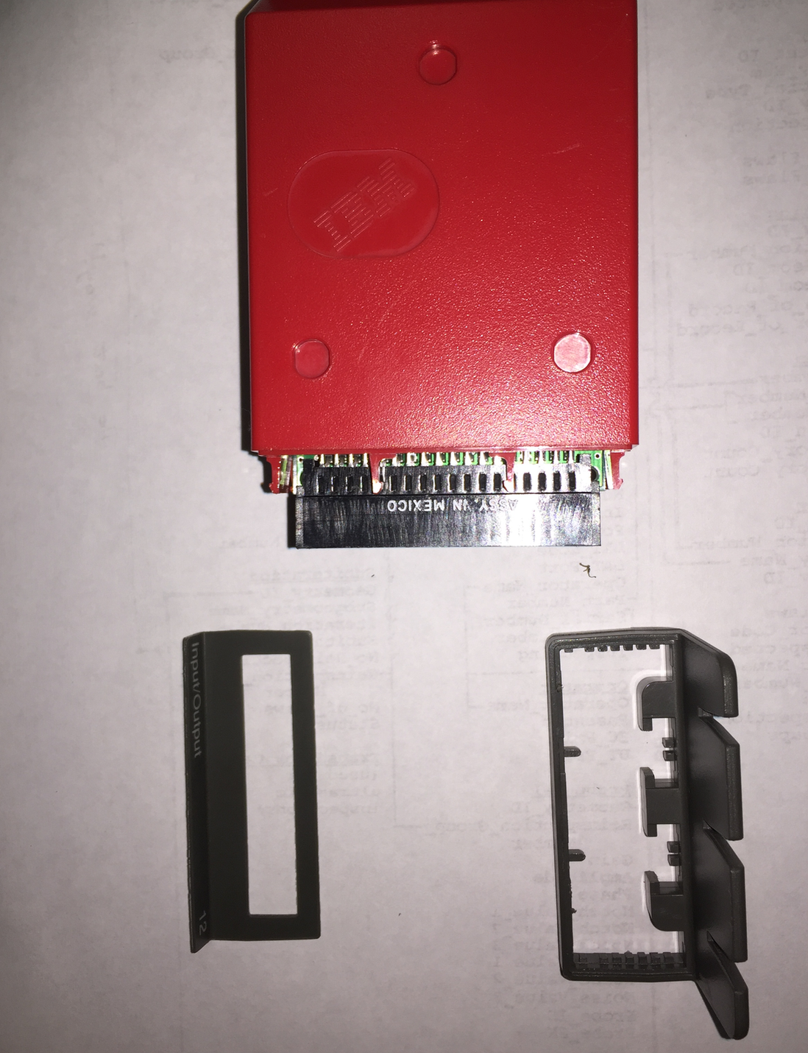
To remove the front:
Remove the label with a thin knife edge
For latches, start with 1 latch and work your way around with a flat bladed screwdriver, gently prying each latch a little. After a few rounds, the front will begin to separate (*)
DIO Module
Module label, removed
Module front, removed
* I broke 1 of 8 latches, so not bad

Slide 2
Module Back
To remove the top cover, slide the top unit in the direction of the arrow – towards the back of the module about 3/16 to clear unseen latch
Top View of Module
Slide this way
Module Front

Slide 3
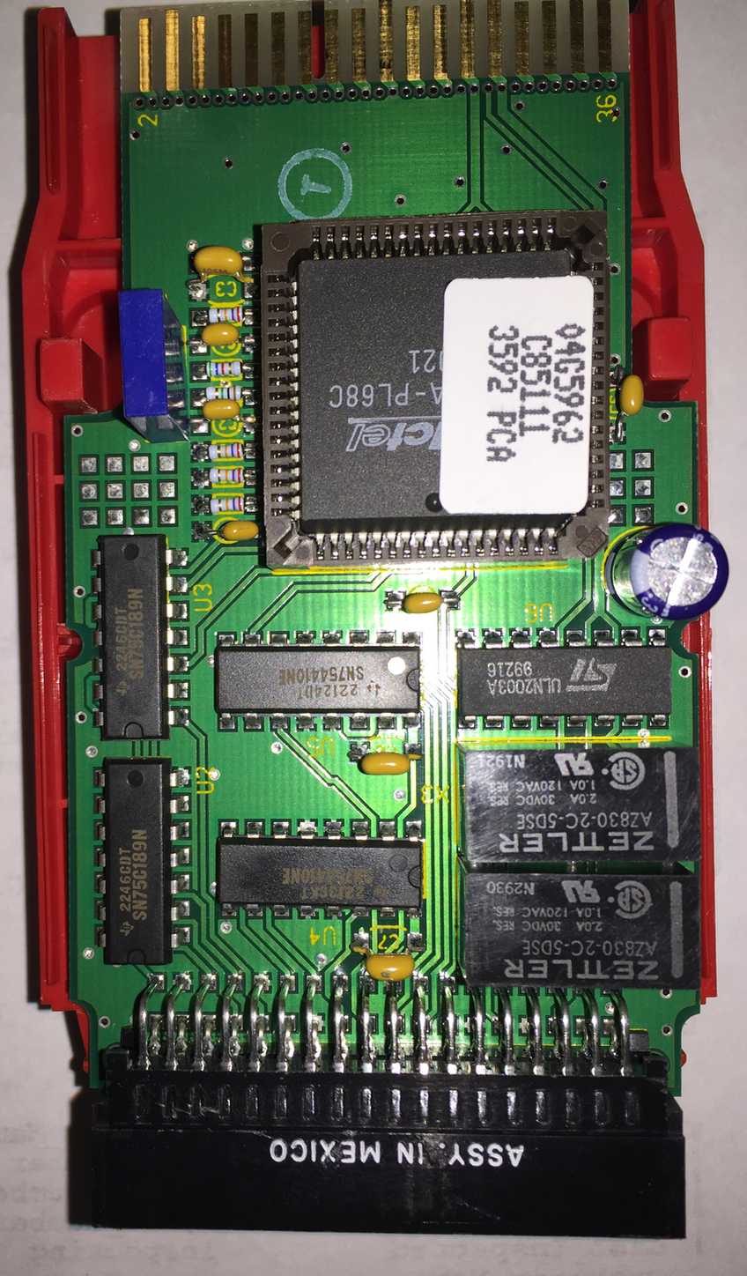
Pin 1
Card edge connector to base unit
Pin 36
X1
U1
U3
U5
U6
X3
U2
U4
X2
Slot connector for I/O ports
36 Pins

Slide 4
Pin 1
Card edge connector to base unit
Pin 36
X1 – CSB 250D
X2 – AZ830-2C-5DSE
X3 – AZ830-2C-5DSE
X1
U1
U1 – A1020A-PL68C
U2 – SN75C189N
U3 – SN75C189N
U4 – SN754410NE
U5 – SN754410NE
U6 – ULN2003A
U3
U5
U6
X3
U2
Resistors/capacitors not shown
U4
X2
Slot connector for I/O ports
36 Pins

Slide 5
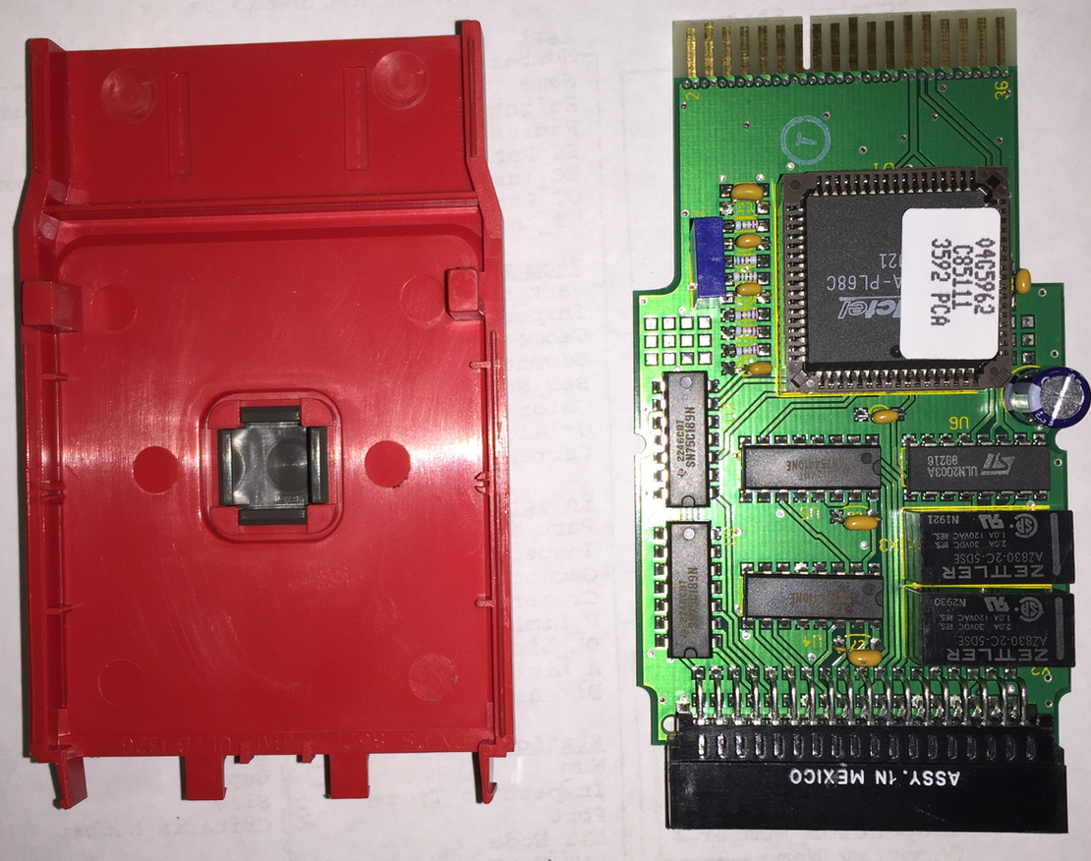
Bottom plate
These 4 clips hold the black/gray stand on the bottom of the module – pinch and it comes off

Slide 6
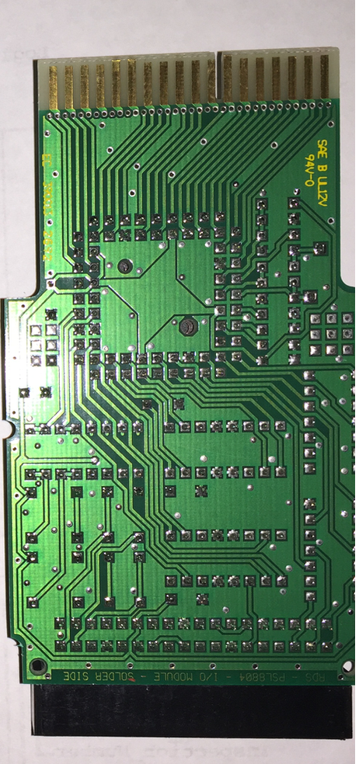
Nothing on back side

