Slide 1

HP Integrity server blades Speed up. Scale up. Strengthen.
Name Date
© Copyright 2012 Hewlett-Packard Development Company, L.P. The information contained herein is subject to change without notice.
Notes:
Today you will hear exciting news about our expanded portfolio and how it will help you evolve your mission-critical Integrity and HP-UX environment

Slide 2
Lasting mission-critical requirements
Data integrity
Zero
Integrated tested
Never compromised
Unplanned downtime
Solutions
Secure
Errors
Recovery in
Seconds
Predicted
Corrected
Transactions
Notes:
In terms of customer context, this slide summarizes what mission-critical means to our customers and to HP
Some of these attributes have been around for decades (unplanned downtime, security needs, recovery times, etc.) These standards are the “high water mark” for Integrity that we design to.
Several “mega” IT trends are accelerating and amplifying these needs in new, unpredictable ways --- an example is the emergence of private and public cloud models. Those models heighten security needs, make issue resolution and downtime recovery more urgent.
With expectations for mc rising, the lifecycle for mission-critical app development/deployment/update/maintenance is accelerating; more important than ever to have an integrated and coordinated way to keep mission-critical workloads available and updated

Slide 3
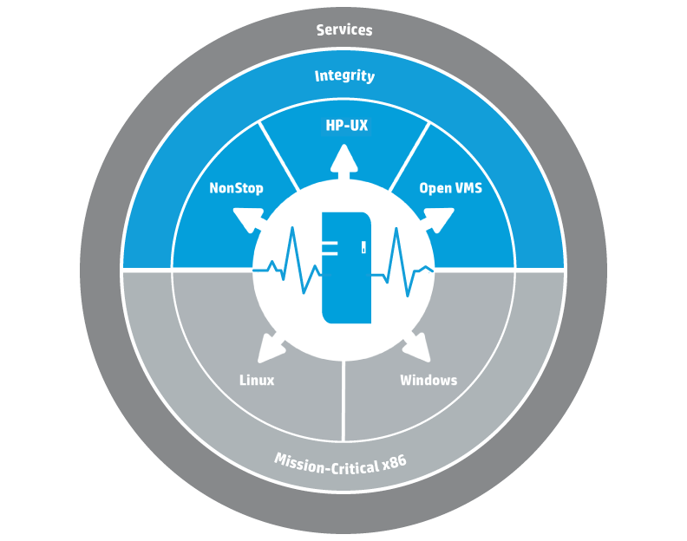
Delivering a unique approach to mission critical
Expanding HP’s Mission-Critical Converged Infrastructure with Project Odyssey
Notes:
Our approach to addressing these mission-critical challenges is the Mission-Critical Converged Infrastructure, built on our long history (over 30+ years) of supporting customers with their mission critical needs..
HP offers an unparalleled Mission-Critical portfolio spanning OpenVMS/NonStop/HP-UX environments, shown here in the top half of the circle. This Integrity portfolio fully supports our m-c customers needs for resiliency, workload flexibility, simplification of their systems management and allows customers to invest in our MCCI knowing that HP provides an infrastructure that addresses your M-C needs today and as they evolve in the future.
HP’s Project Odyssey advances mission critical converged infrastructure with innovations to address our customers’ changing needs. You can think of Project Odyssey as the white arrows on the circle. There are 2 key investment paths where we’re focused:
First, continue to innovate and enhance the mission critical traditional environment for Integrity with HP-UX, Openvms, NonStop, continuing to invest in the “blue” part of the graph. This is our design center for mission critical. Innovation starts in our traditional business. Then bolstering x86 to make a true MC x86 experience a reality. We are going start with the core values that we deliver to our customers today such as making it easy to manage, making sure it’s available, making the most out of your environment and making sure your investments are protected.
At the same time we are going to take that full mission critical experience (including servers, storage, network and support) and cascade these innovations over to x86 environments, to the “grey” section shown here on the graph. This is to make mission critical experience on x86 a reality. So what we are looking at is over the next couple of years, offering a comparable mission critical experience for x86 to what customers have today with HP-UX.

Slide 4



Enabling your continuous business
HP Mission-Critical Converged Infrastructure
Dynamic
Enduring
Always-on
Unified
24x7
Notes:
This slide shows the 4 areas of focus and 4 “lasting values” that we have with our MCCI.
Dynamic: Improve efficiency, optimize resources
Provision infrastructure in minutes
Optimize resources by workload by dialing up or down isolation and flexibility
Choose from electrical and dynamic partitions to virtual machines and containers
Capacity Advisor
Scale resources in real time with instant capacity
Integrated virtualization, management, and high availability
Always-On: Continuous, Uninterrupted application availability
Secure and reliable from CPU to solution
Scale i/o independently from CPU
End-to-end redundant data paths
Predictive error handling
Comprehensive security
Full fault tolerance
Uninterrupted service within data center or over distance
Mission Critical Services
Unified: the datacenter and simplify IT
Common modular server architecture
Unified blade architecture from x86 to Superdome 2 and NonStop
Simplified scaling to match any workload
Common management, storage, and networking across the data center
Single management view across all servers, storage, operating environments, network
Enduring: Future proof IT with investment protection and stability
Platform stability with hundreds of mission-critical innovations
Decades of support life
Simply add a blade to existing chassis
Energy Star qualified
Common architecture for UNIX, NonStop, OpenVMS and Windows/Linux
Project Odyssey innovations on both Integrity and mission-critical x86
4

Slide 5
Executing on our commitments
April 2010
November 2011
November 2012
Future
World’s first Mission-Critical Converged Infrastructure
Project Odyssey announced
Breakthrough value for Integrity and HP-UX customers
Full mission-critical experience for Integrity and x86 environments
Notes:
For context: announcement is a milestone on a path that we’ve been on for several years.
3 strategic announcements over 2 years -- a deliberate path; we have made commitments and kept them consistently, even during challenging years
April 2010 – First MCCI; really set HP apart in the industry. Based on a modular design that ensures an adaptable platform for current and evolving mission critical needs
November 2011 – Redefining MC with Project Odyssey; continuing to invest in established MC while extended full MC experience to x86
November 2012 – We’ll get into the details; this announcement demonstrates how we are taking advantage of the path that we set out on in 2012 --- using our common modular architecture to deliver value to our Integrity and HP-UX customers
Future – We have exciting plans ahead to continue to use this same MCCI for established platforms such as Integrity as well as x86. That’s where Project Odyssey comes in.

Slide 6

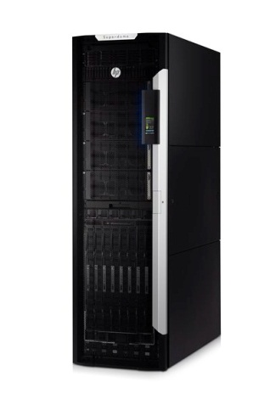
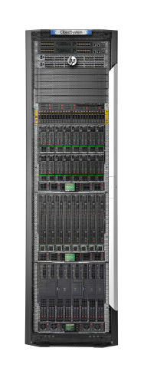
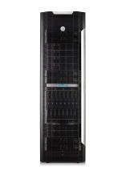
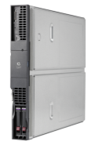
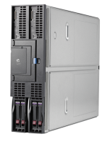
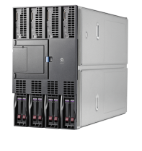

Enable your continuous business with HP Integrity
OpenVMS
NonStop
HP Integrity rack servers
HP Integrity server blades
HP Integrity Superdome 2
HP CloudSystem Matrix with HP-UX
HP Integrity NonStop
Notes:
This slide shows where we are with today’s Integrity portfolio ---- a market-leading, robust product line that is powering some of the world’s largest and most complex workloads. We consider this product line to be the “gold standard” or the “high water mark” for mission-critical design, supporting our customers’ needs for availability, resiliency, workload flexibility, and simplification.
Certainly, we have been through challenging times with this portfolio ---- the products themselves have continued to deliver. Our customers have continued to trust us. ($11B UNIX market where HP has strong share --- approx 21%)
The good news with this portfolio is that --- while it’s well-established, it’s also future-ready. Our customers can continue to invest here, HP provides you infrastructure that addresses your M-C needs today and as they evolve in the future.

Slide 7
HP BladeSystem

Slide 8
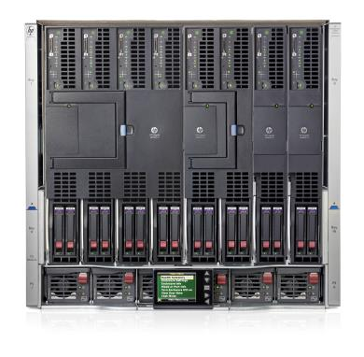
HP BladeSystem
Your Ultimate Converged Infrastructure
Industry’s most advanced bladed architecture with the latest end-to-end innovations
Built-in intelligence to maximize every hour, watt and dollar
One converged infrastructure, the foundation for industry leading solutions from client to cloud
Notes:
Industry’s most advanced bladed architecture with the latest end-to-end innovations
-Unlike traditional rack-based infrastructure, HP BladeSystem utilizes a modular design to share power, network, and storage infrastructure at the enclosure level, reducing hardware cost by 58%
Key points:
-The newest enhancements in February 2013 allows the c7000 Platinum Enclosure to accommodate the next wave of I/O bandwidth capacity required for the coming years including 56GbE FDR Infiniband and 16Gb Fibre Channel. HP also released the first true 40GbE blade switch in the market, providing 40Gb downlinks to each blade server enabling InfiniBand-like performance in an Ethernet blade switch.
Eliminate up to 95% of network sprawl and make network changes in 90% less time with Virtual Connect for wire-once simplicity
Industry’s only FlatSAN solution eliminating 50% of SAN fabric cost, complexity and bottlenecks
Built-in intelligence to maximize every hour, watt and dollar
-Management is built into the enclosure to cover the entire management lifecycle and maximize resources such as admin time, energy, and budget.
Key point:
-Take control of limited power resources with HP Intelligent Infrastructure and Thermal Logic technology inside HP BladeSystem. -In addition, the c7000 Platinum Enclosure, with built-in intelligence, provides advanced insight into your data center with industry first and only Location and Power Discovery Services.
-Simplify and automate your infrastructure to increase productivity with Insight Management which delivers efficiencies in system management, monitoring, and provisioning
One converged infrastructure, the foundation for industry leading solutions from client to cloud
The modular design of HP BladeSystem can be quickly scaled, repurposed, and upgraded to fit your changing business needs. The HP BladeSystem maximizes investment protection by enabling you to easily leverage the latest technologies when they become available by changing just the components that need to be changed instead of the “rip and replace” approach. HP BladeSystem future proofs your business with an infrastructure that can help you realize the full potential of virtualization and build a path to the cloud that protects your investment every step of the way.
Payback in just over 7 months with superior investment protection every step of the way on your path to the cloud.
Confidently grow your business on the industry’s leading converged system that is designed, certified and delivered as a single solution with servers, storage and networking.
The ideal foundation for HP CloudSystem, enabling application infrastructures to be up and running in less than 2 hours rather than days or months
Mission Critical solutions (built on BladeSystem) for always-on, continuous, uninterrupted application availability
4x user density with the industry’s first and only 8 GPUs per workstation graphics server blade for 3D graphic intensive mobile client applications.
Key points:
-Reduce IT costs up to 68% over traditional infrastructures with payback in just over 7 months
-#1 in server virtualization worldwide and industry leading client virtualization portfolio
-HP BladeSystem is the ideal foundation for enterprises and service providers planning to build and manage shared services environments or private cloud infrastructures.
-HP BladeSystem continues to be the #1 blade solution in the market with 26 consecutive quarters of Worldwide leadership. In Gartner’s new 2013 Blade Server Magic Quadrant, HP is the leader for both blade vision and execution.

Slide 9




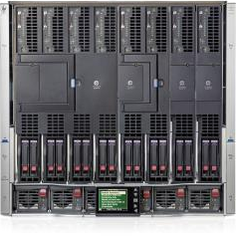

HP BladeSystem delivers real business results
IDC customer research of BladeSystem versus traditional infrastructure
68% Reduction in Data Center Costs
storage
network
manage
server
storage
BUSINESS Value
88% Less time to manage
90% Reduction in downtime
IDC white paper sponsored by HP, “Business Value of Blade Infrastructures”, #227508R2, December 2012
Notes:
IDC interviewed seven midsize and enterprise-level companies, that have migrated 17–100% of their server environment to blades. IDC documented the benefits that customers experienced after transitioning from a traditional rack environment to a BladeSystem environment.
The organizations in this study had selected HP blades as the platform to virtualize their compute environments to converge and simplify their datacenters. Prior to acquiring blades, only one of the seven had implemented any appreciable
virtualization. After the migration to blades, the average server virtualization is 80% and they have also virtualized 67% of their workloads. As a result, the organizations have reduced their annual costs by 68%. In addition to the IT operations and hardware cost savings, the study also shows how migrating to a blade environment improved IT availability. Relative to traditional server environments, customers with virtualized blades incurred 88% fewer server incidents per year and reduced server downtime hours by an average of over 90%.
Substantiation for quants:
IDC white paper sponsored by HP, “Business Value of Blade Infrastructures”, #227508R2, December 2012

Slide 10
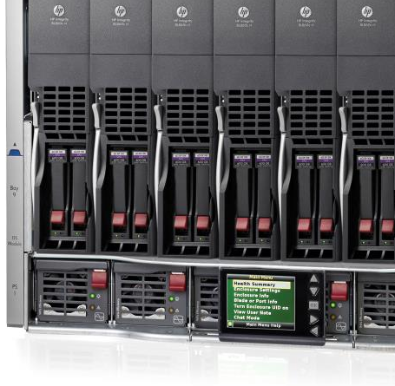
HP BladeSystem Enclosure
The world’s most advanced blade architecture
End-to-end performance
56Gb FDR InfiniBand
40Gb Ethernet
16Gb Fibre Channel-ready
Built-in intelligence
Location and Power Discovery with advanced sensor technology
Energy efficient
Thermal Logic optimizes power utilization without impacting performance
Investment protection
100% compatible
New 2013 Platinum Enclosure delivers 40% more performance
40% increase in bandwidth – 56Gb Versus 40Gb InfiniBand
Notes:
Unlike traditional rack-based infrastructure, HP BladeSystem utilizes a modular design to share power, network, and storage infrastructure at the enclosure level, reducing hardware cost by 58%. The new HP BladeSystem c7000 Platinum enclosure integrates next generation technologies to deliver the most advanced architecture with latest end-to-end performance advancements:
56Gb FDR InfiniBand for 40% more performance
40Gb Ethernet for 4x throughput for low-latency networking
16Gb Fibre Channel-ready for 2x storage bandwidth
Take control of limited power resources with HP Intelligent Infrastructure and Thermal Logic technology inside HP BladeSystem. In fact, you can increase the capacity of your data center without adding power infrastructure and reduce power costs by 36% versus a traditional environment. HP BladeSystem, with built-in intelligence, provides unprecedented insight into your data center. HP Thermal Logic technology lets administrators dynamically track and control power, based on workload demand within the BladeSystem enclosure, so you can reclaim over-provisioned power and cooling capacity without impacting performance. Industry first Location and Power Discovery is next generation sensor technology that automates power configuration and tracking to reduce unplanned downtime and allows customers to pin point server and enclosure location. This combined intelligence provides location with real-time, auto-populated power and thermal data, fully integrated with HP Insight Control, to automate many manual processes all from a central console.
The HP BladeSystem c-Class Platinum Enclosure supports all of the current BladeSystem products across servers, storage, networking, and management.

Slide 11
HP Integrity server blades Speed up. Scale up. Strengthen.

Slide 12
HP Integrity server blades
Speed up your mission-critical applications
With more powerful processors, an enriched memory subsystem, and an enhanced RAID controller, these are the most powerful HP Integrity server blades offered
Scale up to increase performance
HP Blade Link technology and embedded Virtual Connect FlexFabric provide mission-critical scalability and flexibility to meet your changing workload demands
Strengthen with improved reliability and increased manageability
The new Integrity server blades provide you with massive flexibility and availability with electrically isolated hard partitions (nPars).

Slide 13
HP Integrity server blades
Processor
Speed up your workloads with up to 3x performance and 2x core count improvements
Realize investment protection by mixing new and legacy Integrity blades in same enclosure
Memory
Increase efficiency by saving up to 30 watt per blade with support for Low Voltage DIMMs
Improved performance with enhanced Memory subsystem
Software, Partitioning, Infrastructure
Greater software deployment flexibility and efficiencies with HP-UX Virtual Partitions (vPars) and Integrity VM v6.1
Greater flexibility and availability with Electrically isolated hard partitions (nPars)
Simplified and lower cost connectivity with embedded Virtual Connect FlexFabric
Improved rebuild times with SAS Read-only cache
Simplify and automate management with Matrix OE 7.1, Virtual Connect and Insight tools
HP Confidential – NDA required
Notes:
The HP Integrity BL860c i4, BL870c i4 and BL890c i4 server blades are versatile and flexible 2-, 4-, and 8-socket servers ideal for mission-critical enterprise applications. HP continues to enhance the proven HP Integrity server blades. As with the previous generation, the unique Blade Link technology combines multiple blades into a single system with linear scalability from 2 sockets to 4 sockets to 8 sockets. There are a number of new features on the latest Integrity BL860c i4, BL870c i4 and BL890c i4 server blades.
Processor: With the higher frequency, 8-core and 4-core Itanium processor 9500 series, the new Integrity blades provide double the processing power and up to 3x the performance compared to the previous generation of Integrity blades. The Integrity blades start with the 2-socket BL860c i4 with a minimum of 4-cores and scale up to the 8-socket, 64-core BL890c i4.
Memory: An enhanced memory subsystem improves memory performance and supports 4GB, 8GB and 16GB low voltage DIMMS resulting in savings up to 30 watts per blade.
Embedded Virtual Connect FlexFabric reduces infrastructure cost by converging LAN and SAN traffic on the same connection. Each blade has 4 x 10Gb FlexFabric ports - supporting both Fibre Channel and Ethernet traffic.
Hard partitions (nPars): Improved reliability from new electrically isolated hard partitions (nPars) previously only available with high-end systems like Superdome 2. With the simple to use iLO 3 GUI, the BL870c i4 supports 1-2 nPars and the BL890c i4 supports 1-4 nPars.
HP-UX Virtual Partitions (vPars) and Integrity VM v6.1 provides dynamic flexing of CPU resources and shared I/O allowing for more vPars when you share I/O because I/O slots do not need to be dedicated to a particular vPar.
The built-in hardware RAID controller has 512MB of integrated SAS read-only cache to significantly reduce rebuild times; especially noticeable with today’s large capacity hard drives.
In Matrix OE 7.1, Simplify and automate management in several ways:
Automate or guide workload management of the latest HP-UX Virtualization solutions, with Global Workload Manager’s support:
of vPars v5 & Instant Capacity dynamic cores, now with the Windows Central Management Station; and
b) for Converged HP-UX vPars & VM v6.1
Easily reduce IT spend by a few %, by easily identifying and reclaiming idle hardware, with monthly viewing of the new capacity analysis tab.
Reduce time for debugging performance problems, with Capacity Advisor’s continuous data collection, with up-to-date data retrieved in about ~1/2 the time (as previous).
Simplify and secure Systems Insight Management with:
a) Improved Federated CMS search capabilities,
b) Selective suspend/discovery of virtual machines,
c) Automated quiesce operations for unattended backups, and
d) Improved user identity protection with two Factor Authentication

Slide 14
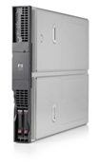
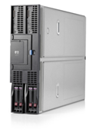
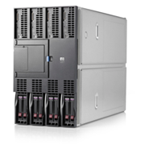
HP Integrity server blades
 | BL860c i4 | BL870c i4 | BL890c i4
Processor SKUs | 8-core 2.53GHz 4-core 2.4GHz 8-core 2.13GHz 4-core 1.73GHz
Processor Sockets | 2 | 4 | 8
Memory | 24 DIMM slots; 1.35V 4GB, 8GB, 16GB DIMMs | 48 DIMM slots; 1.35V 4GB, 8GB, 16GB DIMMs | 96 DIMM slots; 1.35V 4GB, 8GB, 16GB DIMMs
HDD Slots | 2 | 4 | 8
Embedded Controller | 1 HP p410i SAS RAID w/512MB cache | 2 HP p410i SAS RAID w/512MB cache | 4 HP p410i SAS RAID w/512MB cache
Embedded NICs | 4 FlexFabric (FCoE) | 8 FlexFabric (FCoE) | 16 FlexFabric (FCoE)
IO Mezz Slots | 3 Gen2 PCIe | 6 Gen2 PCIe | 12 Gen2 PCIe
Management & Virtualization | Enhanced Integrity iLO3 Virtual Partitions (vPars) Virtual Machines (VMs) | Enhanced Integrity iLO3 Virtual Partitions (vPars) Virtual Machines (VMs) 1 or 2 nPartitions | Enhanced Integrity iLO3 Virtual Partitions (vPars) Virtual Machines (VMs) 1-4 nPartitions
OS | HP-UX 11i v3 1209 release
Options & Accessories | Support for existing hard drives, I/O cards
New features
Notes:
New features are in blue font. Point out what is new in these new server blade products.

Slide 15
Boosting performance as business needs change
Processor improvements: doubled core count, increased core frequency and shared cache + reduced memory and socket latencies
Hardware improvements: memory bandwidth boost, SMI Link speed increase, latency reductions
Software improvements: HP-UX tuning
Up to 3x
Performance
New HP Integrity server blades
Previous generation HP Integrity server blades
Notes:
Substantiation for “up to 3x”
Source: Based on HP internal benchmark conducted by HP internal labs calculating the efficiency of the operating system and underlying server hardware. Compares HP Integrity Blade servers with the Intel® Itanium® processor 9500 series vs. HP Integrity Blade servers with the Intel® Itanium® processor 9300 series . The new server delivered a result of 3.29x the performance of the previous generation, rounded to 3x. . Houston, TX, August, 2012.
All tests were carried out with the 9560 Poulson Processor (8cores per socket, 2.53GHz, 32MB LCC) and the benchmark used was SDET because it is mainly used to stress the HP-UX Core kernel, File system.
CPU Highlights:
Cores per Socket: 8, 2x Tukwila
Run very large HP-UX workloads, 2x the previous size with up to 3x the performance
Increase in Core Frequency(Up to 2.53Ghz): ~45% increase/core vs Tukwila
Shared Last Level Cache: 32 MB, total 700GB/s Bandwidth
Reduced memory latencies: ~15% decrease vs Tukwila
Reduced c2c latencies within the Socket: ~60% decrease vs Tukwila
Intra Blade QPI Link increase from 4.8GT/s to 6.4GT/s, total 128GB/s Bandwidth (This change brought about 10% improvement at 8S blade)
Changes in the HP-UX Scheduler, VxFS: improved the SDET throughput by 4% at 8S
Kernel Tuning: Cannot quantify this to a number
Further Elaboration on Performance related Highlights:
Scalable Memory Interconnect(SMI) Link speed enhanced to 6.4GT/s, total 45GB/s Bandwidth
Support for Low Voltage DIMMs, DDR3 memory operates at 1067MT/s, 33%+ memory bandwidth increase
Support for a variety of new kinds of hardware initiated Data prefetching reduces average latency
New Instruction for integer multiply helps improve performance of integer operations
Compiler directed prefetch using the lfetch instruction exposes more instruction level parallelism to the hardware and thus increasing performance
While it is very tough to quantify the performance improvements on HP-UX to a certain number for the simple reason that the fixes that go into HP-UX are based on a certain condition/workload environment. Many of these fixes go in and improve the overall performance on HP-UX, so performance improvement figures cannot be allocated to one sub-component with certainty.
Per core improvement in SDET was around 70%, Out of this 70%
- Processor improvement is around 50% (clock speed, reduced memory latencies and c2c latencies, scheduling etc)
- Firmware improvement is around 5%-10% (lower to higher sockets)
- Software improvement is around 10% to 15% (higher to lower sockets)

Slide 16

Increase availability and flexibility
With electrically isolated HP nPartitions
Improve flexibility with blade hard partitioning to meet your changing workload demands
Greater availability to continue your operations even in the event of a component failure providing you with more control of system maintenance.
Accelerate and simplify nPars configuration and activation with fast, easy-to-use GUI for true lights-out operation
Full
Compatibility with HP-UX vPars, Integrity VM, and HP-UX Containers
Notes:
Electrically isolated hard partitions is a unique capability that HP offers in their server blades; it allows our customers to increase availability and flexibility.
Top benefits
Maximum flexibility [server blades can be reconfigured to fit specific customers workload demands and electrical isolation means you can leave unneeded resources unpowered until they are needed and brought online.]
Superior Availability [Can continue to run despite component failure, and allows customer to control when the system needs to be maintained]
Simple and Fast Easy to use GUI [Control and reconfigure blades from anywhere in the world] No longer need to have a HP Service person called in to reconfigure blades; as a matter of fact no one needs to even touch the blades for true Lights out operation. Reconfiguration of Servers takes 1-2 minutes not hours or days.]
Works with the full complement of Virtualization technologies available from HP today. HP-UX Virtual Partitions (vPars), Integrity Virtual Machines (Integrity VM) and HP-UX containers.

Slide 17

Realizing 33% TCO savings with a unified architecture
33% reduction
Reduced:
Power and cooling
Support costs
Downtime
Admin costs
Previous generation HP Integrity server blades
3 Year TCO
New HP Integrity server blades
2 x HP BL890c i2 (32 cores) 8 x HP BL860c i2 (8 cores)
2 x HP BL870c i4 (24 cores) 3 x HP BL860c i4 (16 cores)
Notes:
With our common modular architecture, customers are able to add these new blades into their existing enclosures, existing infrastructure and immediately see TCO savings. This scenario focuses on consolidation savings with our Integrity Server Blades, where customers can now carry out the same workload with fewer blades, easier management and less power & cooling. The result in this example is a 33% 3 year TCO reduction.
Power & Cooling savings of 36%
Up to 30 Watt savings per blade with support for Low Voltage DIMMs
Less processors with Poulson ( 32 down to 12 processors)
Server Hardware and support savings of 36% based on:
Poulson processor with higher clock speed
Poulson 8-core processor is more than 2.5x faster than Tukwila quad core processor
Better server utilization with vpars (new with i4)
Server Software and support savings of 33% (Operating Environment, only) based on:
Less processors with Poulson (32 down to 12 processors)
Downtime costs savings of 12%:
Greater mainframe class reliability and scalability
Higher availability with Electrically isolated hard partitions (nPars)
Savings in operation and administration of 38%
Less man-hours required due to faster and easier updates and installing and removing components
Improved rebuild times with SAS Read-only cache
Easier management with Enhanced Integrity iLO3
Simplify and automate management with Matrix OE 7.1
Greater software deployment flexibility and efficiencies with HP-UX Virtual Partitions (vPars) and Integrity VM v6.1
33% TCO savings substantiation:
*3 years cumulative TCO comparison, based on HP results using Alinean, Inc. TCO/ROI tools, Germany, October 2012.
“Before“ Environment
BL890c i2 (8ch/32co) x2
BL860c i2 (2ch/8co) x8
with Itanium 9350 1.73 GHz
After“ Environment
BL870c i4 (3ch/24co) x2
BL860c i4 (2ch/16co) x3
with Itanium 9560 2.53 GHz*

Slide 18
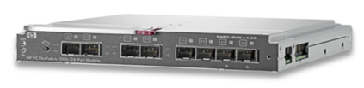

Integrity blades with VC FlexFabric
Optimized for flexible connectivity to LAN & SAN
Configurable LAN & SAN
connections
Adjust bandwidth to meet workload requirements
Provides all your connectivity needs
From 4 FlexNICs per blade
To 12 FlexNICs &
4 FlexHBAs per blade
SAN
LAN
10 Gb
0.5
2.0
3.5
4.0
10Gb
10Gb
10Gb
10Gb
Virtual Connect FlexFabric Module
 | Physical ports | FlexNICs | FlexHBAs
BL860c i4 | 4 | 12 | 4
BL870c i4 | 8 | 24 | 8
BL890c i4 | 16 | 48 | 16
10Gb
10Gb
10Gb
10Gb
HP Confidential – NDA required
Notes:
Key points:
With the Virtual Connect FlexFabric you can connect up to 3 FlexNICs and 1 FlexHBA’s per physical FlexFabric port providing outstanding connectivity for Ethernet and Fibre Channel.
Each of the FlexNICs and FlexHBA’s can be adjusted to the needed bandwidth for the workload – this reduces over-provisioning and under-provisioning.
VC FlexFabric modules provide bandwidth for today’s demanding converged and virtualized LAN & SAN infrastructures.
Sound bites:
One integrated device that does it all – using most common network protocols… Ethernet & Fibre Channel
The right bandwidth for your workload – any way you slice it.

Slide 19

Delivering mission-critical services on-demand
High availability and private cloud security
CloudSystem Matrix with HP-UX
Design and provision infrastructure in minutes
Assure mission-critical SLAs are met utilizing Serviceguard
Accelerate deployment of mission-critical applications with HP Cloud Maps
Now
New
Supporting the latest Integrity server blades
Cloud Map for Oracle featuring Serviceguard HA protection
Notes:
We know most of you are interested in getting the benefits of the cloud, and for you, we offer CloudSystem Matrix with HP-UX,
HP CloudSystem Matrix with HP-UX is the ideal UNIX ® platform for private cloud and Infrastructure as a Service (IaaS) mission-critical environment. It allows you to deliver mission-critical services on demand with the high availability expected from Integrity and HP-UX and with robust security, in a private cloud model. HP Integrity blade servers running HP-UX and HP Serviceguard Solutions provide these robustness, security and resiliency to meet mission-critical requirements.
These mission-critical capabilities integrate with CloudSystem automated infrastructure orchestration and virtualization management to allow you to:
Provision infrastructure and applications in minutes rather than months
Meet mission-critical SLAs
Accelerate deployment of mission-critical applications with Cloud Maps
CloudMaps are:
Pre-packaged application templates integrating decades of HP and ISV expertise
Customized catalogs of application services ready for push-button deployment
Available for applications like Oracle, Microsoft SharePoint and SAP NetWeaver
Complete list of Cloud Maps available for CloudSystem Matrix with HP-UX:
Ericsson
Ericsson iX Collections (HP-UX 11iv3)
Ericsson BSCS iX (HP-UX 11iv3)
IBM
IBM DB2 NGIS (HP-UX 11iV3)
IBM Informix (HP-UX 11iV3)
IBM Websphere Application Server (HP-UX 11iV3)
SAP
SAP Netweaver 7 (HP-UX 11iv3)
Oracle
Oracle Database & Fusion MW (HP-UX)
Oracle E-Business Suite (HP-UX 11iv3)
Oracle E-Business Suite R12.1 (HP-UX 11iv3)
Oracle Fusion Middleware SOA Suite (HP-UX 11iv3)
Oracle PeopleSoft Enterprise Human Capital Management 9.1 (Mixed Platform)
Oracle RAC 11gR2 for HP-UX and Fusion Middleware SOA Suite for Linux (HP-UX)
Temenos
Temenos T24 (HP-UX 11i v3)
In this area there are two new enhancements going along the November 2012 announcement :
From December 4th 2012, CloudSystem Matrix with HP-UX works with the new Integrity platforms featuring the Intel® Itanium® processor 9500 series
The Cloud Map for Oracle DB and Fusion Middleware has been recently enhanced and now features Serviceguard HA protection: http://h71028.www7.hp.com/enterprise/us/en/partners/cloudmaps-oracle.html

Slide 20
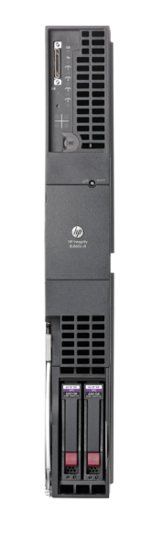
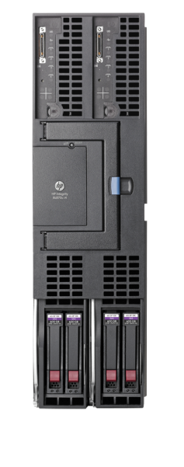
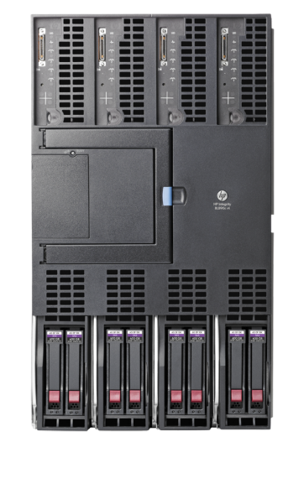
Unique HP Integrity Blade Link technology
Combines multiple blades into a single, scalable system
Scale up, out and within
Scale More
Scale Simply
2s/16c
x2 = 4s/32c
x2 = 8s/64c
Simplified scalability with industry’s first 2, 4, 8-socket HP-UX server blades

Slide 21
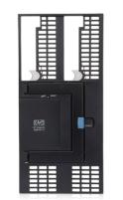
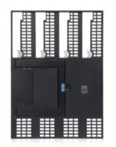

Upgrade kits
Upgrade types
Additions
have a single Integrity blade and want to upgrade
Order upgrade blade(s)
Upgrade blade is CTO and must include at least one processor; other components can be added (memory, IO, etc.)
Order required Blade Link
Proper OE license to be purchased; trade-in available
Proper support level to be purchased
Blade link enables easy and flexible upgrades
Feature
Enhancement!
Upgrade kits
Hardware Components
Combinations
have multiple Integrity blades and want to upgrade by combining them
Order required Blade Link
Proper OE license to be purchased; trade-in available
Proper support level to be purchased
Conversions
have a single Integrity blade and want to convert (e.g. from odd to even slot)
Order required Blade Link
No OE license change required
No support level change required
Upgrade blade No Blade Link
BL2 (3 options) BL870c i4 Blade Link
BL4 (2 options) BL890c i4 Blade Link

Slide 22
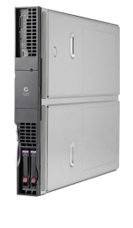


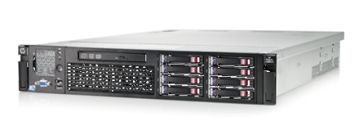
HP Integrity server positioning
rx2800 i4 | Integrity server blades | Superdome 2
Recommended for: Workloads requiring 1-2 processors Remote and branch offices with three or fewer servers Deals requiring the lowest price point while maintaining Integrity-level reliability | Recommended for: Workloads requiring 1-8 processors Configurations requiring the advantages and flexibility of Virtual Connect Environments looking to mix Integrity blades, ProLiant blades and Storage blades in the same BladeSystem infrastructure | Recommended for: Workloads requiring 8-32 processors Scalability beyond 8s SMP Highest levels of RAS PPU pay-per-use utility pricing IO intensive workloads

Slide 23
Strengthen with improved reliability and increased manageability

Slide 24
Increasing resource efficiency for greater agility
With the September 2012 HP-UX 11i v3 release
Double VM density or improve storage redundancy with 2x the virtual Fibre Channel ports
Reduce IT spend by discovering idle hardware with HP Capacity Advisor’s new analysis tool
Extend online workload mobility across a wider Fibre Channel storage fabric, now including routers
Increase networking throughput and redundancy with Auto Port Aggregation of Direct I/O network connections
2x
2x
Integrity Virtual Machines
Virtual Fibre Channel ports
Notes:
This is a summary of benefits from the September release of HP-UX 11iv3 in the ”Dynamic” pillar
Background: In March 2012, for: flexible consolidation, increased server utilization, and rapid deployment of new environments , HP introduced the converged HP-UX vPars and Integrity VM v6. This software product combined the performance and scalability of vPars with the flexibility and management of Integrity VM, made available across our Integrity i2 servers.
In September 2012, with the VM v6.1.5 release, increase your ability to flex your mission-critical infrastructure as business needs change by improving virtualization I/O efficiency, availability and flexibility:
1.With double the number of virtual Fibre Channel storage ports (up to 32) (supported by Net Port ID Virtualization, NPIV):
(Quant 1) HP-UX Bangalore lab testing August 2012
1a. Increase your server efficiency by doubling the number of Integrity VMs that can be supported on a single host system.
1b. Or increase the ability to deploy high availability virtualized workloads by enabling redundancy of your storage ports using HP-UX 11i v3’s built in multi-pathing feature. With multi-pathing, one disk is connected to two Fibre Channel ports. If one controller, port or switch fails, the operating system can route all I/O through the remaining controller transparently to the application, with no changes visible to the applications, other than, perhaps, incremental latency.
2. For virtualized workloads, improve network throughput with the Auto Port Aggregation of Direct I/O network connections providing a combined, fast port with built-in redundancy for high availability
3. Extend online workload mobility by extending the vPar and VM migration environment to include the whole Fiber Channel Fabric - extending beyond switches to also include routers
4. In addition, easily reduce IT spend by a few % by identifying idle hardware with monthly views to the new Capacity Analysis tab in Capacity Advisor 7.1. Estimated by ISS MSL Lab team, Ft. Collins, based on work with customers during the period of March – May, 2012.
The new tool gives visibility to idle, under or over-utilized hardware so you can easily reclaim, reuse & redeploy it. Also, Capacity Advisor now has continuous data collection to help debug and diagnose performance issues… that data collection is now delivered in about ½ the time as in previous version. Another example of ongoing HP-UX innovation. Based on ISS Manageability testing, HP Fort Collins, CO, May 2012.

Slide 25
Simplify and streamline management
Systems Insight Management 7.1, Matrix OE 7.1, HP-UX deployment tools
Streamline performance featuring continuous data collection for up to date performance analysis and alerts. Storage management support of new agile-only Device-Specific-Files (DSF) devices.
Enhance systems management functions of upgrades, backups, Federated CMS search and selective VM suspend/discovery
Workload management of latest virtualization developments with vPars v5 dynamic core support as well as HP-UX vPars and Integrity VM v6
A single, common management interface across data center
Notes:
Simplify and streamline management, in the following key areas
Streamline performance in 2 ways: a) Reduce time for debugging performance problems with continuous data collection by Capacity Advisor (avoiding up-to-date seek time/problem), b) DSFs or Device Specific Files come in two different types for HP-UX 11i “Legacy” and “Agile”
3) Enhance systems management with several updates. a) In 7.0 , simplify software & firmware upgrades with agentless updates for Smart Update Manager (SUM), and then in 7.1: b) Provide an advanced search for the Federated CMS, c) Automate quiesce operations for unattended backups, d) Enable selective discovery of VMs (7.1):
4) Workload manage the latest virtualization: HP-UX Global Workload Manager 7.1 now provides: Windows CMS support for vPars v5 dynamic cores, and new support for converged HP-UX vPars & Integrity VM v6

Slide 26
Easing management of newest Integrity servers
Integrity iLO 3
Easily create, delete and resize nPartitions on the new BL870c i4 and BL890c i4 server blades
Up to 6x faster vMedia
Increased security through progressive login delays for repeated incorrect password attempts
Clear cause-and-action diagnostic statements
Simplified firmware updates using Integrity iLO integrated with HPSUM
HP Confidential – NDA required
Notes:
New iLO 3 enhancements for Integrity server blades:
Configuring nPartitions applies only to new Integrity BL870c and BL890c server blades. It does not apply to the BL860c blade server, the rx2800 server or the Superdome 2 (Superdome 2 nPartitioning is done through OA, not iLO 3).
vMedia: 6x faster than previous iLO 3
Health Management: Agentless management alerts for “can’t boot” type events, reports these conditions to Remote Support Advanced systems. Now provides more information than before (before had to go into the data center to see what is going on)
Increased security: Makes breaking in harder without being annoying to users – makes it harder for programs designed to hack systems
Integrity Diagnostics: Verbose iLO Event Log with cause-and-action diagnostic statements that not only explain the problem, but clearly explains what to do to resolve the issue
Firmware Updates: Integrates with HPSUM to update core Integrity system firmware elements
Contrasting iLO 3 with iLO4:
ISS announced iLO 4 as part of their Gen8 announcement. If asked to contrast the enhanced iLO 3 with iLO 4, here are a couple of points to make -
Integrity iLO 3 focuses on enhancements for real-time server maintenance in HP-UX environments (an emphasis on text-based not graphics-based consoles, and more demand for descriptive cause & action health reports which can help root-cause issues)
ProLiant iLO 4 adds features for easier system deployment and more system health management of x86 environments (no-DVD system setup, built-in health reporting for many system components)

Slide 27


Enduring
© Copyright 2012 Hewlett-Packard Development Company, L.P. The information contained herein is subject to change without notice.
27
Notes:
The last quality of our Mission-Critical Converged Infrastructure is perhaps the most important --- enduring. This is about HP’s commitment to innovation , longevity and investment protection for our customers. It’s about consistent and predictable roadmaps and an architecture that is future-ready.

Slide 28
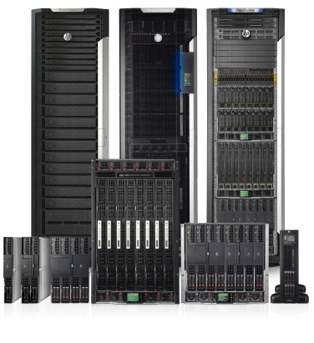



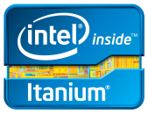
Continuing investment in HP Integrity
2012-2013
Future
HP Integrity
Integrity i4 servers with Intel Itanium 9500
HP-UX – available now
NonStop – available now
Regular updates and continued innovation with HP-UX, OpenVMS and NonStop
Kittson-based Integrity systems
Regular updates and continued innovation with HP-UX, OpenVMS and NonStop
NonStop
OpenVMS
Notes:
2012-2013
-Announcing new Integrity systems today along with updates to HP-UX
--We are also shipping NonStop system with Itanium 9500
--Yearly updates to HP-UX
Future
We will work with Intel to deliver Kittson-based systems, following our typical cadence of system availability 3 months after processor release.
We will continue yearly updates to HP-UX and ongoing enhancements to OVMS and NonStop systems
If asked more specifics about OVMS
OpenVMS will continued to be offered with Integrity i2 servers through Dec 2015
OpenVMS will not be offered with Integrity i4 servers
If asked more specifics about HP-UX (lots of details here)
HP-UX offers a stable operating environment, based on 30 years of development and delivers exceptional value today and for many years to come. One of the hallmarks of HP-UX is the decades of support life that we offer. Recently, we committed to expanding the support life of v3 through 2022. The 11i v3 platform was purposely architected to allow for a continuous cycle of enhancements which allows HP to continue to innovate and meet the needs of our mission-critical customers now and in the future. Because HP-UX 11i v3 is a strong feature-rich platform, we are now planning to directionally invest in key areas, such as: HA, security, virtualization and support for the private cloud.
HP-UX details for 2012
1.Simplified, converged and enhanced our virtualization offering by combining the performance and scalability of vPars with the flexibility and management of Integrity VM, across our Integrity i2 and i4 servers, and then particularly enhancing I/O capabilities and efficiency.
2.Expanded availability to more storage, database, application and virtualization technologies, so that the customer gains greater flexibility and freedom to choose which technology they want to use.
- And, as part of availability, we are introducing electrical isolation of separate blade workloads, with nPartitions now
becoming available on Integrity 9500 Series server blades
3.Expanded manageability with more capabilities, better performance, and improved usability. We simplified management for virtual servers (both the converged vPars & VM v6 offering, as well as physical to virtual to physical migration) – so that the customer reduces administrative costs while increasing control.
4.Significantly increased HP-UX scalability supported on the new Integrity 9500 Series servers
HP-UX details for 2013 and beyond
1.Maximize high availability for additional mission-critical workloads by continuing to expand Serviceguard to encompass new technologies, continuing to expand the choices customers have, enabling them to use lower cost solutions and still maintain mission-critical protection.
2.Enhance disaster recovery testing capabilities - to enable the capability to non-disruptively test the disaster recovery set up for increased preparedness. Includes cluster simulation for visual verification of changes to cluster configurations, which enables the users to visually see the impact of cluster configuration changes, for increased confidence.
3.Comprehensive enterprise-class security enables customers to protect their data and systems from threats and attacks, while enabling collaboration and access to necessary information (in a cloud environment) by their customers and employees. Secure confidential customer data to maintain privacy and maintain compliance, with regulatory and corporate security, and privacy requirements
4.Extended file system capabilities, such as: iSCSI support, >2TeraByte boot disk support, 4K sector size support, LVM online re-layout
5.Mission-critical workload flexibility – continuing our investment to give our customers choices in how to best manage their mission-critical workloads through virtualization and cloud technologies, reducing administrative costs while increasing control.
6.Continued binary compatibility - Allowing our customers and ISVs to get technology innovations in a non-disruptive manner through maintaining binary compatibility and smooth seamless enhancement process.

Slide 29
HP-UX 11i Lifecycle Summary
2025-Future
2000
2003
2007
2015
11i v3*
Supporting new and future Itanium processors
11i v2**
Industry’s most stable UNIX with long support cycle per major hardware release to avoid unnecessary and costly application re-testing
11i v1**
* 11i v3 now supports Intel® Itanium ® 9500 and is planned to support "Kittson“ processor as well. HP-UX 11iv3 will be supported at a minimum through 31-Dec-2022
** Previous Version Support with Sustaining Engineering (PVS w SE) will be offered for HP-UX 11i v1 and 11i v2 for the period 1st Jan 2014 to 31st Dec 2015.
Notes:
Key points
HP made two announcements about support in 2011/2012
First: v3 is now supporting the new Itanium 9500 (formally known as Poulson) based processors systems and v3 will be extended to included Kittson-based systems when they become available.
Second: Confirmation of v3 support through at least 2025
HP-UX provides a stable release that you can continue to run on for many years and unlike major competitors who force upgrades at a fixed cadence. HP-UX continues to enhance and support the current version eliminating the need for costly and timely upgrades just to get the latest platform support.
With HP-UX enabling you to continue to say on v3 as we add value to the line and support new systems. There are also improvements in the upgrading procedures to make moving to the latest technology fast and easy.

Slide 30



Lasting investment protection
3.5
MISSION-CRITICAL
CONVERGED INFRASTRUCTURE
NonStop
OpenVMS
MISSION-CRITICAL
NonStop
OpenVMS
CONVERGED INFRASTRUCTURE
30
Notes:
This slide reinforces the value of our Project Odyssey approach over time to customers. As you can see on the left hand side, our whole strategy starts with continued investment and commitment to Integrity and HP-UX. This robust platform continues to hold tremendous value for our customers and for HP as the “design center” for all of our work in mission-critical.
The key to all this is, to have a strategy that allows our customers to have and deploy an infrastructure today and evolve and adapt that, however you want, in the future. Today, you could take your Superdome or you could take your c7000 chassis and deploy Integrity blades, HP-UX, Itanium and feel confident that that solution that you deploy will be supported, will continue to be enhanced, will have new innovations and will be there for you through the decade and beyond. It is key component of HP’s vision. At the same time, when you want to move to a mission critical Linux environment, for example, that same chassis, that same environment can be leveraged. All you have to do is add the upcoming mission-critical x86 blades into your current infrastructure and load the mission-critical Linux environment. You can leverage that the investment that you make today to support the mission critical environment in the future. The key here is what you are doing today can be evolved, can be switched, can be adapted to support wherever your business is going to take you and you do not have to rip and replace the solution you have today, instead it is a natural evolution of what you have. One of the other key benefits is in the future we are even taking it a step further by within a Superdome we will be able to support the Xeon and Itanium architectures within different nPARS at the same time within the same Superdome. So offering you at a future point in time, the ultimate in flexibility for one Superdome to support whatever your mission critical needs may be including a hybrid environment of both mission-critical Windows/Linux and HP-UX at the same time.
Key talking points
Customers should be buying today: BE BOLD!
Customer can implement HP-UX 11i v3 today and be confident that their environment will be supported and able to evolve into the next decade and beyond
If the customer wants to migrate to a mission critical Linux or Windows environment → that same chassis can be updated with a blade swap
For customers that want to move → avoids a two step hop to get to mission critical LINUX/Windows
For customers that want to stay UNIX→ confidence that the environment will be supported and grow in the future.
11 January 2016
HP Confidential
30

Slide 31

Summary
© Copyright 2012 Hewlett-Packard Development Company, L.P. The information contained herein is subject to change without notice.
31

Slide 32
Summary: HP Integrity server blades
Speed up your mission-critical applications
With more powerful processors, an enriched memory subsystem, and an enhanced RAID controller, these are the most powerful HP Integrity server blades offered
Scale up to increase performance
HP Blade Link technology and embedded Virtual Connect FlexFabric provide mission-critical scalability and flexibility to meet your changing workload demands
Strengthen with improved reliability and increased manageability
The new Integrity server blades provide you with massive flexibility and availability with electrically isolated hard partitions (nPars).
www.hp.com/go/integrityblades

Slide 33
Thank you

Slide 34
Back up

Slide 35
Substantiation for claims
Substantiation for 33% TCO and 34% Operating Expenses Savings
Based on HP results using Alinean, Inc. TCO/ROI tools, Germany, October 2012. Baseline environment included: 2 – HP Integrity BL890c i2 (8ch/32co) servers, 8 - BL860c i2 (2ch/8co) servers, running Itanium 9350 1.73 GHz. Improved TCO environment included: 2 – HP Integrity BL870c i4 (3ch/24co) servers, 3 – HP Integrity BL860c i4 (2ch/16co) servers, with Itanium 9560 2.53 GHz.
Substantiation for 10x Faster Threat Detection
Based on HP-UX Security Lab testing, HP Bangalore, August 2012. Threat detection can be done up to 10x faster with the new common log file per multiple AAA servers that perform authentication, authorization, and accounting on a system. This allows for consolidation of similar threats across various instances per server, using a common log file, (instead of typically 8-10 separate files per system).
Substantiation for Up to 3x performance improvement
Source: Based on HP internal benchmark conducted by HP internal labs calculating the efficiency of the operating system and underlying server hardware. Compares HP Integrity server blades with the Intel Itanium processor 9500 series vs. HP Integrity server blades with the Intel Itanium processor 9300 series . The new server delivered a result of 3.29x the performance of the previous generation, rounded to 3x. . Houston, TX, August, 2012.

Slide 36
Substantiation for claims
Substantiation for 2x Secure Network Throughput
New HP-UX enhancements double network throughput, or the number of rules that can be configured for security filtering with IPFilter performance; this is twice as fast as the previous HP-UX 11i v3 version. Enables faster security threat detection. Based on HP-UX Security Lab testing, HP Bangalore, August 2012.
Substantiation for 2x Integrity Virtual Machines
With double the number of virtual Fibre Channel ports (up to 32) (supported by Net Port ID Virtualization, NPIV), increase your server efficiency by doubling the number of virtual machines. Based on HP-UX Bangalore lab testing August 2012
Substantiation for 11 Month Payback Period and 34% Operating Expense Savings
Upgrade your server with ease and confidence while protecting your investment and saving money! Based on a current environment and workload of 2 x HP BL890c i2 (8 chips / 32 cores), 8 x HP BL860c i2 (2 chips / 8 cores) running HP-UX 11i v3, the Alinean HP Integrity Server i4 TCO-ROI Calculator projects a 34% operating expense savings over a three-year analysis with an 11 months payback period.

Slide 37
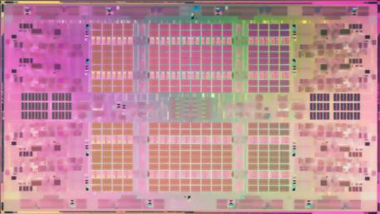
Introducing Intel® Itanium® processor 9500 series
Most significant Itanium® processor to date
Highlights:
New micro-architecture design
>2x performance over Itanium 9300
2x cores, 2x instruction throughput, >40% frequency gain
Greater mainframe class reliability and scalability
Full compatibility with existing applications
Confidential – NDA required
Notes:
Storyline:
Poulson’s 3.1 Billion Transistors makes it the most sophisticated general purpose Microprocessor to date, and this effort means better error resiliency for mission critical application, and increased cache density for better performance
3.1 B transistors represents a 50% transistor improvement over the previous generation of 2B
New 12-wide issue architecture with 8 cores doubles the cores from the Tukwila processor and increases throughput
Massive amount of cache compared to about 30MB cache in Tukwila to improve performance and reduce processing latencies
Improved RAS features with better error detection and correction capabilities to improve application resiliency
Power management advances enable monitors for thousand of power management events to reduce power consumption
Pin and binary compatibility with Itanium 9300 processor series extends platform longevity
New architecture
2x the cores with 2x instructions throughput (12-wide execution)
Total 54MB on-die memory over 30MB on Itanium 9300
Most sophisticated Intel processor to date (with 3.1B transistors)
New features:
Intel® Instruction Replay Technology
Intel® Hyper-Threading Technology, enhanced with dual-domain multi-threading support
Intel® Itanium New Instructions
Instruction Replay Technology:
Replay RAS is a major RAS improvements that allow errors to recover outside of FW and OS involvement on otherwise fatal errors.
Replay value is also not limited to RAS, but the architecture lends itself to performance and power improvements as well. Replay conditions can typically occur in execution, exception detection, and write-back stages of the execution pipeline. In more severe error cases, the replay can go all the way back to fetch stage.
Hyper-Threading Technology:
The new Hyperthreading innovation allow improves thread parallelism w/o sacrificing the high instruction throughput and parallelism that EPIC architectures like Itanium rely on.
Itanium has a highly Instruction parallel EPIC architecture that supports in order execution. Its multi-threading mechanism uses SOEMT (Switch-On-Event-Multi-Threading) – time sharing of pipeline.
Dual Domain pipelines takes SOEMT to the next level to provide some degrees of SMT (simultaneous multi-threading, typical in designs not heavy in instruction parallelism such as x86 or RISC) functionality.
Architecture and new instructions:
While Poulson is optimized to maximize legacy binaries, re-compilation with use of New Instruction can bring additional performance upsides, enabling it to grow with future needs.
Details -
mpy4, mpyshl4: Integer unit multiply instructions. Lower latency than using integer divides in the floating point unit. This leads to better performing integer code.
clz: counts number of leading zeros in a register. This is very useful in cryptography and leads to better performance by crypto code.
hint@priority: Operating system hint to the hardware that the current thread would like priority. Allows better O/S management of hardware and thus better throughput performance.
mov dahr: move to data access hint register. Part of an newly extended mechanism for compilers to provide hints about data accesses. Allows compilers better control of hardware caching and prefetching policies. Will lead to better single-thread and throughput performance.
lfetch.count: software counted prefetch. Allows a single instruction to replace several prefetch instructions. Reduces the number of instructions executed and increases the effectiveness of prefetching data into the caches. Will lead to better performance.
Takeaways:
With a new architecture, Poulson is a processor marvel that intelligently adapts to mission critical workloads. With highly integrated RAS features such as Instruction Replay technology, Poulson helps to prevent crashes, to protect critical data, and to automatically recover from many error cases to sustain critical processes to maintain the highest reliability and uptime, for customer who demands mainframe-class resiliency.
By continuing deep investments to the Itanium architecture, Intel remains committed to its long term viability

Slide 38
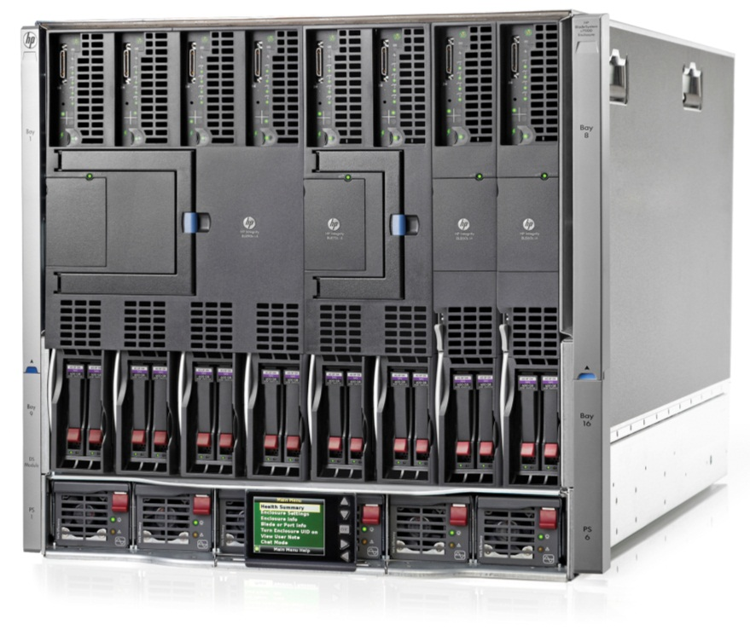
HP BladeSystem Platinum Enclosures
BladeSystem c7000 and c3000 Enclosures for mission-critical Integrity server blades
HP BladeSystem c7000 Platinum Enclosure
New! Increased mid-plane bandwidth
Intelligent Infrastructure
2400W Platinum Hot Plug Power Supply (80 Plus certified)
Single Phase Intelligent Power Module
New! Location Discovery Services
HP BladeSystem c3000 Platinum Enclosure
New! 1200W Platinum Hot Plug Power Supply (80 Plus certified)
Mix and match HP Integrity, HP ProLiant, and HP Storage blades in the same enclosure
BladeSystem c7000 Platinum Enclosure w/HP Integrity server blades
Notes:
What if you could eliminate the need to manually inventory the systems in your data center? What if your servers had the ability to identify and inventory themselves? Not only would you save time and money, you could match server workload to the available power, cooling and space resources efficiently, deploy workloads and increase workload performance.
HP is the first to provide built-in location awareness in the next generation of HP ProLiant servers that works hand-in-hand with technology in the new HP Intelligent Series racks. Together these technologies send the rack identification number and precise U location to the servers. This provides important location information to HP Insight Control Software along with power and temperature data. Also, HP uses secure non-emitting and radio free technology to meet the security requirements of many of our customers.
HP Location Discovery Services provides detailed server information by location and saves hours of tedious manual asset location and tracking data entry into spreadsheets. Combining location data with real-time, auto-populated power, thermal, and workload data into Insight Control provides the information that enables system administrators to optimally place workloads
The result:
100% manual and error prone inventory tracking eliminated: System administrators no longer have to use manual, inaccurate and tedious asset collection and tracking approaches such as spreadsheets and bar code scanners.
Workload placement optimized: Enabled by automated system location data combined with unique graphical power, temperature and performance display in Insight Control.
¹ 100% of manual, error prone inventory tracking eliminated through the use of HP Location Discovery Services and Power Discovery Services. Based on the elimination of manual and semi-manual recording and record keeping of power and asset information.

