Slide 1
iPECS eMG800 Introduction
(Unified Software v1.2)
Innovative Hybrid Communications Platform
* This document is updated based on unified software version 1.2, which will be released from July, 2015
Ericsson-LG Enterprise
July, 2015

Slide 2
Contents
iPECS eMG800 – Overview/Advantages/Values
Positioning and Market Coverage
New Hardware
Expandability
Enhanced features and applications
Licenses
Specifications

Slide 3

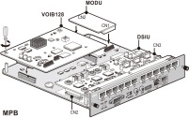
iPECS eMG800 - Overview
iPECS eMG800 is an innovative hybrid IP-PBX,
maximizing the cost and communication effectiveness for SME
With innovated high-performing CPU, VOIP and unified system software, eMG800 provides cost effective telephony features and seamlessly expandable to IP and UC as they are required.
eMG800 provides increased capacity upto 1,200ports, out-of-the box advanced telephony features, valuable applications with easy to deploy, manage and use.
eMG800 also provides simple and cost-effective migration from iPECS-MG by leveraging all the hardware and application licenses.
New MPB
New VOIB
Leveraging
MG100/300 Hardware
Unified System Software
iPECS eMG800

Slide 4
iPECS eMG800 - Highlighted Advantages
High-performing MPB &
High-capacity VOIP
Expanded system capacity : 1,200ports
High-density VOIP option : 128ch
Single MPB with system port license
Cost Effective
Expandable
Simple and Easy
Valuable features and applications
Migration support
Unified
System Software
Simple and Easy to learn and use
Powerful UCP features, applications available to hybrid system cost effectively
Easy and cost effective migration support
(MG to eMG800)
Cabinet, option boards, terminals and existing MG applications can be migrated to eMG800 without migration fee

Slide 5


iPECS eMG800 – What’s new & values
Innovating MG to eMG800 with new MPB, new VOIB and new Unified Software while leveraging all other existing MG options, terminals and applications
Seamless expandability with cost-effectiveness
High-capacity VOIP with enhanced IP features
Advanced telephony features
Embedded UC
Valuable Applications
New Terminals
Software Assurance Policy
Same user experience as UCP
Advanced Telephony Features
Embedded
UC
Enhanced
Applications
New Terminals
Easy
installation
and
management
New license Structure
&
SWA
Software
Unified System Software (v1.2)
KSU/EKSU
(New model name, no h/w change)
MG Option Boards
(Dual Firmware for
MG/eMG800)
New Packages
Hardware
Platform
New MPB
(200port by default → Expand upto 1,200port w/license)
New VOIB
(Option, mounted on eMG800 MPB)

Slide 6





































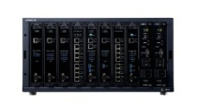
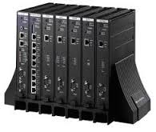








iPECS eMG800 - Portfolio
Delivering complete range of portfolio with UC, mobility, business applications to meet SME communications needs
Clients
LIP-8000E
LIP-9000
LIP-9070
LDP-7000/9000
WiFi
DECT
IP-DECT
IP Attendant
Applications
SIP
TAPI
UCS P4
Clickcall
Contact
Center
Report
Plus
IPCR
Hotel PMS
(ATDH)
NMS
Alarm Messaging
Telephony
Platforms
eMG80
eMG800
Call Servers
Media Gateways
UCP
Switches
L2 Smart
L2 Managed
L3 Managed

Slide 7
Positioning
Serving varying customer types and needs
  iPECS UCP for SME IP/UC market
  iPECS eMG for SMB Hybrid market
UC and applications
Distributed Environments
Redundancy
Scalability
IP/UC Market
UCP2400
UCP600
Hybrid Market
eMG800
UCP
eMG
UCP100
eMG80
Cost effective telephony
Light use of IP and Mobility

Slide 8
Market Coverage
Total TDM port : 840
- 408 CO / 20 PRI (600ch)
- 828 TDM Extension
800port
eMG800
400~600port
Additional
Opportunities
400port
MG300
50~300port
20~200port
Total TDM port : 118
- 24 CO / 1 PRI
- 64 Ext (63 SLT or 48 DKT)
Sweet Spot
100port
MG100
eMG80
5~50port
30port
ipLDK-60

Slide 9
Hardware(1/4) – Summary
New Hardware → New MPB and New VOIP
Renamed Hardware - KSU/EKSU
MG Option boards - Same model name with dual firmware
New packages
Category | iPECS MG | iPECS eMG800 | Remark
Cabinet | MG-KSU MG-EKSU | eMG800-KSU eMG800-EKSU | No hardware change, new model name(eMG800) on KSU/BKSU cabinet and on labels Installed MG-KSU/EKSU can be re-used without any change
MPB | MG-MPB100 MG-MPB300 | eMG800-MPB | Default 200port Expandable upto 1,200port with SPL licenses
VOIP | MG-VOIB8 MG-VOIB24 | MG-VOIB8 (MG/eMG800 F/W) MG-VOIB24 (MG/eMG800 F/W) eMG800-VOIB128 | Daughter board mounting on MPB (Option) 32ch by default → Expandable upto 128ch with 8ch license
Option boards | MG-xxx (MG Firmware) | MG-xxx (MG/eMG800 Firmware) | Dual firmware (compatible with MG and eMG800) Installed MG option boards can be upgraded to eMG firmware via eMG800 MPB
Packages | MG-PAC100A MG-PAC100D MG-PAC100P MG-PAC300 | eMG800-PAC-AS eMG800-PAC-AD eMG800-PAC-DS eMG800-PAC-PS eMG800-PAC-PD | BKSU, PSU, eMG800-MPB, LCOB12, SLIB24 BKSU, PSU, eMG800-MPB, LCOB12, DTIB24 BKSU, PSU, eMG800-MPB, BRIB4, SLIB24 BKSU, PSU, eMG800-MPB, PRIB, SLIB24 BKSU, PSU, eMG800-MPB, PRIB, DTIB24

Slide 10
Hardware(2/4) - New MPB (eMG800-MPB)
New eMG800-MPB supporting upto 840 TDM ports(1,200port including IP)
Enhanced embedded features – VOIP/VM/UC
Category | MG MPB | eMG800 MPB
Hardware | MG100/300 MPB | eMG800 MPB
System Software | MG system software | Unified System Software
Built-in DKT/SLT I/F | 6D + 6S | 6D + 6S
Built-in VM / VOIP | VM 4ch or VOIP 4ch | VM 8ch (default 4ch) / VOIP 4ch or VM 4ch / VOIP 8ch (default 4ch)
Voicemail feature | MG Voice mail | Unified Voice Mail
Multi language VM | 3 VM Service out of 6 VM prompts | 6 language VM Service out of 17 VM Prompts
Embedded UC |  | Yes (Default 5 copy of desktop, 5 mobile)
Clickcall |  | Yes (Default 5 copy)
T-NET | Only LCM mode | CCM / LCM mode
Web-Admin | MG Web Admin | Unified Web-Admin
Licenses | Old license (separate lic) Feature licenses Application licenses On-time trial license | New License (License file) Feature licenses Application licenses Multi time license activation for trial or emergency installations (6 times) System Port lic(SPL, 200port by default) IPEXT License (30 IPEXT by default) SWA licenses
High performance
Seamless expand with single MPB and system port license
Enhanced VM and VOIP
Embedded UC
Advanced telephony features and applications support
Simple and easy management

Slide 11
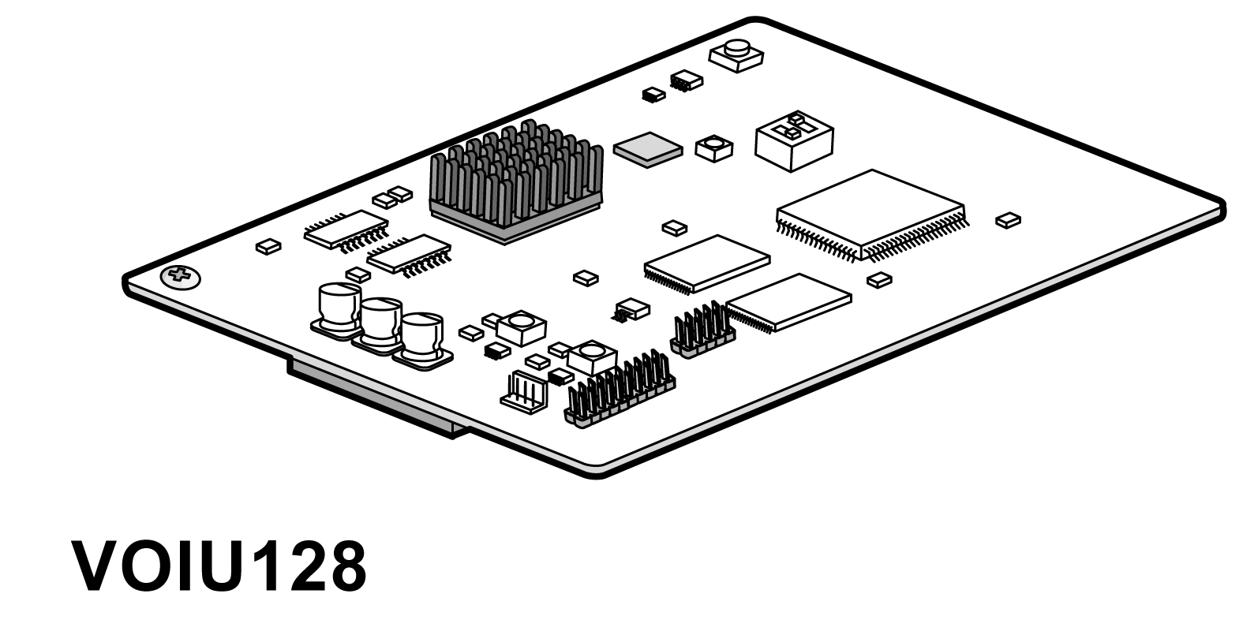
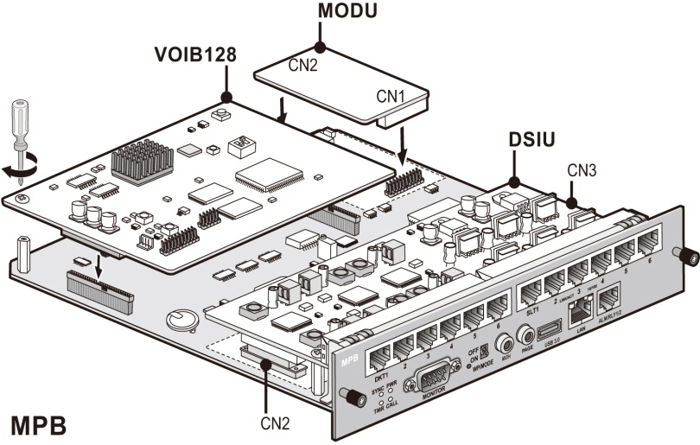
Hardware(3/4) - New VOIB (eMG800-VOIB128)
New VOIP : eMG800-VOIB128 (Option)
  Default 32ch and expandable upto 128ch with license (eMG800-VOIBCL8)
  No slot consumption - Mounted on eMG800-MPB
VOIB128
MPB

Slide 12
Hardware(4/4) - Option board compatibility
No hardware change
Running change with dual firmware (MG/eMG)
Same model name
 | Option boards | MG100/300 MPB | eMG800 MPB
Option board with MG | LCOB4/8/12 BRIB2/4 PRIB DTIB12/12C/24/24C SLIB12/12C/24/24C WTIB4/8 VMIB VOIB8/24 | Yes | Yes (Need firmware Upgrade via Web-Admin of eMG800)
Option board with Dual firmware (MG/eMG800) | LCOB4/8/12 BRIB2/4 PRIB DTIB12/12C/24/24C SLIB12/12C/24/24C WTIB4/8 VMIB VOIB8/24 | Yes | Yes
Same model name with Label Revision update

Slide 13



Expandability - Overview
Simply, Flexibly and cost-effectively expandable
  200 (default) → 600port : with SPL(System Port License) and required hardware components
  601→ 1,200port : with SPL and EXPM/EXPS (System Expansion License for master and slave)
1,200port
(TDM : 840port)
With SPL + Expansion License
SPL : 10, 50, 100, 200port
EXP : EXPM for Master, EXPS for Slave
600port
(TDM : 420port)
With SPL license
10, 50, 100, 200port
Master
System
Expansion
via IP
Slave
System
200port by Default

Slide 14


Expandability – System capacity
Expanded TDM Extension Capacity
  Upto 3 cabinets : 294 → 420
  Upto 6 cabinets : 840
 | MG100 | MG300 | eMG800 | eMG800 with Expansion System
Max System Ports | 200 | 414 | 600 | 1,200
Max Trunk | 80 | 240 | 536 | 600
ACO | 80 | 204 | 204 | 408
PRI | 80 | 240 | 360 | 600
SIP Trunk | 80 | 240 | 536 | 600
Max Extension | 120 | 324 | 600 | 1,200
TDM Extension | 120 | 294 | 420 | 840
Digital | 120 | 294 | 414 | 828
Analog (SLT) | 120 | 294 | 414 | 828
DECT | 96 | 192 | 192 | 192
IP | 120 | 324 | 600 | 600
Standard UC | - | - | 200 | 200
Premium UC | - | - | 600 | 600

Slide 15
Deployment flexibility and expandability
2 system connection as master and slave via IP (Same location or 2 locations)
More than 2 locations – Use T-NET
1) eMG800 Master/Slave
2) T-NET (eMG800 as CCM)
3) T-NET (UCP as CCM)
 | Upto 600ports | Upto 1,200 ports (Master/Slave) | eMG800 as CCM in T-NET | UCP as CCM in T-NET
Network Diagram
Max Capacity | 600 (TDM 420) | 1,200 (TDM 840) | 1,200 | 2,400
Max Capacity (IP/UC) | 600 | 600 | 600 | 2,400
Components for eMG800 | MPB SPL license over 200ports | Master system - MPB & SPL (required when over 200ports) - EXPM - VOIP channel (as required) Slave system - MPB - EXPS - VOIP/VMIU channel (required when to use) *Only EXPS and Local resource (VOIUCL4/VOIBCL8/VMIUCL4) is required in Slave. Other licenses necessary only for Master | CCM - MPB & SPL (required when over 200ports) - TNLS - VOIP/VMIU channel (required when to use) | LCM - MPB - TNLCM - VOIP/VMIU channel (required when to use)
SWA | Yes | Need only for master | Need for CCM and LCM | Need for CCM and LCM
Redundancy | - | - | - | Yes (Call server, Power)
Survivability | - | Yes | Yes | Yes
Master
Slave
.MPB
.SPL(Lic)
.TNLS(Lic)
CCM
CCM
(Active)
CCM
(Slave)
.MPB
.SPL (over 200ports)
.MPB
.SPL(Lic)
.EXPM(Lic)
.VOIP
.MPB
.EXPS(Lic)
.VOIP
IP
.MPB
.SPL(Lic)
.TNLCM(Lic)
.MPB
.SPL(Lic)
.TNLCM(Lic)
LCM
LCM
LCM
LCM
LCM
LCM

Slide 16
Enhanced Features
Pre-packaged embedded features and applications increases business competitiveness with effective communications at less costs
  Embedded UC
  Embedded AA/VM
  VM to Email forwarding
  Embedded Audio conference
  Embedded ACD
  One number service
  Mobile extension service
  Hot desking (LIP only)
  Teleworking
  Flexible deployment for multi-site environment
  Emergency paging
  Emergency call monitoring and recording
Increase Productivity
Mobile workforce
Better Customer service
Reduce costs
Seamlessly scalable
Simple to install and use

Slide 17
Enhanced Applications
Models | eMG80 P1 (v1) | eMG80 P2 (v1.2) | eMG800 (v1.2) | UCP (v1) | UCP (v1.2)
System Features & Interfaces IPN TNET (TNLS for CCM, TNLCM for LCM) MEX (Mobile Extension) Hotel Fidelio Interface TAPI AMP (ACD Manager Protocol) AMSI (*Need IOT) 3rd party SIP Apps (SIPS/SIPC) (*Need IOT) | Yes - Yes (32ea by default) Yes Yes Yes Yes (no license) - Yes | Yes Yes (LCM mode) Yes(32ea by default) Yes Yes Yes Yes (need license) Yes Yes | Yes Yes (CCM/LCM mode) Yes (30ea by default) Yes Yes Yes Yes (need license) Yes Yes | Yes - Yes (100- 30, 600/ 2400-10ea by default) Yes Yes Yes - - Yes | Yes Yes (CCM/LCM mode) Yes (100- 30, 600/ 2400-10ea by default) Yes Yes Yes Yes (need license) Yes Yes
Applications Phontage Communicator UCS Standard UCS Premium CCS Report Plus IP ATD IP ATD Hotel NMS IPCR | Yes Yes - - - - Yes (ATD 2.0) Yes (ATDH 2.0) - Yes (IPCR 1.0) | - - Yes (4.1) Yes (4.1) Yes (1.0) Yes (1.0) Yes (2.1) Yes (2.1) Yes (2.1) Yes (2.0) | - - Yes (4.1) Yes (4.1) Yes (1.0) Yes (1.0) Yes (2.1) Yes (2.1) Yes (2.1) Yes (2.0) | - - Yes (4.0) Yes (4.0) Yes (1.0) - Yes (2.1) Yes (2.1) Yes (2.1) Yes (2.0) | - - Yes (4.1) Yes (4.1) Yes (1.0) Yes (1.0) Yes (2.1) Yes (2.1) Yes (2.1) Yes (2.0)
Notes:
LME
CM base end to end solution.
Integrate both on-premises & 3rd party applications.
In parallel with CM platform enhancement and merge into Cloud solution.
SMB
UCS enhancement
Vertical market solution and feature enhancement
- Hospitality, Education, Retails, etc
API enhancement
Prioritized feature enhancement
Platform enhancement for mobility, conference and VOIP

Slide 18
Enhanced Terminals
Models | eMG80 P1 (v1) | eMG80 P2 (v1.2) | iPECS eMG800 (v1.2) | UCP (v1) | UCP (v1.2)
Digital Phone LDP-7000 LDP-9000 | Yes Yes | Yes Yes | Yes Yes | Yes Yes | Yes Yes
IP Phone LIP-7000 LIP-8000/8000E LIP-9070 (IPKTS) LIP-9000 | Yes Yes - - | Yes Yes Yes Yes | Yes Yes Yes Yes | Yes Yes Yes Yes | Yes Yes Yes Yes
WiFi WIT-400HE | Yes | Yes | Yes | Yes | Yes
DECT GDC-450H GDC-500H GDC-800H | Yes Yes - | Yes Yes Yes | Yes Yes Yes | Yes Yes Yes | Yes Yes Yes

Slide 19
MG to eMG800 Migration
Offering simple and cost-effective migration
  All hardware can be re-used (except MPB100/300) with having firmware of option boards upgraded via eMG800 Web-admin
  All licenses can be transferred without charge until the end of 2016
Category | Items | Reusable | What to do
Cabinet | MG-KSU MG-EKSU | Yes Yes | No action required
MPB | MG-MPB100 MG-MPB300 | No No | Need to buy eMG800-MPB
Option boards | MG-xxx | Yes | Need to upgrade firmware via eMG800 Web-Admin
Licenses | System licenses Application licenses | Yes (by end of 2016) Yes (by end of 2016) | Need to download matching license from the license portal (available by the end of 2016)
Database |  | No | Need to re-program
Notes:
LME
CM base end to end solution.
Integrate both on-premises & 3rd party applications.
In parallel with CM platform enhancement and merge into Cloud solution.
SMB
UCS enhancement
Vertical market solution and feature enhancement
- Hospitality, Education, Retails, etc
API enhancement
Prioritized feature enhancement
Platform enhancement for mobility, conference and VOIP

Slide 20
eMG800 License - Overview
Licenses
Hardware
System Port License (SPL)
IP Extension Licenses
Application and Feature licenses
Software Assurance licenses
Trunk
(TDM/ IP)
TDM Phones
ELG IP/SIP Phones
3rd party SIP Phones
Soft Clients /
UC Clients
Mobile
Extension
(Only virtual registration)
IPEXT License
(ELG IP/SIP Phones)
3SIPEXT License (3rd party SIP Phones)
IPN
TNLS / TNLCM
EXPM/EXPS for system expansion
Hotel
MEX
VOIUCL4 (for built-in voip)
VOIBCL8 (for VOIB128)
VMIUCL4 (for built-in VM ch)
SWL (free)
MNTD (free)
MNTU1S (below 200port)
MNTU1L (Over 200port)
MNT1
MNTD2 (MNTD+MNT1)
MNT2
MNT3
MNT4
MNT5
FIDELIO
TAPI
AMP
AMSI (3rd party alarm solution)
3SIPC/3SIPS (3rd party SIP apps)
MS Lync
eMG800 Basic Pack
Packages
Option boards
Cabinet
Accessories
1,200port
eMG800
SPL+ EXPM/EXPS
600port
UCS Standard/ Premium
UCS Upgrade License
Clickcall
IP Attendant Office
IP Attendant Hotel
IPCR
CCS
Report Plus
NMS
eMG800
SPL
200port
eMG800
*note1 – mobile extension consumes SPL in case of virtual registration. For combined use with hard terminals, MEX doesn’t consume SPL license.
Notes:
LME
CM base end to end solution.
Integrate both on-premises & 3rd party applications.
In parallel with CM platform enhancement and merge into Cloud solution.
SMB
UCS enhancement
Vertical market solution and feature enhancement
- Hospitality, Education, Retails, etc
API enhancement
Prioritized feature enhancement
Platform enhancement for mobility, conference and VOIP

Slide 21
eMG800 License - SPL
System Port License (SPL)
  It is a license for connecting any trunks or extensions above default port.
  No system port license is required within the number of the default port.
Advantages
  Providing seamless scalability and investment protection for future growth while providing the price competitiveness for small segment upto 200ports.
  Saving the operational cost and add-on sales.
Hardware
License
1,200port
System Port License (SPL)
eMG800
TDM
-LCO
-BRI
-PRI
-DTI
-SLT
-DECT
VOIP G/W
-Built-in VoIP
-VOIB
IP Extension License
(IPEXT)
-LIP
-ELG SIP
-WIT
-ACT
-IP-DECT Handset
3rd party SIP Extension License (3SIPEXT)
-3SIPEXT
-3SIPC
Soft Client
License
-UCS
-IP Attendant
Office/Hotel
*IPEXT
license
included
Mobile
Extension
^{*Note1}
SPL+ EXPM/EXPS
600port
eMG800
SPL
200port
eMG800
*note1 – mobile extension consumes SPL in case of virtual registration. For combined use with hard terminals, MEX doesn’t consume SPL license.
Notes:
LME
CM base end to end solution.
Integrate both on-premises & 3rd party applications.
In parallel with CM platform enhancement and merge into Cloud solution.
SMB
UCS enhancement
Vertical market solution and feature enhancement
- Hospitality, Education, Retails, etc
API enhancement
Prioritized feature enhancement
Platform enhancement for mobility, conference and VOIP

Slide 22
eMG800 License - IPEXT
IP Extension License (IPEXT)
  It is a license required for connecting Ericsson-LG LIP phones and SIP phones.
  30 IPEXT are provided by default.
  → ELG LIP/SIP phones require both System Port(SPL) and IPEXT licenses.
  → ELG UC/Soft clients only require System Port License(SPL).
 | SPL License | IPEXT License
ELG IP Phones ELG SIP Phones ELG WIT Phones ELG IP-DECT Phones | Required | Required
ELG UCS/ Soft Clients | Required | No (Embedded in client licenses)
Notes:
LME
CM base end to end solution.
Integrate both on-premises & 3rd party applications.
In parallel with CM platform enhancement and merge into Cloud solution.
SMB
UCS enhancement
Vertical market solution and feature enhancement
- Hospitality, Education, Retails, etc
API enhancement
Prioritized feature enhancement
Platform enhancement for mobility, conference and VOIP

Slide 23
eMG800 License - MEX
Mobile Extension License
  It is a license required for using Mobile Extension for either linked with any type of hard phones
  or virtual use.
  MEX license is provided free of charge as the number of IPEXT license.
  Mobile Extension can be used in linked pair with any type of terminals or virtually within the total number of MEX license, not necessarily bound with LIP phone.
  SPL is also necessary for virtual mobile extension use without binding with any hard phones.
MEX license
1 SPL
1 MEX
LIP
30ea by default as the number of default IPEXT license
1 SPL
1 MEX
Additionally, providing MEX license free of charge as the same number of purchased IPEXT license
LDP
1 SPL
1 MEX
LKA
Buy MEX license for additional use above the number of default + purchased IPEXT
1 SPL
Virtual Port
1 MEX
Notes:
LME
CM base end to end solution.
Integrate both on-premises & 3rd party applications.
In parallel with CM platform enhancement and merge into Cloud solution.
SMB
UCS enhancement
Vertical market solution and feature enhancement
- Hospitality, Education, Retails, etc
API enhancement
Prioritized feature enhancement
Platform enhancement for mobility, conference and VOIP

Slide 24
Temporary License Activation
“Temporary license activation” upto 6 times
  1st time : 60days, next 5 times : 30days each
  Activation by System Admin - No need to download temporary license from the license portal
  Show Pop-up notice when enabling “Temporary License Activation” about “license upload required before expiration, limited service mode without valid licenses after expiration and recommendation on database download”
  Daily Email Notice to pre-registered email address in Web-Admin and Daily notice to system attendant from 7 days prior to expiration
Need valid licenses from this
1st time
(60days)
2nd time
(30days)
3rd time
(30days)
4th time
(30days)
5th time
(30days)
6th time
(30days)
If valid licenses at expiration → Normal operation
If license in-valid at expiration
 | eMG80/800/UCP | CM
1) System feature license | Disable system feature | Disable system feature except TAPI, LNKGW, GR. *TAPI, LNKGW, GR → Go to “Limited Service Mode”
2) Seat/Copy base license | Disable the whole application or feature with in-valid license | Goes to “Limited Service Mode”
3) SPL/IPEXT/3SIPEXT | Goes to “Limited Service Mode” | Goes to “Limited Service Mode”
Support emergency installation as well as multiple application trials
Simple and Quick to implement via Web-Admin
Notes:
LME
CM base end to end solution.
Integrate both on-premises & 3rd party applications.
In parallel with CM platform enhancement and merge into Cloud solution.
SMB
UCS enhancement
Vertical market solution and feature enhancement
- Hospitality, Education, Retails, etc
API enhancement
Prioritized feature enhancement
Platform enhancement for mobility, conference and VOIP

Slide 25
Limited Service Mode
Offer multiple benefits of temporary uses
Valid licenses should be uploaded before expiration
1) Temporary license activation expiration
(1st time – 60days, next 5 times – 30days each)
Validity Check
Normal Operation
2) Default maintenance license(MNTD) upload within 60days of initial installation for LME products
Yes
3) LCM system running as a survivable mode
– needs reconnection to CCM system within 60days
No
4) Stand-by(Slave) system running as a redundancy mode
– needs reconnection to Master system within 60days
Limited Service Mode
(Blocking only normal outgoing calls)
Upload valid licenses
or
2) Delete temp license from the DB
* LCM/Slave system – reconnection to CCM/Master system
5) Illegal (Intentionally changed) license file upload
*Limited Service Mode
- Blocking only normal outgoing calls
Notes:
LME
CM base end to end solution.
Integrate both on-premises & 3rd party applications.
In parallel with CM platform enhancement and merge into Cloud solution.
SMB
UCS enhancement
Vertical market solution and feature enhancement
- Hospitality, Education, Retails, etc
API enhancement
Prioritized feature enhancement
Platform enhancement for mobility, conference and VOIP

Slide 26



Limited Service Mode
Internal calls, Incoming calls and emergency outgoing calls are only supported
Remote PPP Connection is supported
Internal calls
Emergency Calls
Remote PPP Connection
Incoming calls
No Outgoing Calls
Notes:
LME
CM base end to end solution.
Integrate both on-premises & 3rd party applications.
In parallel with CM platform enhancement and merge into Cloud solution.
SMB
UCS enhancement
Vertical market solution and feature enhancement
- Hospitality, Education, Retails, etc
API enhancement
Prioritized feature enhancement
Platform enhancement for mobility, conference and VOIP

Slide 27


