Slide 1
How to use offline web admin (OWA)

Slide 2
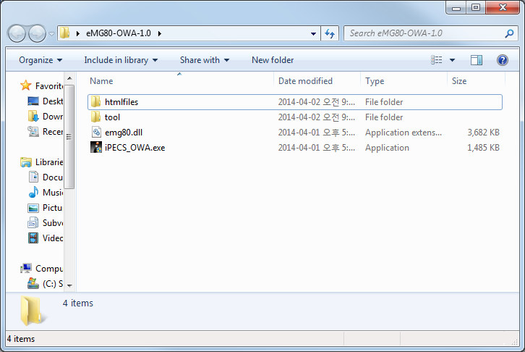
1. Download & unzip program file
Download from global partners site and unzip the program file.

Slide 3
2. Set default web browser
The eMG80 OWA needs browser supporting HTML5.
Set default web browser on your PC such as IE 10+, Chrome, Firefox, Opera etc.

Slide 4
3. Execute program
Execute iPECS_OWA.exe

Slide 5

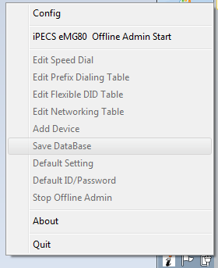
4. Start owa for eMg80
Find OWA icon from tray icons
Click OWA icon to start the program

Slide 6
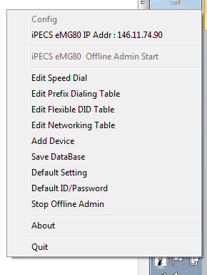
5. Open web browser and access owa
Find OWA icon from tray icons
Click OWA icon and click “iPECS eMG80 IP Addr : xx”
And then web browser will be opened automatically.

Slide 7
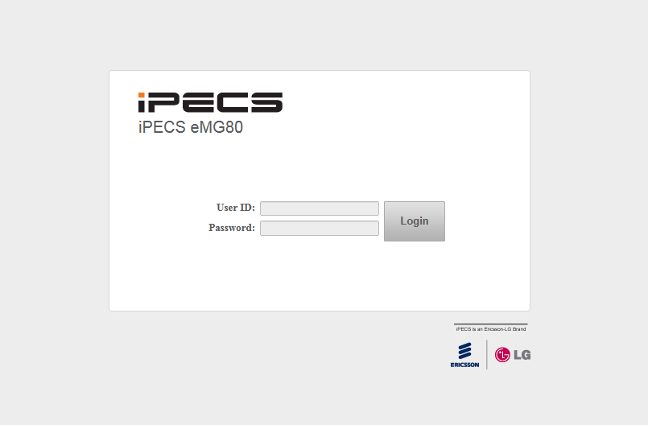
6. Use web admin

