Slide 1
SBG-1000 SRN for 1.0Au
ES R&D) iPECS LIK team
10 Apr 2012

Slide 2
Version History
Version | Release Date | Base LIK | Description
A.0Am | 2011.04.25 | 5.5Cj | DECT S/W QE passed
A.0An | 2011.05.12 | E.5Da | DECT F/T QA passed
A.0Ao | 2011.06.17 | E.5De | PSTN 4 F/T QA trial
1.0As | 2011.08.16 | E.5Eb | PSTN 4 MP QA passed
1.0At | 2011.12.08 | E.5Gg | MP QA
A.0Au | 2012.03.02 | E.5Go | Temporary for F/T & IRs
1.0Au | 2012.04.10 | E.5Gp | MP QA

Slide 3
SBG-1000 A.0Am
ES R&D) LIK team
25 Apr 2011

Slide 4
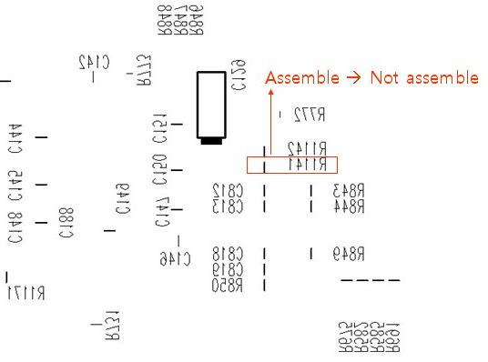
Capacity
from A.0Am
Capacity Lock Key is added
DECT | Lock Key | VoIP | Station
Disable |  | 3 | 12
 | Extended | 6 | 24
Enable |  | 3 | 12
 | Extended | 4 | 24
H/W ECO should be applied to the old H/W without DECT
  Remove R1141 on the bottom side PCB near U17 CPLD
  Hardware Version will be shown as “05” not “01”.
  Contact to myoungsup.shin@lgericsson.com for the detail.

Slide 5
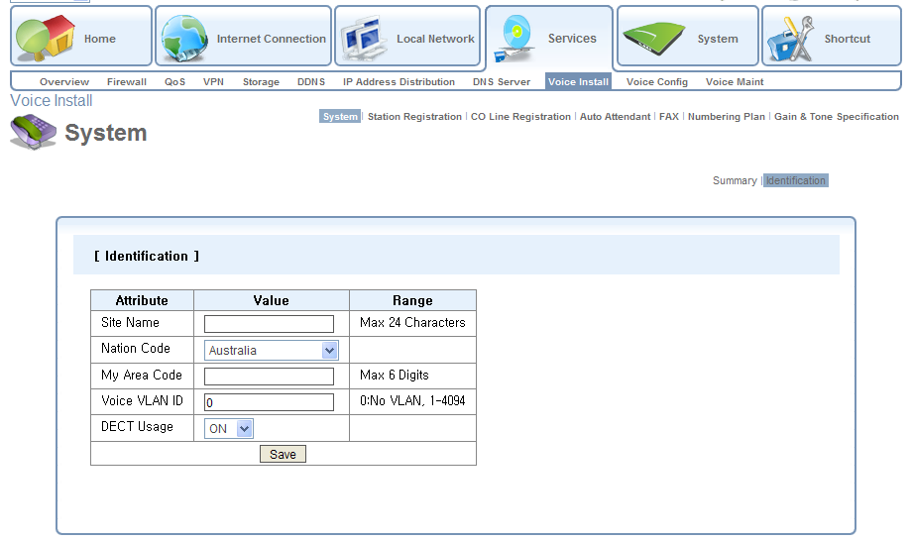
Nation Code and DECT Usage
from A.0Am
Nation Code can be modified in Web GUI
DECT Usage is added
Nation Code and DECT Usage can be modified
only right after Restore Factory Settings.
If Nation Code or DECT Usage is modified,
SBG will be restarted and all Voice DB will be initialized.
Nation Code and DECT Usage can be modified
only right after Restore Factory Settings.
If Nation Code or DECT Usage is modified,
SBG will be restarted and all Voice DB will be initialized.

Slide 6
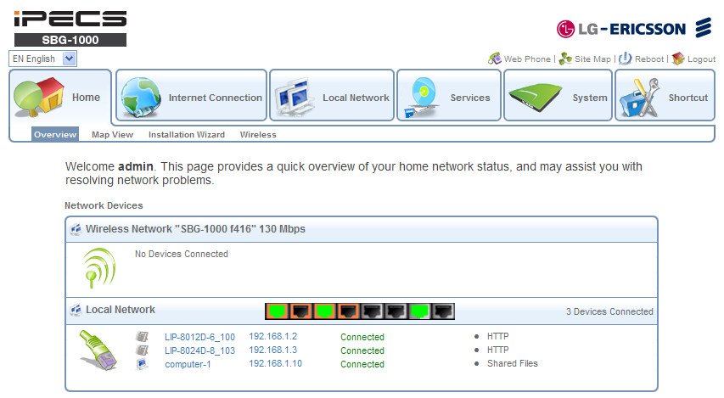
Added Feature - I
from A.0Am
Language Selection and Web Phone are added
Language Selection is added
Web Phone is added

Slide 7
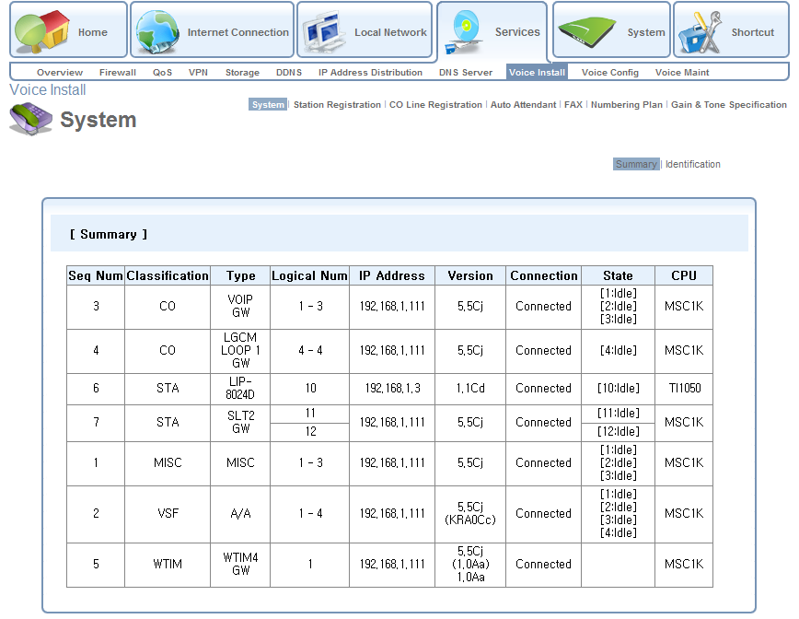
Added Feature - II
from A.0Am
Summary page is added

Slide 8
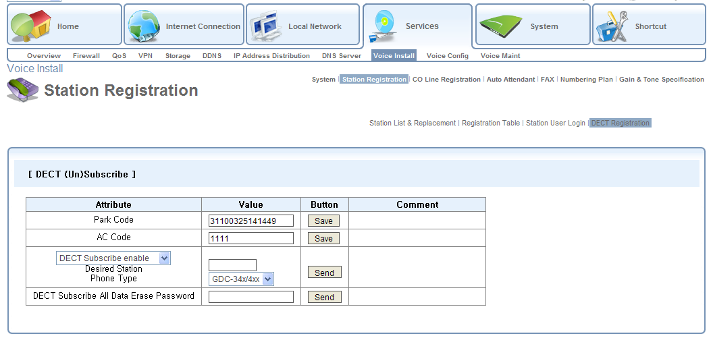
Added Feature - III
from A.0Am
DECT Registration is added

Slide 9
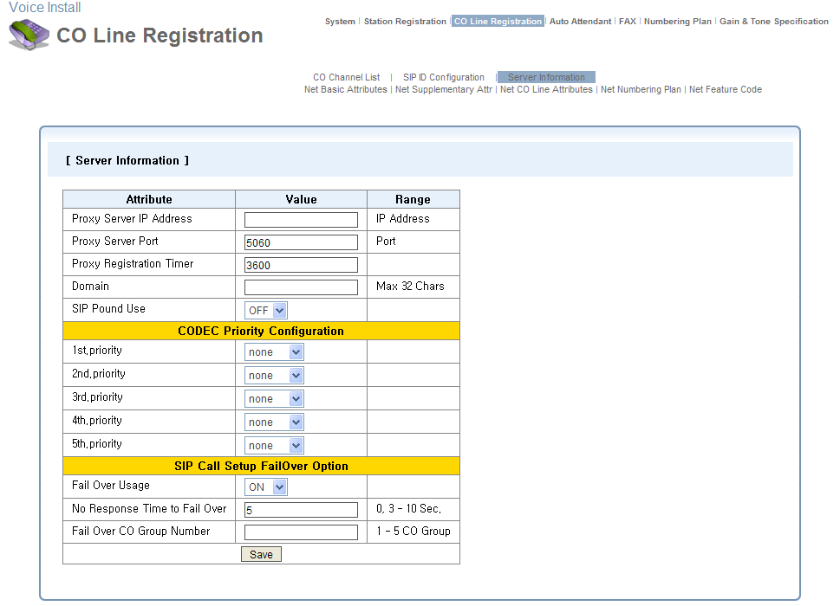
Added Feature - IV
from A.0Am
CODEC Priority and Fail Over are added
Default CODEC Priority when all “none”
g.711-u > g.711-a > g.723 > g.729 > g.729a
If
Fail Over Usage set to “ON”
No Response Time to Fail Over has 3 ~ 10 seconds
Fail Over CO Group Number has 1 ~ 5 CO Group
then SIP Call Fail Over to PSTN Backup CO Group
after No Response Time
directly when WAN link fault

Slide 10
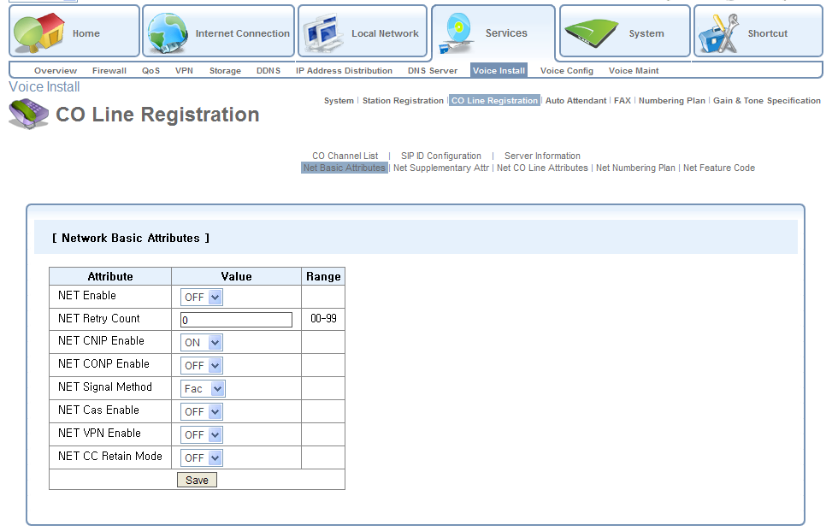
Added Feature - V
from A.0Am
Networking Admin is added

Slide 11
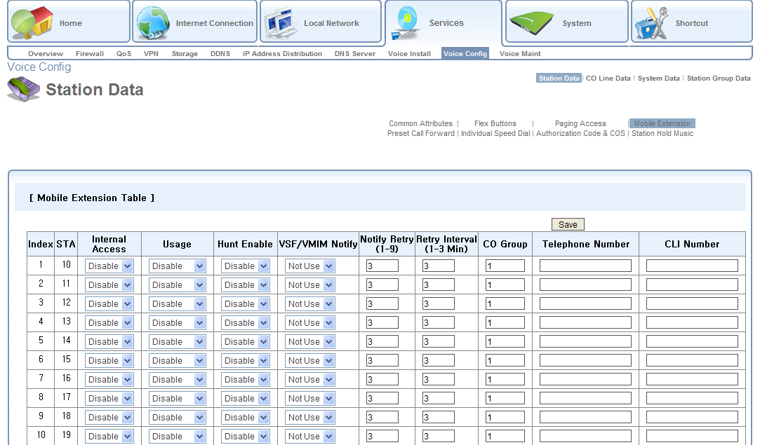
Added Feature - VI
from A.0Am
Mobile Extension is added

Slide 12
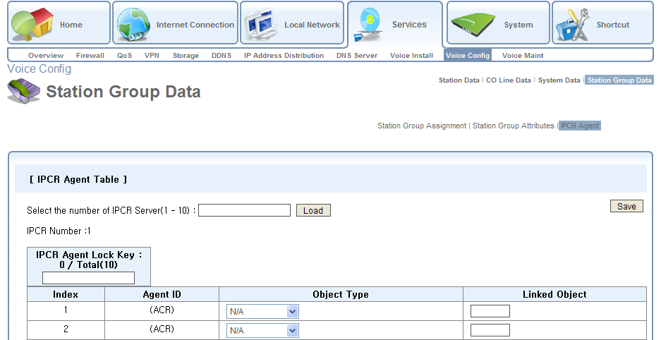
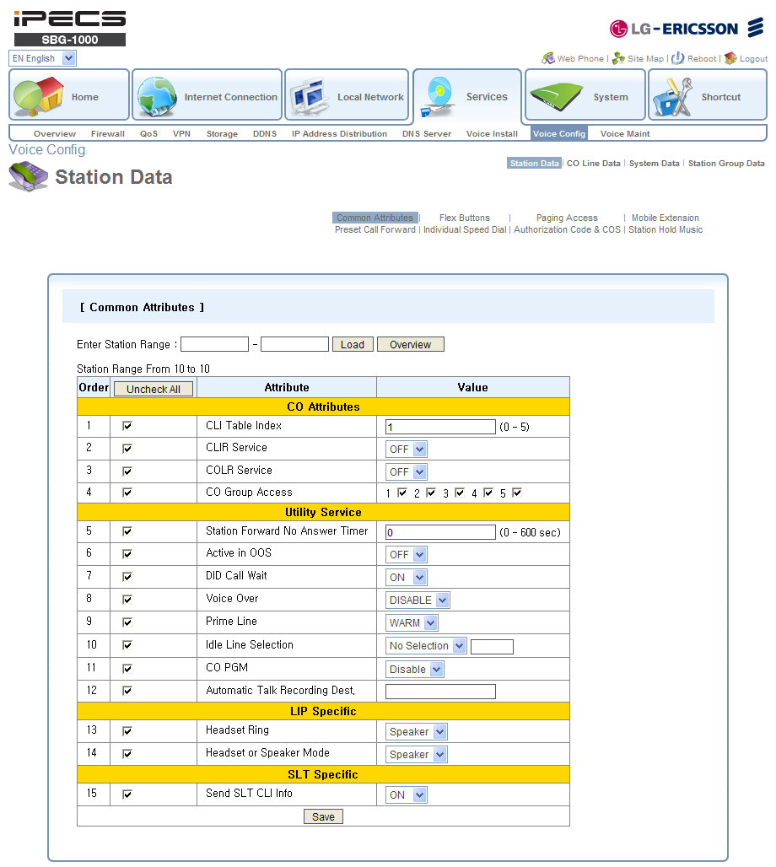
Added Feature - VII
from A.0Am
IPCR is added
Automatic Talk Recording Destination is added in Voice Config > Station Data > Common Attributes for IPCR

Slide 13
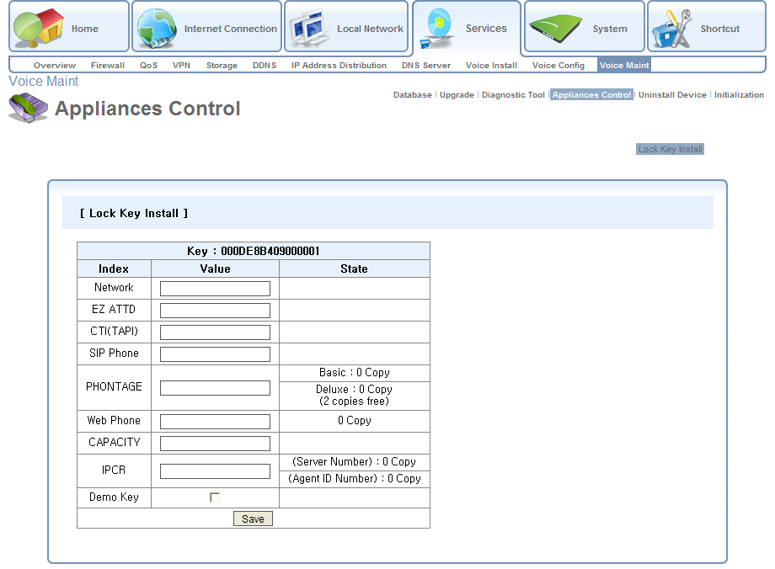
Lock Key added
from A.0Am
Network, EZ ATTD, CTI(TAPI), Web Phone, CAPACITY, IPCR Lock Keys are added

Slide 14
SBG-1000 A.0An
ES R&D) LIK team
12 May 2011

Slide 15
DB Incompatibility
from A.0An
Maximum CO increases from 8 to 10 in order to support PSTN 4 option boards (4 FXO / 2 BRI )
Restore Factory Settings SHOULD be applied by web admin or “Reset to defaults” button after upgrade
  If H/W with DECT, DECT PARK code SHOULD be memorized before upgrade and SHOULD be set after upgrade.
    Attendant LIP
      PGM+0+#+Flex4 : Display PARK code
      PGM+0+#+Flex6 : Set PARK code
    WBM
      Services > Voice Install > Station Registration > DECT Registration
  After re-program PARK code, Reboot to apply new PARK code.
 | ~ A.0Am | A.0An ~
Max. VOIP | 6 | 6
Max. PSTN | 2 | 4
Total Max. CO | 8 | 10

Slide 16
SBG-1000 A.0Ao
ES R&D) LIK team
16 Jun 2011

Slide 17
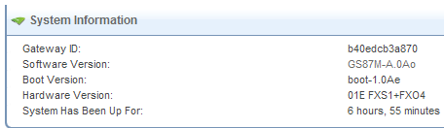
Support PSTN 4 option boards
from A.0Ao
PSTN 4 option boards are supported with new H/W
  Hardware Version XXE means “Enhanced” new H/W.
  Only new H/W can support PSTN 4 option boards
Option Board | Resources
CIU4 | FXO 4
BRIU2 | BRI 2

Slide 18
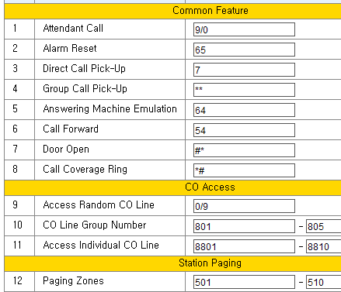
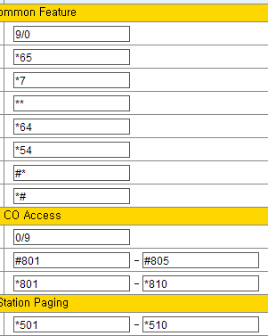
Numbering Plan
from A.0Ao
Services > Voice Install > System > Identification
Two type of Numbering Plan
Normal | Networking
Networking Numbering Plan starts with * or # for the sake of convenient voice networking

Slide 19
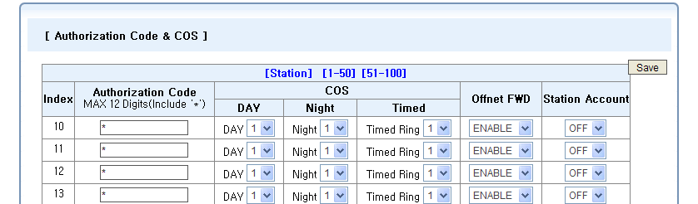
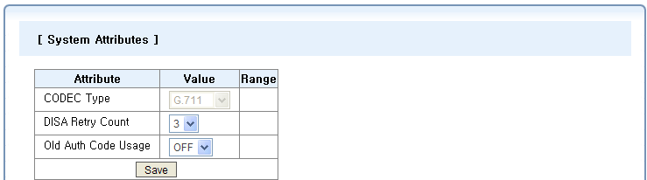
Authorization Code
from A.0Ao
Services > Voice Config > Station Data > Authorization Code & COS
Services > Voice Config > System Data > System Attributes
100 System Authorization codes can be programmed
If it has “ON”,
Forced Account Code is activated and User should enter the authorization codes for outgoing CO call.

Slide 20
SBG-1000 1.0As
ES R&D) LIK team
12 Aug 2011

Slide 21
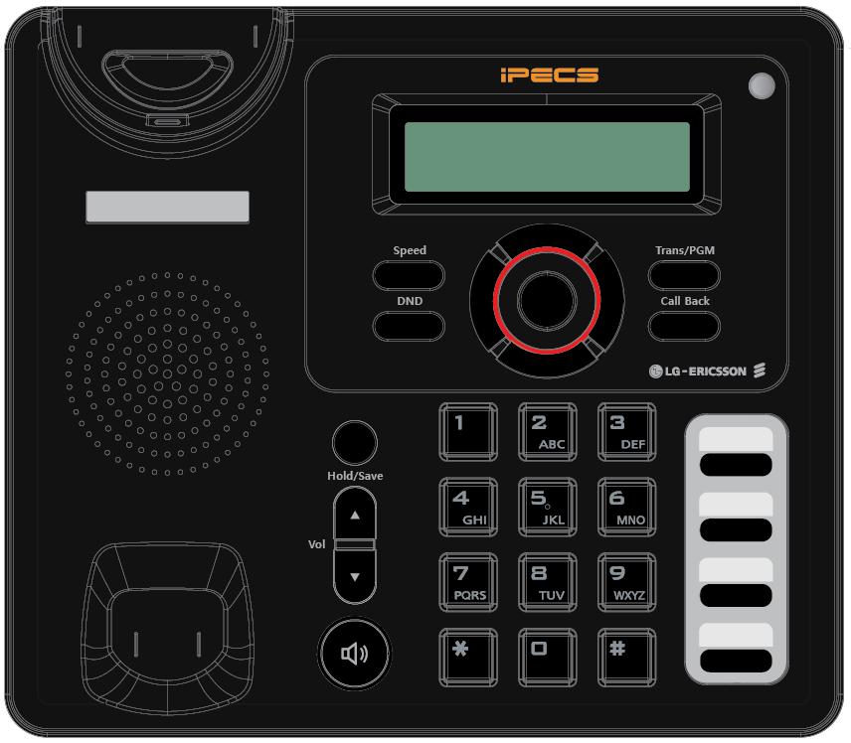
Support LIP-8002E
from 1.0As
LIP-8002E
  New Entry Level LIP based on IPKTS protocol
  Same H/W with LIP-8002 using SIP, but different button silk
Message Wait LED
Dial By Name
Call Log
In OFF-HOOK state,
DND button is used as FWD button

Slide 22
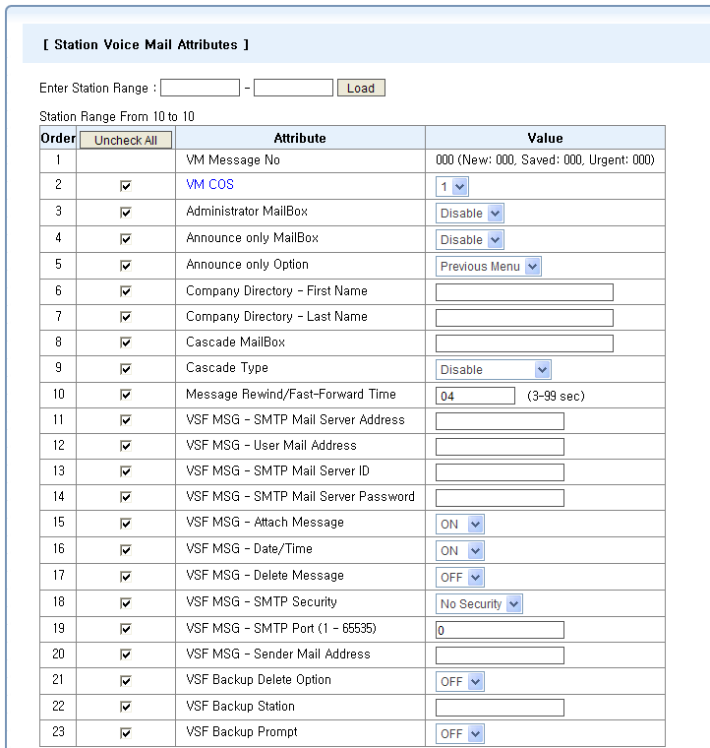
Station VM Attributes
from 1.0As
Services > Voice Config > Station Data > Station VM Attributes
For Enhanced VM features as LIK 5.5

Slide 23
USB Upgrade
from 1.0As
Press PGM + 0 + 9 in Attendant
Press Number to View File
Browse with Vol▲▼ and Press Save
Selected file is copied from USB to Memory
F/W is burned onto NAND file system
Press Save to Restart
SBG will Reboot
[5] REC. VSF ANNCEMENT
[9] USB UPGRADE
ROM FILE NUM: TOTAL 8
PRESS 0-7 TO VIEW FILE
7 : GS87MX0Yz.rom
PRESS [SAVE] TO UPGRADE
7 : GS87MX0Yz.rom
COPY IN PROGRESS
7 : GS87MX0Yz.rom
BURNING IN PROGRESS
7 : GS87MX0Yz.rom
PRESS [SAVE] TO RESTART
7 : GS87MX0Yz.rom
RESTARTING......
F/W (GS87MXXXX.rom) should be in the top directory of USB memory.

Slide 24
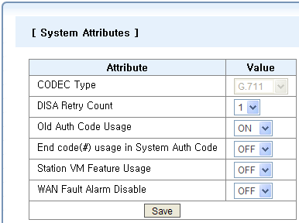
Added & Fixed
from 1.0As
Added
  Services > Voice Config > System Data > System Attributes
Fixed
  Internet Connectivity Test
    Under some ADSL routers which cannot support ping to the public site, this test always fails.
    If ping fails, TCP connection method is used for this test.
For the enhanced security,
if it has “ON”, # should be entered after System Auth Code.
If it has “ON”, Enhanced VM feature is available.
If it has “ON”, WAN Fault Alarm will not be notified on Attendant.

Slide 25
SBG-1000 1.0At
ES R&D) LIK team
8 Dec 2011

Slide 26
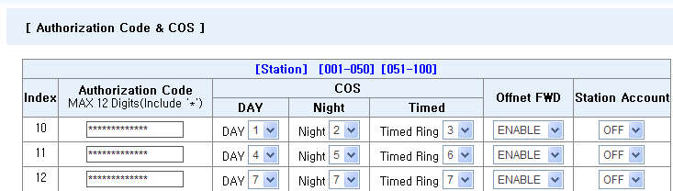
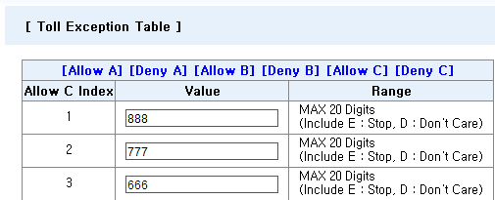
COS 1~7
from 1.0At
COS expanded from 4 to 7
Allow/Deny C Toll Exception Table added

Slide 27
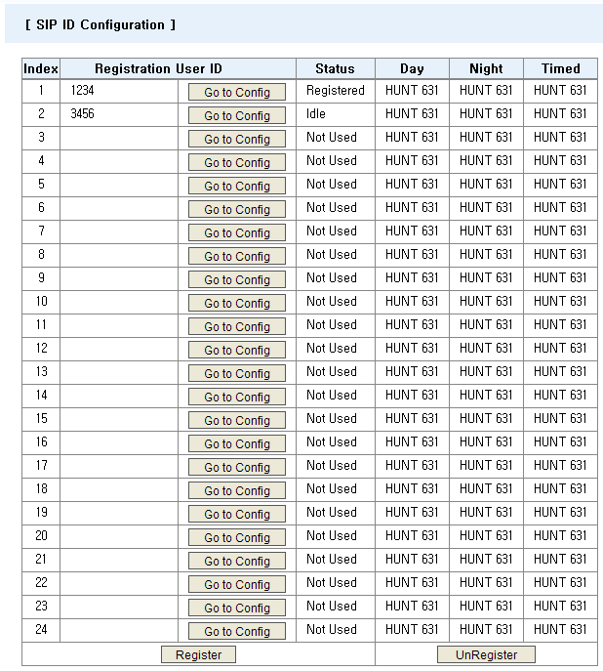
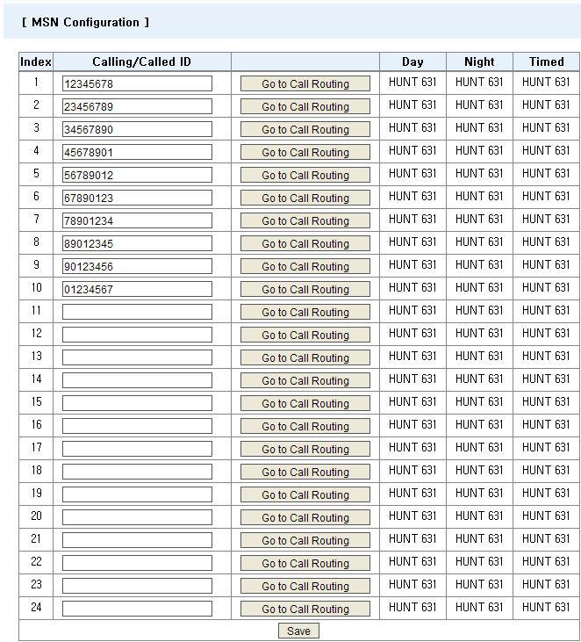
SIP & MSN 24 IDs
from 1.0At
SIP User IDs and MSN IDs are increased to 24 IDs
“UnRegister” added

Slide 28
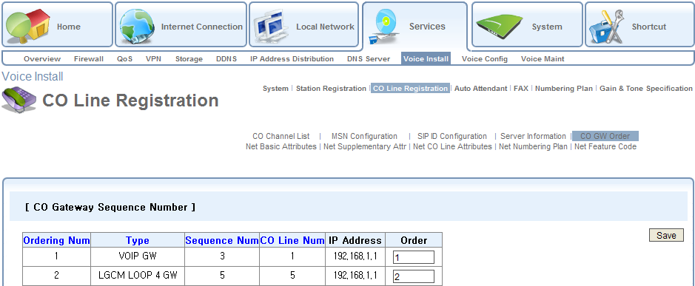
Added Features – I
from 1.0At
CO GW Order is added for PSTN or ISDN user.

Slide 29
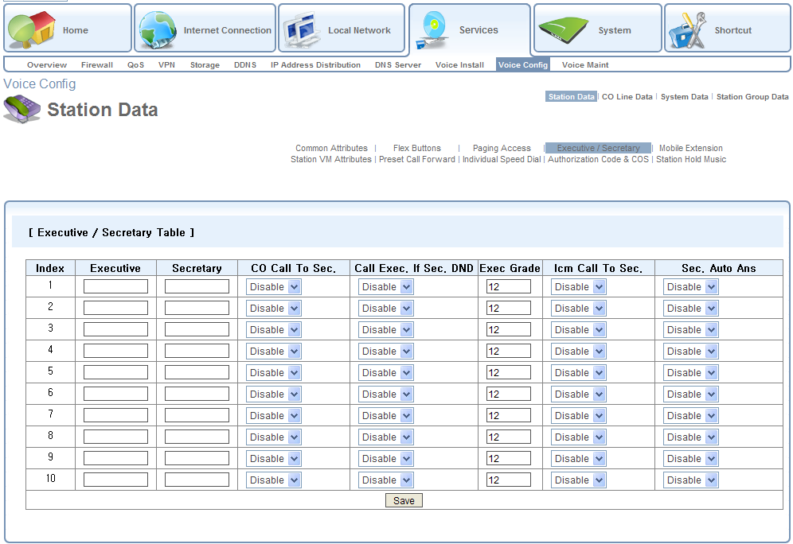
Added Features – II
from 1.0At
Executive / Secretary is added

Slide 30
Fixed
from 1.0At
Ez ATTD
  Ez ATTD interworking bug is fixed.
  Ez ATTD can support SBG-1000 from XC.7Ah version.
PPPoE
  Voice mute using PPPoE WAN interface is fixed.
DB Download
  Only compressed DB can be downloaded for security reason.

Slide 31
SBG-1000 A.0Au
ES R&D) iPECS LIK team
2 Mar 2012

Slide 32
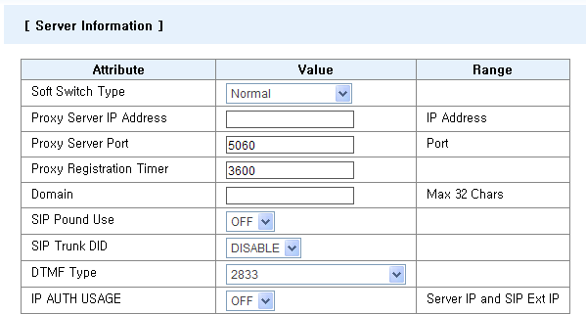
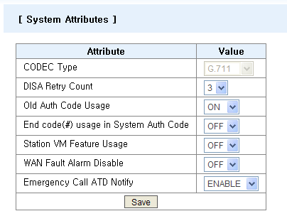
Added Features – I
from A.0Au
Soft Switch Type & IP AUTH USAGE added
Emergency Call ATD Notify added
SBG validated with BroadWorks
Added in order to support Various Servers easily
For Security Enhancement
[NZ-AGT-12021]
If it is set to “DISABLE”,
ATD will not receive Emergency Call Alarm ring.
[NZ-AGT-12021]

Slide 33
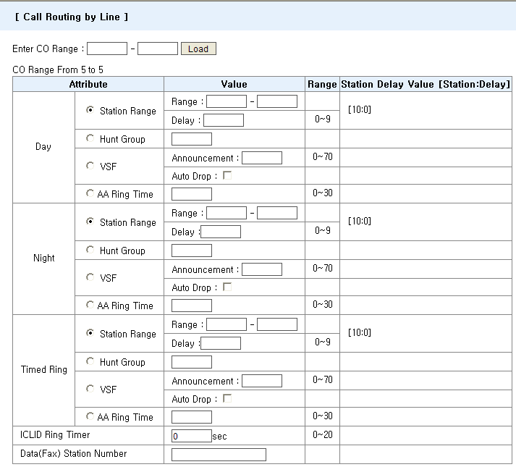
Added Features – II
from A.0Au
Data(Fax) Station Number added
Auto FAX Detection [AU-ARI-11147]
- If it has Station Number,
Incoming call initiates FAX tone detection,
if detected, then specified station will ring to answer.

Slide 34
Fixed IR
from A.0Au
NZ-AGT-12021
  Destination in Call Routing by Auto Attendant was not able to change back to N/A
ZA-MAR-12052
  LWS-WK Flexible button LED did not work correctly
NZ-AGT-12030
  Demo Key includes Capacity expansion. After expired, system should be re-configuration.
  ➔ Capacity will NOT be expanded by Demo Key.

Slide 35
SBG-1000 1.0Au
ES R&D) iPECS LIK team
4 Apr 2012

Slide 36
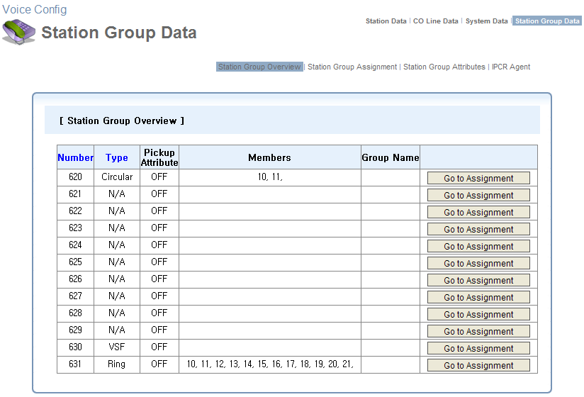
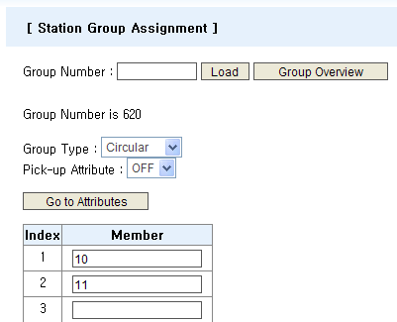
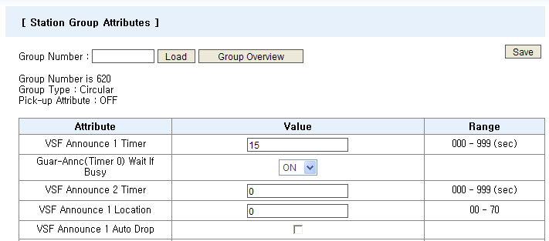
Added Features – I
from 1.0Au
Station Group Jump Buttons added

Slide 37
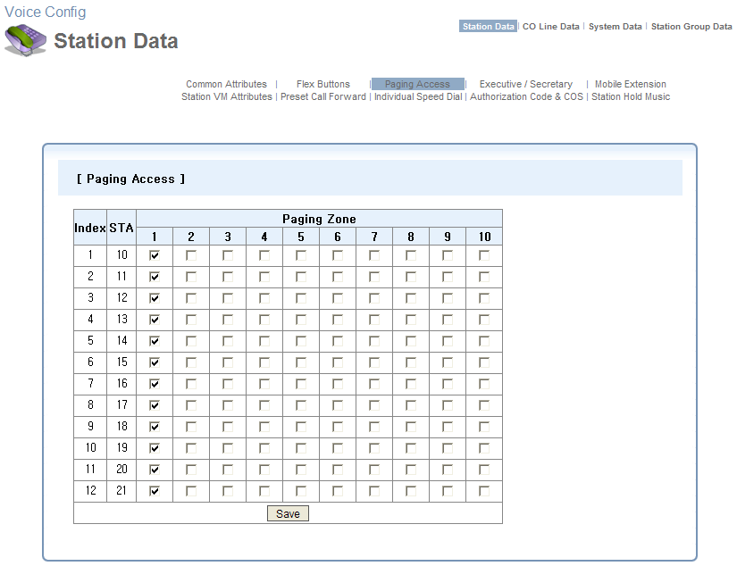
Added Features – II
from 1.0Au
Paging Access of ALL stations in ONE screen

Slide 38
Fixed IR
from 1.0Au
DE-NTP-12019
  Net Station Number type is added in Services > Voice Config > Station Data > Flex Button Assignment menu.

