Slide 1
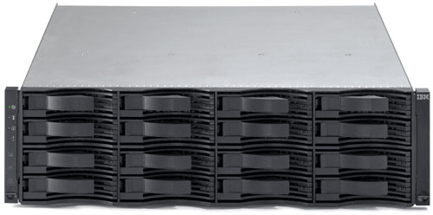
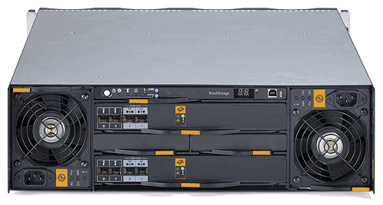
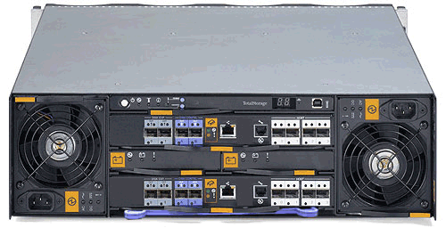
IBM DS6800 Models 1750,EX1,EX2 Training

Slide 2
Instructor :Ian Adams
Profile:
25 Years IBM Systems Experience.
Software and Hardware Skills
IBM Mainframe, Mid-range Systems, Storage systems and tape systems
LAN / WAN / SAN
STK
E-Mail:IanAdams@GMT360.com

Slide 3
Topics

Slide 4
Topics
What is a DS6000
DS6800 Hardware
DS6000 Locations
Service manager
Servicing the DS6000
Code/DFSA
Passwords/IP settings
Powering on/off
Lab

Slide 5
What is a DS6000?

Slide 6
What is a DS6000?
The DS6000 system offers a high-availability, redundant, high-performance storage solution in a space-efficient, modular design. Some of the key hardware features include:
One fibre-channel switch per processor
Dual active controllers that provide continuous operations by using two processors that form a redundant pair to back each other up
73-, 146- and 300-GB fibre-channel drives that can be configured as RAID 5 or 10, or both
Disk drive modules with speeds of 10 000 or 15 000 rpm
A battery-backed mirrored cache
Four GB of cache and the following features shown in orange in the diagrams

Slide 7
Models 1750-511 and 1750-522
The DS6000™ offers the following features:
Two fibre channel processor cards
PowerPC 750GX 1 GHz processor
4 GB of cache
Two battery backup units (one per each processor card)
Two ac/dc power supplies with imbedded enclosure cooling units
Eight 2 Gb/sec device ports
Connectivity with the availability of two to eight fibre-channel/FICON host ports. The host ports autonegotiate to either 2 Gbps or 1 Gbps link speeds.
Attachment to 7 DS6000 expansion enclosures.

Slide 8
Models 1750-EX1 and 1750-EX2
The DS6000™ series expansion enclosure contains the following features:
Two expansion processor cards. Each processor card provides the following:
2 inbound ports (2 Gb/sec.)
2 outbound ports (2 Gb/sec.)
1 fibre-channel switch per processor card
Expansion disk enclosure that holds up to 16 fibre-channel DDMs
Two ac/dc power supplies with imbedded enclosure cooling units
Supports attachment to DS6800

Slide 9
DS6800 Components

Slide 10
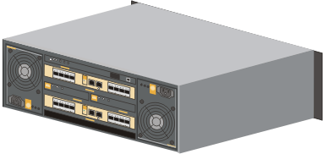
Processor cards
Two fibre-channel processor cards

Slide 11
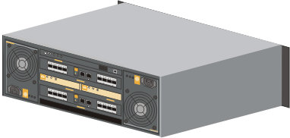
Battery-backup
Two battery-backup units, one for each processor

Slide 12
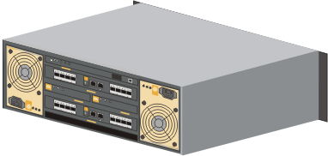
Power supplies
Two fully redundant ac/dc power supplies with enclosure-cooling units

Slide 13
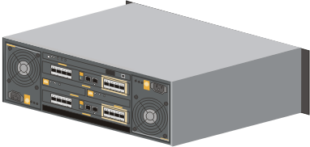
2 Gbps fibre-channel
Two, four or eight 2 Gbps fibre-channel or IBM fibre-channel connection (IBM FICON®) host ports

Slide 14
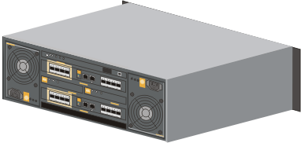
Eight 2 Gbps device ports
Two, four or eight 2 Gbps fibre-channel or IBM fibre-channel connection (IBM FICON®) host ports

Slide 15
Disk enclosure
One disk enclosure that holds up to
16 fibre-channel DDMs

Slide 16
Rear of 511/522
Rear of EXP

Slide 17
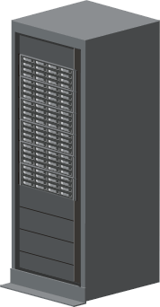
Modular scalability
The DS6000 system integrates the storage capability of a refrigerator-sized machine into a small, lightweight product.
Each enclosure supports up to 16 hard disk drives.
Up to 7 expansion enclosures can be attached to the base controller for a total of 128 disk drive modules
The maximum storage is 4.8 TB for a single enclosure and 38.4 TB for the entire system.

Slide 18
Management console
The management console is a separate computer that is used to configure, service and manage the DS6000.
The DS6000 management software is loaded on the Microsoft® Windows® operating system-based management console with one of the following operating systems:
Microsoft Windows Server 2003 Enterprise Edition
Microsoft Windows Server 2003 Standard Edition
Microsoft Windows 2000 Advanced Server SP4
Microsoft Windows 2000 Server SP4
Microsoft Windows 2000 Professional SP4
Microsoft Windows XP Professional SP2

Slide 19
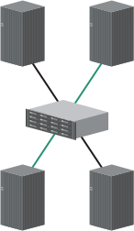
DS6000 host attachments
The DS6000 system provides a variety of host attachments so that you can consolidate storage capacity and workloads for open-systems hosts and IBM System z™ hosts.
It can be configured for fibre-channel adapters, for support of the Fibre-Channel Protocol (FCP) and FICON.

Slide 20
Operating systems
The DS6000 system supports the following operating systems:
Microsoft Windows
Sun Solaris operating environment
IBM z/OS®
IBM AIX®
HP AlphaServer Tru64 UNIX®
HP AlphaServer Open VMS
Linux®
OS X
IBM OS/400®
IBM z/VM®
IBM i5/OS™
VMWare
SGI
It supports both IBM and non-IBM open systems servers such as SGI, Intel®, IBM System p™, Sun, Apple Macintosh and HP, as well as IBM System z and IBM System i™ servers.

Slide 21
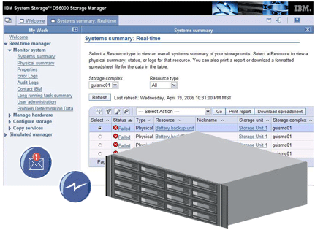
Service features
light path diagnostics, which use indicators to help you identify and replace a failed component without looking at an operator console;
interactive software diagnostics; and Call Home and Remote Support, features that help Service personnel to quickly diagnose and resolve problems

Slide 22
RAID 5
RAID 5 is a method of spreading volume data across multiple disk drives. The DS6000™ series supports RAID 5 arrays.
RAID 5 increases performance by supporting concurrent accesses to the multiple DDMs within each logical volume. Data protection is provided by parity, which is stored throughout the drives in the array. If a drive fails, the data on that drive can be restored using all the other drives in the array along with the parity bits that were created when the data was stored.

Slide 23
Raid 10
RAID 10 provides high availability by combining features of RAID 0 and RAID 1. The DS6000™ series supports RAID 10 arrays.
RAID 0 increases performance by striping volume data across multiple disk drives. RAID 1 provides disk mirroring which duplicates data between two disk drives. By combining the features of RAID 0 and RAID 1, RAID 10 provides a second optimization for fault tolerance.
RAID 10 implementation provides data mirroring from one DDM to another DDM. RAID 10 stripes data across half of the disk drives in the RAID 10 configuration. The other half of the array mirrors the first set of disk drives. Access to data is preserved if one disk in each mirrored pair remains available. In some cases, RAID 10 offers faster data reads and writes than RAID 5 because it does not need to manage parity. However, with half of the DDMs in the group used for data and the other half used to mirror that data, RAID 10 disk groups have less capacity than RAID 5 disk groups

Slide 24
Copy Services features
The DS6000 offers several types of Copy Services features that can help to ensure resiliency and business continuity. These include:
FlashCopy®, for point-in-time copies
Remote mirror and copy, for continuous copies to source and target volumes

Slide 25
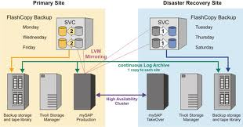
Flash Copy
The Flash Copy feature copies data instantaneously from a source volume to a target volume.
This copy is taken at a particular point in time as hosts continue to access the data.

Slide 26
Remote mirror and copy services
Remote mirror and copy services copies a source volume to a target volume, similar to FlashCopy services.
It differs from FlashCopy services because when using the remote mirror and copy services, your source and target volumes can be located some distance from each other. This allows a backup to be kept at a farther physical location. The other difference is that remote mirror and copy services provides a more consistent copy service by copying all changes that are made on the source volume. FlashCopy creates a single point-in-time copy.
Remote mirror and copy has three different methods of copying:
Metro Mirror, for synchronous remote copies
Global Mirror for asynchronous remote copies and
Global Copy, another option for asynchronous remote copies

Slide 27
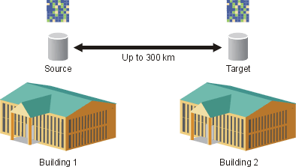
Metro Mirror
Metro Mirror, which is performed at the volume level, provides a continuous, synchronous mirror of a set of data to a different storage system up to 300 km (188 miles) away.
Because the mirror is updated in real time, no data is lost when a failure occurs. Metro Mirror is generally used for disaster-recovery purposes, data protection and data vaulting. It's also used to migrate data from a primary to a secondary system, while the primary system remains active.
Metro Mirror can be implemented when both the source and target are on the same storage area network (SAN) or when they are on separate, remote SANs without having to use channel extenders.

Slide 28

Global Mirror
Like Metro Mirror, Global Mirror provides a continuous mirror of a set of data at the volume level.
But with Global Mirror, the copy is asynchronous, and can support a 3- to 5-second delay between data on the source and target volumes.
This copy service works well for data protection and migration when recovery sites are more than 300 km (188 miles) away

Slide 29
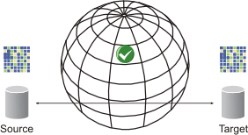
Global Copy
Global Copy is similar to Global Mirror, except that Global Copy supports more than a 30-second delay, so it is generally used for the high-performance, long-distance movement of data.

Slide 30
DS6000 hardware

Slide 31
DS6000 hardware
This section contains overview information for the hardware resources contained within your storage unit.
The following hardware resources are contained within your storage unit:
Disk drive module (DDM)
Front display panel
Rear operator panel
Power supply
Processor card
Battery backup unit
System service card

Slide 32
DS6000 Expansion Models
The DS6000™ series expansion enclosure contains the following features:
Two expansion processor cards. Each processor card provides the following:
2 inbound ports (2 Gb/sec.)
2 outbound ports (2 Gb/sec.)
1 fibre-channel switch per processor card
Expansion disk enclosure that holds up to 16 fibre-channel DDMs
Two ac/dc power supplies with imbedded enclosure cooling units
Supports attachment to DS6800

Slide 33

Disk drive modules
The disk drive modules contain the data for your storage unit.
Disk drive modules (DDMs) are magnetic nonvolatile media that are used to store and manage application and system data. The DDMs are installed in the front of the server or expansion enclosure in a horizontal orientation with the locking handle to the left. DDMs are located in rows and columns on the front of the expansion or server enclosure.
Each server or expansion enclosure must contain a minimum of 4 DDMs. You can install a maximum of 16 DDMs per server or expansion enclosure.
Notes:
Each server or expansion enclosure must contain a minimum of 4 DDMs. You can install a maximum of 16 DDMs per server or expansion enclosure.
You must add DDMs to the storage unit in groups of 4 DDMs of the same type. DDMs must be populated in rows. The first row of 4 DDMs must be placed at the top of the enclosure followed by the second row, then the third and finally, the fourth row. The positions of the DDMs in the storage unit

Slide 34
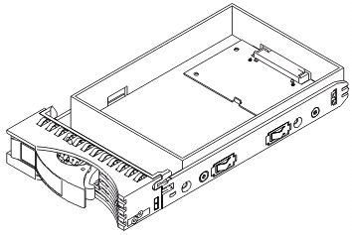
DDM Blank
If you choose to configure your storage unit with fewer than 16 DDMs, you must populate the empty DDM slots with disk drive module blanks to prevent your storage unit from overheating. A drawing of the DDM blank

Slide 35
DDM Indicators
Indicator name colour | Purpose | State descriptions
Ready (green) | Indicates the status of the DDM resource. | Solid: Indicates that both ports are active and that the DDM is idle. Flashing (fast): Indicates that the DDM is processing one or more commands and that both device adapter ports are active. Flashing (slow): Indicates that only one device adapter port is active. Off: The DDM is not receiving power.
Check/identify (amber) | Indicates the fault or identification status of the DDM resource. | Solid: Indicates one of three states: Power on diagnostics are running A fault has been detected The device is in service mode and is ready for removal Flashing (slow): Identifies the DDM as a failing resource. Off: Indicates that there is no fault or no power condition

Slide 36


Front display panel
The front display panel provides information and LED indicators for the storage unit.
The front display panel provides information about the status of the server or expansion enclosure. Each enclosure has a single front display panel that is located on the left of the front of the enclosure
The front display panel contains the power on, location, information, and system alert LED indicators. It also contains fault on rear resource, fault in external enclosure, and data cache on battery indicators

Slide 37


Front display panel
Indicator name (color) | Purpose | State descriptions
Power on (green) | Indicates that power is being delivered to the storage unit. | Solid: The power supply has been activated and is delivering dc output power to the storage unit. Flashing: The power supplies have been deactivated. ac power is present, but dc power output is on standby power only. Off: The storage facility is deactivated, the power supplies are deactivated, and ac power is not present.
System location (blue) | Indicates that the server or expansion enclosure belongs to the specified storage complex. | Solid: The Identify function has been activated and all attached enclosures have illuminated their respective location indicators. Flashing: The Identify function has been activated or deactivated and the attached enclosures are currently turning their respective location indicators on or off. Off: The system is in normal operation and the Identify function has been deactivated

Slide 38


Front display panel
Indicator name (color) | Purpose | State descriptions
System information (amber) | Indicates that an event has occurred for a resource in the storage unit. You must view the logs in the DS Storage Manager to obtain further information about the event. | Solid: An informational event has occurred on a resource in the current enclosure or on a resource that is contained within an attached expansion enclosure. Flashing: The system is initializing and is not yet ready to be accessed by either the management console or host systems. Initialization is complete, and the system is ready for I/O, once the flashing amber light is turned off. Off: No events have occurred or are currently open.
System alert (amber) | Indicates that a fault or error has been detected on the storage complex. | Solid: A fault is present within the storage complex, either in the current enclosure or an attached enclosure. Flashing: The Remind function has been activated but the fault or error has not been corrected. Off: The system is in normal operating condition. Faults have been corrected successfully and no other faults exist.

Slide 39


Front display panel
Indicator name (color) | Purpose | State descriptions
Fault on rear resource (amber) | Indicates that a fault has occurred on a resource located in the rear of the enclosure. | Solid: A fault is present within the enclosure. The fault can be located in the rear of the enclosure and can be repaired through the light path. Flashing: The Remind function has been activated but the fault or error has not been corrected. Off: There are no faulty resources located on the rear of the enclosure that can be repaired through the light path.
Data cache on battery (green) | Indicates the state of the nonvolatile cache. This indicator is only operational for server enclosures. It is not operational for expansion enclosures | Solid: There has been an ac power loss. Any modified data that exists is stored in the cache and is being supported by the battery backup unit. Flashing: The charge state of the battery backup unit has changed. Off: ac power is present and there is no modified data in the cache.

Slide 40

Front display panel
Indicator name (color) | Purpose | State descriptions
Indicates that a fault has occurred on a resource located in the rear of the enclosure. | Indicates that a fault has occurred on a expansion enclosure that is attached to the server enclosure. This indicator is only operational for server enclosures. It is not operational for expansion enclosures. | Solid: A fault exists within an attached expansion enclosure. Flashing: The Remind function has been activated but the fault or error has not been corrected. Off: There are no faults in any of the attached expansion enclosures that can be repaired through the light path.

Slide 41

Rear operator panel
Warning Special service procedures required for change of card!!
The rear operator panel provides informational LED indicators as well as methods to remind and identify resources within your storage unit.
The rear operator panel provides information about the status of the server or expansion enclosure. This panel also provides physical hardware function, such as location and reminder operations. Each enclosure has a single rear operator panel that is located at the top and centre of the rear of the enclosure
The rear operator panel contains the power button, the power on, location, information, and system alert LED indicators. The Remind and Identify function buttons as well as the fault on front resource, fault in external enclosure, and data cache on battery indicators are also located on the rear operator panel. The enclosure identifier indicator, increment button, and the rack identify function connector are located on the right of the rear operator panel.

Slide 42
Rear operator panel
Operator function | Description
Power button | If the storage unit is on standby power, pressing and releasing the power button activates the power-on startup sequence. If the storage unit is in a power-on state, pressing and releasing the power button activates the power-off shutdown sequence. Note: Power-on and power-off operations for expansion enclosures can be managed through the server enclosure
Remind function button | Pressing and releasing this button changes the system alert or system information indicator from a solid to a flashing state. This transition can occur only when the system alert or system information indicators are in a solid state.
Rack identify function connector | This connector allows you the capability to connect the enclosure to the external rack identify hardware.

Slide 43
Rear operator panel
Identify function button | If the system location indicator is off, pressing and releasing this button activates the storage facility identification function. The system location indicator enters a flashing state until all of the system location indicators on the attached expansion enclosures have been illuminated. If the system location indicator is on or flashing, pressing and releasing this button deactivates the storage facility identification function. The system location indicator enters a flashing state or continue flashing until all system location indicators on the attached expansion enclosures have been turned off.
Enclosure identifier indicator (red) | Displays the identification number for the expansion enclosure. The left digit displays the device adapter loop that includes the enclosure. The right digit displays the enclosure fibre-channel arbitrated loop (FC-AL) expansion enclosure address setting. For all enclosures that are contained inside a storage complex, the address setting is accomplished through a programming algorithm and reflected on the LED display. You do not manually set this indicator.
Enclosure address increment button | Press the increment button to set the address for an enclosure

Slide 44
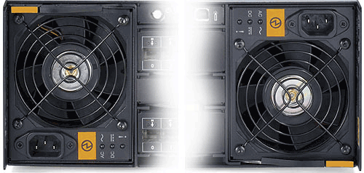
Power supply
The power supplies are the main source of power for your storage unit. They also contain the fans that circulate the air to keep your storage unit cool.
The power supplies are located on the right and left sides of the rear of the enclosure.
The redundant dual ac/dc power supplies in each storage unit provide dc power to the enclosure resources. The power supplies perform the conversion from ac power input to dc power output that is required for the storage unit resources and functions. Each individual power supply has the capacity to independently power the entire server or expansion enclosure.

Slide 45

LED indicators on the power supply
Indicator name (colour) | Purpose | State descriptions
ac power present (green) | Indicates the status of the ac line cord power to the power supply. | Solid: ac power is available to the power supply. Off: ac power is not available to the power supply.
dc power present (green) | Indicates the status of the dc power being output from the power supply to the storage unit. | Solid: The +12 V dc, +5 V dc and +3.3 V dc (standby) power outputs are available. Flashing: dc standby (+3.3 V dc) power output is available. +12 V and +5 V power outputs are not available. Off: dc power output is not available.
Service/fault (amber) | Indicates fault conditions that have been detected within the power supply. | Solid: A fault condition has been detected and this resource requires service. Flashing: The resource has been identified by system management. Off: No known faults exist. This is the default state for this indicator.

Slide 46


Processor cards
Warning Special service procedures required for change of card!!
Processor cards perform the operations required to manage the resources and data for the expansion or server enclosure.
The processor cards are located in the rear of the enclosure. One of the cards is below the rear operator panel and above the battery backup units. The other card is located below the battery backup units and above the system service card.
The server enclosure and expansion enclosure processor cards provide control and management functions for the storage unit. Each processor card is capable of providing control and management for the entire server or expansion enclosure. For a dual processor card design, a single processor card can control the entire enclosure in the event of a processor card failure.
Server Card
Expansion Card

Slide 47
Processor cards
There are two types of processor cards. The server enclosure processor card, shown in Figure 1, can be installed in the server enclosure. It contains two disk expansion ports, two disk controller ports, power on and system alert LED indicators, an Ethernet connection port, one RJ-12 serial connection port and four host SFP ports. Figure 1. Server enclosure processor card
Figure 1
The expansion enclosure processor card, shown in Figure 2, can be installed in the expansion enclosure. It contains two disk expansion ports, two disk controller ports, power on and system alert LED indicators, and an RJ-12 serial connection port
Figure 2

Slide 48
Processor cards LED indicators
Indicator name (colour) | Purpose | State descriptions
Power on (green) | Indicates the state of the DC power available to the processor card | Solid: DC power is being delivered to the processor card Flashing: Main DC power is not present. +3.3 volt standby power is available to the processor card. Off: DC input power is not present in any form.
Service/fault (amber) | Indicates that a fault condition has been detected within the processor card | Solid: A fault condition has been detected and this processor card requires service. Flashing: This processor card has been identified by system management. Off: No known faults exist. This is the default state for this indicator
Disk controller port SFPs | Indicate the state of the disk controller port. | The disk controller SFP ports have the following LED indicators: Device port activity indicator (green, top left) Device port activity indicator (amber, top right)

Slide 49
Processor cards LED indicators
Indicator name (colour) | Purpose | State descriptions
Host port SFPs | Indicate the state of the host port. This indicator is available only on the server enclosure processor card. | The host SFP ports have the following three LED indicators: Host port activity indicator (green, top left) Host port activity indicator (green, bottom left) Service/fault indicator (amber, top right). The service/fault indicator can have the following three states: Solid: A fault condition has been detected on the host SFP port. Flashing: A fault condition has been detected and this host SFP port requires service. Off: No known faults exist. The host SFP port is operating normally.
Storage disk expansion port SFPs | Indicate the state of the storage disk expansion ports | The storage disk expansion SFP port have the following LED indicators: Device port activity indicator (green, top left) Device port activity indicator (amber, top right)

Slide 50

Battery backup unit
Battery backup units (BBUs) provide protection against data loss in the event of a power failure. The storage unit includes a redundant battery backup unit for each ac/dc power supply. Each BBU is charged by the associated power supply.
The battery backup unit can provide enough backup power to preserve data integrity for up to 72 hours without power. The battery does not back up the memory if all nonvolatile data has already been moved to disk storage

Slide 51
DS6000 location codes

Slide 52
DS6000 location codes
The front display panel is identified through the E20 resource location code. For example, U1750511.12ABC3D-P1-E20
The disk drive modules (DDMs) are identified through the Dn resource location code, where n is the assigned location for the specific DDM. DDMs are numbered 1 through 16, starting from the top left, moving right across the row and continue from the left side of the next row. shows the numbered DDMs. For example, U1750511.12ABC3D-P1-D1 through U1750511.12ABC3D-P1-D16.
The rear operator panel is identified through the C1 resource location code. For example, U1750511.12ABC3D-P1-C1

Slide 53
DS6000 location codes
The left-side power supply is identified through the E1 resource location code. For example, U1750511.12ABC3D-E1
The right-side power supply is identified through the E2 resource location code. For example, U1750511.12ABC3D-E2
The upper processor card is identified through the C2 resource location code. For example, U1750511.12ABC3D-P1-C2
The lower processor card is identified through the C4 resource location code. For example, U1750511.12ABC3D-P1-C
The left-side battery backup unit is identified through the E10 resource location code. For example, U1750511.12ABC3D-E10
The right-side battery backup unit is identified through the E11 resource location code. For example, U1750511.12ABC3D-E11

Slide 54
DS6000 location codes
The following examples show two different resource location codes:
U1750511.12ABC3D-E1 : This shows a resource location code for the left power supply that is located on the server enclosure with the 1750 machine type, 511 model number, and 12ABC3D serial number.
U1750EX1.45EFG6H-P1-D7 : This shows a resource location code for the seventh DDM that is located on the expansion enclosure with the 1750 machine type, EX1 model number, and 45EFG6H serial number.

Slide 55
Processor card port location codes
The ports on the server enclosure processor card are identified by adding another suffix to the resource location code for the specific processor card.
The disk expansion ports are located on the left side of the server enclosure processor card. They are identified through the Cx-Ty location code, where x is the location code for either the upper or lower processor card and y is the location code (from 10 to 13) for the specific disk expansion port on that card. For example, U1750511.12ABC3D-P1-C2-T11 is the second disk expansion port from the left on the upper processor card, and U1750511.12ABC3D-P1-C4-T13 is the fourth disk expansion port from the left on the lower processor card.
The Ethernet port is located to the right of the disk expansion ports on the server enclosure processor card. It is identified through the Cx-T20 location code, where x is the location code for either the upper or lower processor card. For example, U1750511.12ABC3D-P1-C4-T20 is the Ethernet port on the lower processor card.
The host attachment ports are located on the right side of the server enclosure processor card. They are identified through the Cx-Ty location code, where x is the location code for either the upper or lower processor card and y is the location code (from 0 to 3) for the specific host attachment port on that card. For example, U1750511.12ABC3D-P1-C2-T1 is the third host attachment port from the right on the upper processor card, and U1750511.12ABC3D-P1-C4-T3 is the first host attachment port from the right on the lower processor card.

Slide 56

Processor card port location codes
First disk expansion port from the left (left DISK EXP. OUT port): U1750511.12ABC3D-P1-C2-T10
Second disk expansion port from the left (right DISK EXP. OUT port): U1750511.12ABC3D-P1-C2-T11
Third disk expansion port from the left (left DISK CONTRL OUT port): U1750511.12ABC3D-P1-C2-T12
Fourth disk expansion port from the left (right DISK CONTRL OUT port): U1750511.12ABC3D-P1-C2-T13
Ethernet (network) port: U1750511.12ABC3D-P1-C2-T20
Fourth host attachment port from the right: U1750511.12ABC3D-P1-C2-T0
Third host attachment port from the right: U1750511.12ABC3D-P1-C2-T1
Second host attachment port from the right: U1750511.12ABC3D-P1-C2-T2
First host attachment port from the right: U1750511.12ABC3D-P1-C2-T3

Slide 57
Expansion processor card port location codes
The ports on the expansion enclosure processor card are identified by adding another suffix to the resource location code for the specific processor card.
The disk expansion ports are located on the left side of the expansion enclosure processor card. They are identified through the Cx-Ty location code, where x is the location code for either the upper or lower processor card and y is the location code (from 10 to 13) for the specific disk expansion port on that card. For example, U1750EX1.12ABC3D-P1-C2-T11 is the second disk expansion port from the left on the upper processor card, and U1750Ex1.12ABC3D-P1-C4-T13 is the fourth disk expansion port from the left on the lower processor card.

Slide 58

Expansion processor card port location codes
First disk expansion port from the left (left IN port): U1750EX1.12ABC3D-P1-C2-T10
Second disk expansion port from the left (right IN port): U1750EX1.12ABC3D-P1-C2-T11
Third disk expansion port from the left (left OUT port): U1750EX1.12ABC3D-P1-C2-T12
Fourth disk expansion port from the left (right OUT port): U1750EX1.12ABC3D-P1-C2-T13

Slide 59
Storage Manger

Slide 60
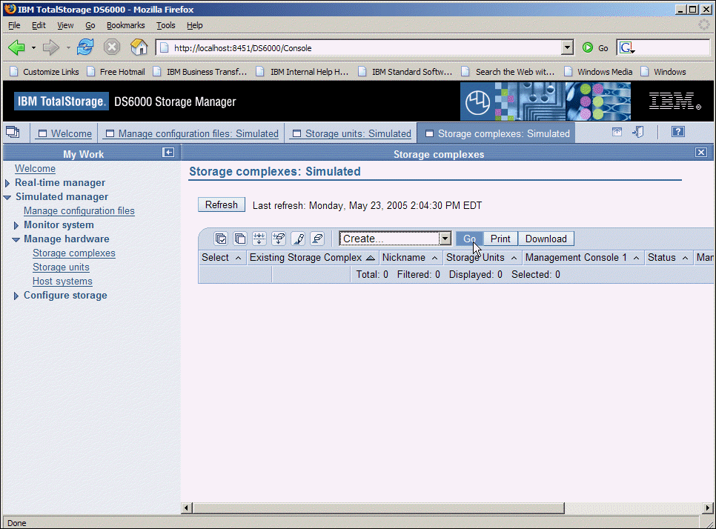
Storage Manger
From the DS Storage Manager, you can manage your configuration files, monitor your system, manage your hardware, configure your storage, and manage Copy Services
The DS Storage Manager can be accessed from any location that has network access using a Web browser

Slide 61
Storage Manger
Under Monitor system, you can: review system summaries
review physical summaries
review long running task summaries
review properties
review logs
find IBM contact information
create and modify user accounts
Under Manage hardware, you can manage: storage complexes
storage units
host systems
Under Configure storage, you can configure:
arrays ranks
extent pools
open-systems volumes
zSeries volumes
Under Copy Services, you can manage:
FlashCopy
Paths
Metro Mirror
Global Mirror

Slide 62
Servicing the DS6000

Slide 63
Servicing the DS6000
Concurrent FRUS
Special procedures FRU’s!
Following a light path to perform unguided service
Performing a guided service through the problem log
Viewing logs
Removing the disk drive module
Removing the front display panel
Removing the power supply
Removing the rear operator panel
Removing the battery backup unit
Removing the processor card
Removing fiber optic cables and SFPs

Slide 64
Concurrent FRUS
Power Supply’s Hot Swap
Disk Hot Swap Note must be same size disk and speed
Front Display Hot Swap
Battery Backup Hot Swap
Fiber optic cables and SFPs Hot Swap

Slide 65
Special procedures FRU’s!
Processor card: The processor cards carries the configurations of the disk array and the configuration of EXP 1 or 2. If a second user processor card is used it will in some case over write the current config of the system and lose customer data! The option are buy new from IBM at $17.500 or if required GMT360 can provide a replacement card at $2000
Rear operator panel: This card can only be replaced with a new IBM cadr as once installed in a system it is writing too by the processor card with the unique ID of system and cannot be changed by IBM or GMT360.These cards rarely fail.

Slide 66
light path to perform unguided service procedure
You can use these steps to follow LED indicators from the beginning to the end of a service action. You do not need to access the DS Storage Manager to replace a resource that has a solid amber error light.
Find the amber system alert light on the front display panel of the server enclosure.
Determine where the fault is located and perform one of the following actions:
If the fault on opposite side indicator is lit on the front display panel, move to the rear of the server.
If the fault in external enclosure indicator is lit on the front display panel, use the location indicators and the Identify button on the rear operator panel to find the enclosure that is connected to the server with a solid amber system alert light.
If the system alert indicator is lit and no other lights or indicators are lit on the front display panel, the fault is on a resource that is found on the front of the enclosure. Continue to next step .

Slide 67
light path to perform unguided service procedure
Find the resource with a solid amber error indicator.
Remove the resource. Attention: Review the remove and replace procedures for a resource before removing it. You must replace some resources within a specific time limit. In some cases, if you remove a resource without immediately replacing it, you must place a blank version of the resource in the empty slot to prevent overheating of the storage unit.
Replace the resource. The system automatically senses the new resource and begins the procedure to resume normal operation for that resource.
Determine if you need to perform further repair actions.
If the system alert indicator is no longer lit, you have successfully replaced all required resources. The error entry in the system log closes and the storage unit resumes normal operation. You do not need to take any further action.
If, after you replace the resource, the system alert indicator is still lit, you must replace another resource. Repeat these steps to identify and replace the next resource.

Slide 68
Performing guided service
Complete this task to locate and repair a resource using the log entries in the DS Storage Manager.
Before you begin, you must review the effects of performing a service action on the resource you are going to repair.
Perform the following steps to service a storage unit using the information found in the Logs pages of the DS Storage Manager.
In the navigation, select Real-time manager > Monitor system > Logs.
The initial log entry table displays new error or informational entries from the preceding 25 hours. If you want to view an entry for an event that occurred longer than 25 hours ago, you must select the appropriate storage unit information to filter the table.
Select the error entry for which you want to complete service.
Select View details, Go, to view more specific log entry information
Find and select the first resource in the list of affected resources. If more than one resource must be replaced, the resources are listed in the order in which they must be replaced. Replace the first resource in the list before the others. Next, replace the second resource in the list. Follow this method until all required resources have been replaced.

Slide 69
Performing guided service
Order a replacement resource, if necessary.
Select Take resource offline to begin to quiesce the resource. Attention: Review the remove and replace procedures for a resource before quiescing and removing it. You must replace some resources within a specific time limit. In some cases, if you remove a resource without immediately replacing it, you must place a blank version of the resource in the empty slot to prevent overheating of the storage unit.
Find the appropriate resource in the storage unit.
Wait for the solid amber alert light to come on.
Remove the resource.
Replace the resource. The resource will automatically begin the procedure to resume operation.
Review the Logs page to determine if the log entry has closed or if you need to perform additional actions.
Note: If you take a hardware resource offline and decide not to remove it from the enclosure, you must bring the resource online through the DS Storage Manager before it can resume operation

Slide 70
Viewing logs
Complete this task to view error and informational log entries for your storage unit.
In the navigation, select Real-time manager > Monitor system > Logs. The log entry table initially shows all log entries, informational or error, generated in the preceding 25 hours. If the entry that you are looking for is contained within the initial table, you do not need to choose sorting criteria.
Choose the storage complex that you want to view log entries for.
Choose the storage unit that you want to view log entries for.
Choose the level of severity that you want to view log entries for. The table defaults to show log entries for all severity levels.
Choose the status that you want to view log entries for. The table defaults to show log entries for all status levels.
Select to view all log entries or a range of log entries. If you choose to view a range of log entries. Perform the following steps:
Indicate the beginning date and time for the range of log entries.
Indicate the finishing date and time for the range of log entries.
Click Refresh to obtain the most up-to-date information in the table.
View the informational and error log entries shown in the table.
Click on the Message ID to view the log entry details for the specific log entry. You can perform maintenance actions or view maintenance information for the resources that are associated with the log entry on the log entry details page.
You can also view the details for a log entry by selecting View details from the Select Action drop-down list and clicking Go

Slide 71
Removing the disk drive module
Review the installation requirements in the disk drive module (DDM) installation procedure before you remove a DDM from an enclosure. You must be able to meet specific requirements before you begin the replacement procedure. For example, you must have a replacement DDM available at the correct temperature to replace the DDM that you are removing.
Removing and replacing a disk drive module (DDM) might result in the following effects: Removing a DDM that does not have the error indicator lit might cause a lengthy rebuild operation. The risk of losing data is increased during this rebuild operation.
You might need to rebuild your array.
If more than one disk drive module is faulty or missing, you will lose the data on that array.
Important: When replacing DDMs in an enclosure, care should be taken to ensure that all resources from a particular server enclosure or expansion enclosure are reinstalled into the same physical enclosure and in the same location inside that enclosure.

Slide 72
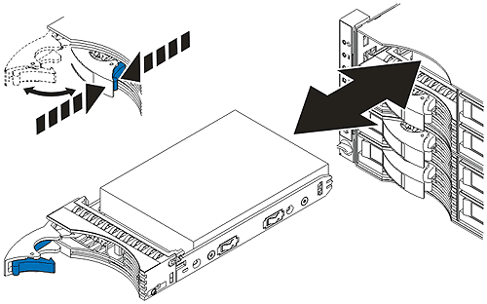
Removing the disk drive module
Always handle a defective disk drive module carefully. Damage to defective disk drive modules can have a negative effect on failure analysis test results and warranty recovery.
Press the blue latch to release the disk drive module handle and pull the handle out and to your left. This action partially ejects the disk drive module out of its slot. Wait 30 seconds for the disk drive to spin down.
Grip the disk drive module with both hands to pull it toward you and completely out of the slot. Ensure that the disk drive is properly aligned in a horizontal position until the drive is clear of the enclosure. Failure to do so can result in physical damage to the drive or the drive component.
These images show a disk drive module removal procedure

Slide 73
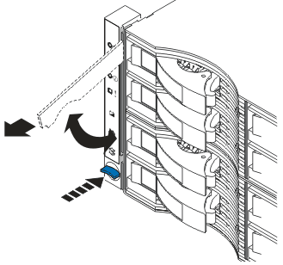
Removing the front display panel
System alerts and LED indicators cannot display properly while the front display panel is removed or nonfunctional.
To remove the front panel display, perform the following steps:
Press the blue release button. This releases the handle.
Pull the handle up. This action partially ejects the bottom of the display panel.
Use the handle to pull the bottom of the panel up and release the top portion of the panel. This completely removes the display panel.
This image show a front display panel removal procedure.

Slide 74
Removing the power supply
Attention: You must have a replacement resource unpacked and ready to insert into the expansion enclosure before you remove the existing power supply. The power supply must be replaced within three minutes to prevent possible loss of access to data.
Before you remove the power supply, the error indicator on the resource must be lit, unless the power supply is no longer receiving power.
Removing and replacing a power supply might result in the following effects: Overheating has the potential to shut down the storage unit.
Access to data is lost if both power supplies are faulty or missing.
If the second power supply fails and the first power supply is not present in the enclosure, the enclosure loses power and you will lose access to all data.
If you are replacing the power supply in the server enclosure and the second power supply fails, the server enclosure and all attached expansion enclosures lose power and you will lose access to all data within those enclosures.

Slide 75
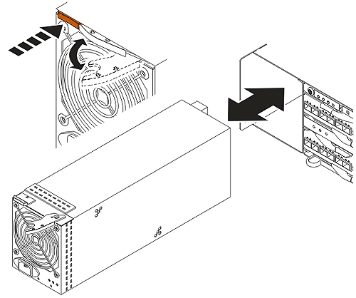
Removing the power supply
Detach the power cable from the power supply.
Press the release button. This releases the handle.
Pull the handle out and towards the middle of the enclosure. This action partially ejects the power supply from the slot.
Use the handle to pull the power supply partially out of the slot.
Grip the power supply with both hands to pull the unit completely from the slot.
These images show a power supply removal procedure.

Slide 76
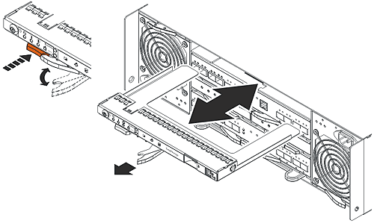
Removing the rear operator panel
Removing and replacing a rear operator panel might result in the following effects: System alerts and LED indicators cannot display properly while the rear operator panel is removed or nonfunctional.
Power-cycling without the rear operator panel will cause an enclosure to have a default serial number that no longer applies to the enclosure.
Press the orange release button. This releases the handle.
Pull the handle out and to the right. This action partially ejects the display panel from the slot.
Use the handle to pull the rear display panel partially from the slot.
Grip the rear display panel with both hands to pull the unit completely from the slot.
These images show a rear display panel removal procedure.

Slide 77
Removing the battery backup unit
You must wait a minimum of 45 minutes after the initial failure, as recorded in the Log details page, before replacing the battery backup unit. You must also ensure that the error indicator is lit on the resource and have a replacement battery backup unit ready for replacement.
Removing and replacing a battery backup unit might result in the following effects: While a battery backup unit is out of the enclosure slot, the enclosure is more susceptible to single point of failure errors.
Removing a battery backup unit that does not have a lit error indicator results in a processor card failover.
Removing the battery backup unit might result in loss of access to improperly configured host systems.
Removing a battery backup unit without immediate replacement by either another battery backup unit or a battery backup unit blank might result in the overheating of the enclosure.
The storage unit might experience performance degradation while a battery backup unit is missing from its slot.

Slide 78
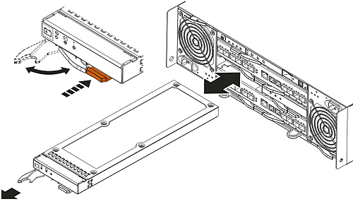
Removing the battery backup unit
Press the orange release button. This releases the handle.
Pull the handle out and to the left. This partially ejects the battery backup unit from the slot.
Use the handle to pull the battery backup unit partially out of the slot.
Grip the battery backup unit with both hands to pull it completely from the slot.
These images show a battery backup unit removal procedure.

Slide 79
Removing the processor card
Before you remove the processor card, you must ensure that the error indicator is lit. If the error light is not lit on the processor card, you must first go to the DS Storage Manager and take the processor card offline. You must also ensure that you have a replacement processor card.
Removing and replacing a processor card might result in the following effects: Removing a processor card that does not have a solid amber error indicator lit causes performance degradation and loss of access to data. Note: Removing a processor card that has a solid amber error indicator does not have any effect on the operation of the storage unit.
Removing a processor card will cause loss of access to host systems if multiple paths from the storage unit to the hosts are not configured.
For these reasons, you must remove and replace only one processor card at a time. The processor card that stays in the enclosure retains the configuration settings and transfers the configuration information to the new processor card once you replace it in the enclosure. The time that is required to transfer the configuration settings depends on network connectivity, I/O traffic, and other factors.
After you remove the processor card from the enclosure, wait a minimum of 2 minutes before you replace the card.
After card replacement you may have to wait over to 2 hours for card to come back on line!

Slide 80
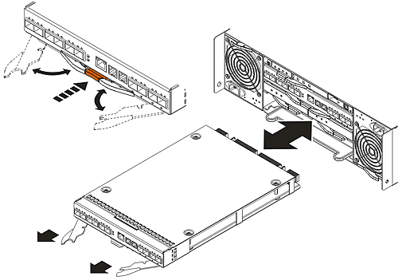
Removing the processor card
Press the orange release button. This releases both handles.
Grip both handles, one with each hand.
Pull both handles out and towards the outside of the enclosure. The right handle pulls out and to the right of the enclosure. The left handle pulls out and to the left of the enclosure. This partially ejects the processor card from the slot.
Use the handles to pull the processor card partially out of the slot.
Grip the processor card with both hands to pull the resource completely from the slot.
These images show a processor card removal procedure.

Slide 81
Removing fiber optic cables and SFPs
Removing and replacing cables and SFPs might result in the following effects: Disconnecting a host cable might result in loss of access to data if multiple paths from the host to the storage unit have not been configured.
Disconnecting an Ethernet cable might result in loss of the ability to query and configure the storage unit.
Disconnecting a cable between enclosures might result in loss of access to the data in all of the subsequently attached storage enclosures.
The fiber optic ports are located on the processor card in the server enclosure.
Remove the fiber optic cable from the SFP module.
Replace the protective caps on the fiber optic cable.
For SFP modules with a plastic tab, pull the plastic tab outward at a 10° angle to release the SFP module latch. For SFP modules with a wire tab, pull the wire tab outward at a 90° angle to release the SFP module latch.
Grasp the main portion of the SFP module and pull it from the SFP module port. Do not grasp the wire or plastic tab. This might damage the SFP module.
Replace the protective cap on the SFP module.
Replace the protective cap on the SFP module port.

Slide 82
Code/DFSA

Slide 83
Code/DFSA
Verifying the current code level
Upgrading the DS6000 code level
Licensing on the DS6000
Licensed functions
Locating the serial number, model, and signature
Obtaining activation codes

Slide 84
Verifying the current code level
Complete this task to verify the current level of code on your DS6000™.
In the navigation, select Real-time manager > Manage hardware > Storage units. On the Storage units - Main Page, select the appropriate storage unit.
From the Select Action list, select Apply firmware update, and then click Go. The Apply firmware update page is displayed.
Locate the Current firmware level row in the table to view your current level of code.
Compare your current code level with the latest available code level. Follow the instructions for upgrading your code level to find the latest available code level.

Slide 85
Upgrading the DS6000 code level
Perform the following steps for each storage unit that is connected to the DS Storage Manager.
Check for firmware updates. Follow the instructions in Checking for code updates (real-time only). If you are not required to upgrade your code, stop here.
To upgrade the code successfully, before you proceed with the code upgrade you must ensure that no alert LEDs are illuminated and that there are no open problems in the problem logs. Correct any problems before you proceed with the firmware upgrade. You can correct problems by performing the steps in either Following a light path to perform unguided service or Performing guided service through the problem log.
Obtain the downloadable files from the DS6000 support Web site. Follow the instructions in Downloading code updates.
Install the code update on your storage unit. Follow the instructions in Installing code upgrades (real-time only). You must perform this step for each storage unit that is managed by your DS Storage Manager before you proceed to the next step.

Slide 86
Upgrading the DS6000 code level
Upgrade the DS Storage Manager. Begin the installation of the new DS Storage Manager by completing one of the following sets of steps:
If you are installing from the ZIP file bundle, follow these steps:
Extract the DS Storage Manager ZIP folder that is located in the file path where you extracted the ZIP file bundle information.
Navigate to the folder that you just extracted and run setup.exe. You can perform the upgrade using either the graphical mode or silent mode. See Upgrading the DS Storage Manager on a Windows operating system using the graphical mode or Upgrading the DS Storage Manager on the Windows operating system using unattended (silent) mode for the steps. When the installation is complete, a prompt to restart might be displayed. If possible, do not restart at this time. You will perform a restart after you install the DS CLI upgrade.
lluminated and that there are no open problems in the problem logs. Correct any problems. You can correct problems by performing the steps in either Following a light path to perform unguided service or Performing guided service through the problem log.

Slide 87
Upgrading the DS6000 code level
If you are installing from the ISO image that you used to create an installation CD, insert the CD and navigate to the DS Storage Manager installation files and run setup.exe. You can perform the upgrade using either the graphical mode or silent mode. See Upgrading the DS Storage Manager on a Windows operating system using the graphical mode or Upgrading the DS Storage Manager on the Windows operating system using unattended (silent) mode for the steps. When the installation is complete, a prompt to restart might be displayed. If possible, do not restart at this time. You will perform a restart after you install the DS CLI upgrade.
Perform the following steps to upgrade the DS CLI:
Begin the installation of the new DS CLI by completing one of the following sets of steps: If you are installing from the ZIP file bundle, follow these steps:
Extract the DS CLI ZIP folder that is located in the file path where you extracted the ZIP file bundle information.
Navigate to the folder that you just extracted. To install using graphical mode, run the file setupwin32.exe. To install using console mode, run the file setupwin32console.exe.
If you are installing from the ISO image that you used to create an installation CD, insert the CD and navigate to the DS CLI installation files. To install using graphical mode, run the file setupwin32.exe.
To install using console mode, run the file setupwin32console.exe.
Follow the instructions for upgrading the DS CLI. See Installing the DS CLI application using the graphical mode or Installing the DS CLI using the console mode to perform the upgrade using either the graphical mode or console mode.

Slide 88
Upgrading the DS6000 code level
If you have not already done so, restart your management console.
After the DS Storage Manager is installed, use Storage units — Main page to verify that you can view the status of the storage complex and its associated logical configuration. In the navigation, select Real-time manager > Manage hardware > Storage units. On the Storage units - Main Page, select the appropriate storage unit.
Ensure that no alert LEDs are illuminated and that there are no open problems in the problem logs. Correct any problems. You can correct problems by performing the steps in either Following a light path to perform unguided service or Performing guided service through the problem log.

Slide 89
Licensing on the DS6000
The DS6000™ is licensed at the following levels:
Machine licensing uses licensed machine code (LMC) to license the base models and expansion models. When you receive a base or expansion model, you receive an LMC agreement. The use of the machine constitutes acceptance of the license terms outlined in the LMC agreement.
Operating environment licensing manages the machine operating environment. An operating environment license (OEL) is required on every DS6000 base unit . The licensing must cover the physical capacity of the base unit and all attached expansion 4 units, excluding inactivated Standby CoD capacity.
Function licensing controls the Copy Services and parallel access volume licenses. Function licensing depends on the type of data (count key data or fixed block data) that is used with the function.

Slide 90
Licensed functions
Machine licensing uses licensed machine code to activate base functions on your machine. When you receive a DS6800 and/or DS6000 expansion enclosure, you receive an licensed machine code agreement. The use of the machine constitutes acceptance of the license terms outlined in the licensed machine code agreement. The DS6800 system requires licensed machine code level 5.0.0, or later. Some DS6000 series features and functions may not be available or supported in all environments. Current information on supported environments, prerequisites, and minimum operating systems levels is available at: http://www.ibm.com/servers/storage/disk/ds6000/
Operating environment licensing manages the machine operating environment and is required on every DS6800 system. The extent of IBM authorization acquired through the DS6800 feature numbers (50xx) must cover the physical capacity of the DS6800 system, where system is defined as the base enclosure and all attached expansion enclosures. If the operating environment license has not been acquired and activated on the machine, disk drives installed within the DS6800 system cannot be logically configured for use. Upon activation, disk drives can be logically configured up to the extent of authorization.
As additional disk drives are installed, the extent of IBM authorization must be increased by acquiring additional DS6800 feature numbers (5xxx). Otherwise, the additional disk drives cannot be logically configured for use.
Feature licensing controls the licenses of features of each DS6800. Each DS6800 licensed function feature number enables the use of, and establishes the extent of, IBM authorization for licensed functions that are acquired for a DS6800 system. Each licensed function feature number is applicable only for the specific DS6800 (by serial number) for which it was acquired and is not transferable to another serial numbered DS6800.

Slide 91
Locating the serial number, model, and signature
To locate the serial number, model, and signature, perform the following steps:
Locate the MTMS label on the flange on the front right side of the enclosure at the right front bezel. The MTMS label is a black label with white lettering.
From the MTMS label, record the model and serial number in the table below. The Machine Type - Model Number - Serial Number (MTMS) is a string that contains the machine type, model number, and serial number. Only the last seven characters of the string are the machine serial number. For example, if the MTMS is IBM.1750.511.75FA120, then the machine type is 1750, the model is 511, and the serial number is 75FA120.
Start the DS Storage Manager application.
In the navigation panel select, Real-time Manager > Manage Hardware > Storage Units. On the storage unit main page, select the storage unit, click Properties in the Select Action list, and then click Go. The properties page displays for the storage unit.
From the Machine signature column, note the machine signature in the table below.

Slide 92
Obtaining activation codes
The machine serial number, model, and signature. See Locating the serial number, model, and signature for more information.
To obtain your activation codes, perform the following steps:
At a computer with an Internet connection and a browser, connect to the IBM Disk Storage Feature Activation (DSFA) Web site at http://www.ibm.com/storage/dsfa.
The DSFA application displays in the browser. Use the application to obtain the activation codes and follow the instructions on the screen. Note: In most situations, the DSFA application can locate your order confirmation code when you enter the DS6000™ (1750) serial number and signature. However, if the order confirmation code is not attached to the 1750 record, you must assign it to the 1750 record in the DSFA application. In this situation, you will need the order confirmation code (which you can find on the License Function Authorization document).

Slide 93
Passwords/IP settings

Slide 94
Passwords/IP settings
Unlocking an administrative password
Setting the IP address

Slide 95
Unlocking an administrative password
There might be times when administrative users forget the password that they use to access the DS Storage Manager. Beyond the set number of allowable attempts with the wrong password, the account is locked. If the administrative account is locked, the administrator must use the security recovery utility tool to reset the password to the default (administrative). You cannot unlock an administrative password using the DS Command-Line Interface. The administrative user is forced to establish a new password. Using the chuser command, you can specify a password that expires after the initial use, and then create a new password. See DS CLI documentation for more information
This task only explains how to use the security recovery utility tool to unlock the administrative account. The topic "Unlocking a user account" describes how to unlock a non-administrative user account.
The security recovery utility tool is a script that is installed in a file directory. You run the script from the directory.
Open a command prompt and navigate to the C:\Program Files\IBM\dsniserver\bin\ directory where the recovery tool (script) has been installed.
Type the script name, securityRecoveryUtility.bat -r
Press the Enter key. The script runs and the administrative account is unlocked. The password is reset to the default (admin).

Slide 96
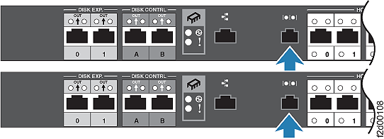
Setting the IP address
You can create a direct connection from your computer to either of the processor cards on the DS6000™. You can use the direct connection to set IP addresses, network masks, gateway IP addresses, and other network settings for one or both of the processor cards. To set the IP address, perform the following steps:
Use the serial conversion cable that was shipped with the enclosure to attach your computer to the serial port on the enclosure.

Slide 97
Setting the IP address
Use a terminal emulator, such as NetTerm or Windows® HyperTerminal to connect to the server enclosure through the serial port that is located on the processor card. If you are using Windows HyperTerminal, you might need to provide a connection name and icon before you can specify the connection settings. Choose a communications port, such as COM1 or COM3, and connect to the processor card using the following settings:
Remote connection setting :Remote connection value Bits per second 38400,Data bits 8 ,Parity None, Stop bits 1, Flow control Hardware
Use the default user ID guest and the default password guest to access the processor card. Press Enter to get the command prompt.
If this is your first time setting the IP address, change the default guest password to one that you select.
Select Change 'guest' password from the Main Menu options.
Enter the current password. This is guest if you are changing it for the first time.
Enter the new password that you have chosen. You will receive a message stating that the password has been changed successfully. Passwords must meet the following criteria: Be six to 16 characters long.
Must contain five or more letters, and it must begin and end with a letter.
Must contain one or more numbers.
Cannot contain the user's user ID.
Is case-sensitive.
Four unique new passwords must be issued before an old password can be reused.

Slide 98
Setting the IP address
Select Configure network parameters from the Main Menu options.
Select Use static IP addresses from the Network configuration menu options. Set the IP addresses and network masks for both processor cards by performing the following steps:
Change the IP address for the processor card to which you are connected. Select IP address for this node from the Static IP addresses configuration menu options, enter the new IP address for the current processor card, and press Enter.
Change the IP address for the other processor card. Select IP address for other node from the Static IP addresses configuration menu options, enter the new IP address for the other processor card, and press Enter.
Change the network mask for the processor card to which you are connected. Choose Network mask for this node from the Static IP addresses configuration menu options, enter the new network mask for the current processor card, and press Enter.
Change the network mask for the other processor card. Choose Network mask for other node from the Static IP addresses configuration menu options, enter the new network mask for the other processor card, and press Enter.
Select Gateway for this node from the Static IP addresses configuration menu options, enter the new Gateway IP address for the current processor card, and press Enter. Note: To assign a storage unit without a gateway, enter the address 0.0.0.0.
Select Gateway for other node from the Static IP addresses configuration menu options, enter the new Gateway IP address for the other processor card, and press Enter. Note: To assign a storage unit without a gateway, enter the address 0.0.0.0.
Select Back to Network Configuration to return to the Network configuration menu.

Slide 99
Setting the IP address
Select Advanced Configuration Options to set the domain name server and the gateway settings.
Select First DNS server from the Advanced network configuration options, enter the new DNS server address for the current processor card, and press Enter.
Select Second DNS server from the Advanced network configuration options, enter the new DNS server address for the other processor card, and press Enter.
Select Back to Network Configuration.
Select Back to Main Menu to return to the Main Menu.
Select Apply changes and exit from the options in the main menu to save your changes and exit the application. You can then disconnect the serial conversion cable from your computer to the processor card.
Ensure that you set the IP address on the management console and that it is cabled to the same subnet as the DS6000. Change the default guest password for the second processor card. This processor card might appear to already be set, but you must still change the default guest password.

Slide 100
Powering on/off

Slide 101
Powering on
Perform the following steps to turn on the power for the initial startup of the storage unit:
Turn on the power to the supporting devices (for example, Ethernet switches and management stations) before turning on the server enclosure.
Turn on the server enclosure by pressing the power button that is located on the left side of the rear operator panel. Notes: The unit powers on the server enclosure and then automatically powers on the attached expansion enclosures in the necessary sequence. After the server enclosure has completely powered on, the power-on sequence continues down the line of attached expansion enclosures. Each expansion enclosure powers on the enclosed resources in the necessary order before the power-on sequence continues to the next attached expansion enclosure. Enclosures on loop 1 might power on after the enclosures that are connected to loop 0, and they can take several minutes to power on.
If you are powering on a new enclosure or if the enclosure has been powered down long enough for the battery backup unit (BBU) to lose its charge, the BBU must build at least a 50% charge before the storage unit is fully functional. This can take up to two and one-half hours. The storage unit might not be able to communicate with the DS Storage Manager and host systems until the BBUs have accumulated a sufficient charge.
After powering on the enclosure, the information indicator flashes to indicate that the system is initializing and is not yet ready to be accessed by either the management console or host systems. Once the flashing amber light turns off, initialization is complete and the system is ready for I/O.

Slide 102
Powering off
Powering off Complete this task to turn off the power to a server enclosure and all attached expansion enclosures. Perform these steps to turn off the power to a storage unit:
Ensure that all I/O operations are stopped.
Press and hold the power button that is located on the left side of the rear operator panel on the server enclosure for five seconds. The unit completes the power-off sequence to turn off the server enclosure and each of the attached expansion enclosures. The server enclosure controls the power-off sequence for the entire storage unit, including all of the expansion enclosures. Each expansion enclosure turns off the enclosed resources in the necessary order.
A delay of several minutes can occur before the system fully turns off all of the enclosures, depending on how many attached expansion enclosures are connected. The enclosure is completely powered off after the fans have stopped spinning, the dc LED indicator on the power supply is flashing, and the ac LED indicator on the power supply is a solid green light. The power-on LED indicators on both the rear operator panel and the front display panel flash intermittently after the enclosure is fully turned off.
CAUTION: Do not remove the ac power cords from any enclosure while any of the fans are still spinning. You must wait until the complete power off sequence has finished before you remove the power cords. Failure to follow the correct power off procedure may cause loss of access to your data or the inability to successfully restart the DS6000.

Slide 103
LAB
Set IP address
Setup Storage Manager
Assign Storage array
Setup SNMP
View Logs
Exchange DDM
Exchange power supply
Exchange Processor card
Configure array
Find firmware level
Upgrade firmware
View activation file

Slide 104
The End
Any questions?

