Slide 1
Disk Alignment
File System Partitions on Storage Devices

Slide 2
Overview
The following slides show an example of how miss-alignment between a file system partition and a physical drive can occur and what the consequences can be
By no means it suggests that this misalignment applies to all possible combinations of OS/File System types and disk drives
It is just a basic explanation of how overhead can occur because of this and how re-alignment can reduce this overhead and for that reason improve performance

Slide 3
Misalignment between File System Partition and HDD
Track 1
Track 2
Track 3
MBR
Ext
1 |  |  |  | 63 | 1 |  |  |  | 63 | 1
Sector
Start of 1st Partition
(before alignment)
Track 1
Track 2
Int
0 |  |  |  |  | 63 | 64 |  |  |  |  | 127 | 128
Block
Start of 1st Partition
(after alignment)
Or here…
Disk drive reported to OS with 63 sectors per track (External)
Partitions must be on track boundary, 1st partition starts on track2/sector1
HDD layout (Internal) is different and uses logical blocks, 64 blocks per track
This is a track boundary misalignment when writing multiples of 64 bytes, e.g. 4KB
A physical drive can have hundreds of sectors per track; in this example 128

Slide 4
Re-alignment Tools for Windows
Tools (Microsoft)
  diskpar.exe (blocks)
  diskpart.exe¹ (KBs)
Can improve performance by removing cache processing overhead
  E.g. look at: "Recommendations for Aligning VMFS Partitions" by VMware
¹ as from W2K3 SP1

Slide 5
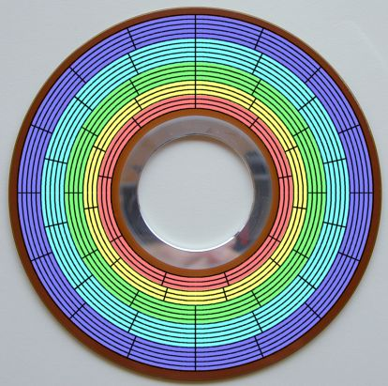
Zoned Bit Recording
Moderns hard disks do not have a fixed number of sectors per track; different zones have a different number of sectors
Drives report 63 sectors/track:
→ external geometry
A drive can have hundreds of sectors per track
Internally Logical Block Addressing is used: → internal geometry
Because of this, re-alignment may not be straightforward and requires benchmark testing; e.g. Jetstress tool for Microsoft Exchange

