Slide 1
Cisco NCS5500/5700
Innovation/ J2 MDB Profiles, Use cases
Nikita Bagaria, MIG PM
Akshaya Kumar Sankaran, MIG TME
Deepak Balasubramanian, MIG TL
9th Feb 2022

Slide 2
Cisco Disclaimer
Many of the materials and screen captures described here are highly confidential - the BRCM J2 Pipeline charts etc. The Multi-Dimensional Scale numbers are relevant for the specific use cases only. Please keep this for Cisco internal reference only

Slide 3






NCS 5500/NCS5700
Innovation
Fill this with a relevant photo,
illustration, graph, etc.
NCS 5700 Solution Roadmap
Deployments, Challenges, Solutions - Today
New NCS5700 Enhancements - J2 MDB
NCS5700 Resources Deepdive
Yes, It Works Beyond Slides
Usecases: Peering, Business EVPN

Slide 4

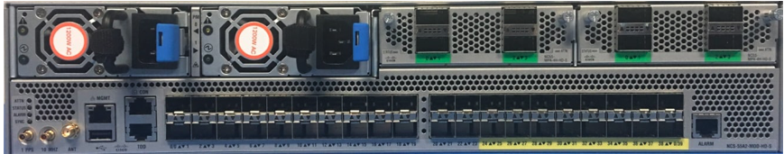
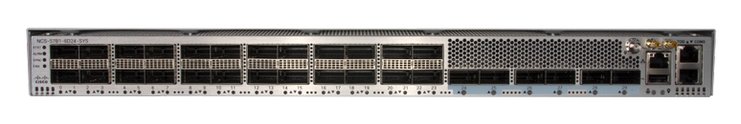
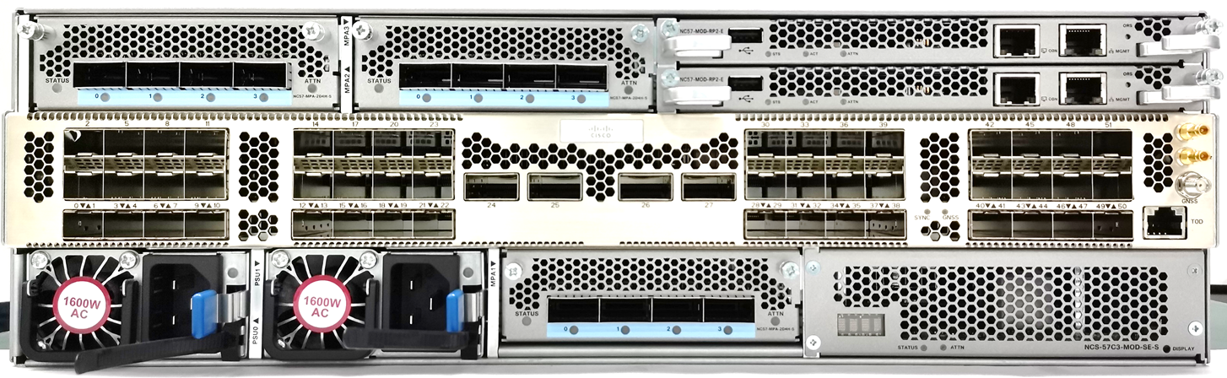


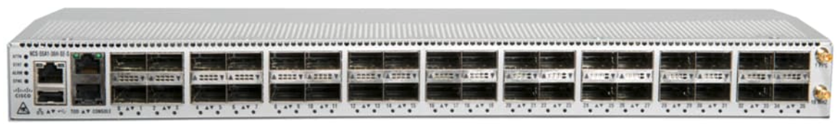


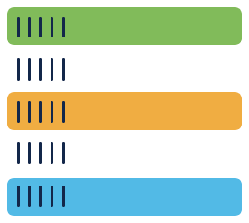
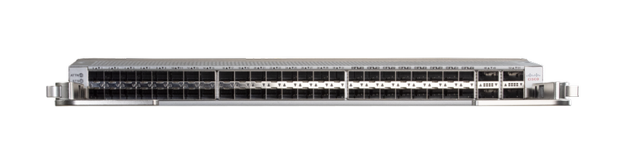



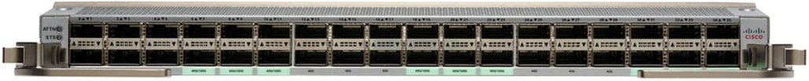



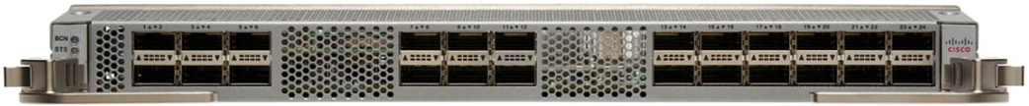
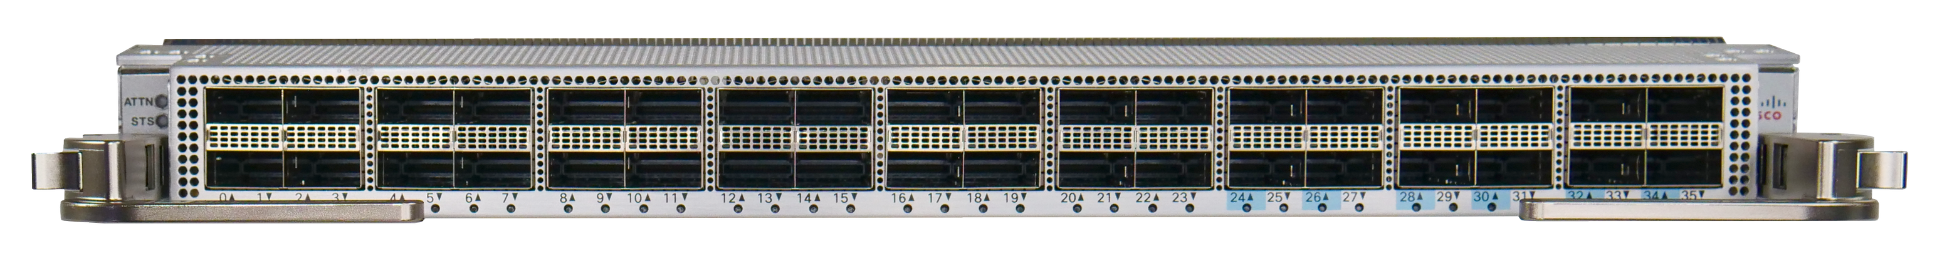
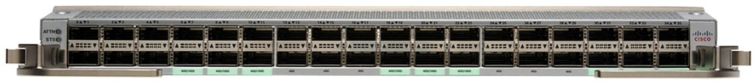
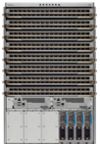
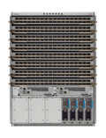


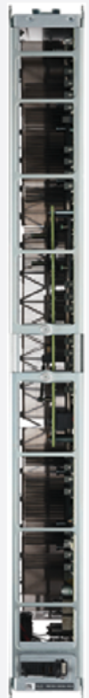


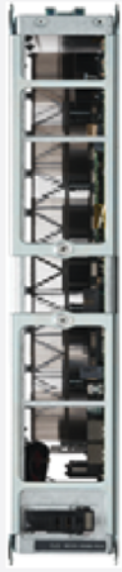

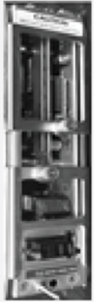

NCS 5500/5700 Portfolio
Jericho
Jericho+
Jericho2
Jericho2C/
Qumran2C
Jericho2C+
NCS 5502/SE
NCS-55A1-48Q6H
NCS 55A2-MOD-S/SE/HD/HX
NCS-57B1-6D24/5DSE
NCS-57C3-MOD/SE
NCS-57D2-18D
NCS 5501/SE
NCS 55A1-36H-S/SE
NCS-55A1-24Q6H-S/SS
Fixed
NCS 55A1-24H
NCS-57C1-48Q6D-S
NC55-MOD-A-S/SE
NC57-18DD-SE
NC55-36X100G/-S
NC55-32T16Q4H-A
NC57-24DD
NC57-48Q2D-S/SE*
Linecards
NC55-24H12F-SE
NC55-36X100G-A-SE​
NC55-24X100G-SE
NCS 5516
NC57-36H-SE
NC55-18H18F
NC57-36H6D-S
NCS 5508
NC57-MOD-S
NC55-6x200-DWDM-S
NCS 5504
Modular
4/8/16 J2 Ready FC2 & FAN2
* Under Consideration
Notes:
NC55-32T16Q4H-A
NC55-MOD-A-S
NC55-MOD-A-SE-S
NC55-18H18F
NC55-24H12F-SE
NC55-24X100G-SE
NC55-6x200-DWDM-S
NC55-36X100G-A-SE
NC55-36X100G/-S
NCS-55A1-36H(-SE)-S
NCS-55A2-MOD-S / HD-S / HX-S
NCS-55A2-MOD-SE-S /-SE-H-S
NCS-55A1-24H
NCS-55A1-24Q6H-S / 24Q6H-SS
NCS-55A1-48Q6H
NCS-5501(-SE)
NCS-5502(-SE)

Slide 5



NCS 5500/5700 Positioning & Portfolio of Services
Aggregation
LSR/Core
VPWS, EVPN P2MP, L2/L3 VPN
L2 MCAST, BGP PIC-Edge, mVPN
SRV6
IPv4/v6 MPLS, BFD, LSR, MPLS-TE, PIM
TI-LFA, LDPoTE
IPv6 BFD, SRv6
IOS-XR
as an App
Common across
form factors
Peering
SP Access / 5G
v4/v6 Scale ACL/LPTS/
LI, uRFP, Hybrid ACL, Storm Control
BGP FlowSpec, QPPB
Ingress/Egress Netflow
IOS-XR
VPWS, L2/BVI
TWAMP, Y.1732, Eth Loopback, Timing
G.8032, DHCP, GTP Hashing
IP-SLA, Y.1564
64-Bit Container
Simplified Operations
Ultra High Density
Boot Time Optimization
Data Center
R-PHY (CIN)
IP/MPLS LSR, EVPN/SR, MACsec, IPoDWDM
EVPN/SR-TILFA/TE/ODN
Sticky EMCP
VXLAN DC GW/GPE
L2 MCAST, IGMP Snooping
802.1X, Dual v6 Source, DHCP snooping
MLD Snooping

Slide 6
NCS 5500/5700 SW Plan in CY22/CY23
CY22 SW Release
CY23 SW Release
XR 75x/761
XR 771
XR 781*
XR 791*
HW/NPI
Fixed: Twins
Modular: Vigor-Mod
MPA: Bearfoot MPA
HW/NPI
MPA: Private Line Emulation MPA
HW/NPI
Fixed: Castle Black
MPA: Wingbow MPA
HW/NPI
Modular: Vigor-LS
New Use cases
ETM, MDB Scale
High Scale Aggregation: L2Max & L2Max-SE profile configuration J2/J2C/Q2C
New Use cases
MDB Scale: High Scale Aggregation
J2C/Q2C specific enhancements – L3Max and L2Max
New Use cases
PWHE Phase1
New Use cases
PWHE Phase2, VXLAN DCI
Critical Customer Escalations
SRV6, BGP MP, Mcast, EVPN, BFD, ACL
Critical Customer Escalations
EVPN, L2PT,Mcast/MVPN
Critical Customer Commitments/Escalations
Critical Customer Commitments/Escalations
J2 Parity
Achieved: 86% J2 Native Parity
J2 Parity
Achieved: 87% J2 Native Parity
J2 Parity
Plan : 92% J2 Native Parity
L2, EVPN, Mcast, Forwarding
J2 Parity
Plan : 100% J2 Native Parity
L2, EVPN, Mcast, Forwarding
Optics, Timing
ZR/ZR+, Class C
L2, L3 and Transport Layer features
Optics, Timing
100G-ZR4, ZR/ZR+, Class C
L2, L3 and Transport Layer features
Optics, Timing
CFP2, QSFP EDFA, Class C
L2, L3 and Transport Layer features
SRV6, SR-OAM
Optics, Timing
High power ZRP
L2, L3 and Transport Layer features
SRV6, SRTE,SR:PM
* Release not EC’d yet, planning still in process.

Slide 7
MDB Scale - XR Release Strategy
7.3.1
7.4.1
Enable MDB profile infrastructure including Grid and other enhancements
L3 scale Enhancements
No user configurable MDB profile
Default profiles for Base and SE
L2 Scale enhancements
Support L3Max and L3Max-SE profiles with overall higher scale
Not configurable. Base defaulted to L3Max and SE/eTCAM defaulted to L3Max-SE.
7.5.2 & 7.6.1
7.7.1/7.8.1
CLI configuration for various profiles – J2/J2C/Q2A/Q2C with MDB profiles.
Support L2Max & L2Max-SE profile configuration J2/J2C/Q2C
J2C/Q2C specific enhancements – L3Max and L2Max
L2Max for Q2A, MDB Profiles for J2C+
Provide any additional scale enhancements for L2Max and L2Max-SE

Slide 8
Deployment with NCS 5500/ NCS 5700

Slide 9
Services scale requirements
Core & Peering
LSR & Internet scale
IPv4/ IPv6 L3 Route Table
Multicast route
Mobile Packet Core/ Broadband
Content Provider
Peering /
Direct Connect
Public Cloud
Core
Private Cloud
Aggregation
Business Services
L2 Services – P2P, P2MP (VPWS/VPLS/EVPN)
Higher MAC Table
MPLS services label /SRTE/SRv6
Bridge domain/ BVI
L2 Sub-interface
Aggregation
Aggregation
Mobile Services
L3 Services – VRF, L3VPN
BGP LU
L3 Sub-interface
ARP scale
SRTE/SRv6 PIDs
Cable
FTTH
Metro Ethernet
Mobile Backhaul
Residential
Business
Mobile

Slide 10


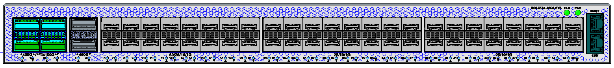

High Scale Converged SDN Network
Mobile Packet Core/ Broadband
Peering /
Direct Connect
NCS 5504/08/16
NCS5504/08/16
NC57 Line card
NCS5504/08/16
NC57 -SE Line cards
Core
NCS-57B1 -SE
Modular: up to 9.6T/slot
153.6Tb System
NCS-57B1
Content Provider
NC57-24DD
NCS57-18DD-SE
NC57-36H-SE
NC57-36H6D-S
NCS-57C3
NCS-57C3 -SE
Public Cloud
Unique services / scale for different use cases
Next-Gen ASIC
Private Cloud
NCS-57B1
L3 Profile
L2 Profile
Aggregation
NCS-57C3
NCS 57B1
NCS-57C1/C3
Fixed: Up to 4.8T
NCS-57B1-6D24H
NCS-57B1-5D24H-SE
Pre-Aggregation
NCS540
Metro Ethernet
Access
Cable
FTTH
Mobile Backhaul
NCS 57C3
J2
J2C/
Q2C
Fixed: Up to 4T
NCS-57C3-MOD
NCS-57C3-MOD-SE
NCS57C1-48C6-SYS
Residential
Business
Mobile
NCS 540
Q2A
J2C+
NCS-540
N540-24Q8L2DD-SYS

Slide 11
NCS 5500 Enhancements
Quick review

Slide 12
ASIC Resource enhancement in J/J+
Jericho
Jericho+
J2
J2c
J2c+
NCS55A2-MOD-S
NCS55A1-24H
NC55-36X100G-A-SE
NC55-MOD-A-S
NCS57C3-MOD
NCS5501
NCS5502
NC55-18H18F
NC55-36X100G
NCS57B1-6D24H
NC57-24DD
NC57-18DD-SE
NC57-36H6D-S
NC57-36H-SE
NCS57D2
57xx for J2/J2c/J2c+
B/C/D for fixed platforms

Slide 13
ASIC Database resource to Feature/Application mapping
Database | Description | Feature/Application
LPM/ KAPS | Longest Prefix Match or KBP Assisted Prefix Search | IPv4/v6 prefixes
LEM | Large Exact Match Database | IP Host /32, MAC, MPLS
iTCAM | Internal TCAM | ACL
eTCAM | External TCAM on Scaled formfactors (–SE) only | Extended unicast routes, ACL & counters
OEM | OAM Exact Match | OAM Classification
FEC | Forwarding Equivalence Class | Forwarding Information
VSI | Virtual Switch interface | L3 interface, Bridge domains
In-LIF | Ingress Logical Interface table | Logical interface table
EEDB | Egress Encapsulation Database | Tunnel Encapsulation information
GLEM | Global LIF exact Match | Global Id Match
Some commonly known Databases in ASIC
Each database is used for 1 or more use cases /Feature in pipeline.
Feature to database scale not 1:1 mapping.( other parameters also influence scale)

Slide 14
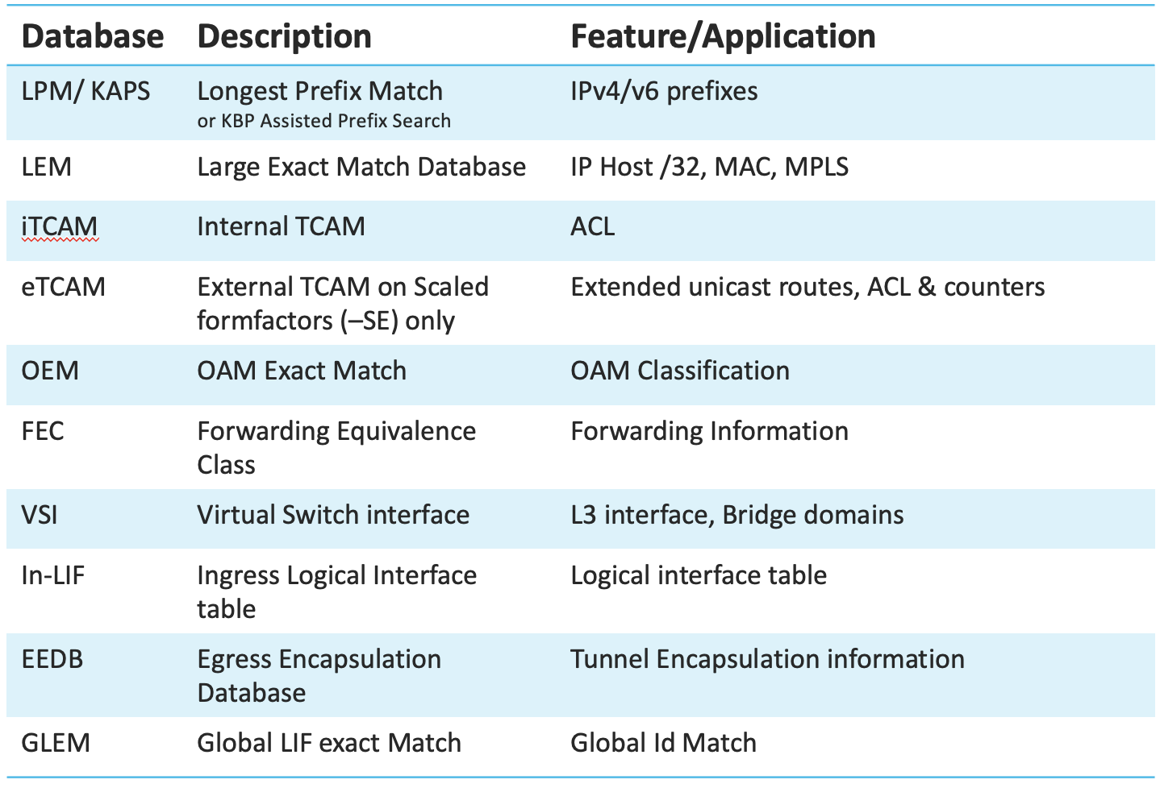
Enhancements in NCS5500 – J/J+ based platforms
LEM/ LPM
  ( eTCAM) – higher route/ mcast acl etc
EEDB resources
  With SR we have swap labels
ECMP FEC
  Resource optimizations with dlb programming
  LSR & LER – with services ( XR7.1.1, XR7.4.1)
  BGP-LU enhancement – (XR7.5.2)
SRv6 – on J+
All enhancements focuses on how features mapped to fixed set of resources

Slide 15
NCS 5700 Enhancements

Slide 16
Transition from NCS5500 (J/J+) to NCS5700 (J2)
Transitioning to NCS5700 (J2) is already beneficial given the improvements over NCS5500 (J+)
Top resources/ features improved in NCS5700(J2)
L3 Services | NCS5700 (J2/J2C/Q2C) | NCS5500 J/J+
IPv4 Routes | 5M | Upto 4M
IPv6 Routes | 3M | 2M
ECMP-FEC resource | Upto 32K | Upto 4K
Label Stack
Without recycle | 10 ( 8 Transport + 2 services) | 6 Transport (or) 3 Transport + 2 Service
With recycle | 12 | 12 Transport (or) 9 Transport + 2 Service
Support for 50G SerDes in J2/J2C/Q2C
ASIC SERDES
NCS5700 can support
Port Speeds Up to 400G
Header Parser
Support for 144bytes System header (vs 128 bytes in J+)
L2 Services | NCS5700 (J2/J2C/Q2C) | NCS5500 J/J+
Number of BDs/EVI | 2000 | 1500
ACs per BD | 4K | 512
VPLS PWs (across all BDs) | 4K | 3K
MACs per System | 300K | 128K
NCS5700 can natively support SRv6 Labels
All scale values are planned in (1D) Single Dimension

Slide 17
What's new with J2/J2C/Q2A/Q2C/J2C+
MDB
Modular Database
Enhancements on how ASIC resources are carved
Enhancement on how features mapped to resources

Slide 18

MDB in J2/ J2C/Q2C/Q2A/J2C+..
Network Interface
PP
TM
PP
TM
HBM
On-chip Buffer
MDB
OTM
MDB : Modular Database
  Instead of dedicated memories
  Different allocation for different profiles
  LEM / LPM-KAPS / FEC / …
OP2
eTCAM
PP
TM
PP
TM
Ingress
Egress
Fabric Interface
Network Interface
LPM
PP
TM
LPM
PP
TM
LEM
LEM
Off-chip
Buffers
On-chip Buffer
TCAM
OTM
TCAM
STAT
OP
eTCAM
PP
TM
STAT
PP
TM
FEC
FEC
Ingress
Egress
Fabric Interface

Slide 19
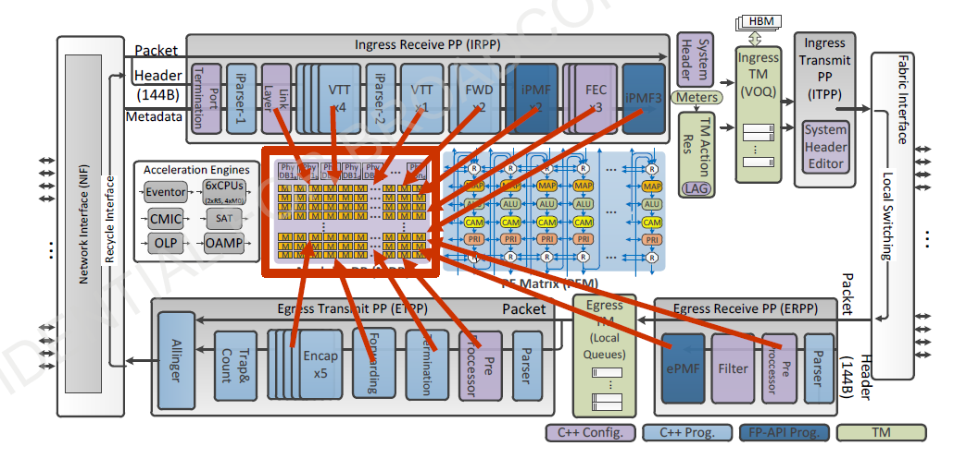
MDB: Shared between Cores,
Shared between Ingress & Egress paths
Total MDB space is shared by different functions in the pipeline
MDB databases are created at boot time
Database carved for features will increase or decrease based on MDB Profile
Total MDB Space

Slide 20
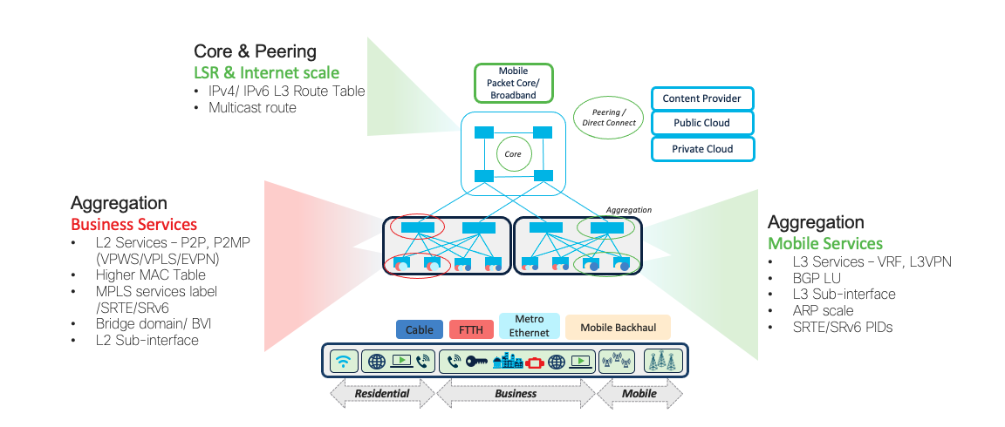
MDB Profile resource carving
LEM
LPM
ISEM
LEM
LPM
ISEM
L2 Profile
Higher or Lower database based on usecase
Total Database is still same
If LPM reduced by X amount, then LEM need not be increased same amount
L3 Profile

Slide 21
MDB Profiles
Today we have planned 4 MDB Profiles
Target platforms from XR7.6.1
MDB Scale
L3Max-SE
Fixed
NCS-57B1-SE
NCS-57C3-SE
Modular
NC57-18DD-SE
NC57-36H-SE
L2Max-SE*
Scale Platform can run MDB Base Profile also ( although not required)
MDB Base
Fixed
NCS-57B1
NCS-57C3
NCS-57C1-48S6H**
NCS-57D2**
Modular
NC57-24DD
NC57-36H6D-S
NC57-MOD-S**
L3Max
L2Max*
* L2Max/ L2Max-SE planned for XR7.6.1
** Roadmap

Slide 22
Some resources are not modified between MDB Profiles
Fixed Resources across 4 MDB profiles
Broadcom MDB Carving allows modifying internal J2 resources
Cisco IOS XR can carve internal resource and also the eTCAM
Some resources are not changed between MDB Profiles
ECMP-FEC
While FEC changes, ECMP-FEC 32K remains same across all 4 MDB Profiles
VOQ
QoS resources such as VoQ remains same across all 4 Profiles
eTCAM ( only for –SE)
The size of eTCAM would remain same-
But the applications used will vary based on profile
Counters
Counters and Stats resources are fixed for all 4 MDB profiles
Multicast
Multicast DB (for MCID ) will remain same for all 4 MDB profiles
MDB Profiles available today
L3Max, L3Max-SE, L2Max, L2Max-SE

Slide 23

Platforms with MDB Profile Support
All 4 MDB Profiles will be supported
L3Max/L2Max/L3Max-SE/L2Max-SE
J2 Scale
J2C and Q2C MDB internal resources same as J2
Q2A Scale
J2C+ Scale
J2
J2C/Q2C
Q2A
J2C+
NCS57B1
NC57-24DD
NC57-18DD-SE
NC57-36H6D-S
NC57-36H-SE
NC57-MOD
NCS57C3
NCS57C1
NCS540
N540-24Q8L2DD-SYS
NCS57D2

Slide 24

MDB scale vs MD scale vs 1D scale
Multi-Dimension Scale ( MD scale)
  Refers to feature scale of platform measured with multiple features enabled at same time ( Usually refers to specific customer profiles validated)
One-Dimension Scale ( 1D scale)
  Refers to feature scale of platform measured by configuring single feature only ( Max platform scale for specific Feature)
MDB Profile Scale
  Ability to carve same ASIC resources to multiple Profiles based on Use-cases. The scale numbers for each profile are often 1D.
  ASIC
  J2/Q2A/J2C/Q2C/J2C+
  Profiles
  L3Max/L2Max/L3Max-SE/L2Max-SE

Slide 25
MDB profiles Scale comparison
Compare between all 4 Profiles on NCS5700
Target Scale numbers till XR7.7.1 release – Refer 1D scale for validated scale
Notes:
Cisco MDB profile based on Real customer use-cases & more features
- Preferring one profile doesn’t deplete resource for other service completely
( which is Broadcom default design)
(eg) There is basic L2 scale in L3Max and basic L3 scale in L2Max – providing

Slide 26
Compare NCS5500 (J/J+) to NCS5700 (J2) with MDB
Transitioning to NCS5700 (J2) with MDB - NCS5500 (J+)
Top resources/ features improved in NCS5700(J2)
L3 Services | NCS5700 L3Max-SE (J2/J2C/Q2C) | NCS5500 (-SE) J/J+
IPv4 Routes | 5M | Upto 4M
IPv6 Routes | 3M | 2M
VRF | 8K | 4K
L3 subinterface without QoS | 8K | 2K
L2 subinterface without BVI/QoS | 12K | 8k
MACs per System | 500K | 128K
BVI | 8K | 1250
L2 Services | NCS5700 L2Max-SE (J2/J2C/Q2C) | NCS5500 (-SE) J/J+
Number of BDs/EVI | 2000 | 1500
L2 subinterface without BVI/QoS | 16K | 8K
Total PWs (across all BDs) | 12K | 3K
MACs per System | Upto 600K | 128K
BVI | 10K | 1250
All Scale values are 1D scale – some are still in Roadmap
Refer 1D scale sheet for validated scale

Slide 27
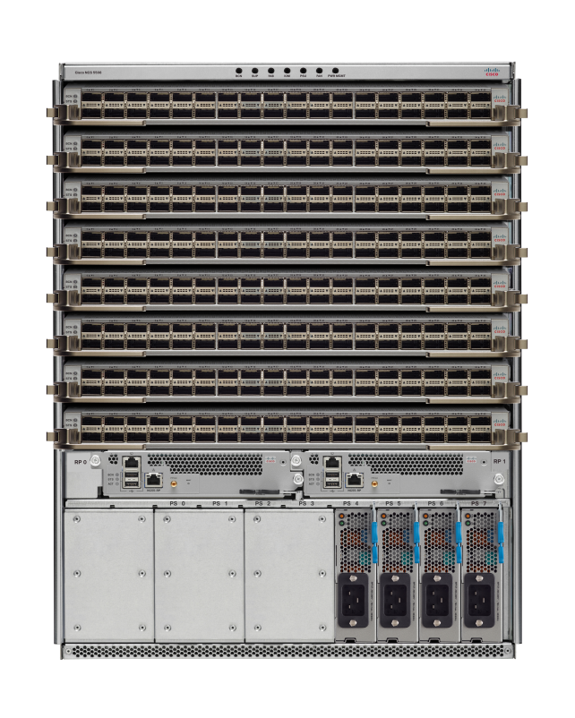
How to configure MDB
NCS5500 Modular platform
hw-module profile npu native-mode-enable
Can configure both hw-profiles
Single Reload
hw-module profile mdb l3max-se
STEP
System Boot up
STEP
1
STEP
2
L3Max
2
L3Max
Jericho2-SE
Jericho2-SE
Jericho2-SE
Jericho
Jericho+
Jericho2-SE
Jericho2-SE
Jericho
Jericho2-SE
Jericho2-SE
Jericho2-SE
Jericho
J2 Comp to J2 Native mode
L3Max to L3Max-SE
Jericho2-SE
Reload required
Jericho2-SE
Reload required
Jericho2-SE
hw-module profile npu native-mode-enable
hw-module profile mdb l3max-se
Jericho2-SE
System with J+ & J2 cards
System with only J2 cards
System with only J2 cards
J2 Comp
vs
J2 Native
J2 Compatibility Mode
J2 Native Mode
Modular Chassis default loads in Compatibility Mode ( even with only J2 cards )
Configure hw-module for Native mode after remove J/J+ Line cards.
J2 Native Mode
MDB Profile
  No MDB Profile
  L3Max
  L3Max-SE
  MDB profile not Supported in
  J/J+ and J2 Compatibility Mode
J2 Native by default loads with L3Max MDB Profile
When Chassis has only –SE card MDB L3Max-SE can be configured

Slide 28
MDB Profiles : Cisco vs Other Vendors
NCS5700 carving has validated profiles for L3 and L2
Arista 7800R3K Series
L3-XL Profile (default) | L3-XXL Profile | L3-XXXL Profile | Balanced-XL Profile
Cisco NCS5700 ( -SE)
L3Max-SE | L3Max | L2Max | L2Max-SE
Note: All 4 MDB Profiles supports all features only scale will change
1D Scale published by any Vendor is not usually real
But we validated higher scale because of our MDB approach (ex: MAC scale)
7800R3K Series | 7800R3K Series
Profile | L3-XXXL Profile
MAC Addresses | 384K
NCS5700 –SE ( Scale) | 7800R3K Series
Profile | L3Max-SE & L2Max-SE
MAC Addresses | 500K

Slide 29
MDB Profile Configuration/ Verification
Configure Native Mode
hw-module profile npu native-mode-enable
Verify J2 Native mode - Only for Modular (NCS5504/08/16)
show hw-module profile npu-operating-mode
Verify Resource Utilization
Check NPU resources
show controllers npu resources lem location all
show controllers npu resources lpm location all
show controllers npu resources exttcamipv4 location all ( for –SE)
Configure MDB Profile
“hw-module profile mdb <l3max | l3max-se | l2max | l2max-se>
Verify MDB Profile
Check MDB Profile
show hw-module profile mdb-scale
Broadcom SDK view of carving
show controllers fia diagshell 0 "mdb info" location all
Notes:
Planned and carved 4 MDB profiles for J2 family.
MDB profile carving, loading and Grid Infra ready for all platforms based on J2/J2C/Q2A and Q2C.
Same command applies for all platform/ASIC types. System internally maps the profiles to platform and line card types.
Default profiles for all platforms automatically loaded and does not require config.
show command will be added to display the currently active MDB profile (7.5.2 onwards)

Slide 30
Deployment with J2 MDB

Slide 31
How MDB Profile works in Modular
NCS5500 + NC57 Line card
NCS5504 Mix Base and Scale Linecards
Only Base MDB Profiles supported
NCS5504 Only Scale Linecards
All MDB Profiles supported
User Input
CLI or Default Profile
hw-module profile mdb <l3max|l2max>
hw-module profile mdb <l3max-se|l2max-se>
Base MDB Profiles supported
Enhanced MDB Profiles supported*
RP
Scale Profile
System Scale : L3Max
System Scale : L3Max-SE
RP :
System-level profile in RP determines scale
LC NPU :
Scale line card –SE profile will always have SE profile, even if L3Max is configured at RP.
Scale is determined by Scale profile Globally in RP.
LC0: L3Max
LC1: L3Max
LC2: L3Max
LC3: L3Max
LC1: L3Max-SE
LC2: L3Max-SE
LC3: L3Max-SE
LC NPU
ASIC MDB setting
Base
Linecard
Scale
Linecard
Scale
Linecard
Scale
Linecard
No
Linecard
Scale
Linecard
Scale
Linecard
Scale
Linecard
Slot 0 : Base J2 Linecard
Slot 1-3: Scale J2 Line cards
Slot 0 : Remove Base LC
Slot 1-3: Scale J2 Line cards
Remove Base LC and reload –
hw-module config admin reload rack 0
Notes:
“hw-module profile mdb <l3max | l3max-se | l2max | l2max-se>
Planned and carved 4 MDB profiles for J2 family.
MDB profile carving, loading and Grid Infra ready for all platforms based on J2/J2C/Q2A and Q2C.
Same command applies for all platform/ASIC types. System internally maps the profiles to platform and line card types.
Default profiles for all platforms automatically loaded and does not require config.
show command will be added to display the currently active MDB profile (7.5.2 onwards)
show hw-module profile mdb-scale

Slide 32
How MDB Profile works in Fixed
NCS5700, NCS540 (N540-24Q8L2DD-SYS)​​​​
Fixed Base Platform
J2/J2C/Q2A/Q2C/J2C+
Fixed Scale Platform
J2/J2C
User Input
CLI or Default Profile
hw-module profile mdb <l3max|l2max>
hw-module profile mdb <l3max-se|l2max-se>
Base MDB Profiles supported
Enhanced Profiles supported
RP
Scale Profile
System Scale : L3Max
System Scale : L3Max-SE
LC NPU
ASIC MDB setting
NPU0: L3Max
NPU0: L3Max-SE
Notes:
“hw-module profile mdb <l3max | l3max-se | l2max | l2max-se>
Planned and carved 4 MDB profiles for J2 family.
MDB profile carving, loading and Grid Infra ready for all platforms based on J2/J2C/Q2A and Q2C.
Same command applies for all platform/ASIC types. System internally maps the profiles to platform and line card types.
Default profiles for all platforms automatically loaded and does not require config.
show command will be added to display the currently active MDB profile (7.5.2 onwards)
show hw-module profile mdb-scale

Slide 33
Understanding Resource carving
MDB
[On-Chip Resource]
LEM DB
Labels, l2 BRMAC, host routes*
External TCAM
[SE LC/ Systems ]
KBP_TCAM_FWD DBs
Internal TCAM
[On-Chip- no static carving]
QoS
I/f, Tunnel & OAM DBs
EEDB Cluster banks
Indirection pointer for GLIF & label Instructions
ECMP_FEC
Outlif tables for LABELS, ARP ..
V4, V6 Unicast prefixes,
Multicast routes,
RPF DB
Ext_FG DBs
v4,v6 Flowspec (SE only),
v4,v6 LPTS(75x Rls)
v4,v6 Ingress ACL (inc chained ACL)
Stats –
OAM DBs- CFM/BFD
ACL
LI
Stats
All Flow-Group & Stats DBs*
InLif, VSI,ISEM, ESEM..
QoS, VoQ, l3/l2 Rx/TX
Egress, Hybrid ACL
ACL, FS, MPLS, LPTS etc
LPM KAPS DB
v4,v6 Unicast prefixes*, Multicast routes*
FEC Hierarchies
“hw-mod mdb profile”
  used to set the “system profile” & control the system scale
  MDB resources carved based on the LC profile
* For Base LC

Slide 34
NCS5700 - 3 Level FEC Hierarchy
16 Banks
FEC
FEC carving at Init Time based on MDB
3 Level of Hierarchy of H1, H2, H3 in FEC & ECMP FEC
Different ranges for each Hierarchy
ECMP FEC
FEC
Applications
H1 ECMP
H1 FEC
Hierarchy 1
VPN/EVPN over BGP-LU Loopback Peering
ECMP-FEC
H2 ECMP
H2 FEC
Hierarchy 2
  BGP-LU Loopback Peering, Recursive MPLS routes, VPN over IGP MPLS, RSVP-TE Mid-Point Protection., SRv6 DT4/DT6/DX2, L2vpnPW
Total 32K Entries
16 Banks (each 2K entries)
Every Bank to 1 Hierarchy only
H2 ECMP
H3 FEC
Hierarchy 3
IGP Routes, BGP-LU Interface Peering, SRTE, Multicast, L2Sub
FEC usage per hierarchy | show controllers npu resources fec location 0/0/CPU0 | Note: OOR is per FEC hierarchy ​
ECMP FEC usage per hierarchy | show controllers npu resources ecmpfec location 0/0/CPU0 | Note: OOR is based on total ECMP FEC consumption (NOT per hierarchy)​

Slide 35
NCS5700 Encapsulation in EEDB
EEDB management in NCS5700(J2) uses Logical_phase - (represented by the - 1,2,3.. 8)
Logical_phase maps to Physical phase - (represented by the size - XL/L1/M1/S1 ..etc)
Output : show controller npu resources encap
Understanding EEDB bank pairs and usage
Cluster Bank Pair : EEDB_S2_XL Cluster S2 and XL combined
Max-Entries : 98304 /*S2 and XL combined MAX entries, fixed*/
Total In-use : 0 /* S2 and XL combined in use*/
Start of second block XL in bank pair S2_XL
Logical_phase : 1 (Encap_Rif) /*Logical phase 1 /feature map: Encap Rif for this bank block*/
Cluster Bank
Bank Size : S2 /*This is S2 cluster bank*/
Estimated Max Entries : 98304 /*Dynamic calc estimated max entries for S2*/
OOR State : Green /*OOR state for S2/ Phase 1*/
Total In-Use : 0 /*Total used entries for phase 1*/
EEDB Bank: /*Start of LL banks for S2 block*/
Estimated Max Entries : 8192 /*Dynamic calc estimated max entries for LL bank*/
OOR State : Green /*State of LL bank*/
Total In-Use : 0 /*Entries used in LL bank of S2 block*/
Start of second block XL in bank pair S2_XL
Logical_phase : 6 (Tunnel4) /*Logical phase: 6 /feature map: Tunnel4 for this bank block*/
Cluster Bank
Bank Size : XL /*This is XL cluster bank*/
Estimated Max Entries : 73728 /*Dynamic calc estimated max entries for XL*/
OOR State : Green /*OOR state for XL block*/
Total In-Use : 0
EEDB Bank: /*Start of LL banks for XL block*/
Estimated Max Entries : 63488 /*Dynamic calc estimated max entries for XL block*/
OOR State : Green /*State of LL bank*/
Total In-Use : 0 /*Entries used in LL bank of XL bl

Slide 36
EEDB phase Map
Note
EEDB carving Specific to L2MAX MDB profile
Cluster Bank Pair | Physical Phase (size) | Logical Phases (from L2MAX) | Applications
EEDB_S2_XL | S2 | Logical_phase : 1 (Encap_Rif) | RIF, SRv6 H.Encap
 | XL | Logical_phase : 6 (Tunnel4) | IGP, BGP-LU interface peering, SRTE(1,2 label), SRv6 T.Insert
EEDB_L2_M3 | L2 | Logical_phase : 2 (Encap_NativeArp) | VPN/EVPN/SRTE(9,10 label), SRv6 T.Insert
 | M3 | Logical_phase : 8 (Encap_Ac) | AC Outlif, Non-VRF ND
EEDB_M1_M2 | M1 | Logical_phase : 3 (Encap_NativeAc or Tunnel1) | BGP-LU Loopback peering, SRTE(7,8 label), SRv6 T.Insert
 | M2 | Logical_phase : 5 (Tunnel3) | SRTE(3,4 label), SRv6 T.Insert
EEDB_S1_L1 | S1 | Logical_phase : 4 (Encap_Tunnel2) | SRTE(5,6 label), SRv6 T.Insert
 | L1 | Logical_phase : 7 (Encap_Arp) | ARP, ND, SRv6 H.Encap
Bank Pair to phase map changes based on configured MDB profile

Slide 37
NCS5700 Deployments
Use case #1 Peering L3 Services
MDB Profile
L3Max-SE
IOS XR
7.5.1

Slide 38



Peering Network Requirements
L3 Internet Edge
Use Case | Peering
Line Cards | J2-SE
MDB Profile | L3Max-SE
Peering Profile with Higher route scale,
  Internet route scale
  IPv4 : Upto 1M ( with uRPF)
  IPv6 : Upto 200K ( with uRPF)
Security Focus
  BGP FlowSpec
  ACL
  uRPF
High density peering interfaces – 8K
Routing Control Plane
  20% BGP
  80% static
Peer 1
High Scale Peering
SP Network
Peer 2
Transit

Slide 39
Peering - Network Requirement Summary
Use Case | Peering L3 Services
Line Cards | J2-SE
MDB Profile | L3Max-SE
High Scale Peering specific Requirements
ACL Entries ( v4/ v6) | 37000
BGP Flowspec | 20K
BGP Peers | 2400
Interfaces Logical L2/L3 | 8000
ECMP Groups | 32K
Routing Scale
IPv4 UC routes - per system (uRPF) | 1.4M
IPv6 UC routes - per system (uRPF) | 200K
MPLS Labelled routes (BGP-LU) IPv4/v6 ( single-path) | 50K
VRF Instances | 5
Static IPv4 / IPv6 routes | 50K /20K

Slide 40
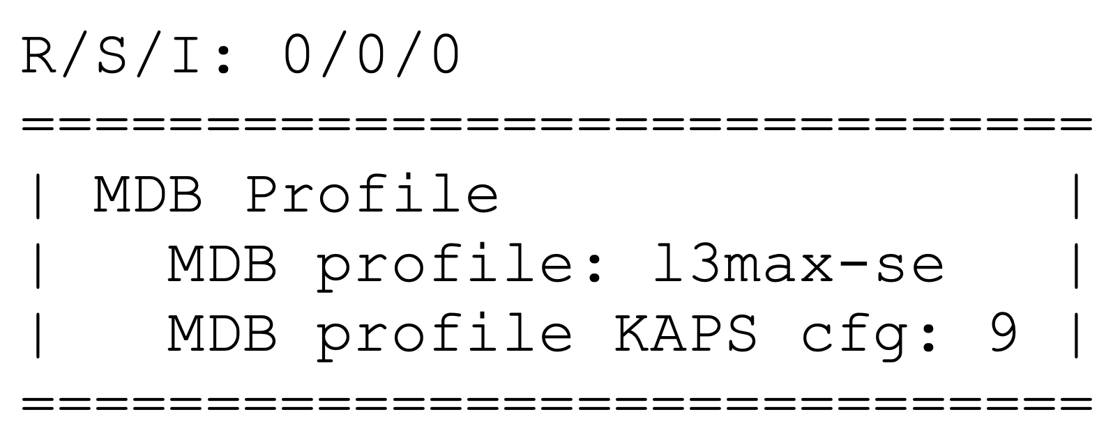
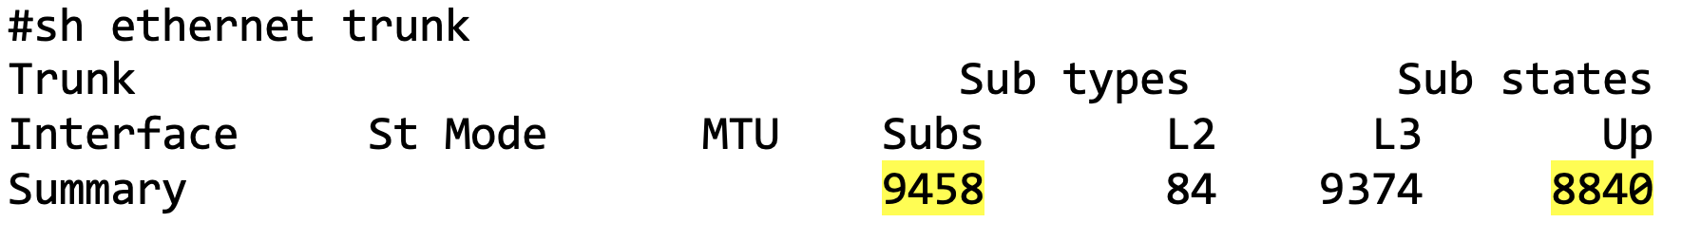
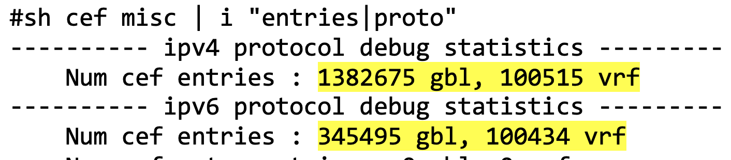
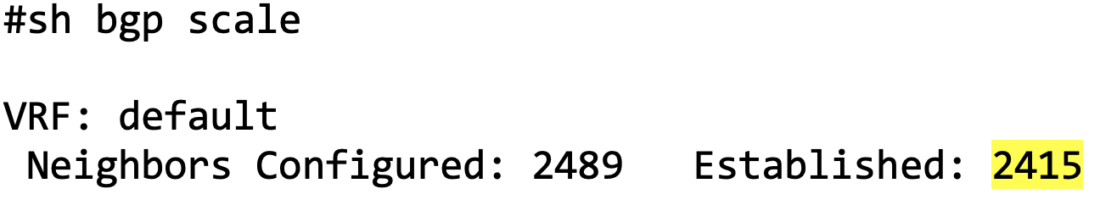
Route Scale
L3 Interfaces | 8000
IPv4 ( Global/VRF) (uRPF) | 1.3M/ 100K
IPv6 ( Global/ VRF) (uRPF) | 300K/ 100K
BGP Peers | 2400

Slide 41
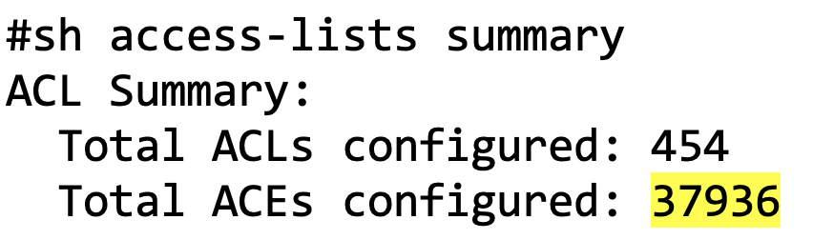
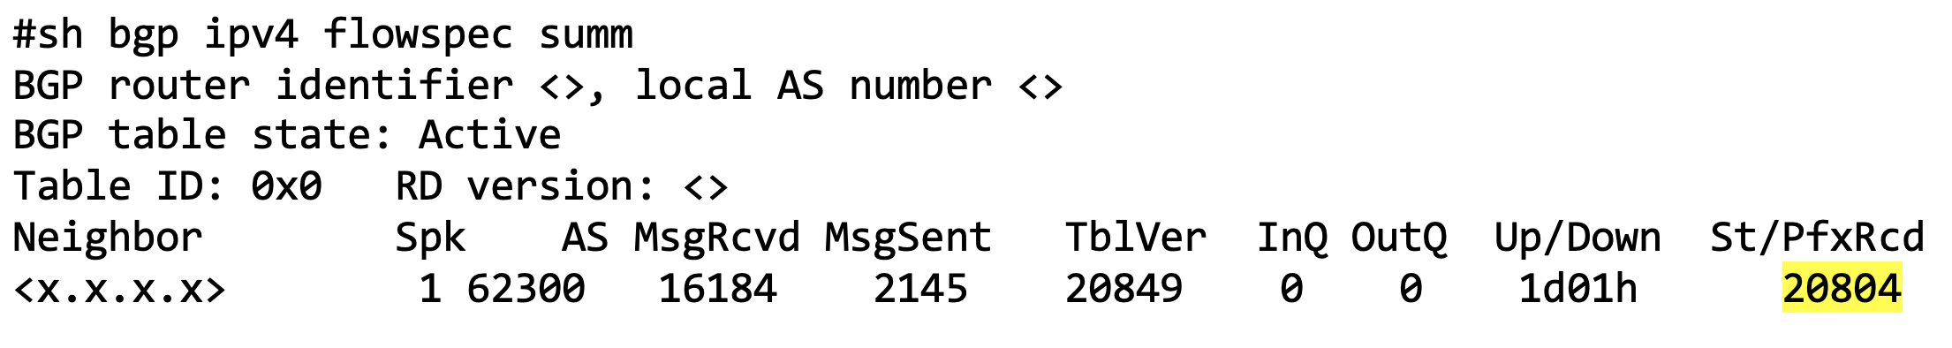
Security – ACL, BGP-Flowspec
ACL Entries | 37930
BGP Flowspec | 20804

Slide 42
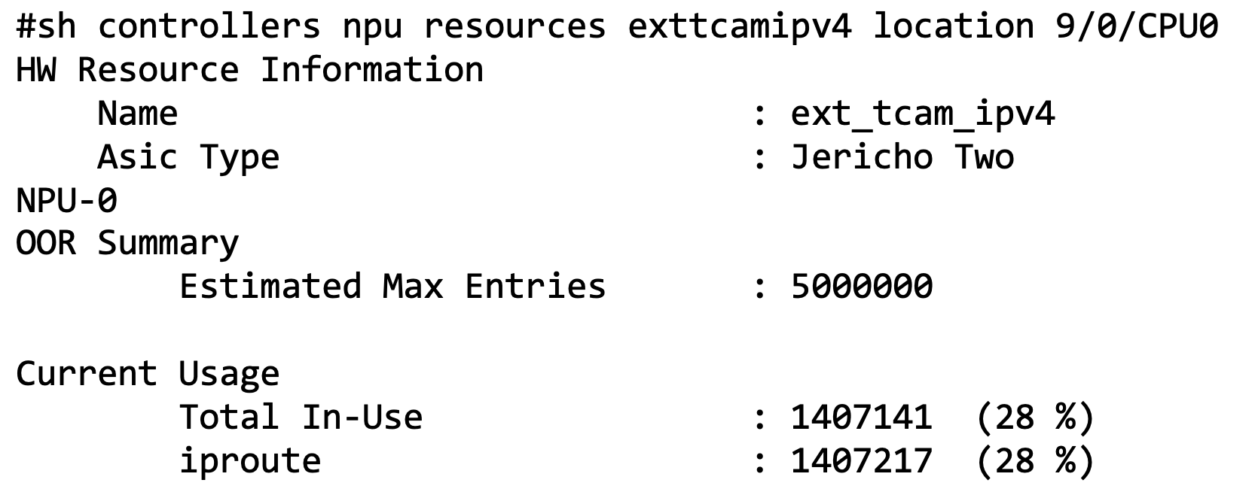
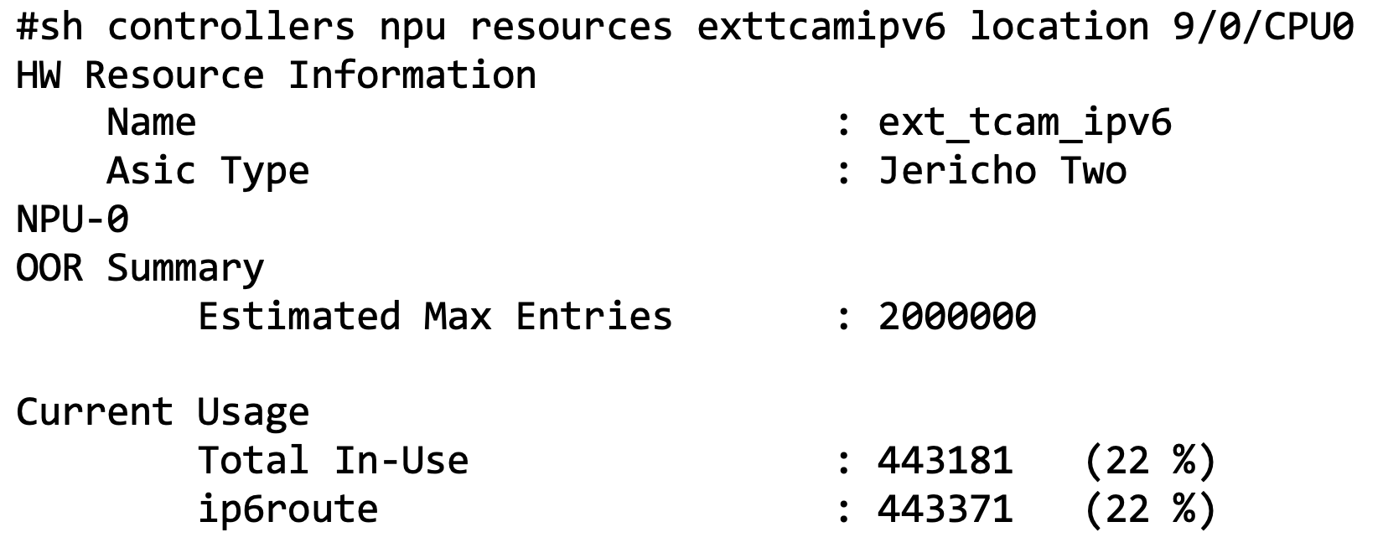
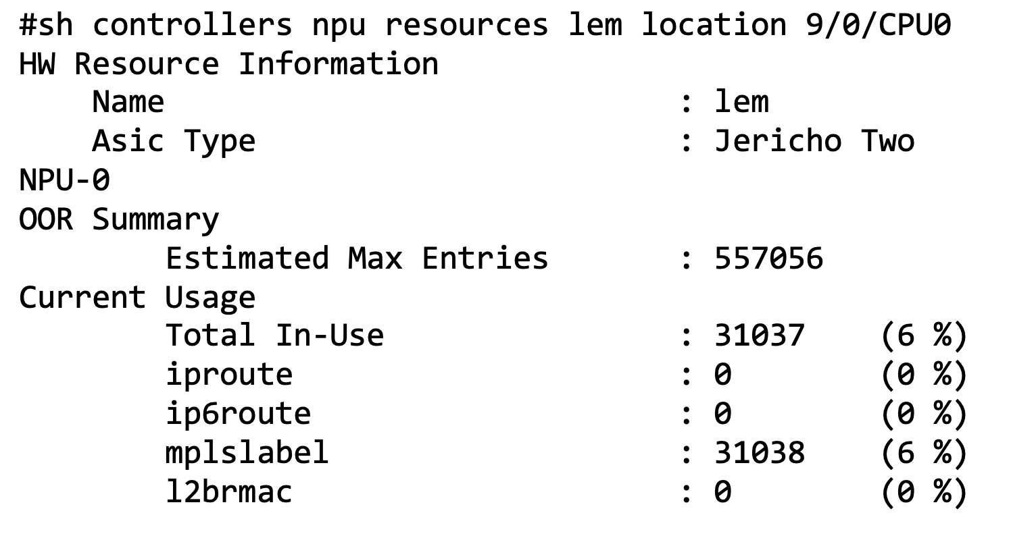
Route scale – Transport IPv4/v6/ BGP LU
Resources
IPv4 Routes
IPv4 Route | 1.4M
IPv6 route | 443371
BGP-LU (MPLS Label) | 31000
IPv6 Routes
MPLS Label: BGP-Labelled Unicast

Slide 43
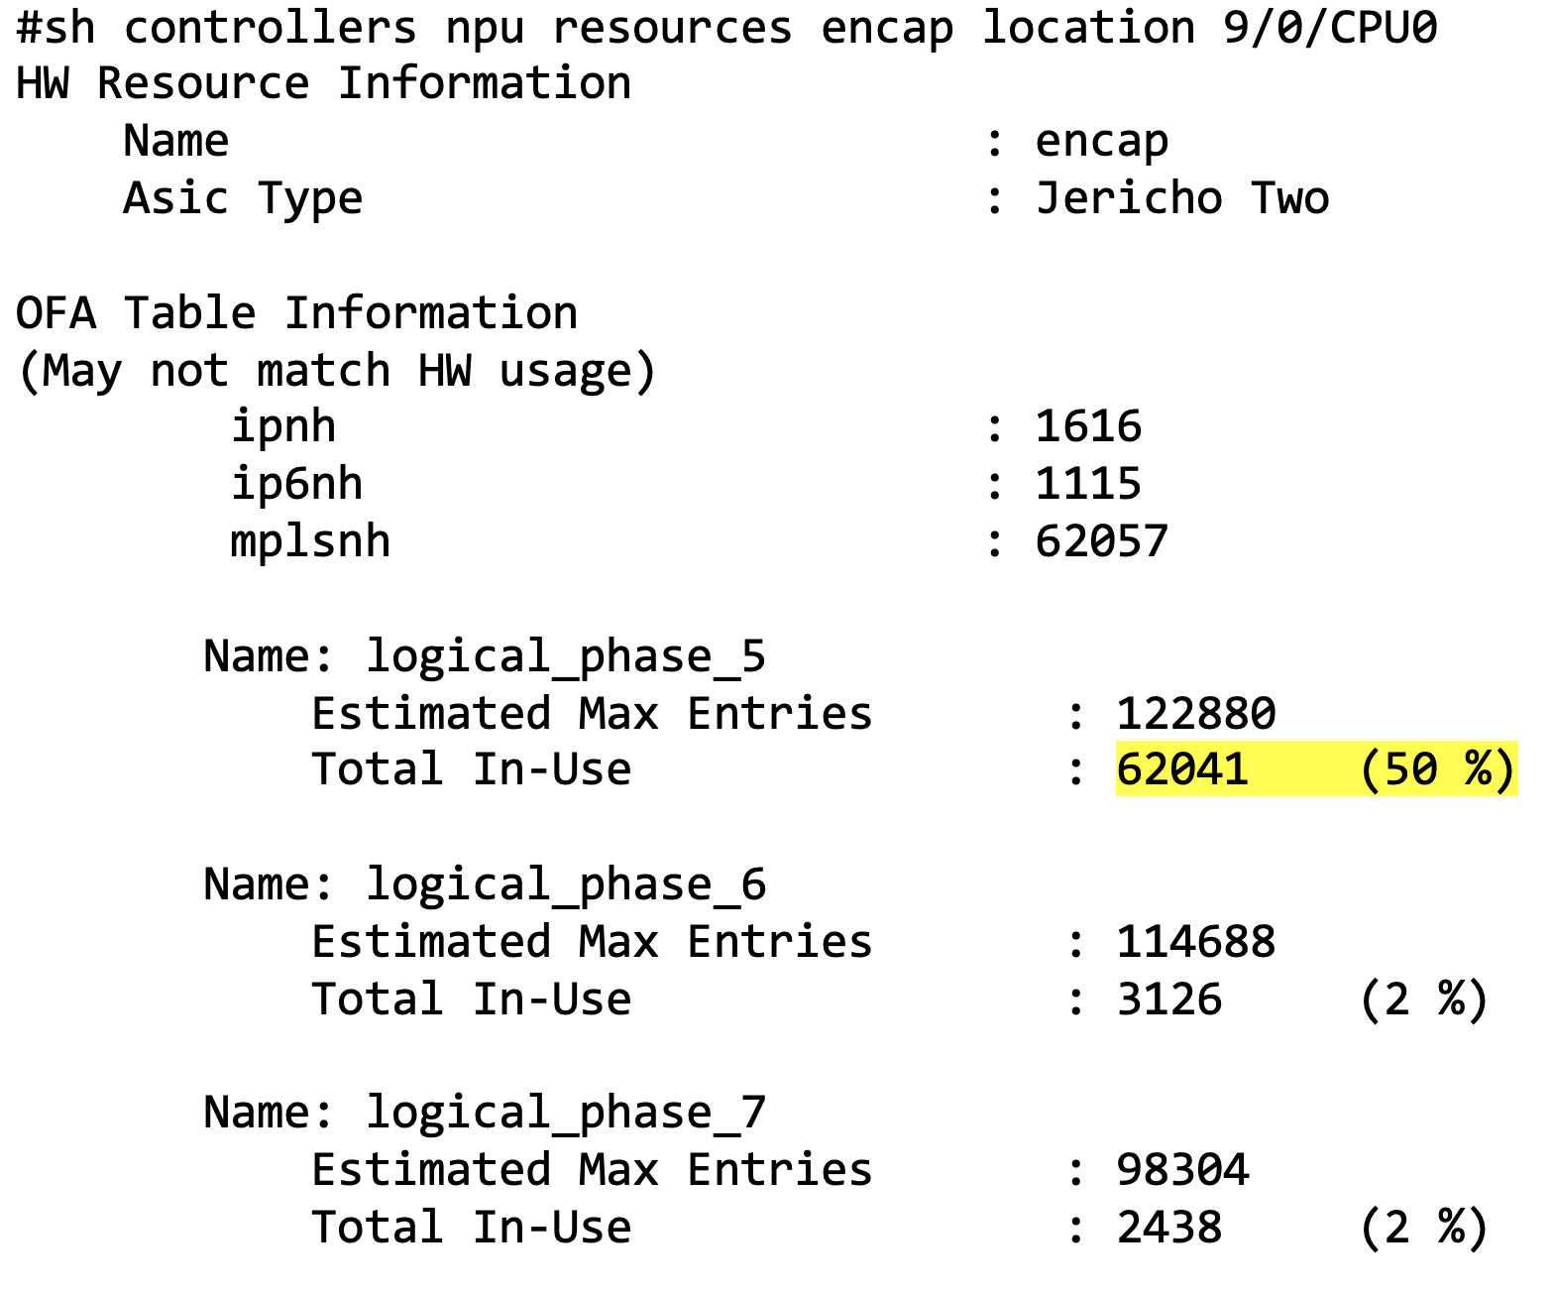
Egress Encapsulation stored - EEDB
Encapsulation for Outgoing packets
IPv4 Next Hop (ARP) | 1616
IPv6 Next Hop (ND) | 1115
MPLS ( Labelled/BGP-LU ) | 62057
EEDB Logical Phases
Encapsulation Database has upto 8 Phases
Each phase can be used by different applications and internally mapped to MDB resources
Resources Mapped will vary based on Profile

Slide 44
NCS5700 Deployments
Use case #2 Business L2 Services
MDB Profile
L3Max-SE
IOS XR
7.5.1

Slide 45
Business L2 Services
Use Case | Business L2 Services
Line Cards | J2-SE
MDB Profile | L3Max-SE
NCS5700 is Aggregation node for L2 Services
Old Network based on L2VPN VPLS/ VPWS
Port and VLAN Based L2 Services
BGP EVPN
  EVPN-VPWS (Point to Point)
  EVPN-VPLS (Point to Multi-point)
  Single Port-active ( Active/Standby) LAG (2x100G)
EVPN control plane based for MAC learning over core
BGP-LU
BGP-LU
BGP-LU
EV-LAG
MH - Single Port-Active
EV-LAG
MH Single Port-Active
Business &
Residential
Connectivity
CABLE
NCS 5700
(Agg)
Core
NCS 5700
(Agg)
Business
Connectivity
L2 Services - Point to Point, Point to Multi-Point ; BGP - L2VPN(EVPN)
Transport : iBGP LU / Static route

Slide 46
Business L2 Services
Network Requirement Summary
Use Case | Business L2 Services
Line Cards | J2-SE
MDB Profile | L3Max-SE
High Scale Peering specific Requirements
MAC Address | 500K
MAC Address per VSI | 1000
Interfaces Logical L2/L3 | 8000
ECMP Groups | 32K
BGP Policies / community list/ RT/RD | 5K
Services Scale
EVPN P2P instances | 8K
EVPN MP2MP | 8K
Global IPv4/v6 Routes | 100K
MPLS Labelled routes (BGP-LU) IPv4/v6 | 50K
VRF Instances | 50
CFM MEP ( Local, remote) | 8K

Slide 47
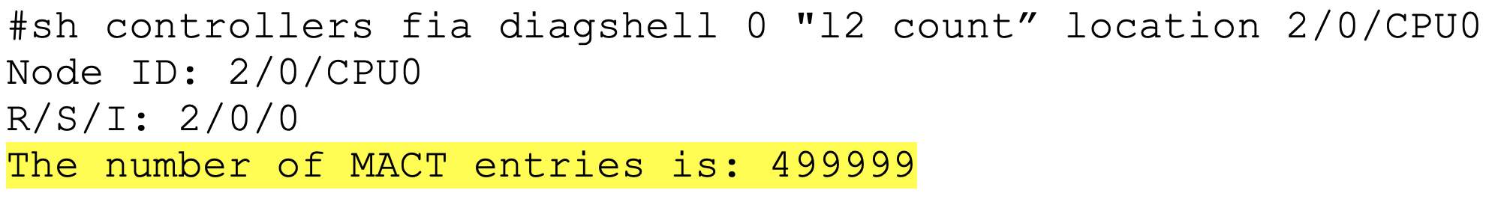
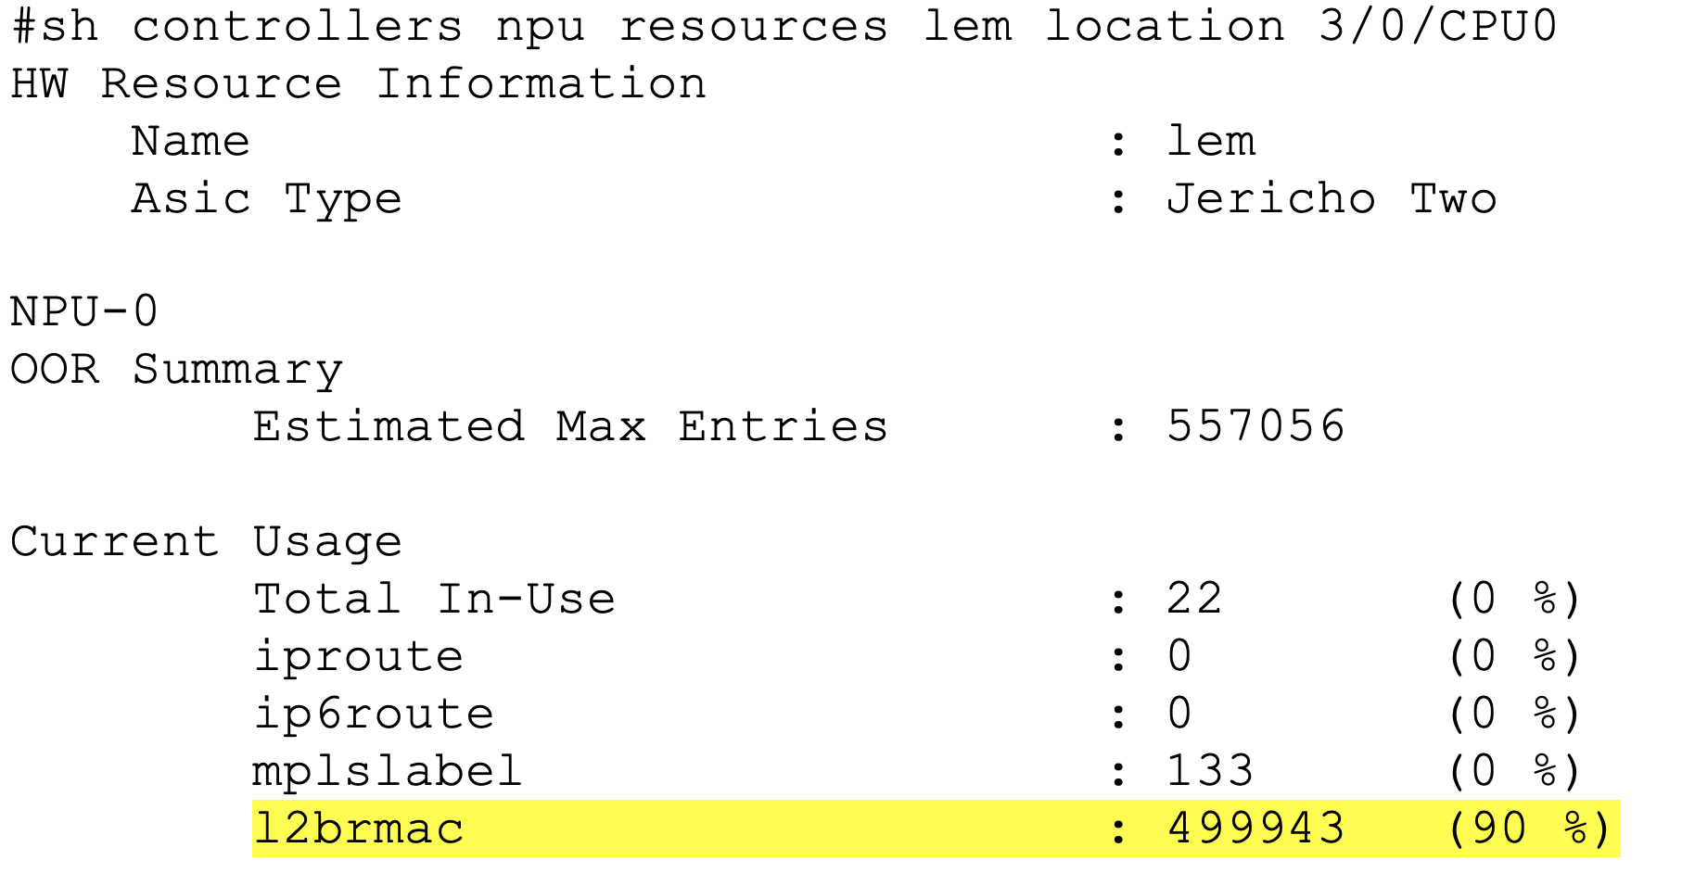
L2 Services Scale – 500K MAC
500K MAC Scale
L2 Services Scale | 1.4M
MAC Scale | 499,999
500K MAC Programmed in LEM

Slide 48
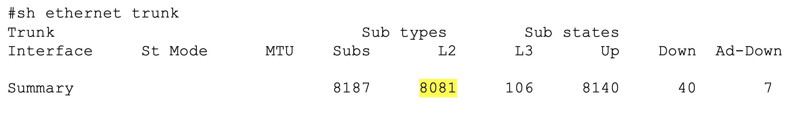
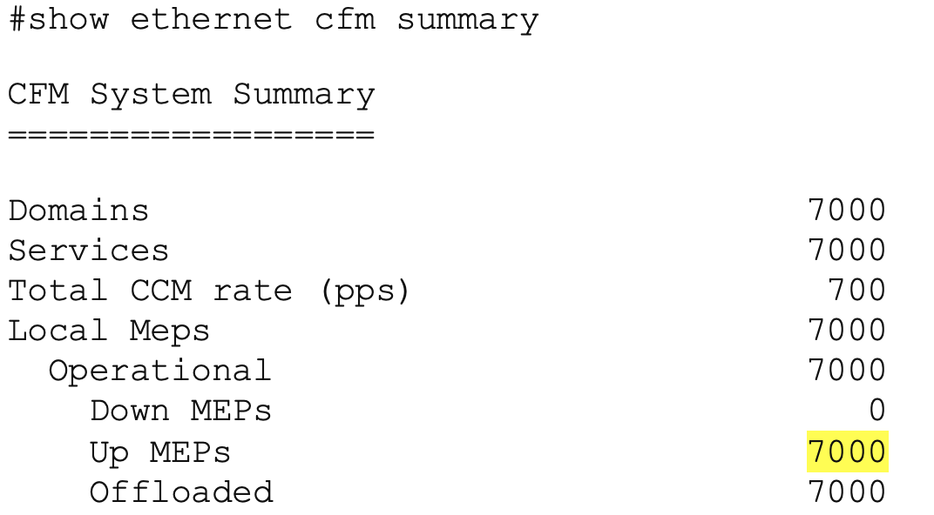
L2 Services Scale - Interfaces
L2 Interfaces
L2 Services Scale | 1.4M
L2 Interface | 8000
CFM MEP | 7000
CFM MEP

Slide 49
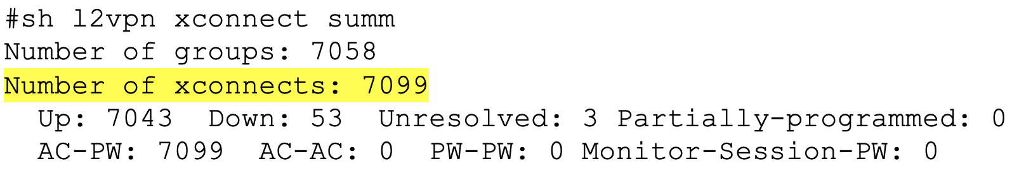
L2 Services Scale - EVPN
L2 EVPN
L2 Services Scale | 1.4M
EVPN P2P -VPWS | 8000
EVPN MP2MP -VPLS | 7000
Notes:
Future enhancements for resources

Slide 50
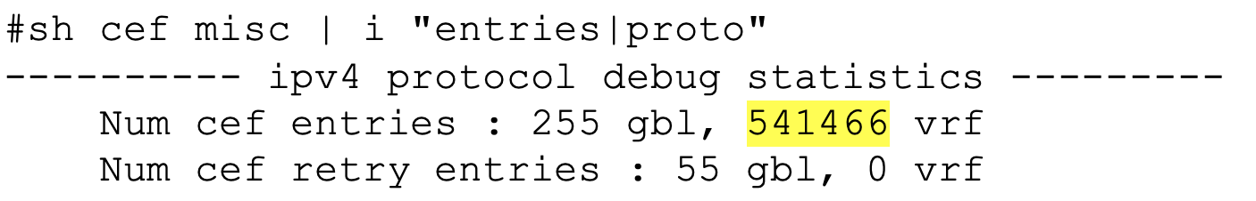
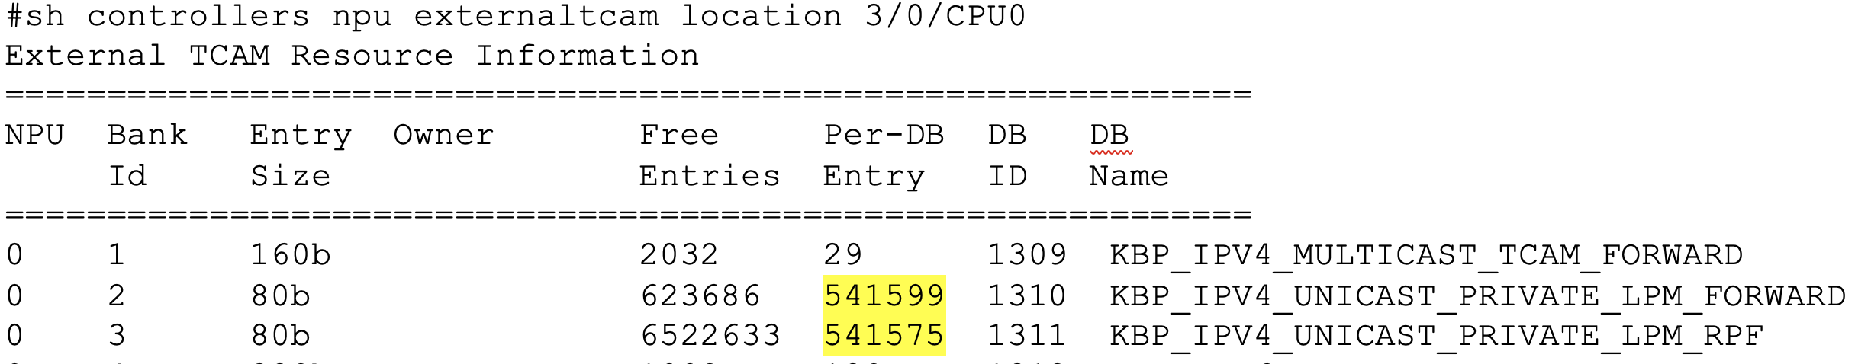
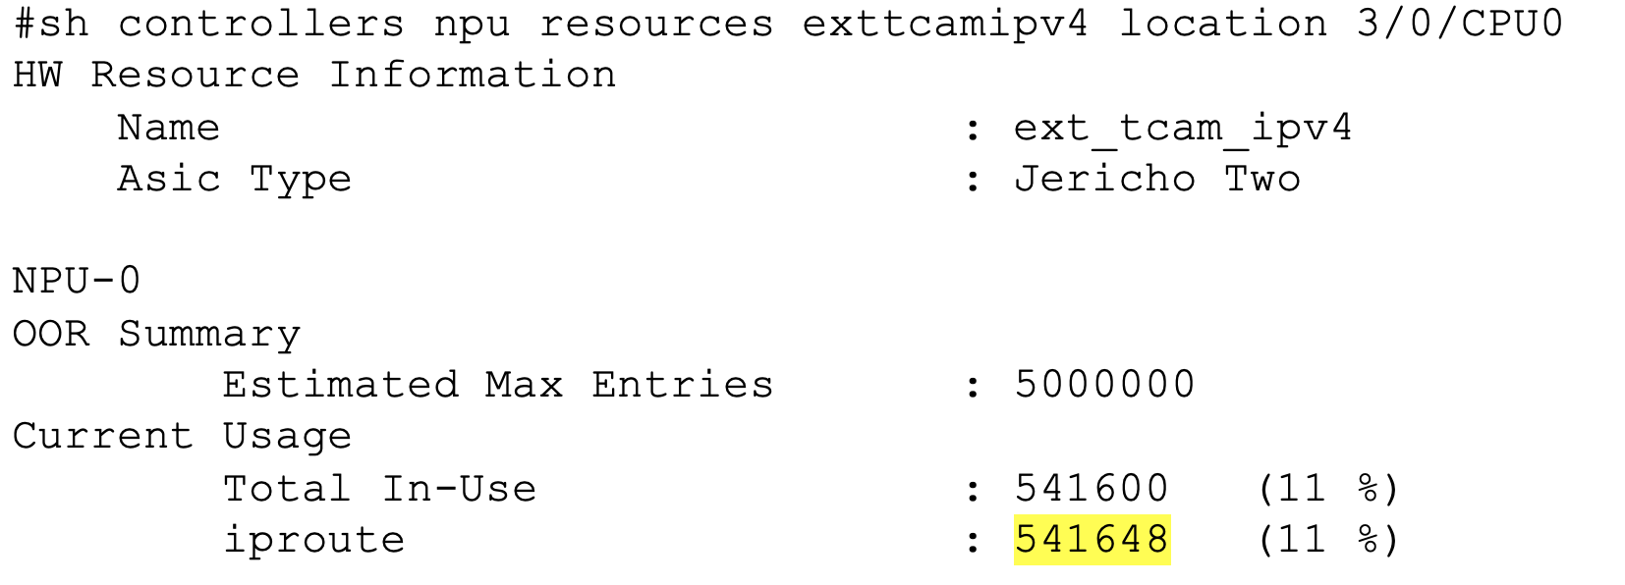
L3 URPF Route Scale - eTCAM
L3 URPF Route
L3 Route Scale | 1.4M
IPv4 URPF Route | 500K
L3 eTCAM Entry
Note : requirement was 100K only

Slide 51
Sales Resources

Slide 52
Sales Resources on Sharepoint
Link to NCS5500 Sharepoint
SharePoint NCS-5500/5700 top level
https://cisco.sharepoint.com/sites/MIGRoutingPMTMECommunications/SitePages/NCS5500/NCS-5500-Routers.aspx

Slide 53
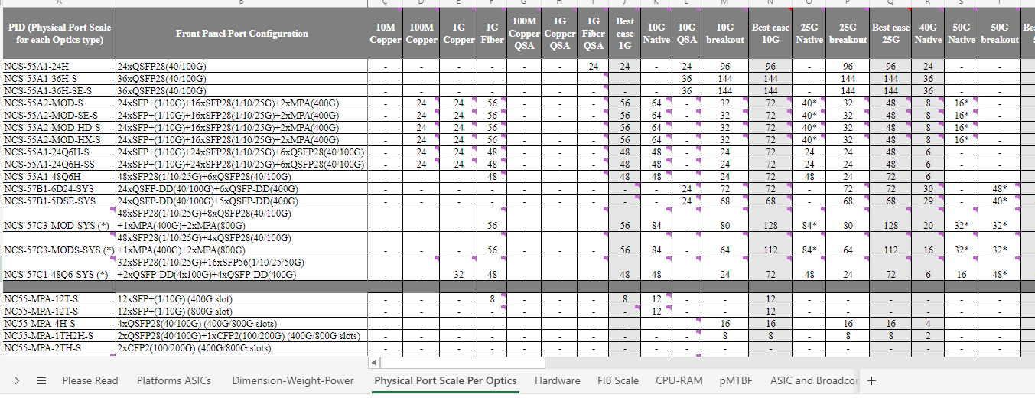
Boilerplate on SharePoint
Link to Boilerplate
https://cisco.sharepoint.com/sites/MIGRoutingPMTMECommunications/SitePages/NCS5500/NCS-5500-Routers.aspx

Slide 54
1D Scale sheet on Sharepoint
Link to 1D Scale Sheet
https://cisco.sharepoint.com/:x:/s/MIGRoutingPMTMECommunications/EbHpIe84bF1MrXf3sIRF11gBx-nTEGXpGC_0FHfaR4_wtg?e=bbhwMe

Slide 56
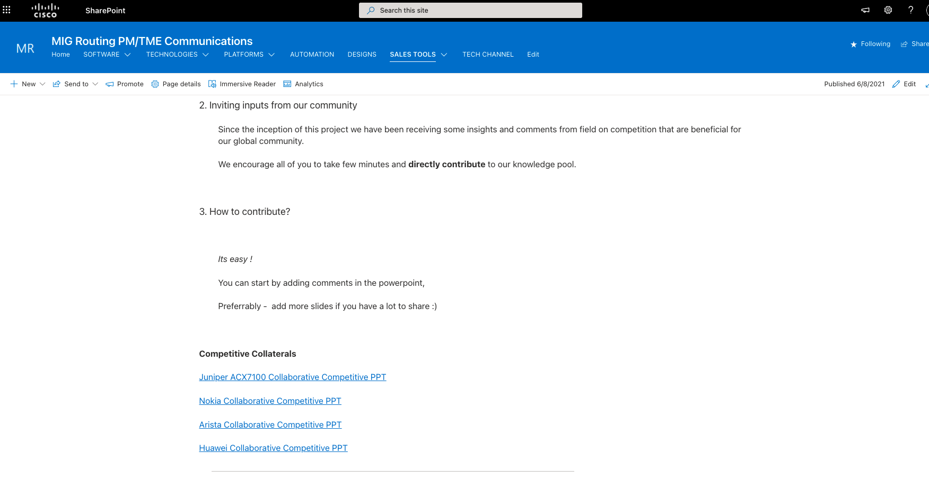
Competitive - Crowdsourcing activity
Competitive Collateral
Inviting you to join !!!
What … Simple way to combine our knowledgebase on competition
How … if you learn something new about Vendor J/N/A/H
> Directly update your inputs in new slide
> or drop us an email
fretta-tme@cisco.com

Slide 57
NCS-57C3 default MDB Profile is
L3Max
NCS57C3 (Base) and NCS57C3–SE (Scale ) by default loads with L3Max MDB Profile
Reminder
All Modular chassis NCS5504, NCS5508, NCS5512
  Runs eXR
  In J2 Native mode default profile is L3Max (even with J2-SE)
  NCS-57C3
  Consider NCS-57C3 as 3RU Modular
  NCS-57C3 also runs eXR image
  Will load L3Max by default

Slide 58
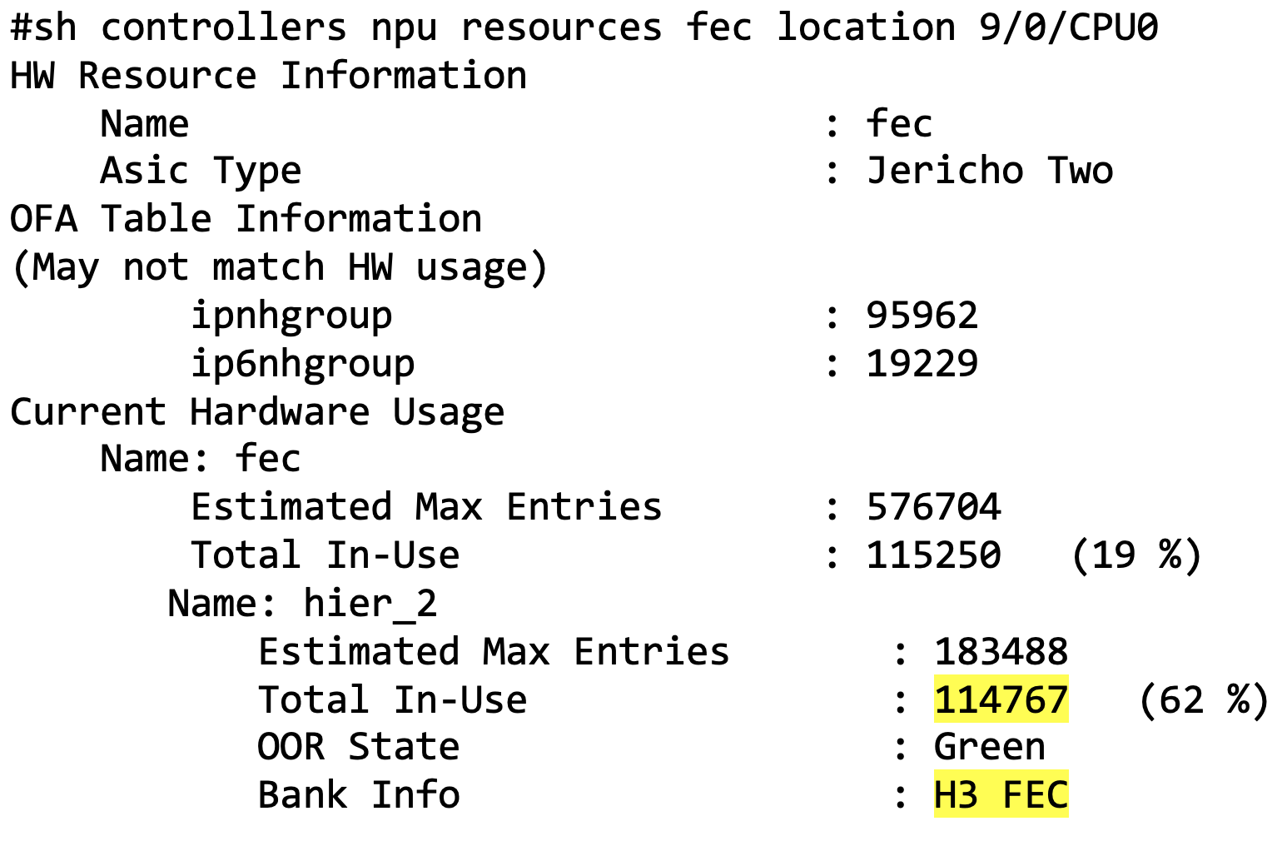
Forwarding Paths programmed - FEC
Forwarding Paths
Total FEC | 115250
Non-Recursive ( Transport) | 114767
FEC- Hierarchy 3
J2 has 3 Level FEC hierarchy
H3 -> Bottom of Hierarchy for non-recursive paths

