Slide 1
NCS5500/5700
ASIC Flexibility / MDB Profiles - Demo
Akshaya Kumar Sankaran
MIG TME
19 Jan 2021

Slide 2
Cisco Disclaimer
Many of the products and features described herein remain in varying stages of development and will be offered on a when-and-if-available basis.
This roadmap is subject to change at the sole discretion of Cisco, and Cisco will have no liability for delay in the delivery or failure to deliver any of the products or features set forth in this document.
Some of the product information listed in this document is highly Cisco confidential and customer is under NDA with Cisco.

Slide 3
Services scale requirements
Core & Peering
LSR & Internet scale
IPv4/ IPv6 L3 Route Table
Multicast route
Mobile Packet Core/ Broadband
Content Provider
Peering /
Direct Connect
Public Cloud
Core
Private Cloud
Aggregation
Business Services
L2 Services – P2P, P2MP (VPWS/VPLS/EVPN)
Higher MAC Table
MPLS services label /SRTE/SRv6
Bridge domain/ BVI
L2 Sub-interface
Aggregation
Aggregation
Mobile Services
L3 Services – VRF, L3VPN
BGP LU
L3 Sub-interface
ARP scale
SRTE/SRv6 PIDs
Cable
FTTH
Metro Ethernet
Mobile Backhaul
Residential
Business
Mobile

Slide 4


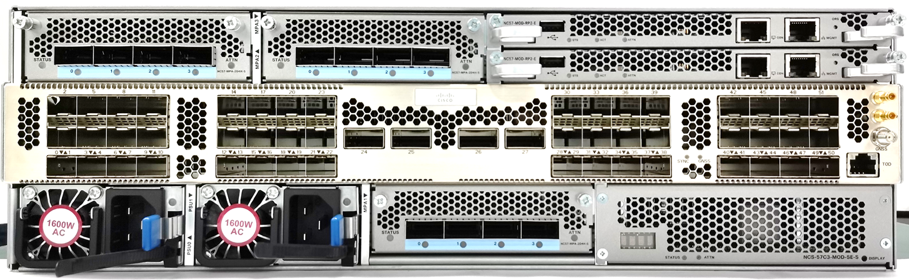
High Scale Converged SDN Network
Mobile Packet Core/ Broadband
Peering /
Direct Connect
NCS 5504/08/16
NCS5504/08/16
NC57 Line card
NCS5504/08/16
NC57 -SE Line cards
Core
NCS-57B1 -SE
NCS-57B1
Content Provider
Modular: up to 9.6T/slot
153.6Tb System
NC57-24DD
NCS57-18DD-SE
NC57-36H-SE
NC57-36H6D-S
NCS-57C3
NCS-57C3 -SE
Unique services / scale for different use cases
Same underlying ASIC
Public Cloud
Private Cloud
NCS-57B1
L3 Profile
L2 Profile
Aggregation
NCS-57C3
NCS 57B1
NCS-57C3
Fixed: Up to 4.8T
NCS-57B1-6D24H
NCS-57B1-5D24H-SE
Pre-Aggregation
Cable
FTTH
Metro Ethernet
Mobile Backhaul
NCS 57C3
J2c
Fixed: Up to 4T
NCS-57C3-MOD
NCS-57C3-MOD-SE
NC57-MPA-2D4H
J2
Residential
Business
Mobile
Q2C
Q2A
J2C+
*Roadmap
*Roadmap

Slide 5

MDB Profiles in J2
Network Interface
PP
TM
PP
TM
HBM
On-chip Buffer
MDB
OTM
Modular Database
  Instead of dedicated memories
  Different allocation for different profiles
  LEM / LPM-KAPS / FEC / …
OP2
eTCAM
PP
TM
PP
TM
Ingress
Egress
Fabric Interface
Network Interface
LPM
PP
TM
LPM
PP
TM
LEM
LEM
Off-chip
Buffers
On-chip Buffer
TCAM
OTM
TCAM
STAT
OP
eTCAM
PP
TM
STAT
PP
TM
FEC
FEC
Ingress
Egress
Fabric Interface

Slide 6
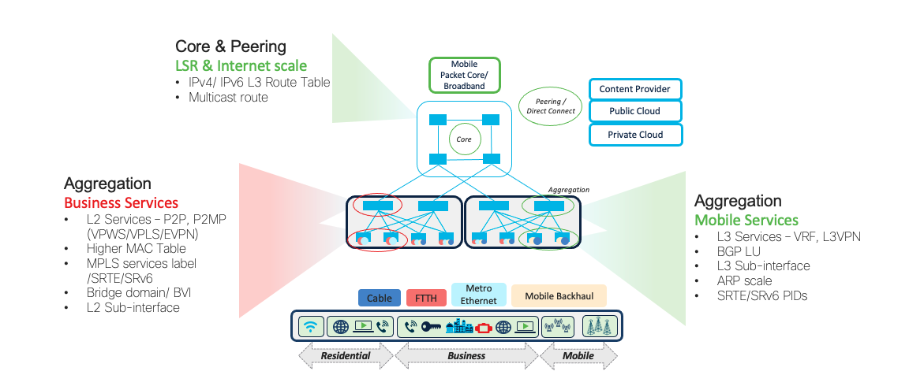
MDB Profile resource carving
LEM
LPM
ISEM
LEM
LPM
ISEM
L2 Profile
L3 Profile

Slide 7
MDB Profiles
Today we have planned 4 MDB Profiles
Target platforms from XR7.6.1
MDB Scale
L3Max-SE
Fixed
NCS-57B1-SE
NCS-57C3-SE
Modular
NC57-18DD-SE
NC57-36H-SE
L2Max-SE*
Scale Platform can run MDB Base Profile also ( although not required)
MDB Base
Fixed
NCS-57B1
NCS-57C3
NCS-57C1-48S6H**
NCS-57D2**
Modular
NC57-24DD
NC57-36H6D-S
NC57-MOD-S**
L3Max
L2Max*
* L2Max/ L2Max-SE planned for XR7.6.1
** Roadmap

Slide 8
Target Scale Number for MDB profiles
Target Scale numbers till XR7.7.1 release – Refer 1D sheet for validated scale

Slide 9
MDB Scale - XR Release Strategy
7.3.1
7.4.1
Enable MDB profile infrastructure including Grid and other enhancements
L3 scale Enhancements
No user configurable MDB profile
Default profiles for Base and SE
L2 Scale enhancements
Support L3Max and L3Max-SE profiles with overall higher scale
Not configurable. Base defaulted to L3Max and SE/eTCAM defaulted to L3Max-SE.
7.5.2 & 7.6.1
7.7.1
CLI configuration for various profiles – J2/J2C/Q2A/Q2C with MDB profiles.
Support L2Max & L2Max-SE profile configuration J2/J2C/Q2C
J2C/Q2C specific enhancements – L3Max and L2Max
L2Max for Q2A
Provide any additional scale enhancements for L2Max and L2Max-SE

Slide 10
Demo!

Slide 11
Demo – Commands Used
Fixed
show platform | i RUN
show ver | i "NCS|Version"
Check MDB Profile
show hw-module profile mdb-scale
Check NPU resources
show controllers npu resources lem location all
show controllers npu resources lpm location all
show controllers npu resources exttcamipv4 location all ( for –SE)
Broadcom SDK view of carving
show controllers fia diagshell 0 "mdb info" location all
Modular
show platform | i RUN
show ver | i "NCS|Version"
Check MDB Profile
show hw-module profile mdb-scale
Check if system is in Native mode
show hw-module profile npu-operating-mode
Check NPU resources
show controllers npu resources lem location <>
show controllers npu resources lpm location <>
show controllers npu resources lpm location <>( for –SE)
Broadcom SDK view of carving
show controllers fia diagshell 0 "mdb info" location all

Slide 12
Resources
NCS 5500 Sharepoint
NCS 5500 Boiler Plate
NCS5500 1D scale
NCS 5500 Deep Dive Deck
@XRDOC
NCS 5500 Sales Connect

